Slide 1


Youssef Moustaid
05/08/2025

Slide 2

Outline
Executive Summary
Introduction
Methodology
Results
Conclusion
Appendix

Slide 3
Executive Summary
Summary of methodologies
Summary of all results

Slide 4
Introduction
Project background and context
Problems you want to find answers

Slide 5

Section 1

Slide 6
Methodology
Executive Summary
Data collection methodology:
  Data was collected through published data sets and the SpaceX api.
Perform data wrangling
  Data wrangling was done through multiple methods : one hot encoding, scalling, transforming types...
Perform exploratory data analysis (EDA) using visualization and SQL
Perform interactive visual analytics using Folium and Plotly Dash
Perform predictive analysis using classification models
  To build the classification models, it is necessary to try multiple hyperparamaters to find the best ones, and that is done using cross validation and grid search.

Slide 7
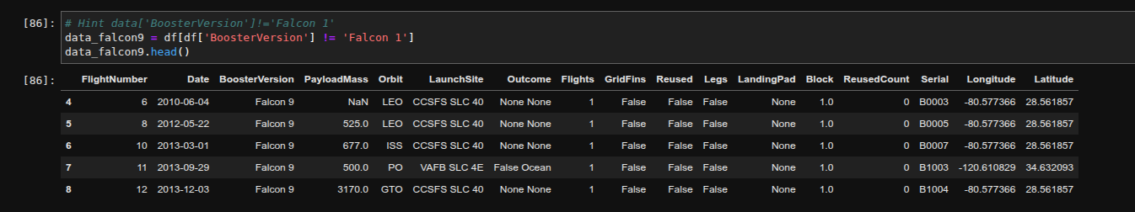
Data Collection – SpaceX API
The API used is: https://api.spacexdata.com
It has many endpoints such as payloads, launchpads , rockets, cores, launches and much more. Here is the result after multiple endpoint calls and merging.
  The API provides data about many types of rocket launches done by SpaceX, the data is therefore filtered to include only Falcon 9 launches.
  Every missing value in the data is replaced the mean the column that the missing value belongs to.

Slide 8
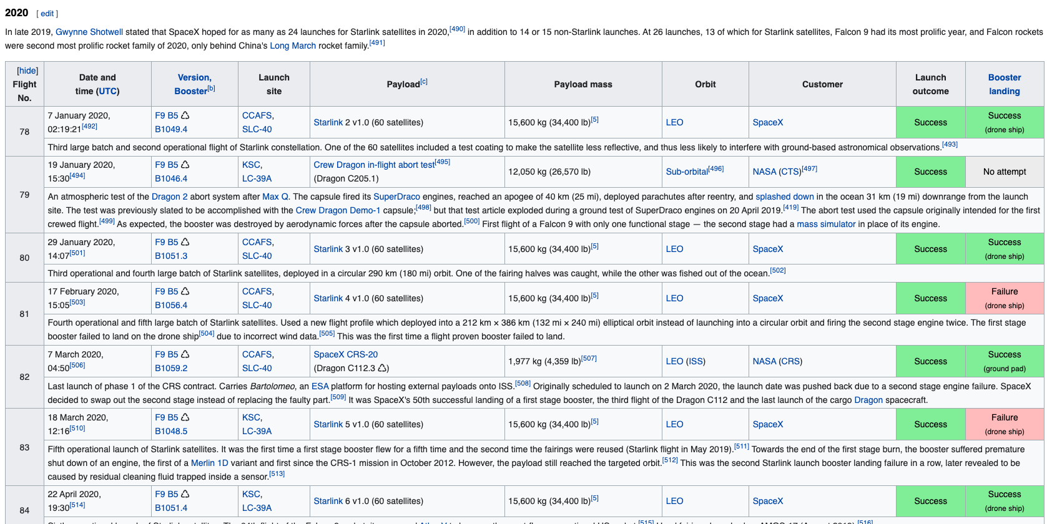
Data Collection – Web Scrapping from Wikepidea
  The data is scraped from https://en.wikipedia.org/w/index.php?title=List_of_Falcon_9_and_Falcon_Heavy_launches&oldid=1027686922
  The website contains only the data about Falcon 9 launches.
  We end up with 121 rows or instances and 11 columns or features. The picture below shows the first few rows of the data:

Slide 9
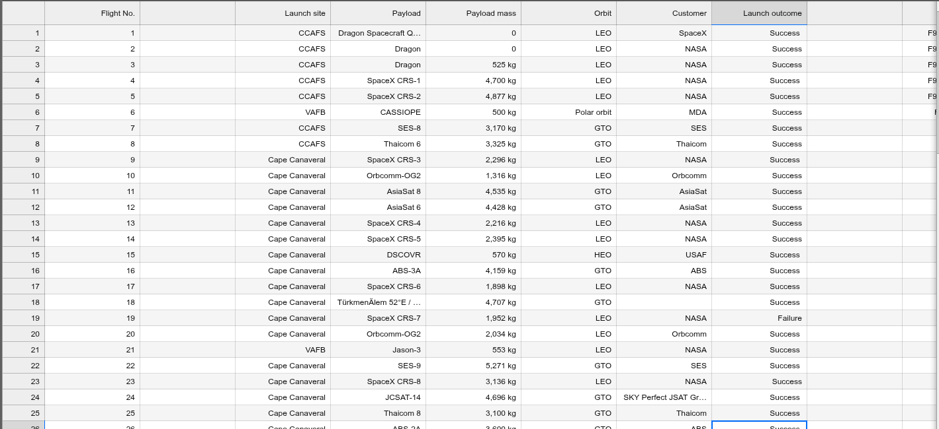
Data Collection - Web Scrapping from Wikepidea
Here is the CSV after the web scrapping process

Slide 10
Data Wrangling
The data is later processed so that there are no missing entries and categorical features are encoded using one-hot encoding.
A column called ‘Class’ is was added to the data frame. The column ‘Class’ contains 0 if a given launch is failed and 1 if it is successful.
In the end, we end up with 90 rows or instances and 83 columns or features.

Slide 11
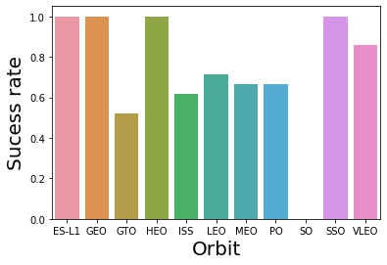
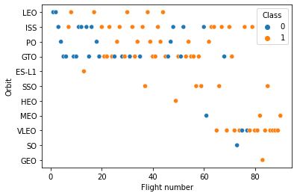
EDA with Data Visualization
Pandas and NumPy
  Functions from the Pandas and NumPy libraries are used to derive basic information about the data collected, which includes:
    The number of launches on each launch site
    The number of occurrence of each orbit
    The number and occurrence of each mission outcome
SQL
  The data is queried using SQL to answer several questions about the data such as:
    The names of the unique launch sites in the space mission
    The total payload mass carried by boosters launched by NASA (CRS)
    The average payload mass carried by booster version F9 v1.1

Slide 12
Build an Interactive Map with Folium
Matplotlib and Seaborn
  Functions from the Matplotlib and Seaborn libraries are used to visualize the data throughscatterplots, bar charts, and line charts.
  The plots and charts are used to understand more about the relationships between severalfeatures, such as:
    The relationship between flight number and launch site
    The relationship between payload mass and launch site
    The relationship between success rate and orbit type
Folium
  Functions from the Folium libraries are used to visualize the data through interactive maps.
  The Folium library is used to:
    Mark all launch sites on a map
    Mark the succeeded launches and failed launches for each site on the map
    Mark the distances between a launch site to its proximities such as the nearest city, railway, orhighway

Slide 13
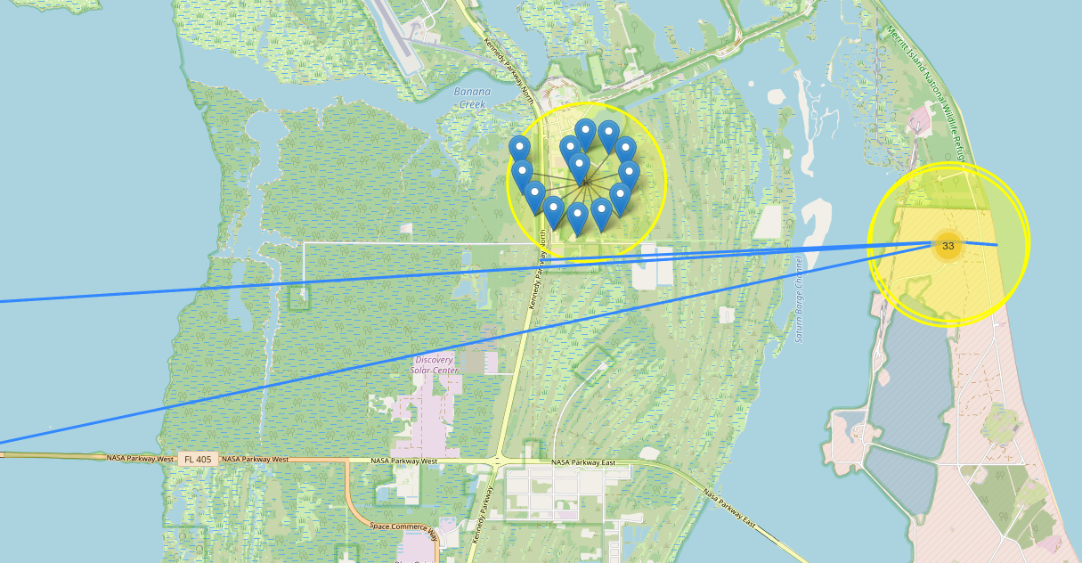
Build an Interactive Map with Folium

Slide 14
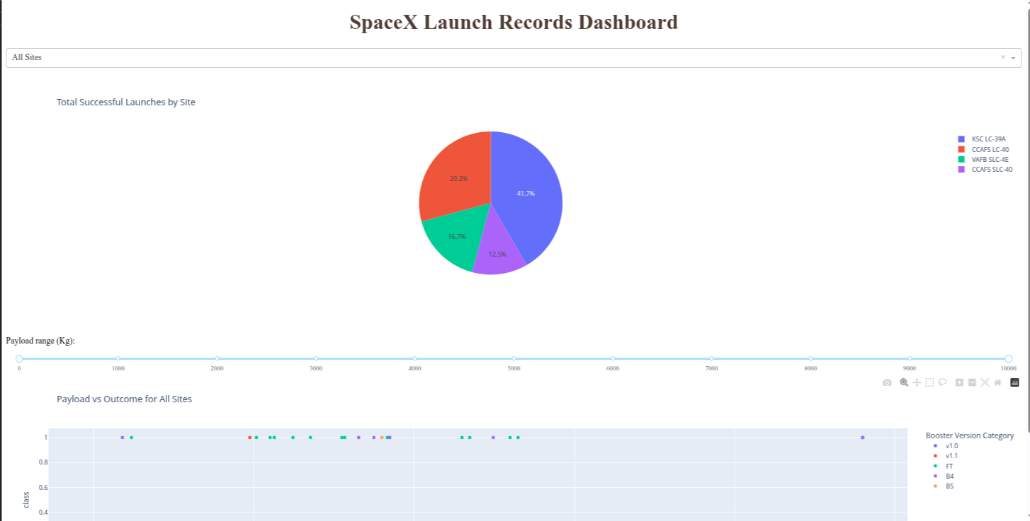
Build a Dashboard with Plotly Dash
Dash
  Functions from Dash are used to generate an interactive site where we can toggle the inputusing a dropdown menu and a range slider.
  Using a pie chart and a scatterplot, the interactive site shows:
    The total success launches from each launch site
    The correlation between payload mass and mission outcome (success or failure) for each launchsite

Slide 15

Predictive Analysis (Classification)
Functions from the Scikit-learn library are used to create our machine learningmodels.
The machine learning prediction phase include the following steps:
  Standardizing the data
  Splitting the data into training and test data
  Creating machine learning models, which include:
    Logistic regression
    Support vector machine (SVM)
    Decision tree
    K nearest neighbors (KNN)
  Fit the models on the training set
  Find the best combination of hyperparameters for each model
  Evaluate the models based on their accuracy scores and confusion matrix

Slide 16

Section 2

Slide 17
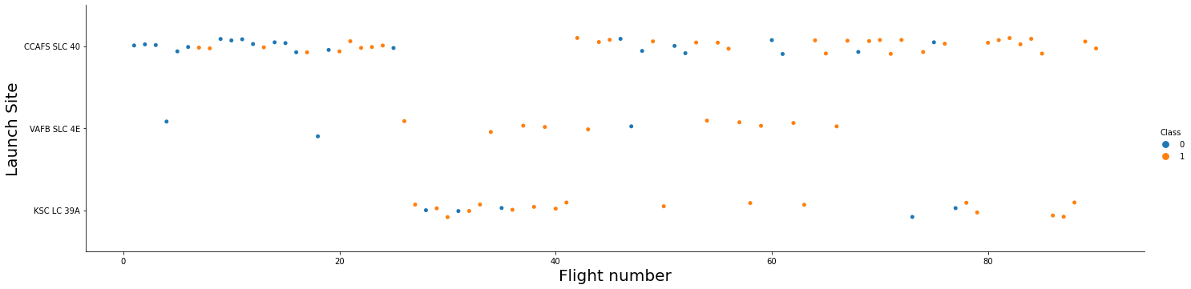
Flight Number vs. Launch Site
Show a scatter plot of Flight Number vs. Launch Site
Show the screenshot of the scatter plot with explanations

Slide 18
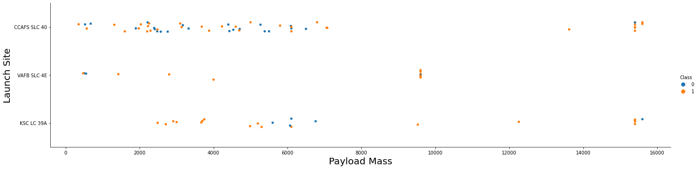
Payload vs. Launch Site
Show a scatter plot of Payload vs. Launch Site
Show the screenshot of the scatter plot with explanations

Slide 19
Success Rate vs. Orbit Type
Show a bar chart for the success rate of each orbit type
Show the screenshot of the scatter plot with explanations

Slide 20
Flight Number vs. Orbit Type
Show a scatter point of Flight number vs. Orbit type
Show the screenshot of the scatter plot with explanations

Slide 21
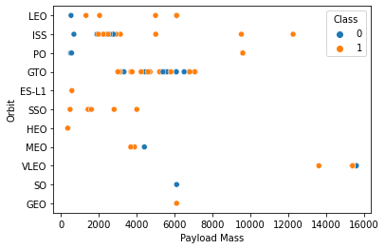
Payload vs. Orbit Type
Show a scatter point of payload vs. orbit type
Show the screenshot of the scatter plot with explanations

Slide 22
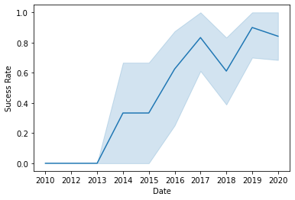
Launch Success Yearly Trend
Show a line chart of yearly average success rate
Show the screenshot of the scatter plot with explanations

Slide 23
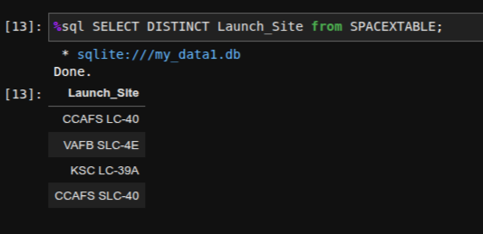
All Launch Site Names

Slide 24
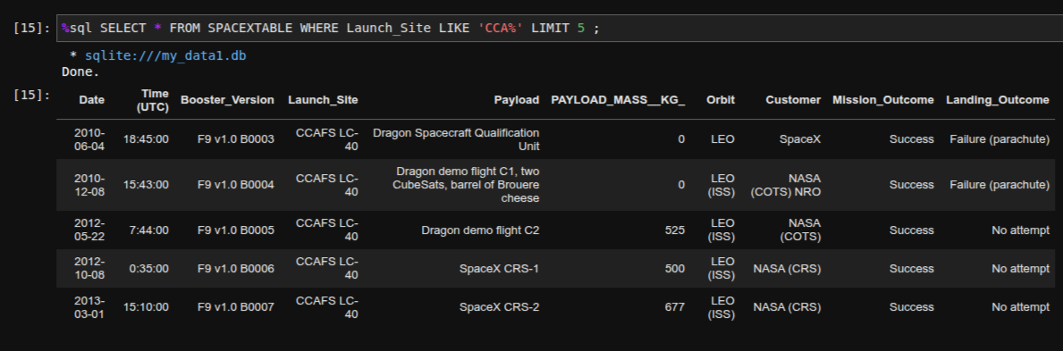
Launch Site Names Begin with 'CCA'

Slide 25
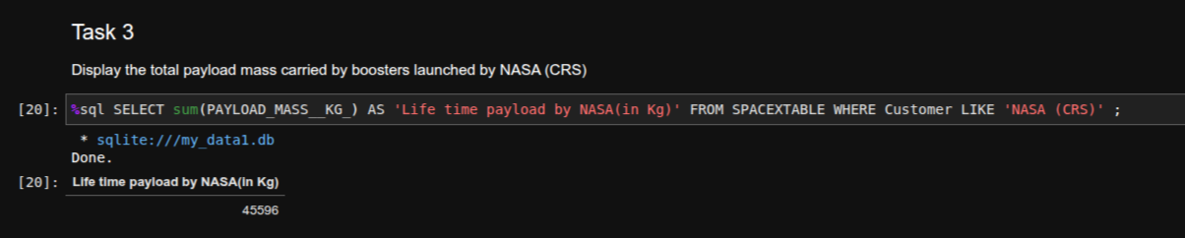
Total Payload Mass

Slide 26
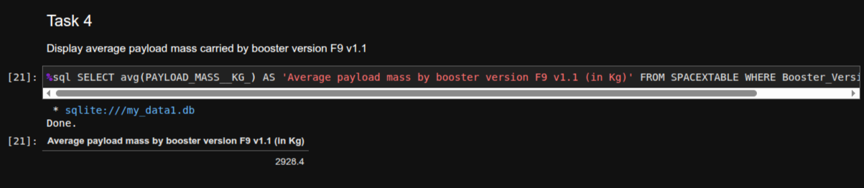
Average Payload Mass by F9 v1.1

Slide 27
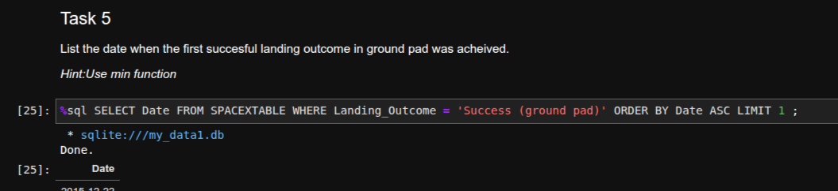
First Successful Ground Landing Date

Slide 28
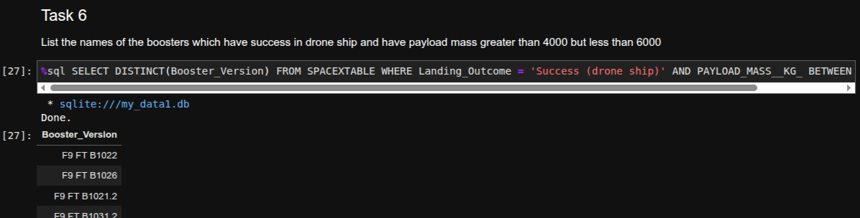
Successful Drone Ship Landing with Payload between 4000 and 6000

Slide 29
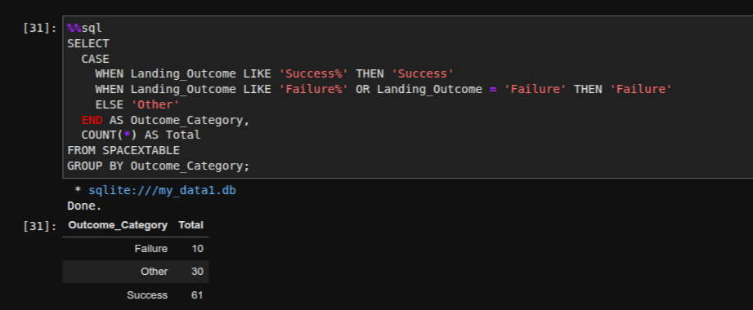
Total Number of Successful and Failure Mission Outcomes

Slide 30
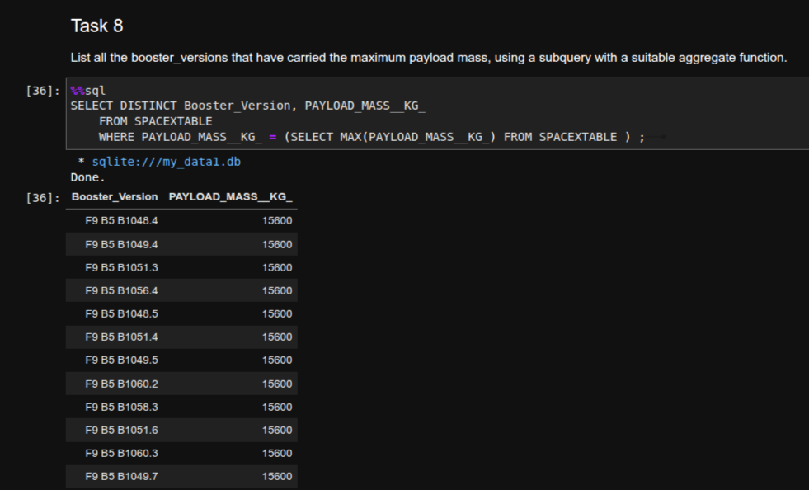
Boosters Carried Maximum Payload

Slide 31
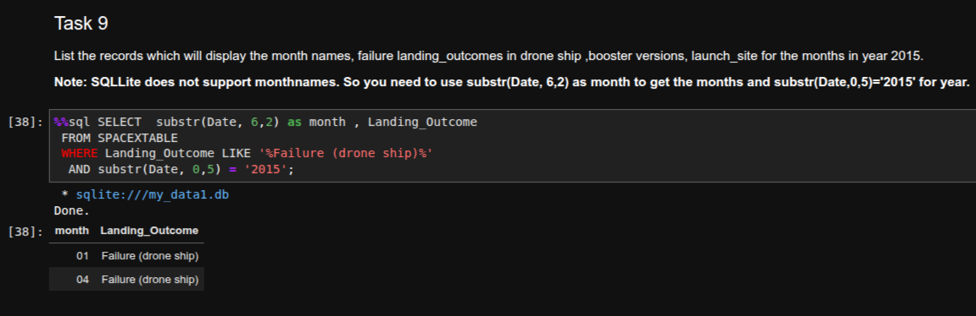
2015 Launch Records

Slide 32
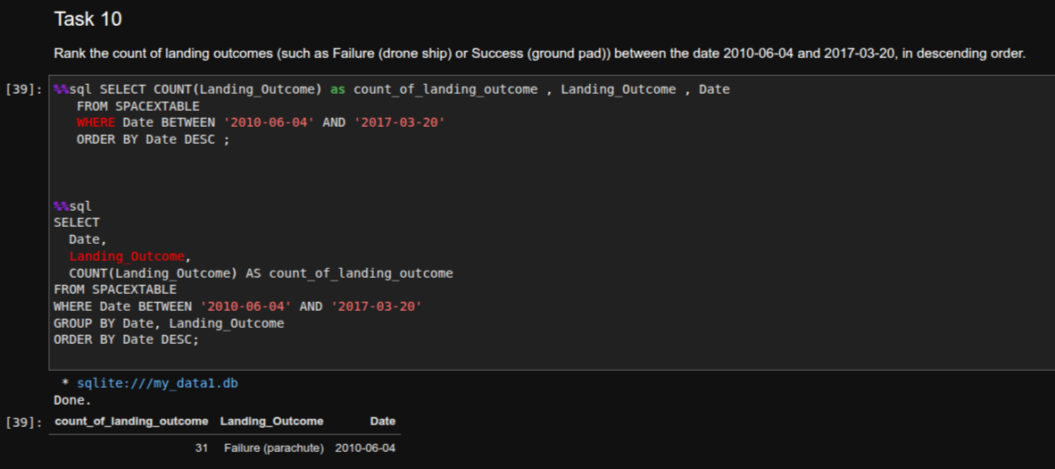
Rank Landing Outcomes Between 2010-06-04 and 2017-03-20

Slide 33

Section 3

Slide 34
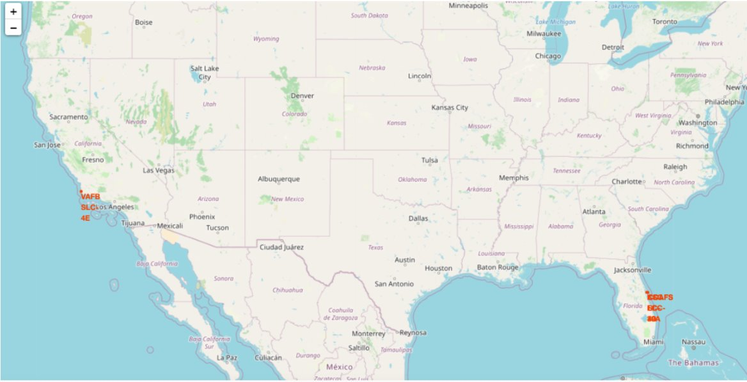
All Launch Sites on Map

Slide 35
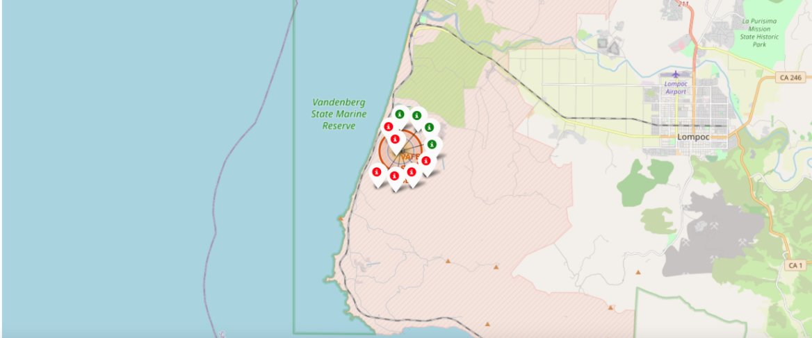
Success launch sites

Slide 36
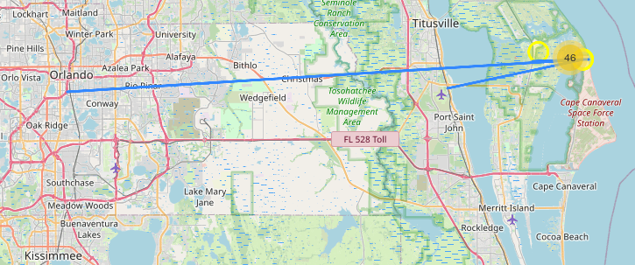
Approximation to nearest ciry, railway and highway

Slide 37

Section 4

Slide 38
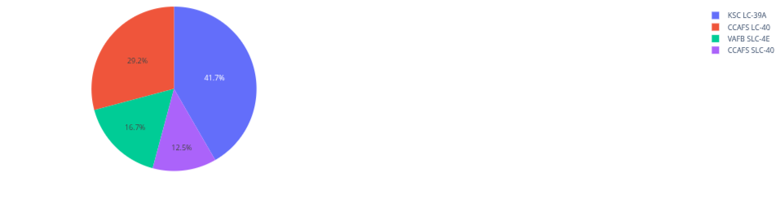
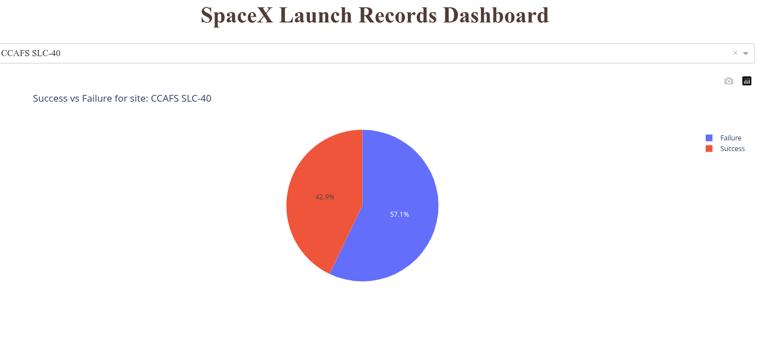
Dashboard
As shown , we can clearly see that KSL LC-39 A has the highest succesull launches being 41.7%.
It is also possible to select a launch site and have the pie chart updated

Slide 39
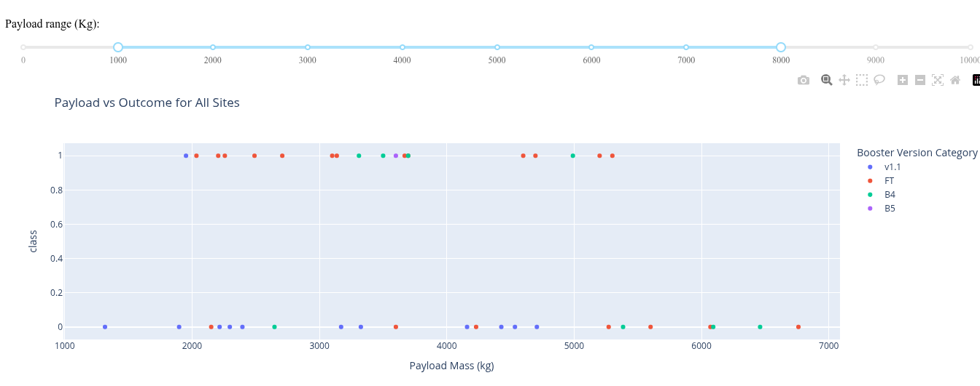
Success of laning to payload mass
For the payload selection to success rates, we can select a mass range and have the scatter plot updated in real time thanks to dash.

Slide 40

Section 5

Slide 41
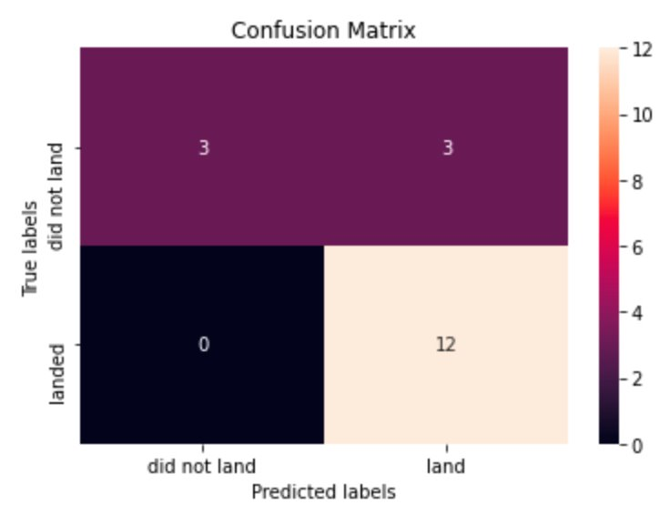
Classification Accuracy
Logistic regression​
  GridSearchCV best score: 0.8464285714285713​
  Accuracy score on test set: 0.8333333333333334​
  Confusion matrix:​

Slide 42
Classification Accuracy
Support vector machine (SVM)
  GridSearchCV best score: 0.8482142857142856
  Accuracy score on test set: 0.8333333333333334
  Confusion matrix:

Slide 43
Classification Accuracy
Decision tree
  GridSearchCV best score: 0.8892857142857142
  Accuracy score on test set: 0.8333333333333334
  Confusion matrix:

Slide 44
Classification Accuracy
K nearest neighbors (KNN)
  GridSearchCV best score: 0.8482142857142858
  Accuracy score on test set: 0.8333333333333334
  Confusion matrix:

Slide 45
Compairason of the models
After evaluating the performance of the four models using confusion matrices, we decided to rank them based on their best scores from GridSearchCV, as it provides a more objective comparison. The models are ranked below from best to worst according to their GridSearchCV best scores:
  Decision Tree – Best Score: 0.889
  K-Nearest Neighbors (KNN) – Best Score: 0.848
  Support Vector Machine (SVM) – Best Score: 0.848
  Logistic Regression – Best Score: 0.846

Slide 46
Conclusion
This project focuses on predicting whether the first stage of a Falcon 9 rocket will successfully land, a factor that significantly influences launch cost efficiency.
Key launch features—such as payload mass, orbit type, and other mission-specific variables—are analyzed to understand their impact on the landing outcome.
To uncover meaningful patterns in historical launch data, we applied multiple machine learning algorithms. These models were trained to recognize correlations and trends that could predict future outcomes.
Among the four algorithms tested, the Decision Tree model delivered the highest performance, making it the most effective approach for this classification task.

Slide 47


My Github repo

Slide 48


