Slide 1
Automatic Soft Tissue Detection in X-Ray Intensity Images
Joseph Bullock, Carolina Cuesta-Lázaro, Arnau Quera-Bofarull
Supervised by: Marion Weinzierl

Slide 2
Problem description
Current algorithms require user input to define the soft tissue, bone and open beam regions.
Need an automatic prior selection.
The main goal is to identify 100% soft tissue regions in a robust way.

Slide 3
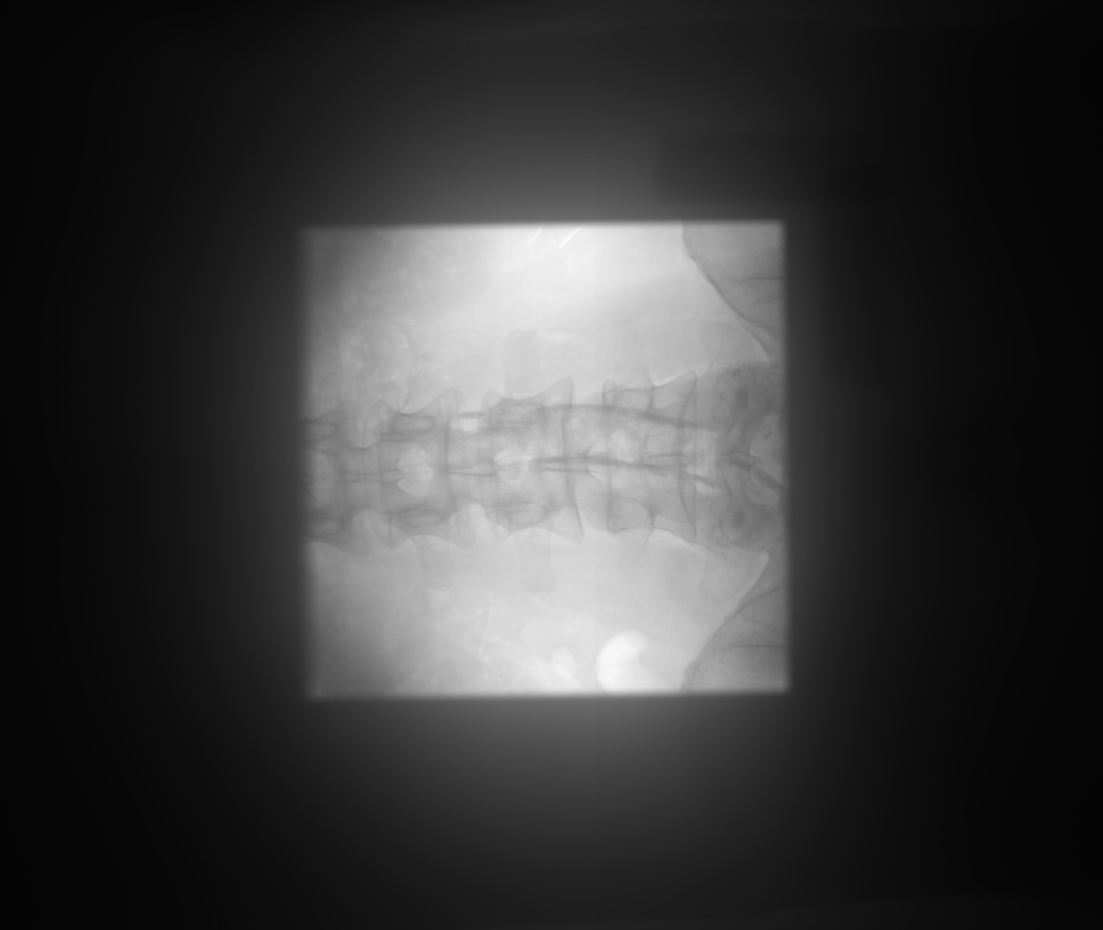
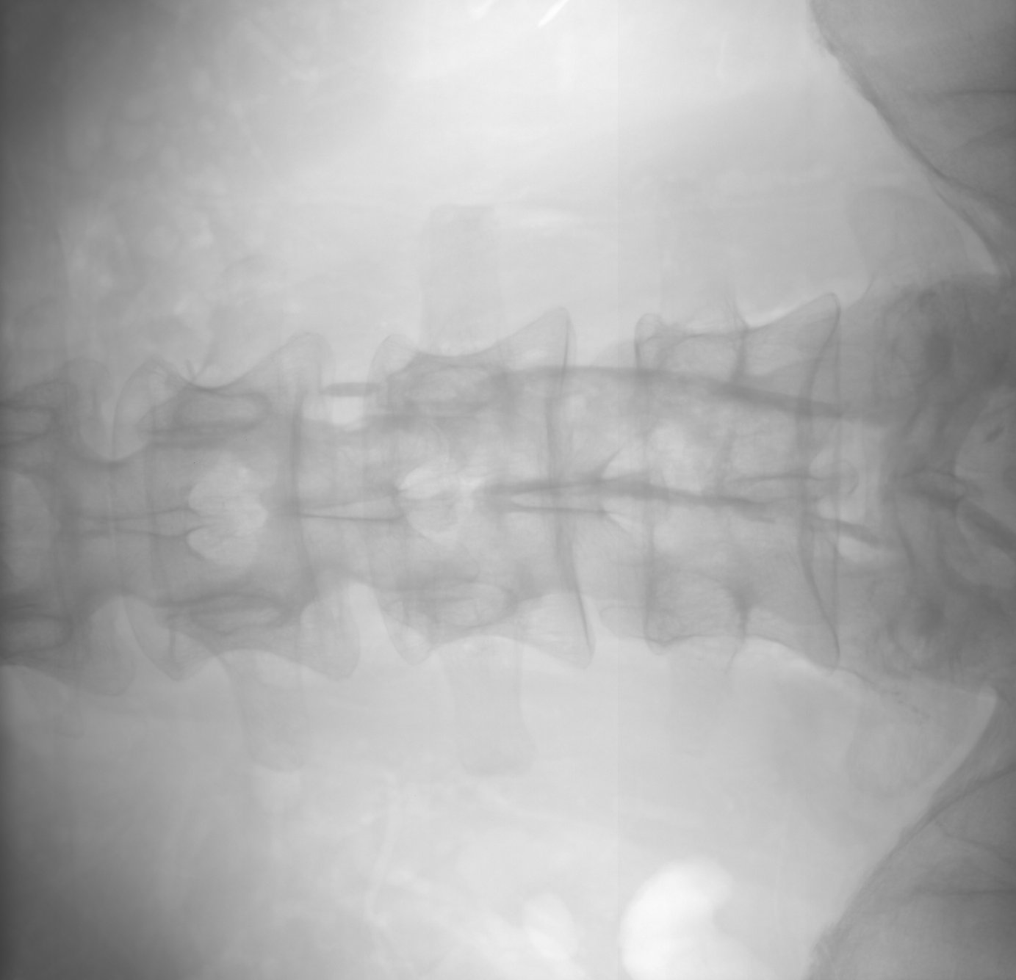
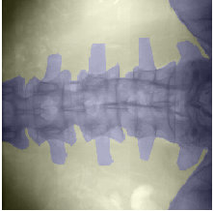
Approach
Machine learning based algorithms:
  Supervised learning: Training sets with labelled samples.
Remove
collimator
Labelling

Slide 4
Collimator detection
Joe adds plots
Hough transform → fail

Slide 5
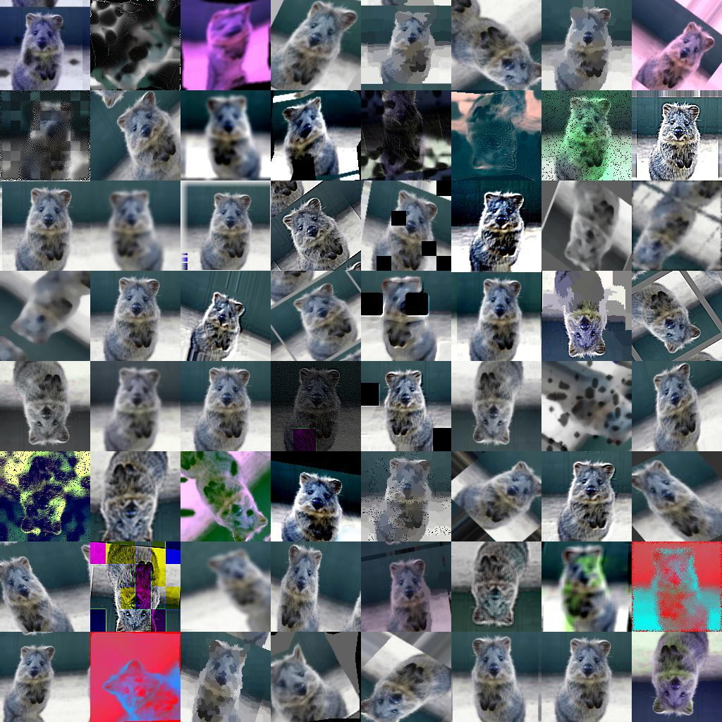
Data augmentation
We currently have a small database, ~ 50 images.
We generate more data
by slightly altering the
images
github.com/aleju/imgaug

Slide 6
Supervised Learning
Decision Tree
Feature 1
Yes
No
Feature 2
Feature 2
Yes
No
Yes
No
Bone 30%
Soft Tissue 100%
Bone 70%
Open beam 100%

Slide 7
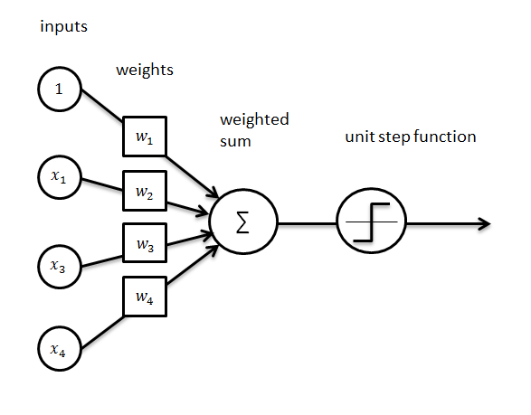
Supervised Learning
Perceptron
update weights
cost function
J
Compares prediction with truth
Credit: Ahmet Taspinar

Slide 8
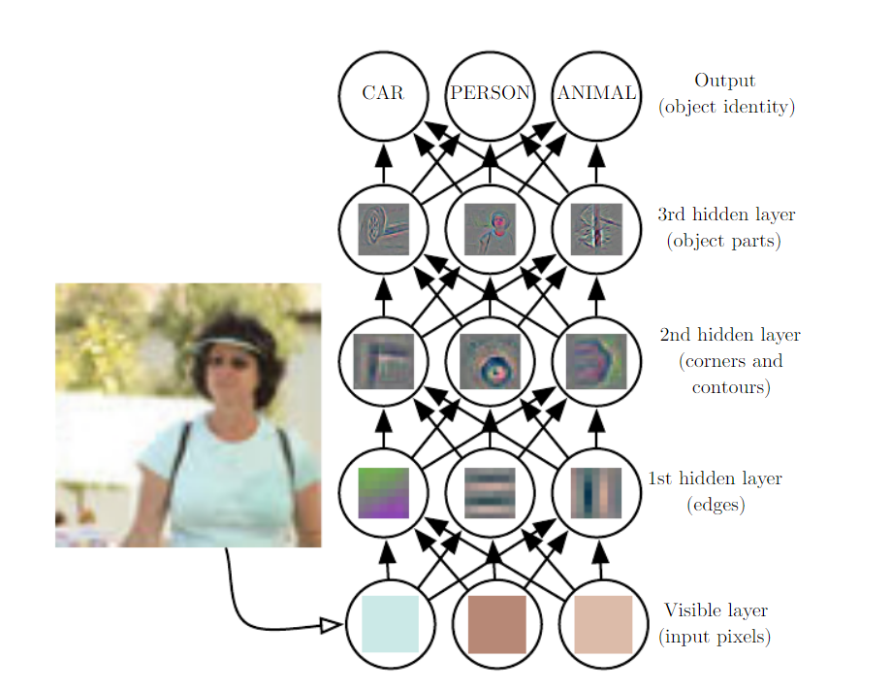
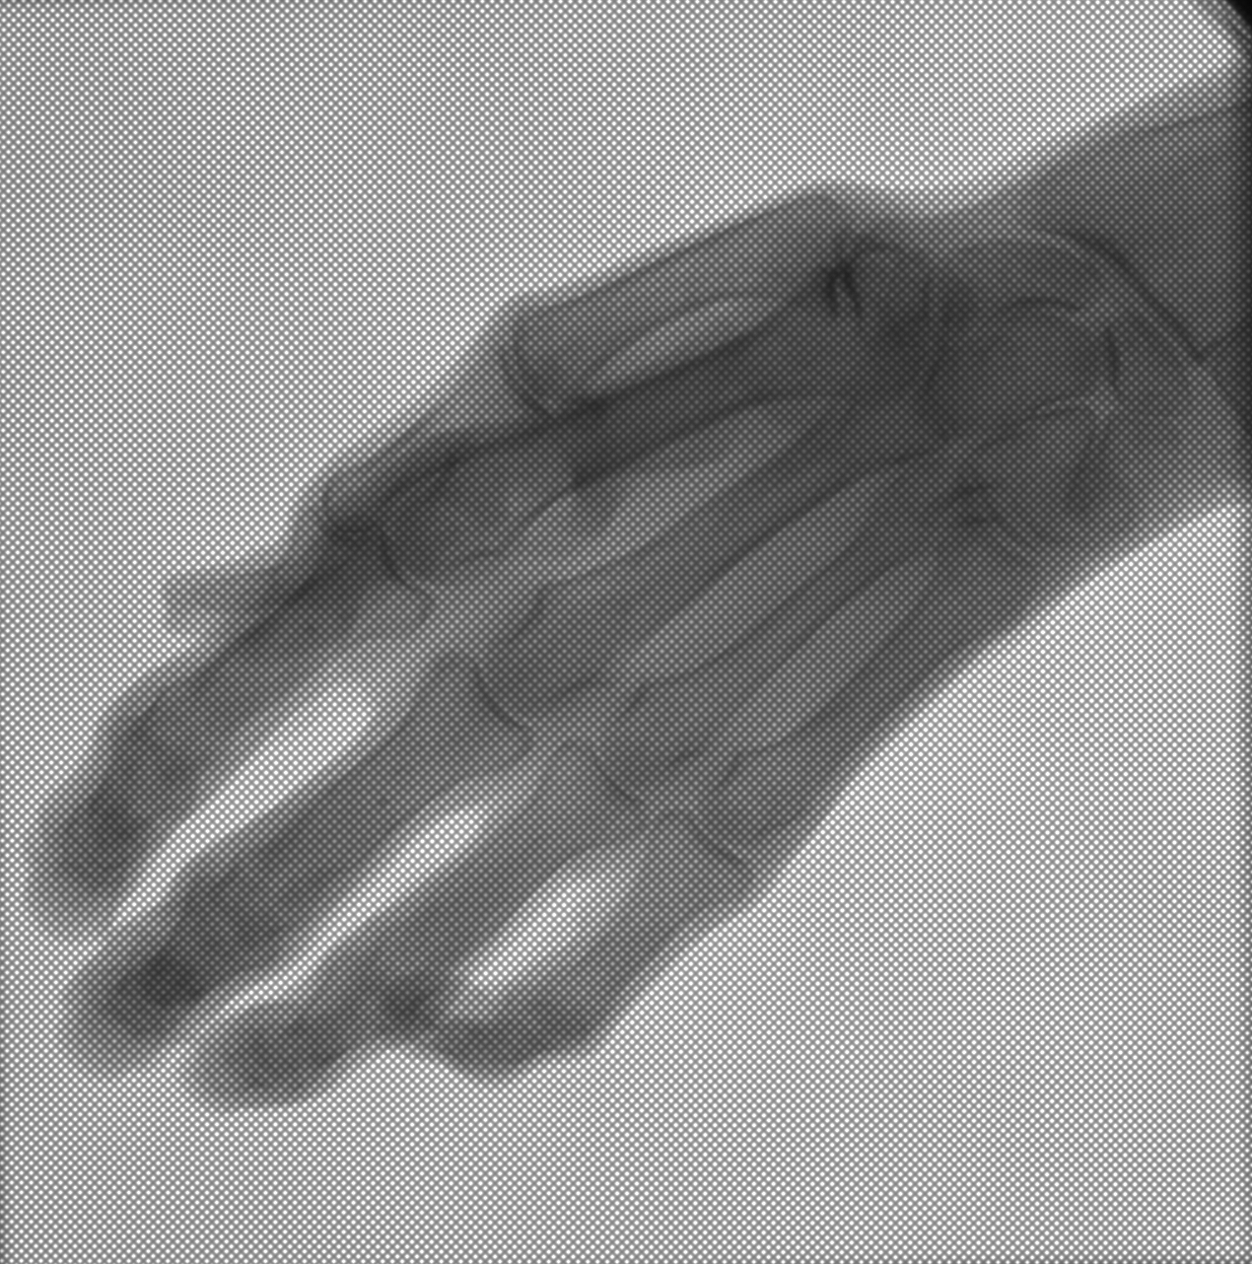
Supervised Learning
Neural Networks
Bone
Soft
Tissue
Open
Beam
Adapted from: Goodfellow et al 2016

Slide 9
Other Algorithms
Unsupervised Learning
  K-means
  Expectation–maximization algorithm
Non-ML methods
  Smart edge detection + thresholding + ...

Slide 10
Other Algorithms
Unsupervised Learning
  K-means
  Expectation–maximization algorithm
Non-ML methods
  Smart edge detection + thresholding + ...

Slide 11
Deliverables
Implementation of one or more image segmentation algorithms for soft tissue identification.
Benchmarking (speed, robustness...)
Test the suitability of the methods in other contexts (food contamination, security applications...)

Slide 12
