Slide 1
Test Scenarios
The following test values were arbitrarily chosen to show the output for different scenarios

Slide 2
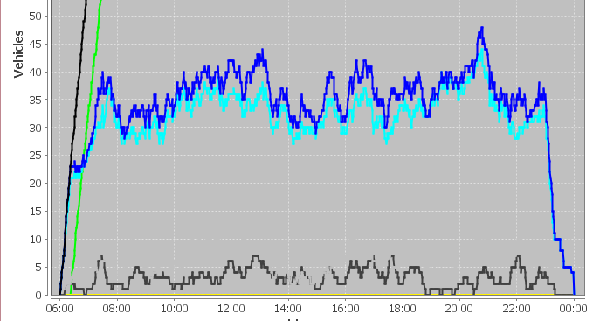
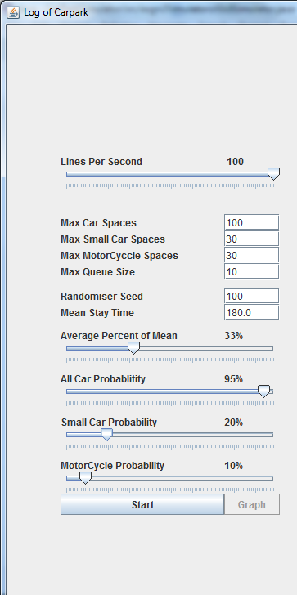
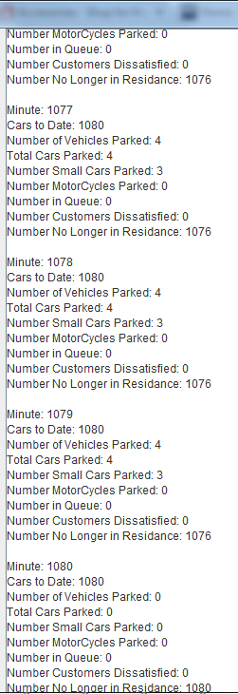
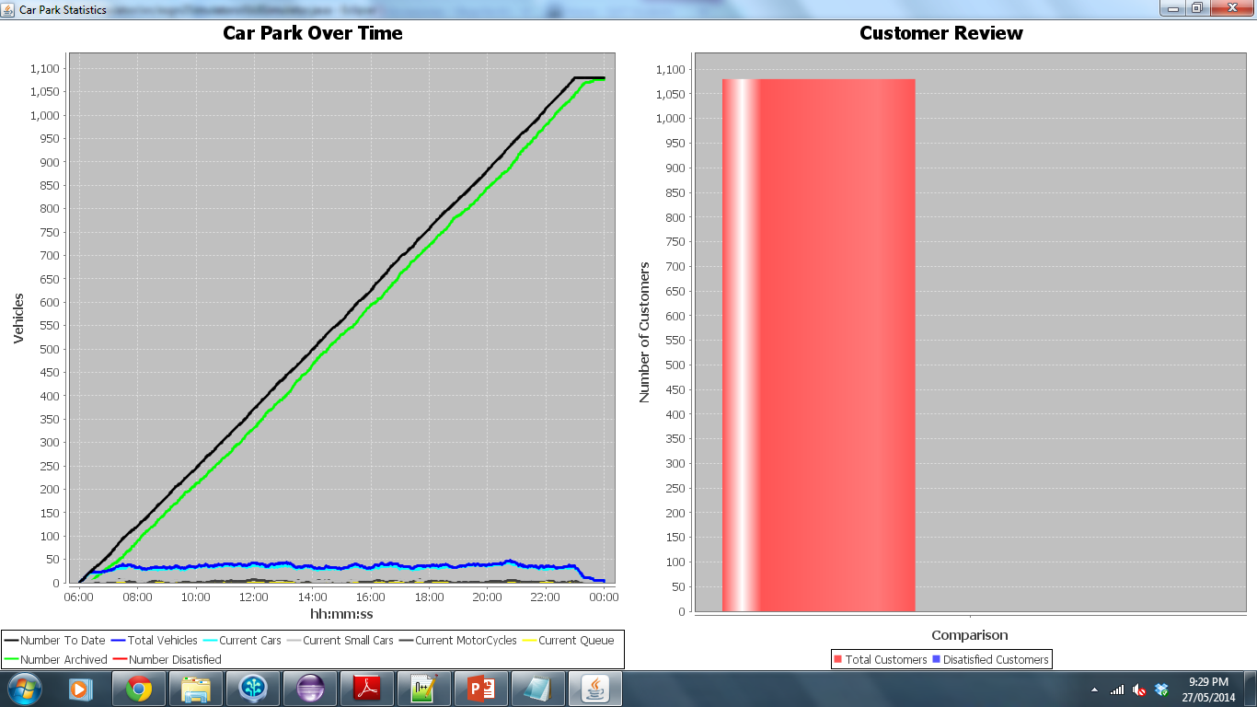
High Car Probability
The car probability was set to high, 95% with the small car probability only being 20%. As there were a lot more normal car spaces than small car spaces it was expected that all the normal cars would be parked and therefore the customers would be satisfied. The results below support this.

Slide 3
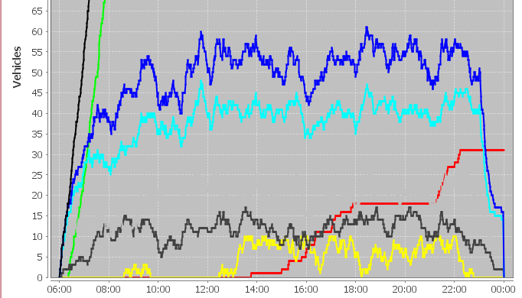
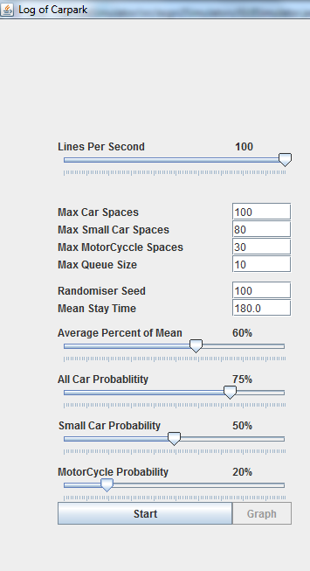
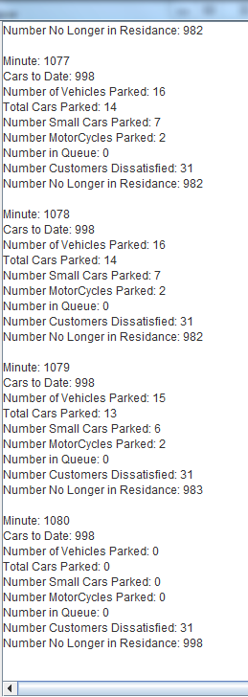
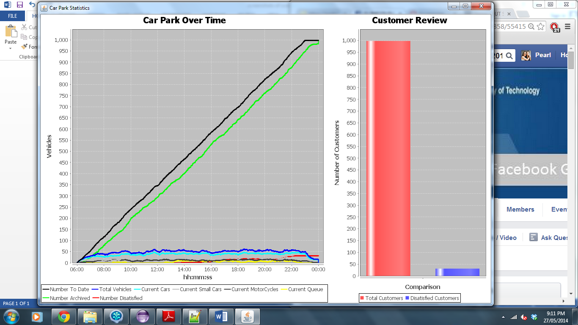
Small Car Spaces
A high number of small car spaces were created along with a fairly high probability of small cars. This resulted in some customers being dissatisfied as large cars would have been turned away. The simulator showed the dissatisfied customers as expected.

Slide 4
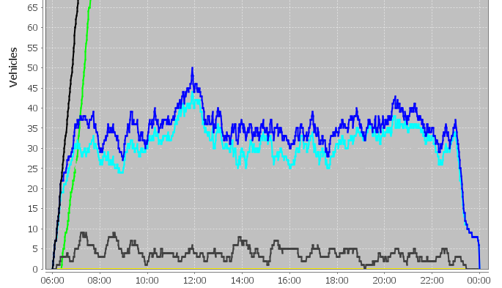
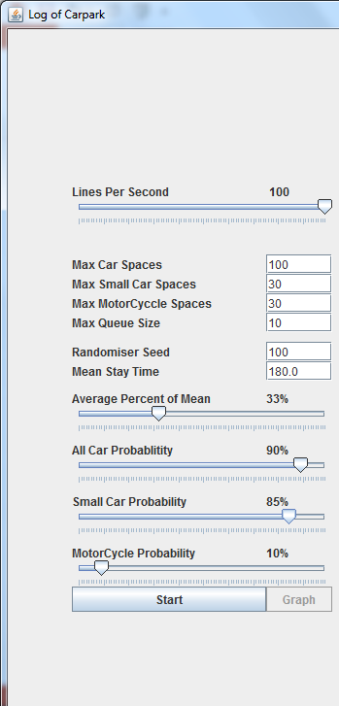
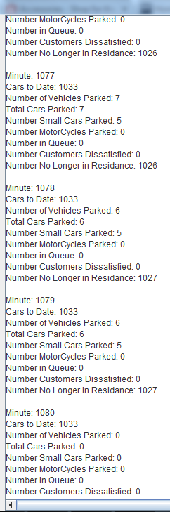
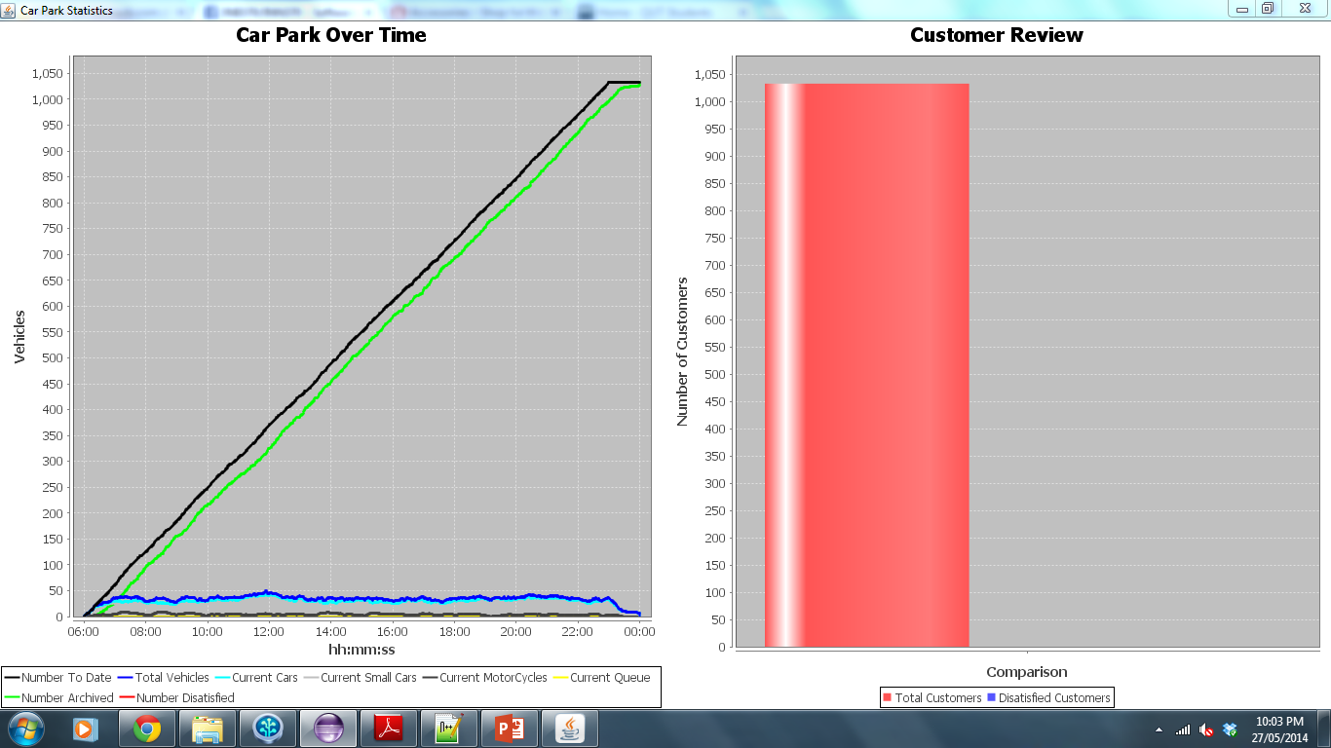
High Small Car Probability
The probability of small cars was set to high as was the probability of all cars. As small cars can park in normal car spaces it was expected that most if not all customers would be satisfied.

Slide 5
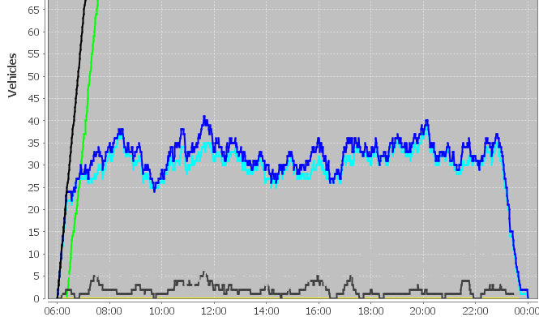
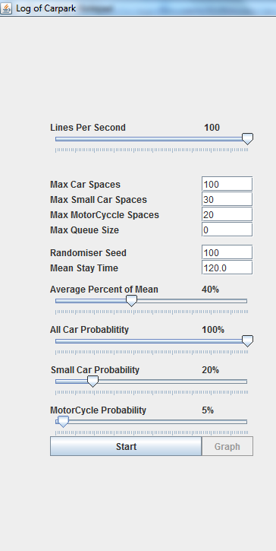
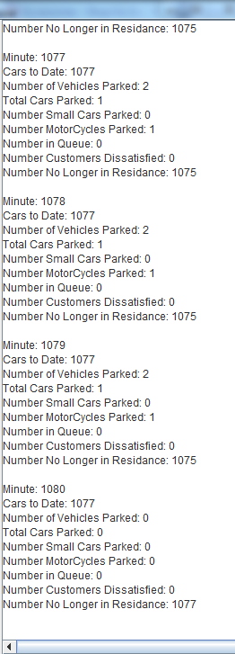
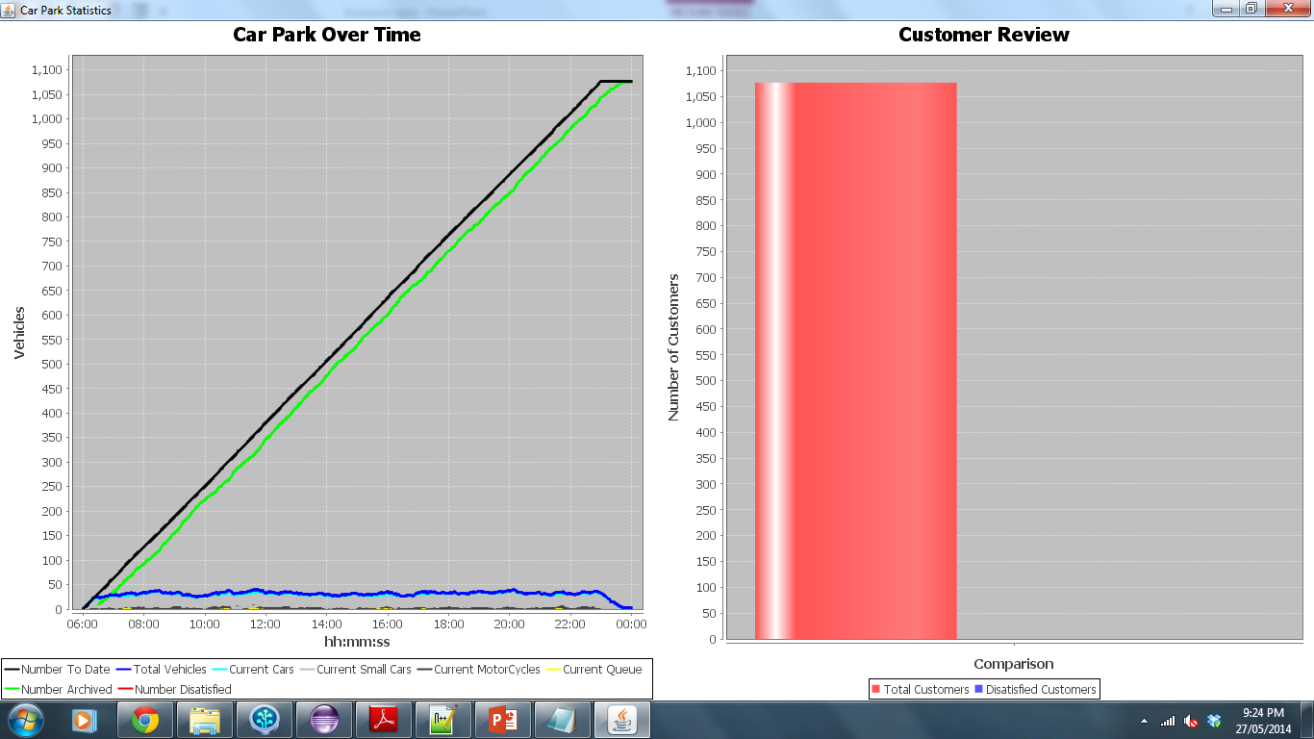
No Queue
Although there was no queue the number of small car spaces created was fairly low as was the probability of small cars being generated. The probability of motorcycles was even lower, therefore it is unlikely that customers would be turned away due to lack of appropriate spaces. Thus the customer review in which all customers were satisfied was expected.

Slide 6
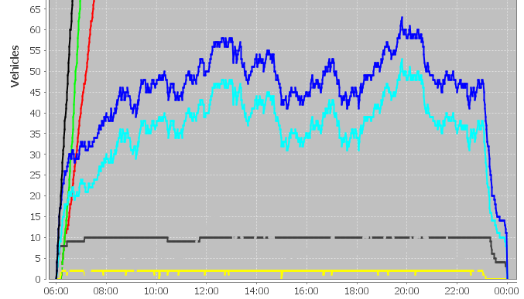
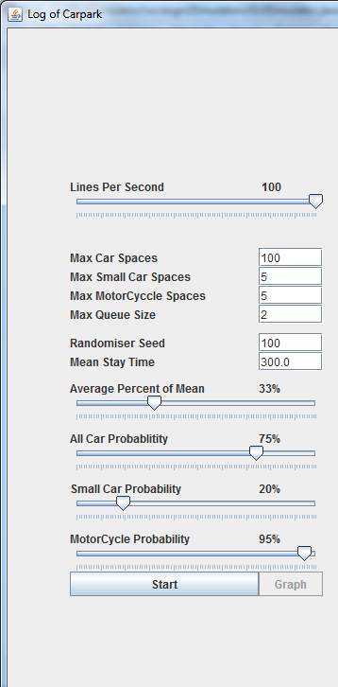
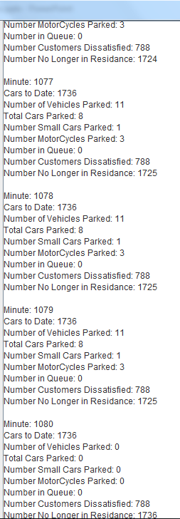
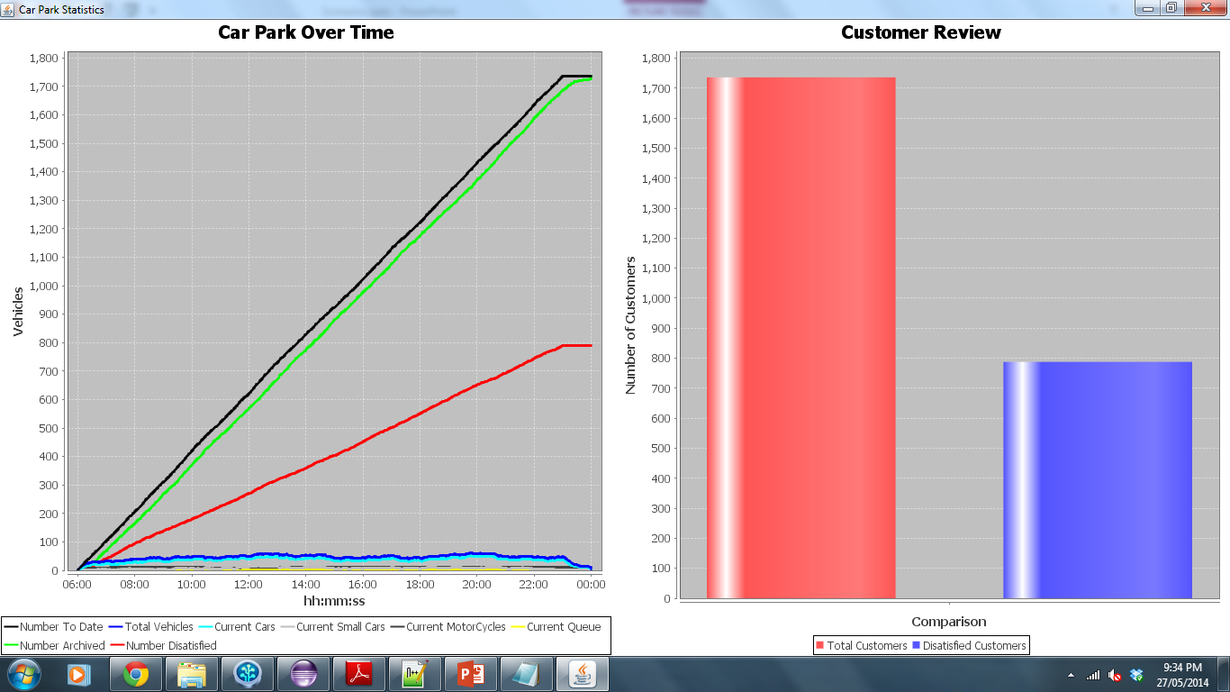
High Motorcycle Probability + low space
The motorcycle probability was set to high, 95%, while both the max small car spaces and max motorcycle spaces were set to 5. In addition to this the queue size was set to 2. These values were used to expect a high number of dissatisfied customers, as shown in the graph below.

