Slide 1
4-Bit Counter/Adder
Adrian and Peter

Slide 2
4-Bit Counter

Slide 3
Basic Flip Flop
AKA latch
Created by William Eccles and F.W. Jordan in 1918
Two stable states that stores information about state in binary
Square Wave
Comes in varieties (early variants)
Astable multivibrator
Monostable multivibrator
Bistable multivibrator
Comes in varieties (modern variants)
D flip flop
T flip flop
JK flip flop

Slide 4
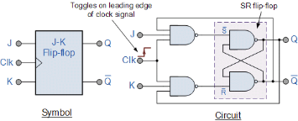
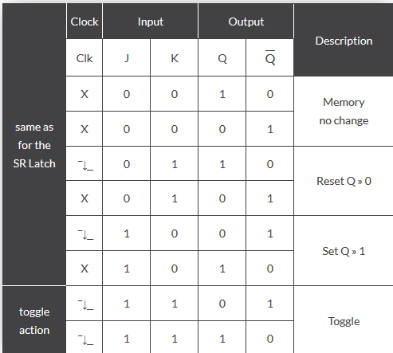
J-K Flip Flop
The JK flip flop is basically a gated SR flip-flop with the addition of a clock input circuitry that prevents the illegal or invalid output condition that can occur when both inputs S and R are equal to logic level “1”. Due to this additional clocked input, a JK flip-flop has four possible input combinations, “logic 1”, “logic 0”, “no change” and “toggle”.
Also when both the J and the K inputs are at logic level “1” at the same time, and the clock input is pulsed “HIGH”, the circuit will “toggle” from its SET state to a RESET state, or visa-versa.

Slide 5
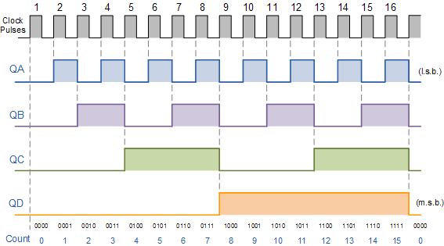

Slide 6
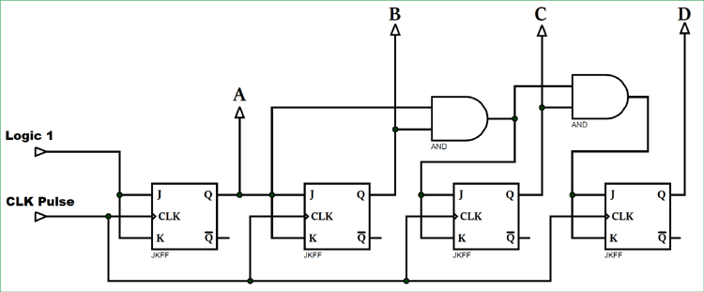

Slide 7
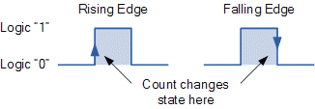
Explanation
- Think of the circuit as four timers controlling an LED that will power on depending if it is toggled or untoggled.
- It can be seen above, that the external clock pulses (pulses to be counted) are fed directly to each of the J-K flip-flops in the counter chain and that both the J and K inputs are all tied together in toggle mode, but only in the first flip-flop, flip-flop FFA (LSB) are they connected HIGH, logic “1” allowing the flip-flop to toggle on every clock pulse

Slide 8
4-Bit Adder

Slide 9

Half Adder
Two inputs (2 binary numbers) are fed into XOR gate and AND gate
Output S is the sum
Returns 1 if either A or B are TRUE
Returns 0 if both are FALSE
Returns 0 if both are TRUE
Output C is the carry
AND returns 1 if both A and B are true

Slide 10

Full Adder
3 inputs (2 for binary, 1 for previous carry)
XOR gate A
Returns 1 if either A or B are TRUE
XOR gate B
Output 1 if either gate A or previous Carry is true
If both inputs are TRUE see gate C
AND gate C
Returns 1 if gate A and there was a previous carry
Output 1 because 1 + 11 = 100 or 1 + 3 = 4
AND gate D
Checks to make sure input A and input B are TRUE because gate C will return TRUE if A and B are FALSE and there was a previous carry
Also carry if there was no previous carry
OR gate
If Gate C or D are TRUE there must be a carry output of 1
A
B
C
E
D

Slide 11
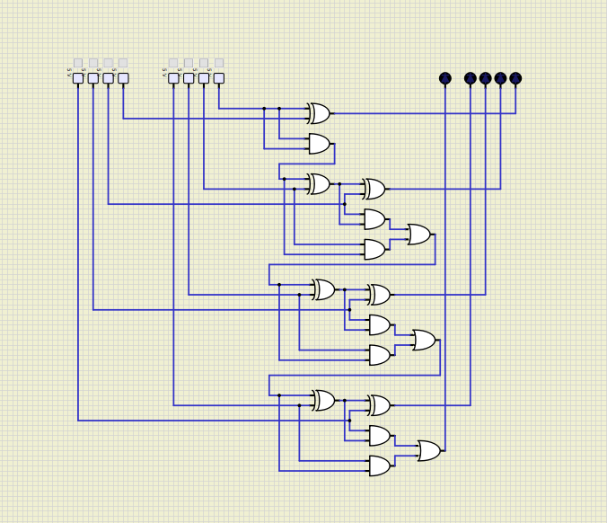
Schematic
1 half adder and 3 full adder
Half adder does not have previous carry option
After 1 half adder, all full adder afterwards are tileable for as many bits needed
Toggle the current for each one to determine whether it is on or off
All output (S) are directed to LEDs
Final adder carry output sent to 5th LED (15 + 15 = 30)

