Slide 1





Cell2Cell Customer Retention
Group 2

Slide 2


Addressing Customer Churn in Cell2Cell’s Consumer Business
What Factors and Customers Drive Customer Churn?
High Credit Rating (credita, aa)
Customer Needs
Number of three way calls (threeway)
Married (marryyes)
?
Expected Impact on Customer Retention
Current Equipment Age
(Eqpdays)
Has Made Retention Call (retcall)
Overage Minutes Usage (overage)
Number of dropped or blocked calls (dropblk)
Customer Choice

Slide 3
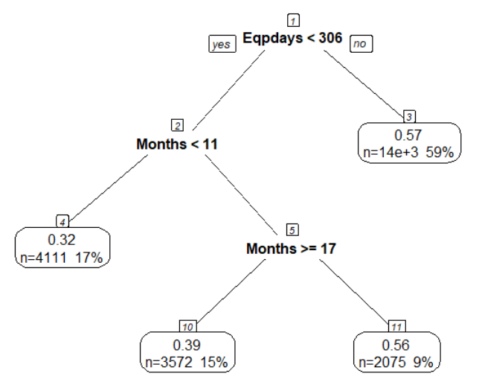
Customer Churn Predictions
Decision Tree Model
Customer churn can be predicted with a 77% true positive rate using just 2 features:
Current Equipment Days
Months of Service
There are 2 leaves that show a >50% likelyhood of churning.
A
B
Customers with relatively older equipment (>306 days)
Customers with new equipment and members between 11 and 17 months
Newish customers that have had to replace their equipment multiple times

Slide 4
LOGISTIC REGRESSION MODEL-RELATIONSHIPS
VARIABLE | ESTIMATE | IMPORTANCE | MEANING
Eqpdays | 0.0026 | 15.04 | For every extra month that a customer uses the current equipment, the odds of churning go up by 3%.
Retcall | 0.74 | 10.49 | If the customer has made a call to the retention team, the odds of churning go up by 74%.
Overage | 0.002 | 9.74 | Using overage minutes only increases the probability of churning by 0.2%- which is negligible.
Uniqsubs | 0.2 | 7.84 | For each additional unique subscriber, the odds of churning go up by 20%.
Mailres | -0.2 | 7.59 | For customers who respond to mail offers, the odds of churning go down by 20%.

Slide 5
VARIABLE | ESTIMATE | IMPORTANCE | MEANING
Refurb | 0.3 | 7.38 | If the handset is refurbished, the odds of churning goes up by 30%.
Setprcm | -0.25 | 6.02 | If the data on handset price is missing, the odds of churning go down by 25%.
Creditde | -0.2 | 5.75 | For users who have a lower credit rating, the odds of churning go down by 20%.
Actvsubs | -0.2 | 5.27 | With each additional active subscriber, the probability of churning goes down by 20%.
Changem | -0.0002 | 4.7 | The change in minutes of use has negligible impact on the probability of churning.

Slide 6
VARIABLE | ESTIMATE | IMPORTANCE | MEANING
Roam | 0.01 | 4.29 | With the number of roaming calls made by a user, the probability of churning goes up by 10%.
Eqpdays:months | -0.00004 | 8.11 | The combined effect of months in service and months a customer holds the equipment has an extremely low impact on the probability of churning.
Months:mou | -0.00001 | 4.99 | The combined effect of months in service and average monthly minutes used by a customer has negligible impact on the probability of churning.
Months | -0.0016 | 0.48 | For each additional month in service, the odds of churning go down by 1.6%.
Mou | -0.00002 | 0.36 | The average monthly minutes used by a customer has negligible impact on the probability of churning.

Slide 7

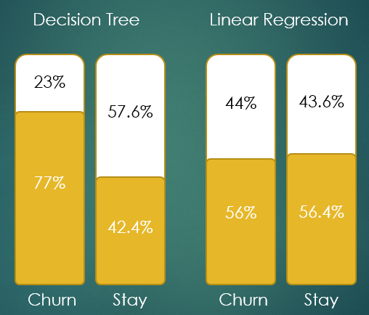
Model Chosen: DECISION TREE Model Comparisons i.e. reasons why we chose the model that we did
True Positive rate
Decision Tree-77% vs Logistic Regression-56%
Interpretability
Decision Tree(2 factors-months in service and equipment in use) vs Logistic Regression(15 factors including a few complex interactions)
Model Evaluations:
Other(Lift)
Decision Tree-1.15 vs Logistic Regression-1.26(comparatively similar)
The Decision Tree with a higher true positive rate and more interpretable results is a more concrete representation of the real world as compared to the Logistic Regression Model.

Slide 8
Predictions(based on Decision Tree)
USER # | PROBABILITY OF CHURN
8695 | 0.7729
29301 | 0.1707
15747 | 0.7729
34573 | 0.1707
Users 8695 and 15747
High probability of churning
These users should be targeted with proactive offers to drive higher retention
Users 29301 and 34573
Low probability of churning
Proactive offer cost should be considered against revenue generated by the users

Slide 9
Recommendations
Users 8695 and 15747
What defines them?
Middle-aged
Held equipment for 391 and 716 days, respectively
The Plan: Locked Phones
Partner with cell phone manufacturers to offer phones at discounted rates locked with Cell2Cell’s network for one year
We expect probability of churn to decrease by more than 35pps (0.77 to 0.49)
Users 29301 and 34573
What defines them?
Aged over 60 and married
New users who spend lot of time talking over the phone
The Plan: Personalized Plans
Offer plans with increased talk time at a slightly increased cost
We do not expect probability of churn to decrease a lot since these users already have low probability of churning

