Slide 1
Marketing Analytics Cell2Cell Part 2: Retention Campaign
Joseph Standerfer, Daniel Lesser, Jasmine kaur, spriha gupta

Slide 2
Cell2Cell’s Customer Retention Challenges
Every month 2% of Cell2Cell’s customers leave the wireless provider for another company
What models can accurately reflect the customer base of Cell2Cell?
What marketing campaigns can be used to increase customer retention and drive increased revenue?

Slide 3
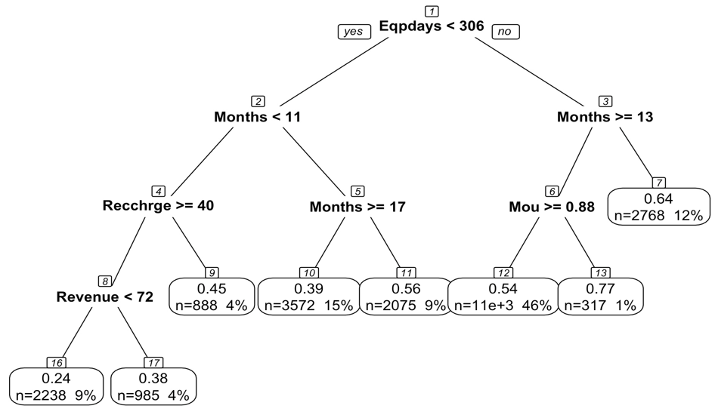
Decision Tree Model
Three potential targets for our marketing campaign
Infrequent Users
New user with Old Equipment
Frequent phone swapper

Slide 4
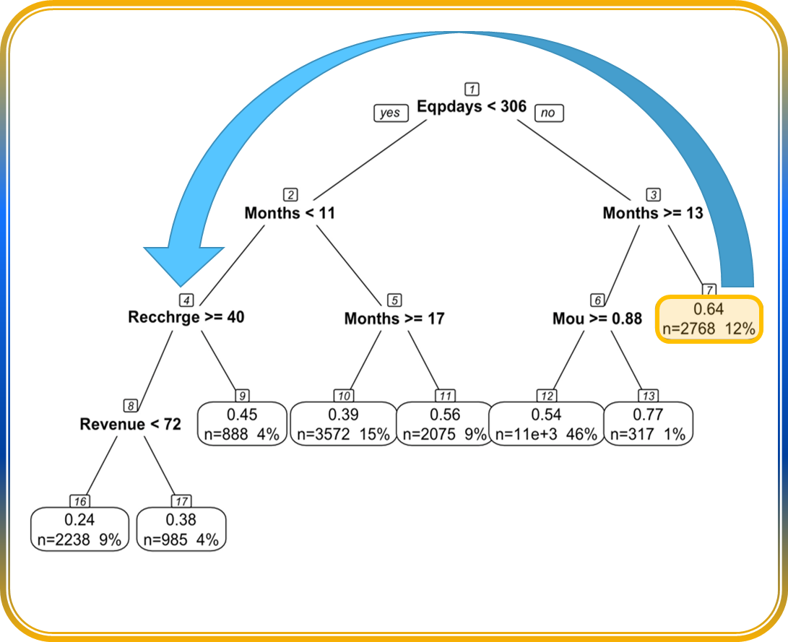
Promotional Program for Group 13: Infrequent Users
Encourage Connections
Own an old phone
Long-time customers
Increase Engagement
Highlight top 5 contacts
Retention
Move from Group 13 (6.5% churn) to Group 12 (2.3% churn)
Offer half off next three months if they have >5 calls per month
Almost never make calls (<1 minute/month)
Generate $$xxx extra lifetime value
Please fill in LTV Spriha/Jasmine

Slide 5
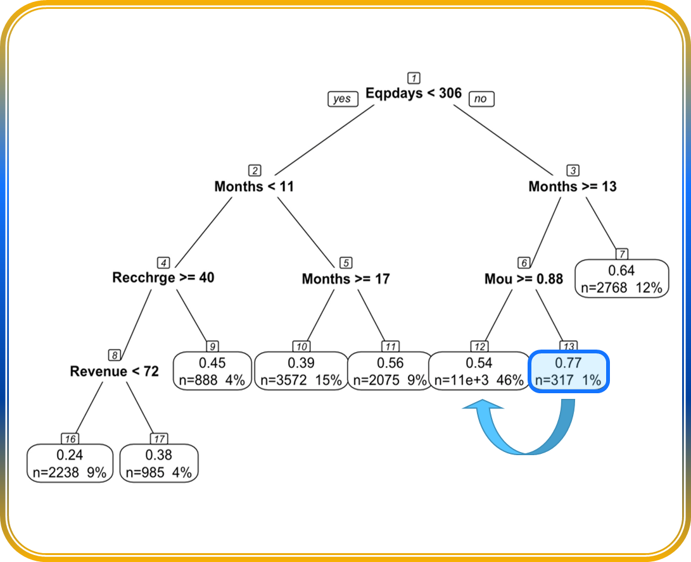
Promotional Program for Group 7: New User with Old Equipment
Offer new device
Own an old phone
Relatively new customers
Refresh their user profile
Offer them a new device or $150 credit on a new phone if they renew their contract
Retention
Move from Group 7 (3.6% churn) to mostly Groups 9, 16, 17 (1.6%, 0.7% and 1.2% churn)
Generate $$xxx extra lifetime value
Please fill in LTV Spriha/Jasmine

Slide 6
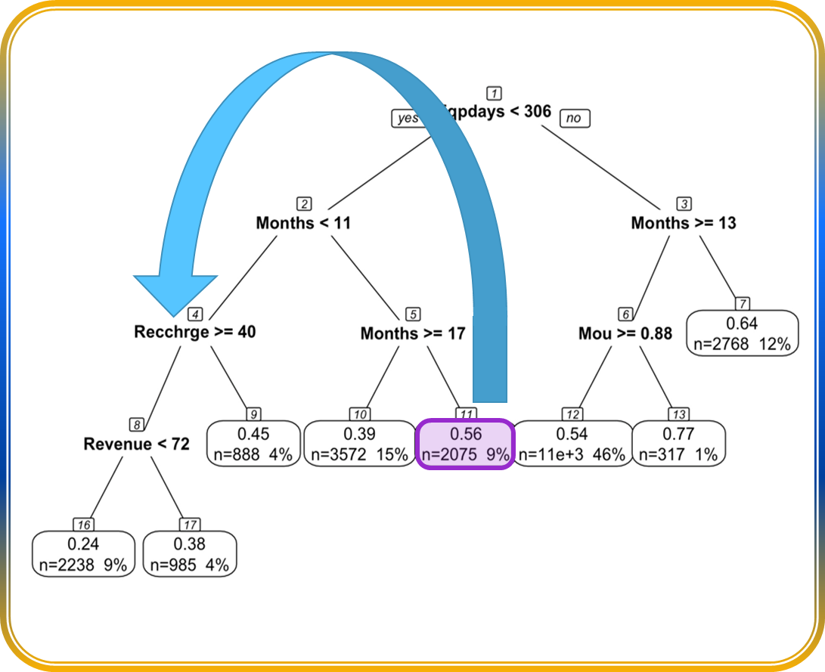
Promotional Program for Group 11: Frequent Phone Swapper
Offer Gift
Own an newer phone
Mid-range customer longevity
Renew Customer Mindset
Offer $50 prepaid visa gift card
Retention
Move from Group 11 (2.5% churn) to mostly Groups 9, 16, 17 (1.6%, 0.7% and 1.2% churn)
Make them feel like a new customer
Generate $$xxx extra lifetime value
Please fill in LTV Spriha/Jasmine

Slide 7
Slides Below can be deleted: left in for templating purposes

Slide 8
Title and Content Layout with Chart

Slide 9
Two Content Layout with Table
First bullet point here
Second bullet point here
Third bullet point here
Class | Group 1 | Group 2
Class 1 | 82 | 95
Class 2 | 76 | 88
Class 3 | 84 | 90

Slide 10
Title and Content Layout with SmartArt
Step 1 Title
Task description
Task description
Step 2 Title
Task description
Step 3 Title
Task description
Task description
Task description

Slide 11
Add a Slide Title - 1

Slide 12
Add a Slide Title - 2

Slide 13
Add a Slide Title - 3

Slide 15
Add a Slide Title - 4

Slide 16
Add a Slide Title - 5

