Slide 1
Marketing Analytics Cell2Cell Part 2: Retention Campaign
Joseph Standerfer, Daniel Lesser, Jasmine kaur, spriha gupta

Slide 2
Cell2Cell’s Customer Retention Challenges
Add your first bullet point here
Add your second bullet point here
Add your third bullet point here

Slide 3
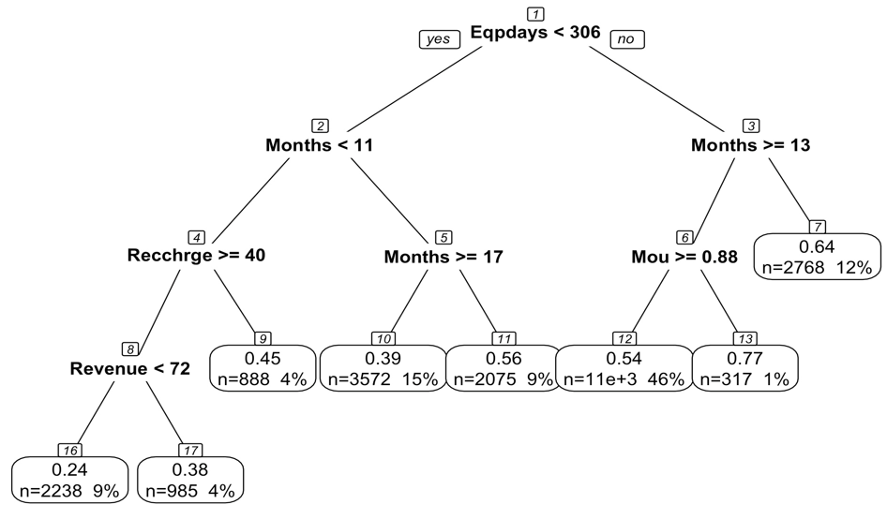
Decision Tree Model
Three potential targets for our marketing campaign
Infrequent Users
New user with Old Equipment
Frequent phone swapper

Slide 4
Decision Tree Model
Three potential targets for our marketing campaign
Infrequent Users
New user with Old Equipment
Frequent phone swapper

Slide 5
Decision Tree Model
Three potential targets for our marketing campaign
Infrequent Users
New user with Old Equipment
Frequent phone swapper

Slide 6
Decision Tree Model
Three potential targets for our marketing campaign
Infrequent Users
New user with Old Equipment
Frequent phone swapper

