Slide 1
Marketing Analytics Cell2Cell Part 2: Retention Campaign
Joseph Standerfer, Daniel Lesser, Jasmine kaur, spriha gupta

Slide 2
Cell2Cell’s Customer Retention Challenges
Every month 2% of Cell2Cell’s customers leave the wireless provider for another company
What models can accurately reflect the customer base of Cell2Cell?
What marketing campaigns can be used to increase customer retention and drive increased revenue?

Slide 3
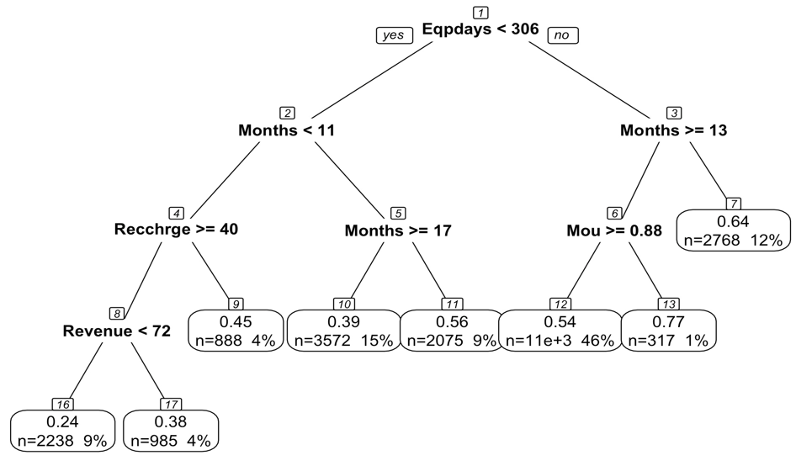
Decision Tree Model
Three potential targets for our marketing campaign
New user with Old Equipment
Infrequent Users
Frequent phone swapper

Slide 4
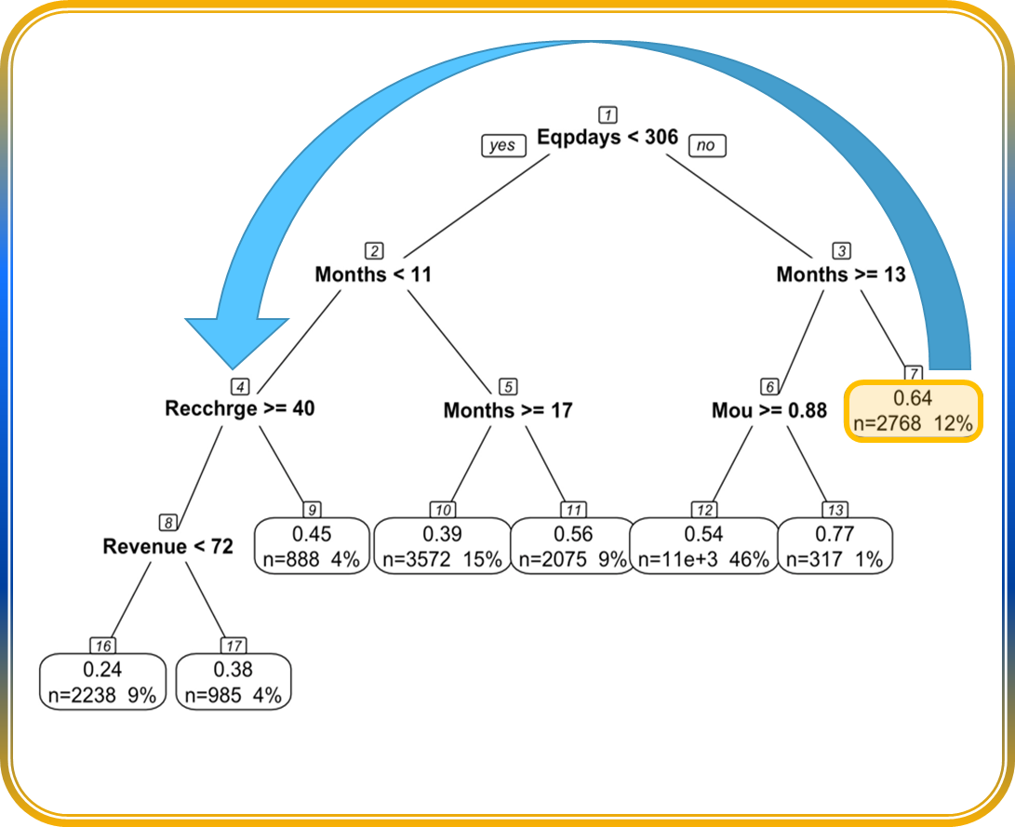
Promotional Program for Group 7: New user with Old Equipment
Offer new device
Own an old phone
Relatively new customers
Refresh their user profile
Offer them a new device or $150 credit on a new phone if they renew their contract
Retention
Move from Group 7 (3.6% churn) to mostly Groups 9, 16, 17 (1.6%, 0.7% and 1.2% churn)
Generate $111,665 extra lifetime value

Slide 5
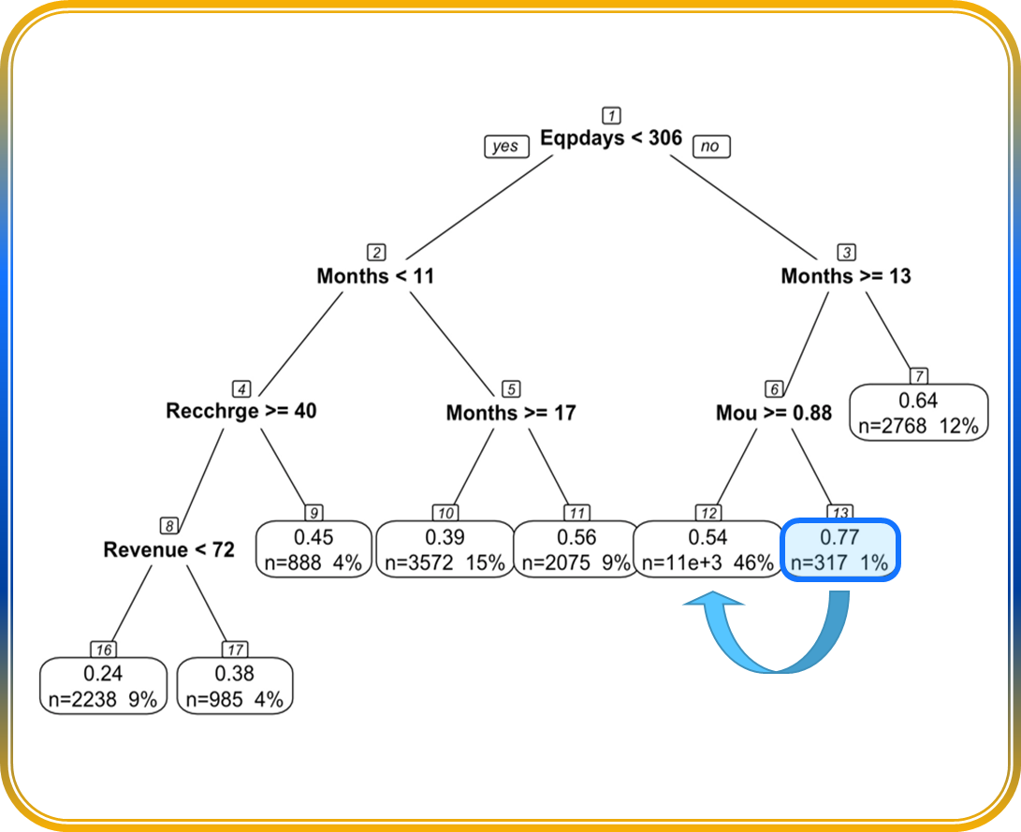
Promotional Program for Group 13: Infrequent Users
Encourage Connections
Own an old phone
Long-time customers
Increase Engagement
Highlight top 5 contacts
Retention
Move from Group 13 (6.5% churn) to Group 12 (2.3% churn)
Offer half off next three months if they have >5 calls per month
Almost never make calls (<1 minute/month)
Generate $6,373,695 extra lifetime value

Slide 6
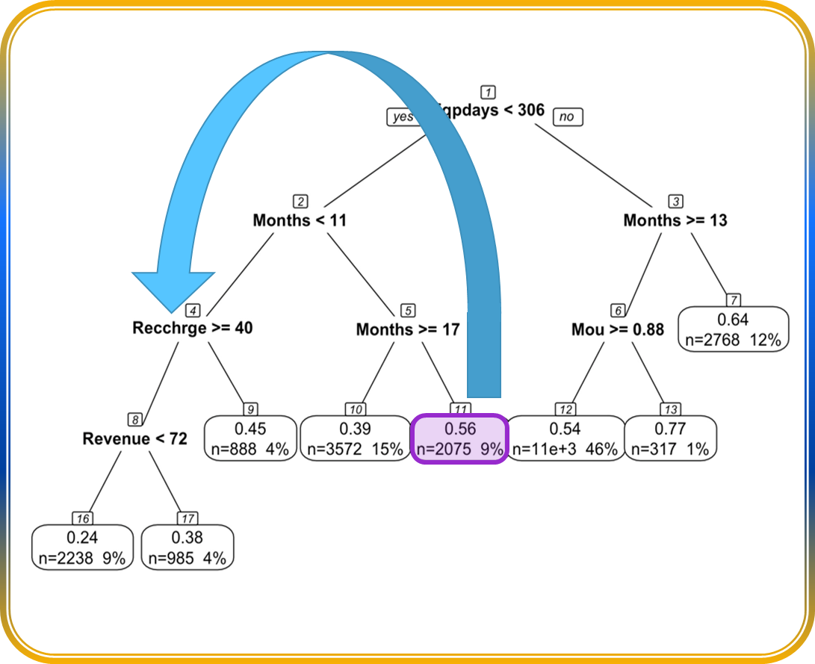
Promotional Program for Group 11: Frequent phone swapper
Offer Gift
Own an newer phone
Mid-range customer longevity
Renew Customer Mindset
Offer $50 prepaid visa gift card
Retention
Move from Group 11 (2.5% churn) to mostly Groups 9, 16, 17 (1.6%, 0.7% and 1.2% churn)
Make them feel like a new customer
Generate $6,821,204 extra lifetime value

Slide 7
Impact of our offers on Customer LTV
We expect 50% of all our targeted customers to be retained on average(15524) (Assuming 50% of customers respond favorably to our offers)
This proportion may be higher for Group 11 as these customers already have a relatively low churning.
Whereas for Group 13, the proportion is likely to be lower as they already have a high probability of churning.
However, since the number of customers in Group 13(1%) is lower compared to those in Group 11(9%), the total impact on our average customer churn rate on the entire population will not be affected.
Class | Old LTV | Expected LTV
Group 7 | $3,215,663 | $9,589,358
Group 11 | $6,018,396 | $12,839,600
Group 13 | $27,107 | $138,772

Slide 8
Expected Gain in Average LTV across groups

Slide 9
Recommendations
Group 7:
Call them to offer a new phone for up to $150 off . They’ll be able to redeem this offer at any of our stores. Providing them a new phone should bring them out of the high churn segment of the tree and calling them personally would be a good way of telling them that we value them.
Group 13:
Present an offer of 50% off their bills for 3 months if they make greater than 5 calls a month. This would encourage more phone usage amongst these customers. A habit that will hopefully continue in subsequent months and bring them out of the high churn segment.
Group 11:
Mail them a Visa Gift card worth $50, along with a personalized message thanking them for being a loyal customer. These customers have been using our service for a long time, so we would want them to feel like a new customer by acknowledging their loyalty.

