Slide 1
Answering the Question: Doctor Who?
A study by Yossi Szpigiel

Slide 2
Problem
Doctor Who is the longest running Sci-Fi show in existence, amassing fans spanning several generations from across the globe.
Like fans of any series, Whovians (fans of Doctor Who) love to debate what makes the show special and what they’re favorite parts of Doctor Who’s lengthy and complex canon are.
Unfortunately, most fans have little to no data to back them up.

Slide 3
Solution
Using textual analysis techniques, episode transcripts were broken down and analyzed to hopefully increase the level of discourse surrounding what makes Doctor Who great.
TRANSCRIPTS
ANALYSIS
DATA

Slide 4
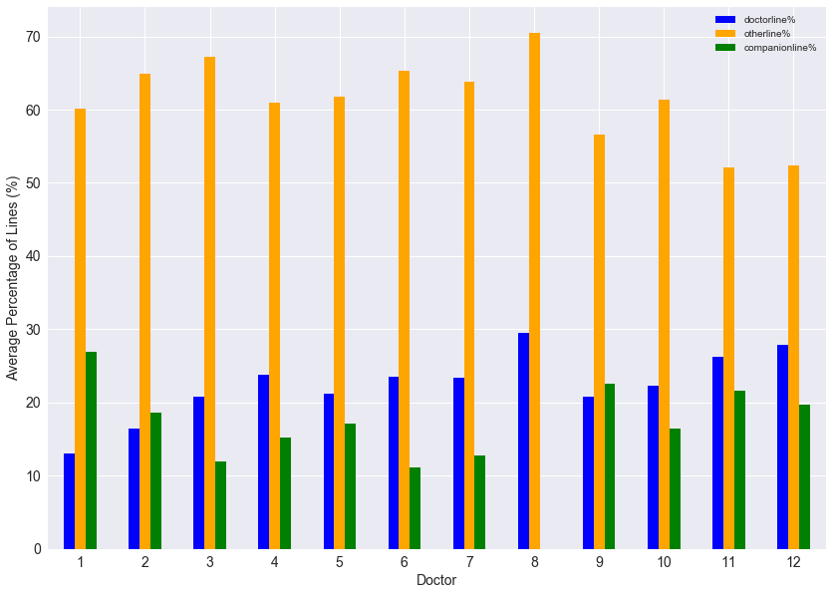
Who’s getting lines? – Overall

Slide 5
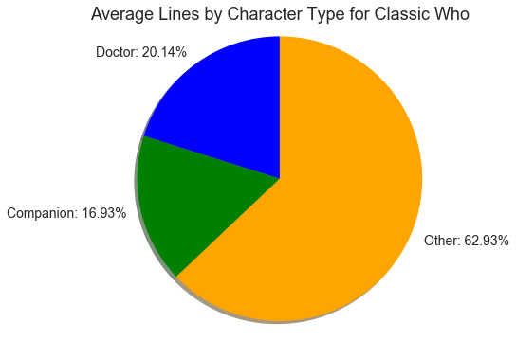
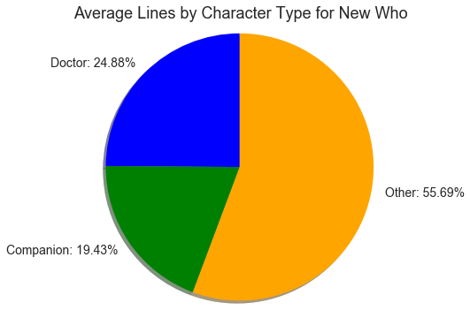
Who’s getting lines? – By Era

Slide 6
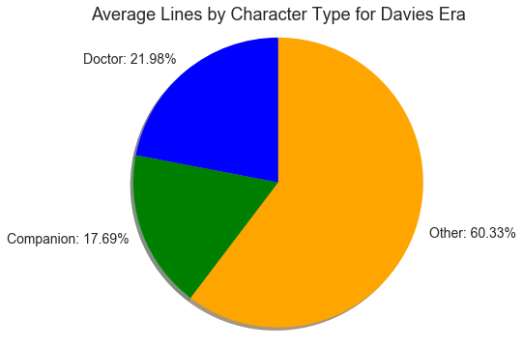
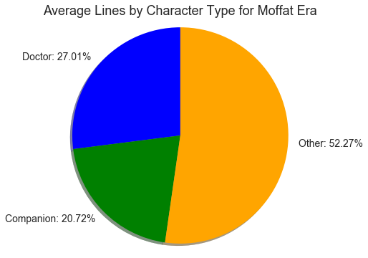
Who’s getting lines? – New WHo by Showrunner

Slide 7
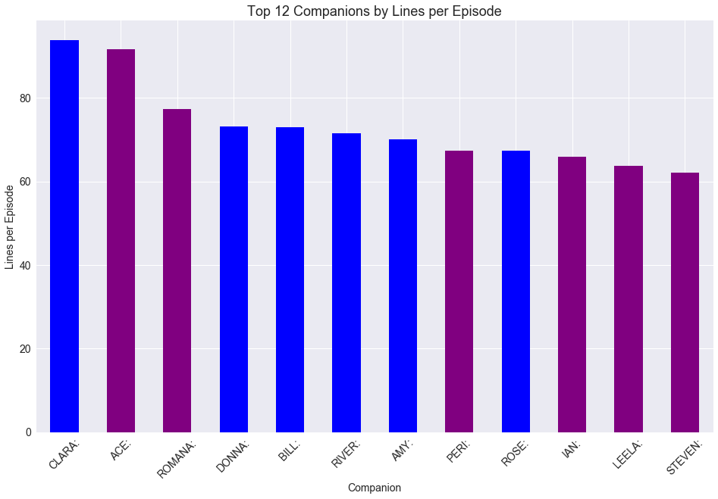
WHO’s Speaking Most? – Companions

Slide 8
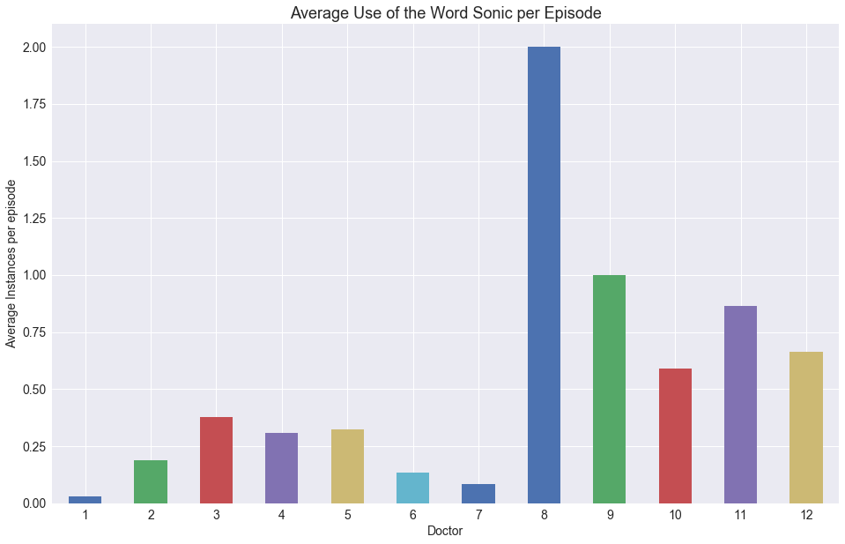
What are they saying? – Sonic

Slide 9
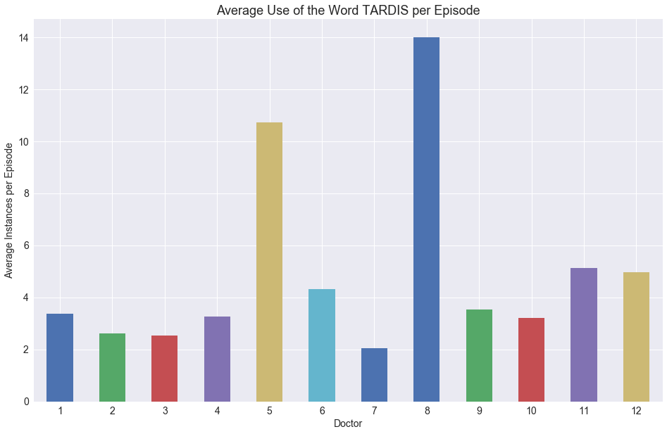
What are they saying? – TARDIS

Slide 10
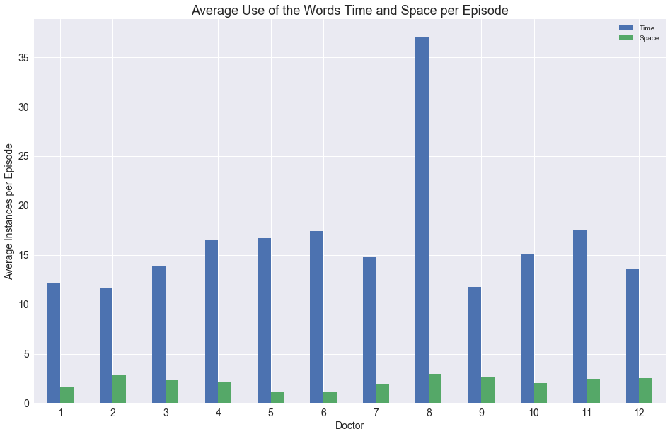
What are they saying? – Space vs time

Slide 11
Observations
New Who gives the Doctor 4.74% more of the lines per episode when compared to the Classic Era, while giving the companions a 2.5% increase in lines.
An even greater split can be seen between the Davies and Moffat episodes, with Moffat giving the doctor an additional 5.03% of lines compared to the Davies era, and the companions an increase of 3.03%.
All of these lines come at the expense of the other characters in the episodes, who’s story we are supposed to invest in.
Clara is the most talkative companion with an average line per episode count of 93.8, with Ace coming up a close second with 91.6 lines per episode.
Despite the Sonic Screwdriver being around throughout most of the second through fifth Doctors of Classic Who, every Doctor of New Who almost doubles the average Sonic count per episode of any Classic Who Doctor.
The word TARDIS is relatively level across the various Doctors, as is it’s component nouns, Time and Space. But when comparing the relative frequencies of the words Time and Space, it is clear that Time is a much more discussed topic.

