Slide 1
Bayesian Machine Learning approach for modelling gene expression time series
Joseph Lee
MSc Bioinformatics and Systems Biology
Friday 5th June 2025

Slide 2
Defining
Time-series RNA-seq requires modelling of complex temporal patterns
Traditional models assume ficed variance, biological data is overdisperesed, with lots of biological and technical noise
Gaussian Process with a negative binomial likeligood offer flexibility, non parametric approach
This study uses a liver gene expression dataset in fasting and fed mice to highlight model dependent transcriptional responses

Slide 3
Contextual information
Non parametric?
Bayesian?
Negative binomial likelihood

Slide 4
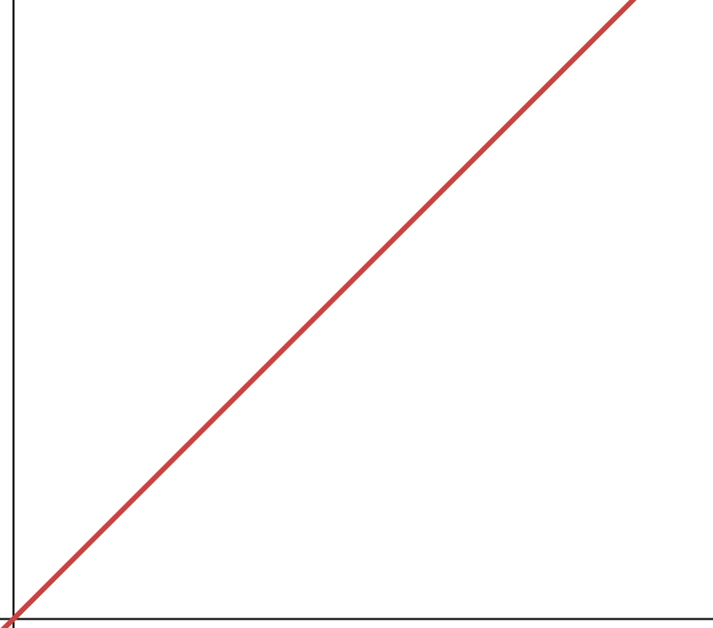
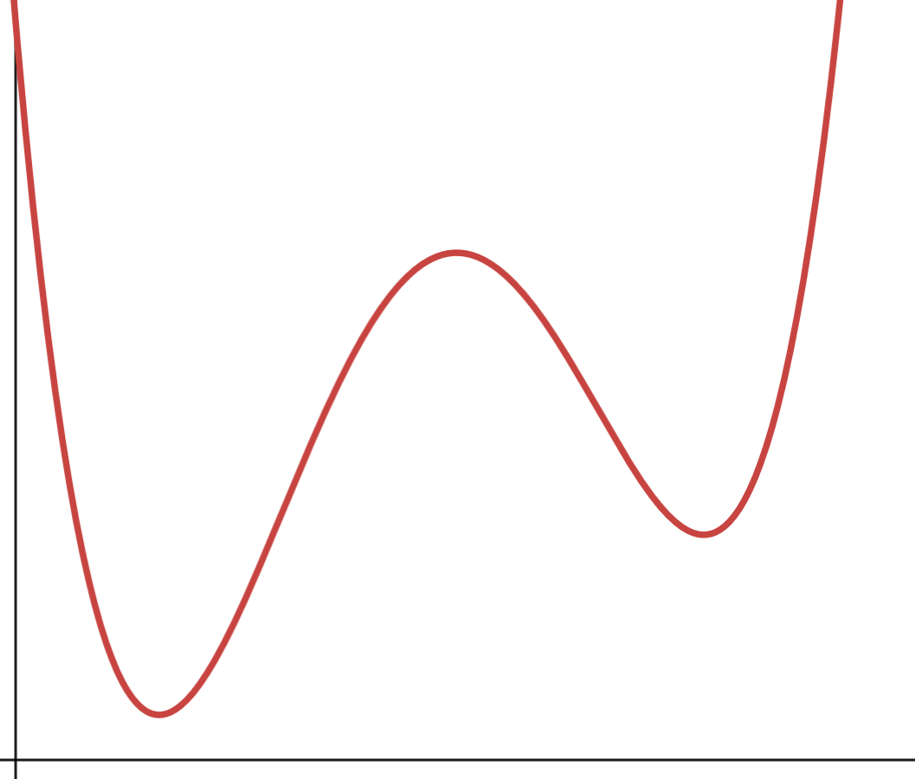
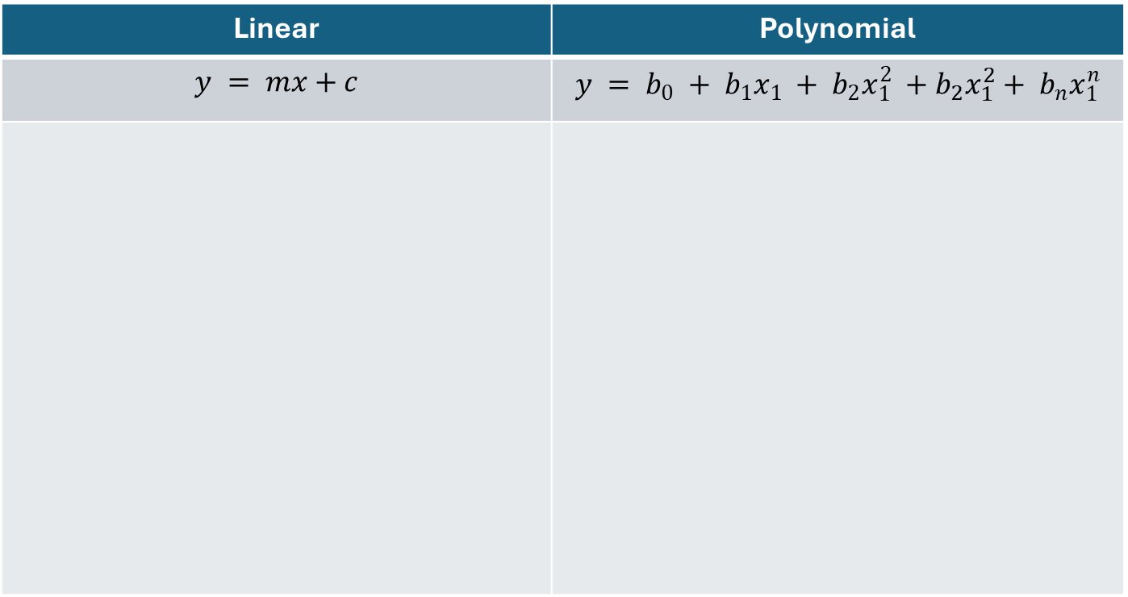
Fixed Linear Regression
Linear | Polynomial
$$y = mx+c$$ | $$y = b_{0} + b_{1}x_{1} + b_{2}x_{1}^{2} +b_{2}x_{1}^{2}+ b_{n}x_{1}^{n}$$

Slide 5
Gaussian Process Negative Binomial Likelihood
Non-parametric: Makes no prior assumptions about data distribution
Kernels define similarity between time points, assuming a zero-mean latent function
Log-link function links the latent function to gene expression
Counts follow a negative binomial distribution to capture overdispersion

Slide 6
Data
Data: 80 mouse liver samples (40 fasting, 40 ad libitum; 40 males, 40 females)
10 time points (4-hour intervals), 2 replicates per point, 20,545 genes
Fasting responses have been linked to increased stress resistance, extended lifespan, reduction of B amyloid accumulation (Alzheimers)

Slide 7
Masigpro and GPcounts

Slide 8
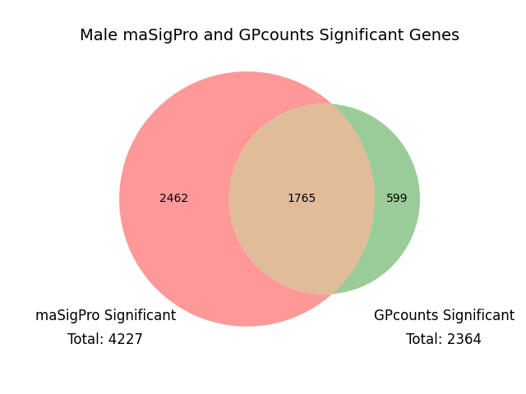
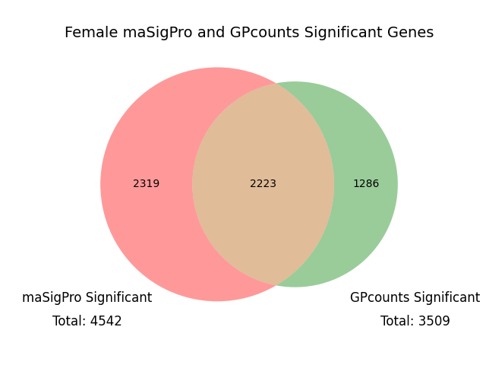
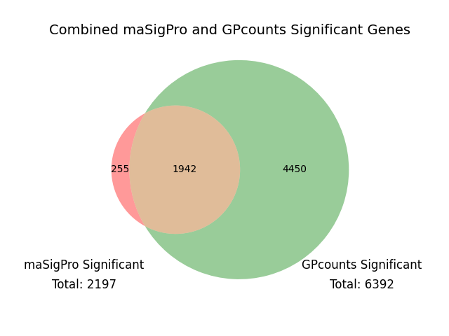
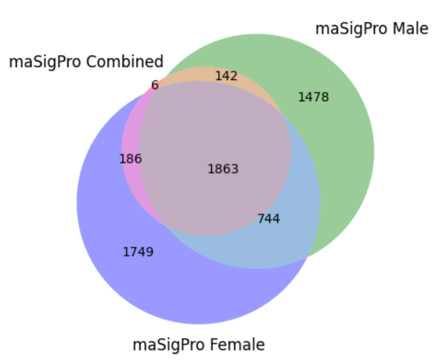
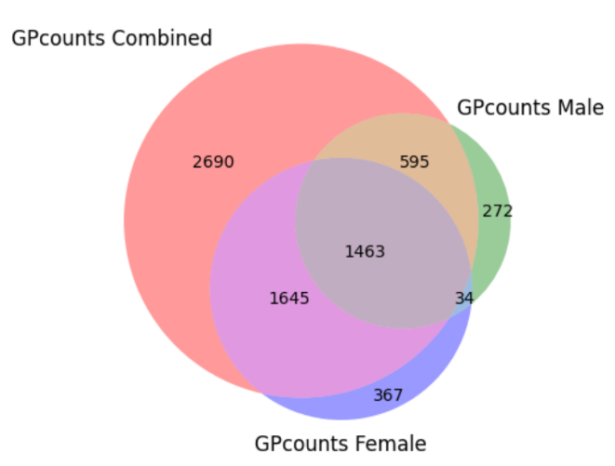
Significant Genes | Male | Female | Combined
Identified by maSigPro | 4227 | 4542 | 2197
Identified by GPcounts | 2364 | 3509 | 6392
Consistently Identified | 1765 | 2223 | 1942
Unique to GPcounts | 599 | 1286 | 4450
Unique to maSigPro | 2462 | 2319 | 255

Slide 9
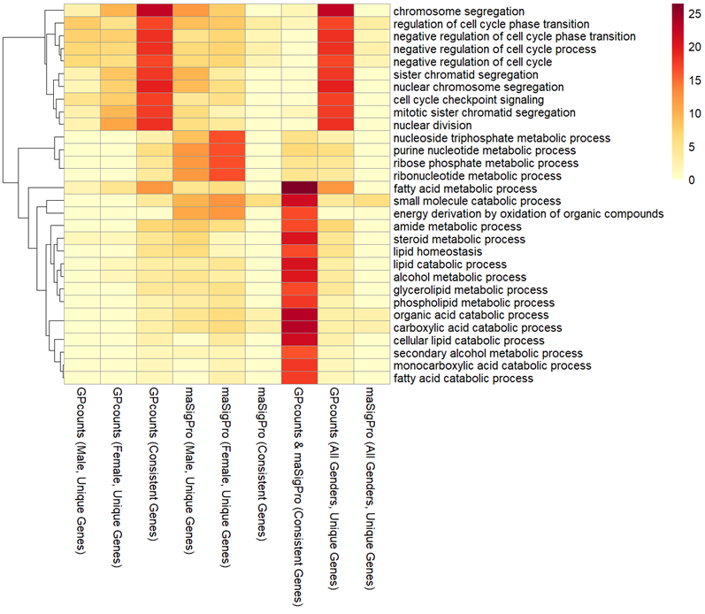

Slide 10
 | Cell Cycle regulation | Fatty acid metabolism
 | E2F1 | Acox1
GPcounts and maSigPro Significant
 | RIOK2 | Ppat
maSigPro Significant
 | Pola1 | HAGH
GPcounts Significant

Slide 11
What is Gpcounts
Gpcounts is a machine learning package which implements GP regression methods for modelling counts data using a negative binomial likelihood function
GP regression allows values to be predicted smoothly whilst estimating uncertainty

Slide 12
More in depth on gaussian distribution with a negative binomial distribution. Break down every factor

Slide 13
Switch back to y = mx + c. Mouse
All the different factors affecting gene expression
Like loads of bubbles and that

Slide 14
Link back to circadian and time series
Periodic and RBF kernels

Slide 15
Results differential expression
Show crossover. Show ones only Gpcounts is identifying
Show that is better than MASIGPRO

Slide 16
Results periodicity and rbf
More X vs Y look at the difference here is an example. You can clearly see this one is circadian and is xyz
Explain the process

Slide 17
Pros and Cons
Pros – more accurate modelling of highly variable gene sequencing
Explicitly accounts for uncertainty
Modelling of circadian and RBF data
Cons – computationally very intensive
MASIGPRO, locally ~5 minutes. Gpcounts, CSF ~ 24 hours <
How useful is this for a wet lab scientist?
Slow single Gpflow model, per each GP fit for each single gene and likelihood

Slide 18
Future directions
Improve computational efficiency further
Bayesian inference already has been implemented but could you do xyz?
Make it a package.
Error handling and reproducibility
Collaboration between Wet Lab and dry lab to understand needs and when it is applicable. May not be necessary always.
More user friendly. Python. Packages. Optimisation. How would a wet lab scientist with no bioinformatic experience do stuff. I didn’t know how to when I did.

Slide 19
References I assume

