Slide 1
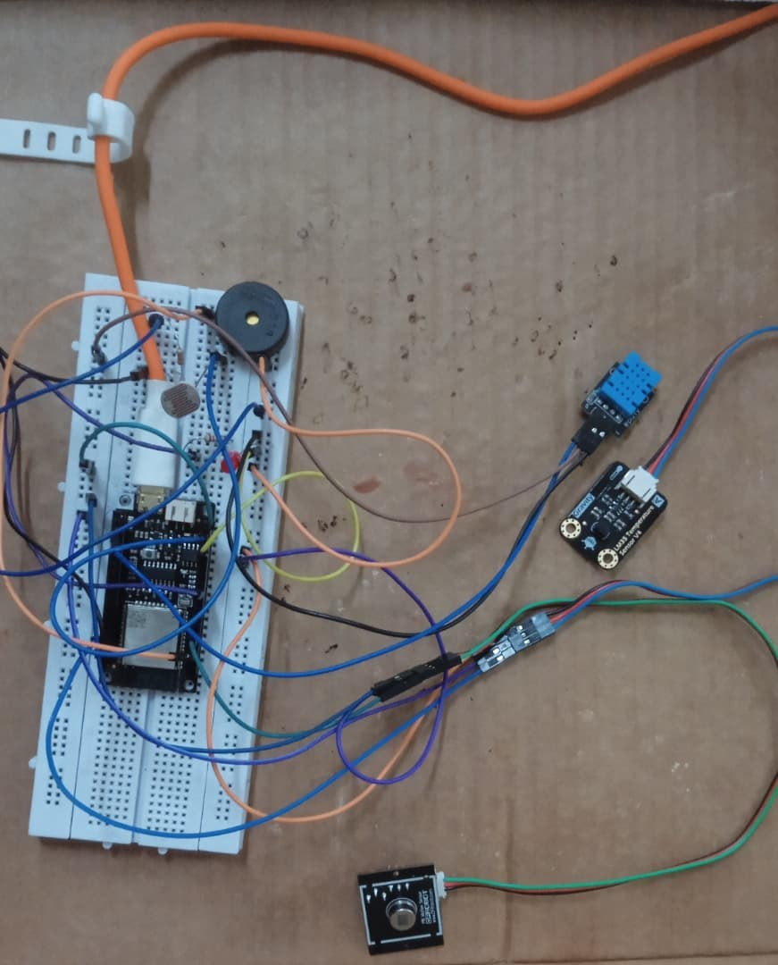
WIRELESS SENSOR NETWORKS: LAB 1
Multi-Sensor Edge Node
ESP32 Sensing, Calibration & Edge Decisions · WSN Lab 1
NAME | STUDENT NUMBER
Joseph Walusimbi | 2401600068
Patience Clare Esaete | 2401600415
Ritah Kobusingye | 2401600224

Slide 2
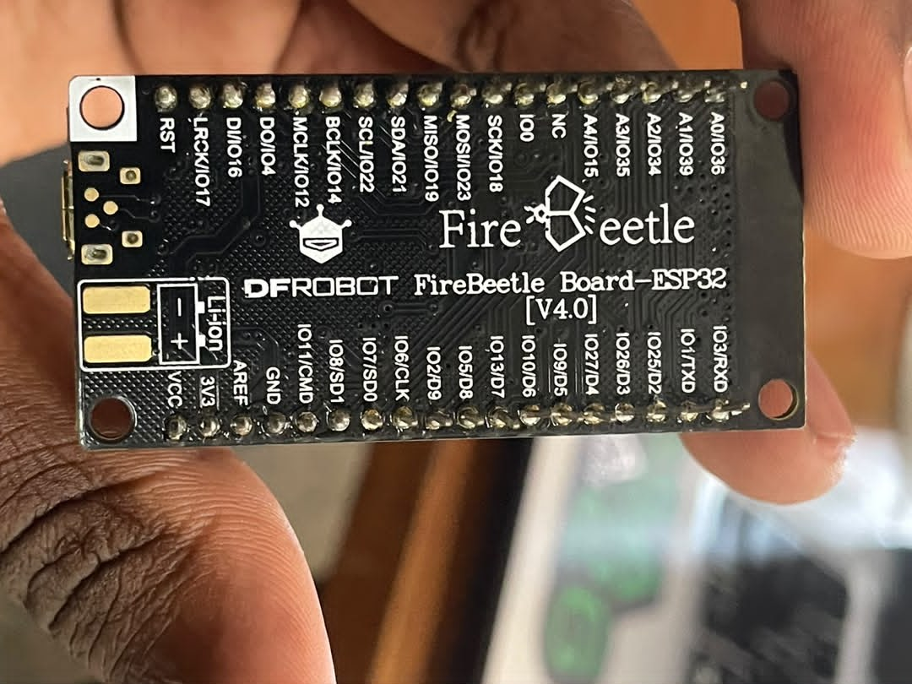
OBJECTIVES
Build a low-cost ESP32 edge node that senses, validates, calibrates, filters and decides, then streams clean, timestamped data for analysis. The lab required us to:
3 Sensing Modalities | Validate Every Reading | Calibrate vs a Reference | Filter On-Device | Track Rate of Change
1 Hz CSV Data Stream | Make a Local Decision | LED & Buzzer Alerts | Analyse in Python | Edge Processing

Slide 3
SYSTEM OVERVIEW
  Sense: DHT11, LDR, PIR and the LM35, read every second
  Process: validate, calibrate, average, check thresholds
  Act & report: LED/buzzer, one CSV row per second
  Analyse: Python loads the CSV and plots the results

Slide 4
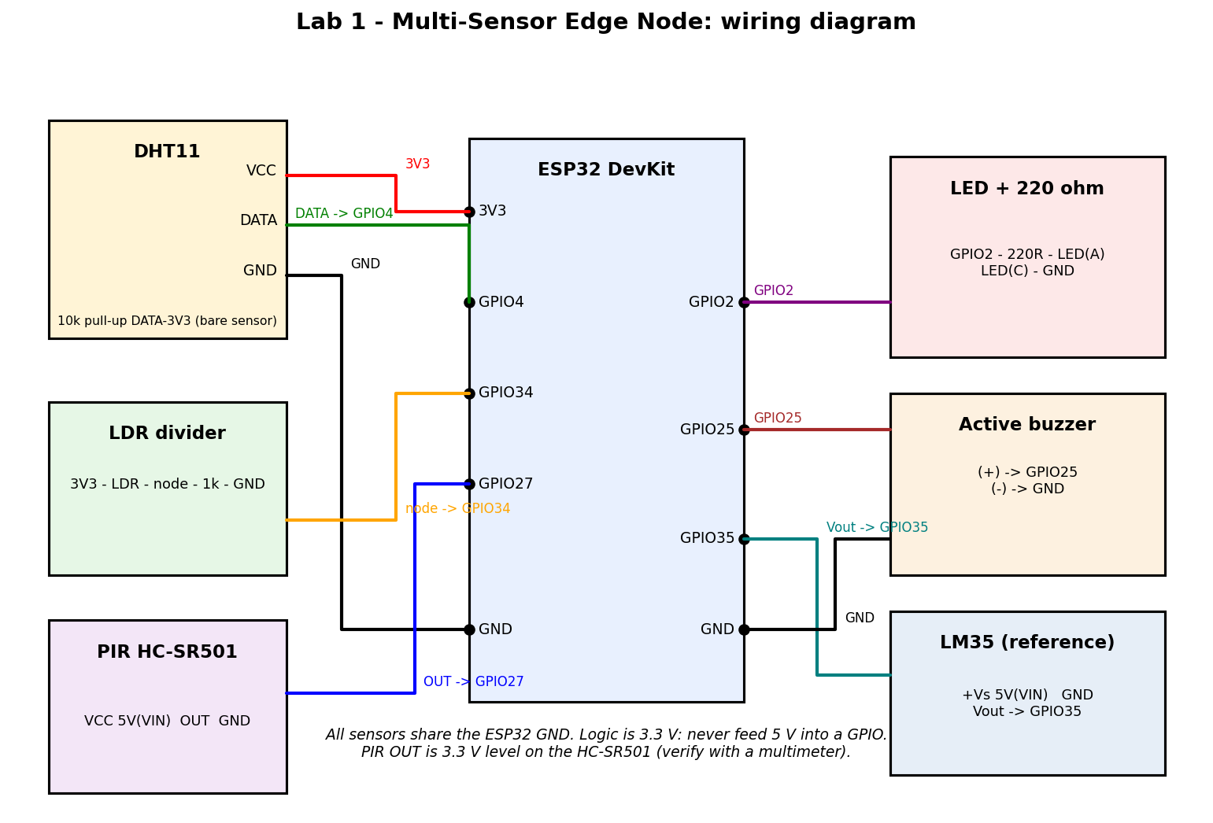
HARDWARE & WIRING
  DHT11 (temp/humidity): GPIO4
  LDR + 1 kΩ divider (light): GPIO34
  PIR HC-SR501 (motion): GPIO27; LM35 reference: GPIO35
  LED GPIO2, buzzer GPIO25; shared ground, 3.3 V GPIOs only

Slide 5
THE PROTOTYPE
  Built on a breadboard around an ESP32 DevKit (FireBeetle V4.0)
  Every sensor wired to its own GPIO, one shared ground rail
  LED and buzzer sit beside the board for instant feedback
  Powered and programmed over a USB cable

Slide 6
FIRMWARE & SAMPLING
  setup() configures the pins, ADC and DHT library once
  loop() runs at a steady 1 Hz, drift-free millis() timer
  DHT is slow, so it's read only every 2nd pass
  LDR and LM35 are oversampled 8–32× and averaged to cut noise

Slide 7
EDGE PROCESSING TECHNIQUES
Six techniques turn noisy raw readings into a clean, trustworthy signal, all on the ESP32, with no network needed:
Validation Reject NaN, out-of-range or impossible jumps | Calibration temp_cal = gain × temp + offset | Moving Average Smooths the last 5 readings
Rate of Change delta_temp between fresh reads | Hysteresis Separate ON/OFF limits stop flicker | Event Detection Counts a change once, not every second

Slide 8
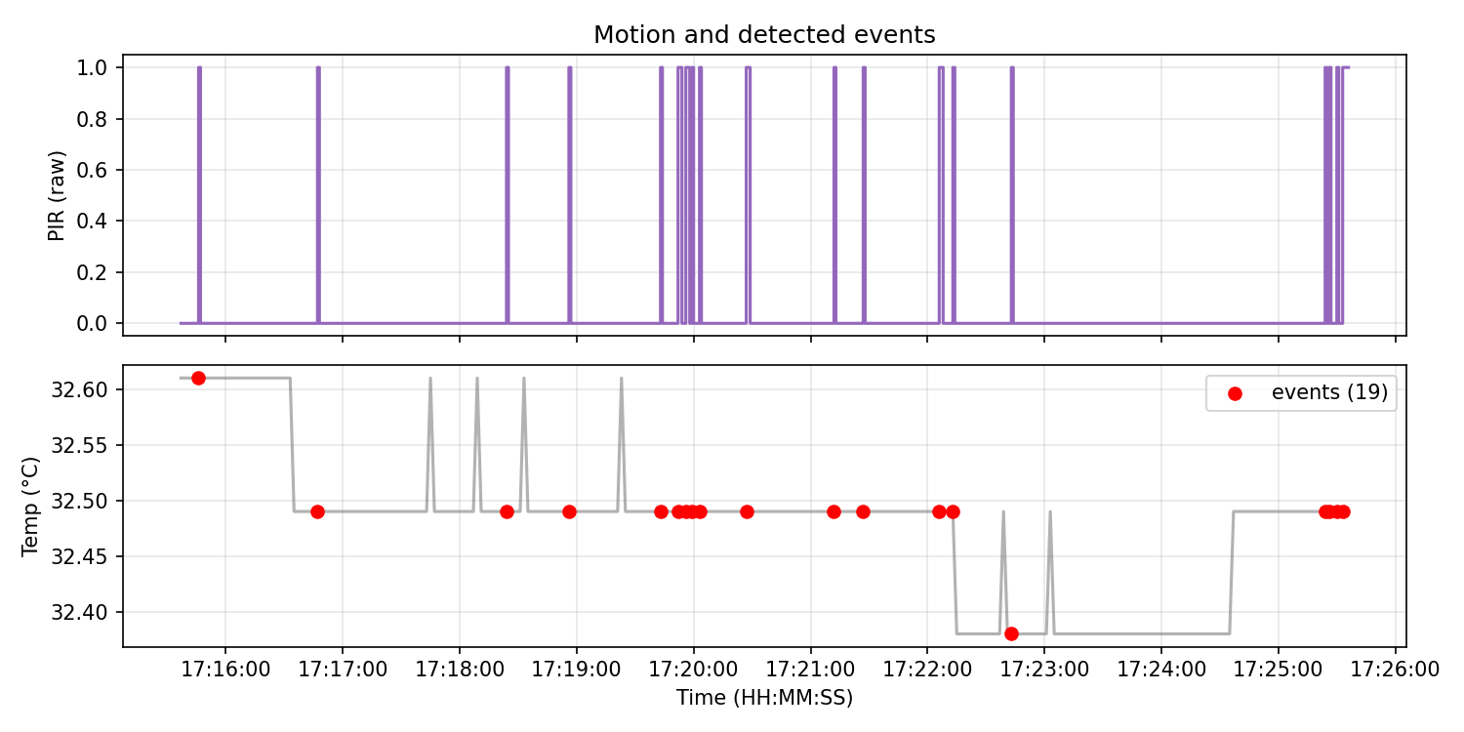
DECISION LOGIC & THRESHOLDS
  HIGH_TEMP on above 35.0 °C, off below 34.5 °C (hysteresis)
  MOTION from the PIR, ignored for its first 30 s warm-up
  An event is logged once, when status leaves NORMAL
  LED for any active status; buzzer alarms or chirps

Slide 9
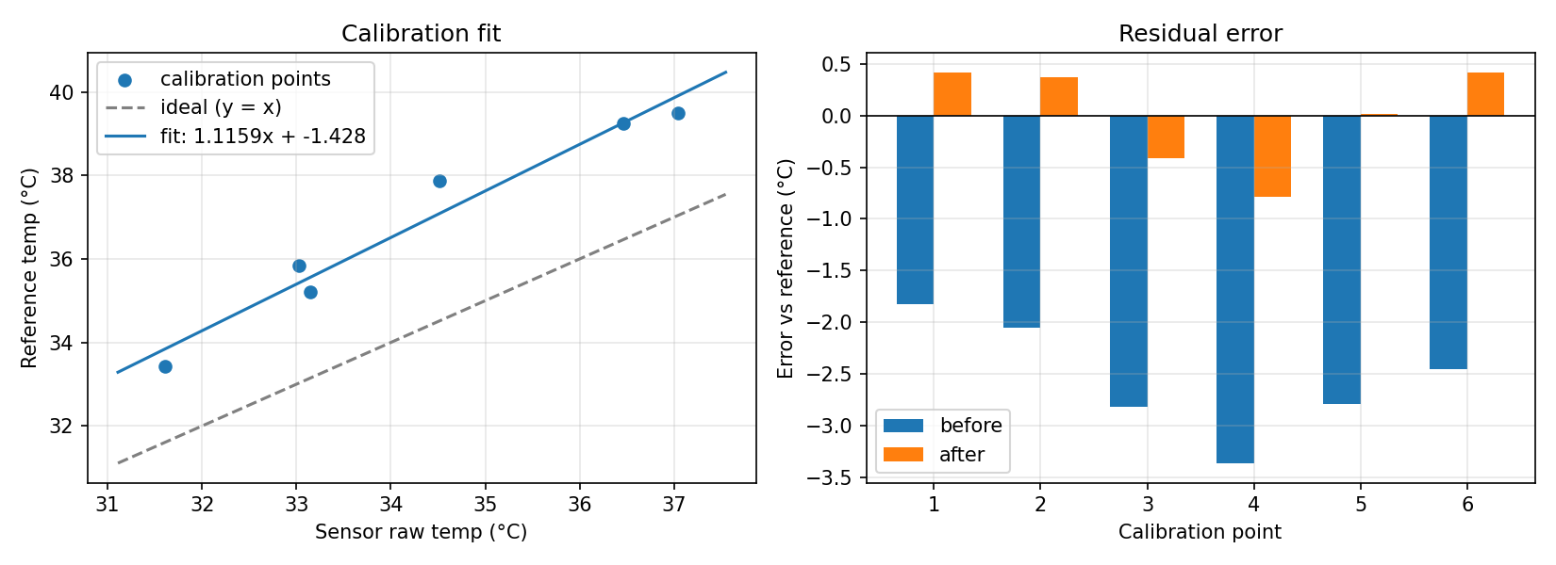
CALIBRATION RESULTS
  LM35 reference; 6 points fitted by least squares
  temp_cal = 1.11587 × temp_raw − 1.42758 (R² = 0.957)
  MAE: 2.55 °C → 0.40 °C; RMSE: 2.60 °C → 0.46 °C
  Valid only inside the fitted range, about 31.6–37.0 °C

Slide 10
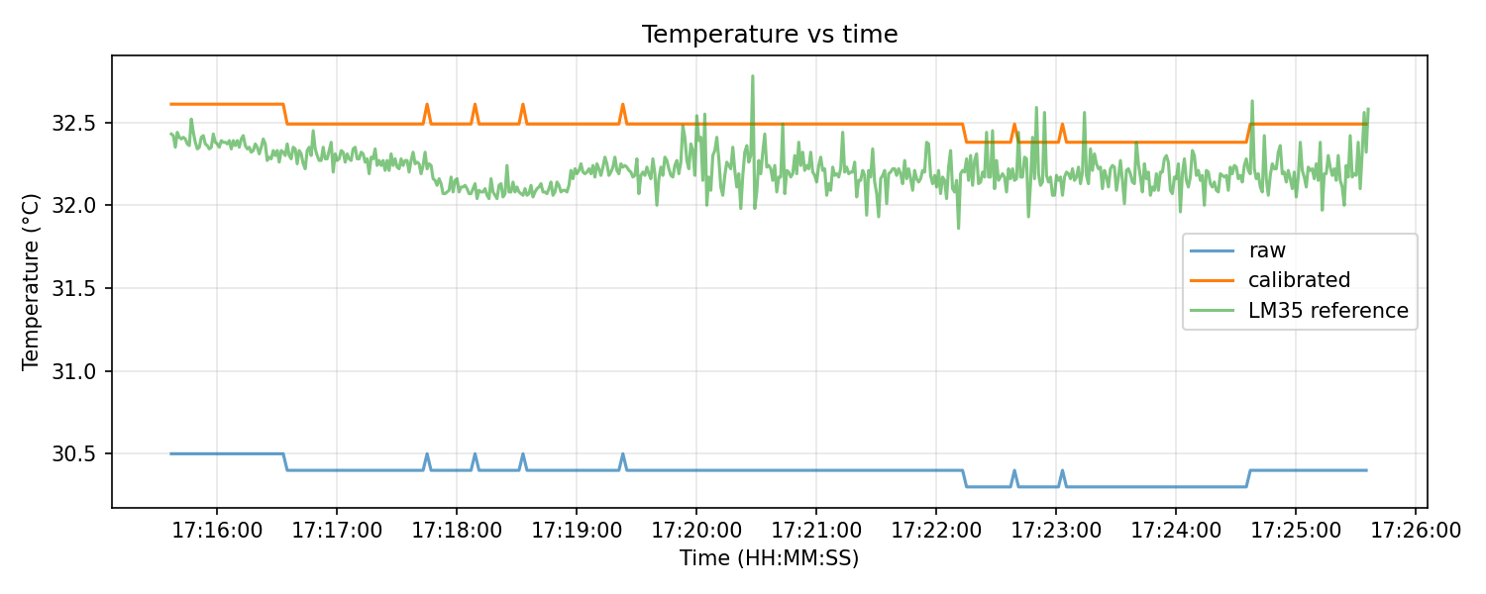
DATA QUALITY & RESULTS
  10-minute log, 600 rows at 1 Hz
  0 invalid DHT readings; 19 motion events detected
  Status stayed NORMAL on 574 of 600 rows
  Every row is kept: invalid data is flagged, never dropped

Slide 11
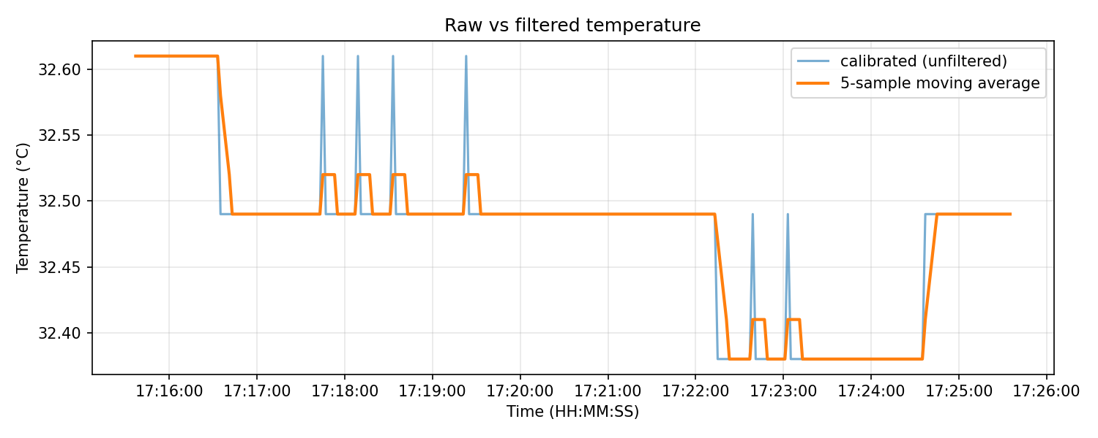
FILTERING
  5-sample moving average smooths the calibrated temperature
  Sample-to-sample noise dropped by 69.5% after filtering
  Trade-off: about 2 samples (~4 s) of lag
  Rate of change (delta_temp) computed between fresh DHT reads

Slide 12
KEY RESULTS
What the 10-minute test log and the calibration showed:
600 rows logged at 1 Hz | 0 invalid DHT readings | 19 events motion detected
84% lower temperature error (MAE) | 69.5% less sample-to-sample noise | ±1 °C calibrated accuracy

Slide 13
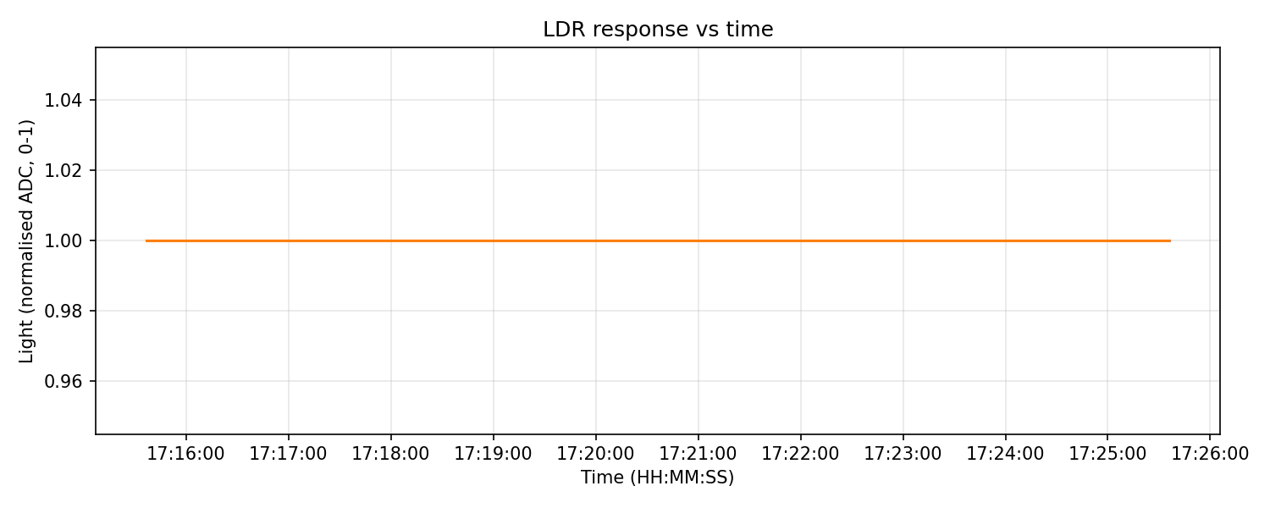
LIMITATIONS
  LDR stuck at 1.0 for the whole log, a wiring fault
  DHT11 is slow (2 s) and coarse (±2 °C, 0.1 °C steps)
  Calibration covers only ~31.6–37.0 °C, not room temperature
  Wired only: no local buffer or wireless (MQTT) yet

Slide 14
CONCLUSION
  A working ESP32 edge node: validated, calibrated, filtered sensors
  Local decisions (LED/buzzer) plus a 1 Hz CSV stream for Python
  Calibration cut temperature error by about 84% (2.55→0.40 °C)
  Lesson: keep invalid data visible, match sensors to the ADC range

Slide 15
REPOSITORY & TEAM
  github.com/JosephWalusimbi-eng/lab1
  firmware/, simulation/, python/, data/, figures/, docs/
  Joseph Walusimbi · Patience Clare Esaete · Ritah Kobusingye
  Soroti University, Wireless Sensor Networks, Year 3

