Slide 1
MUSICURSUM
E-Commerce website
P-16218862

Slide 2
Musicursum – what is it all about?
Musicursum – music and cursum. Cursum in latin means course. Hence the name.
This e-commerce website allows customers to discover and buy music courses.

Slide 3

User Requirements
Requirements :
Customer register on Musicursum
Customer Login to buy music courses
Customers can make payments
Business provides music courses(Admin represents business) by updating them on the website
Customer can rate courses

Slide 4
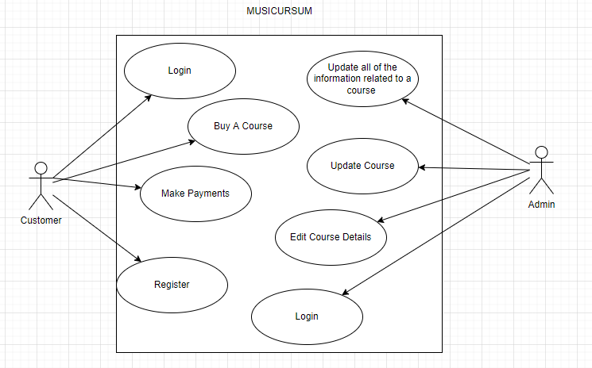
Use-case Diagram
Brief Description
This doesn’t show all of the possible actions that a customer or admin can have. They are all presented in the video.

Slide 5
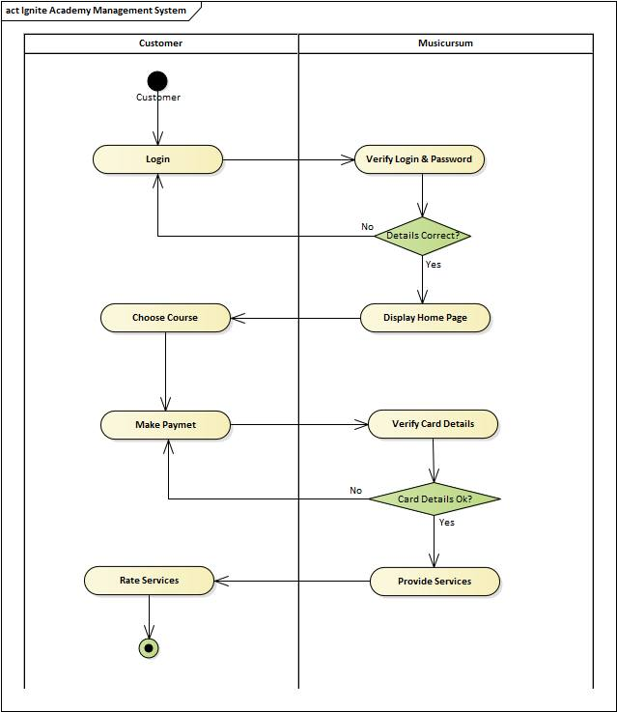
Sequence Diagram

Slide 6
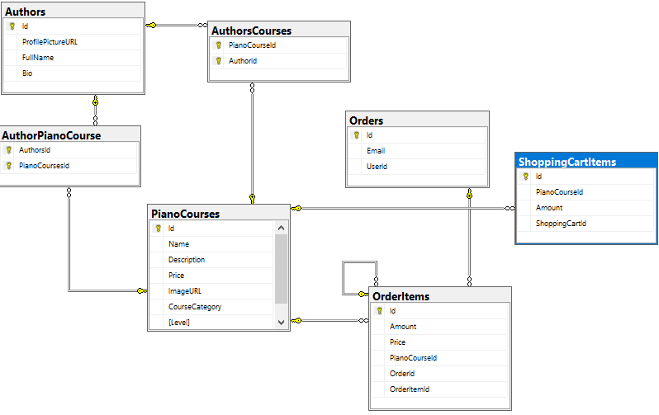
Class Diagram

Slide 7
Technologies and approach
Asp.net core 5
Model view controller
Entity framework core
Rest api paypal sandbox
Approach : model – migration – controller – view

