Slide 1
Machine Learning for Medical Diagnosis
Bennett Hellman, Jeffrey Mayolo, Joseph Zuccarelli

Slide 2
Agenda
Introduction
Exploratory Data Analysis
Modeling
Results
Discussion
References

Slide 3

Introduction
ML applications in healthcare
Chest X-ray pathology classification system
Goal: Apply transfer learning to develop a CNN model that accurately predicts a diagnosis label given a chest X-ray image
Notes:
Given the rise of big data, machine learning is currently being applied to inform decision making across various fields of study, one of them being healthcare. There are numerous applications of machine learning within the medical field that can be used to drastically improve patient care and outcomes. For instance, researchers are continuing to develop classifiers for the detection and/or diagnosis of disease. These classifiers have ranged anywhere from decision tree models trained on basic patient vitals all the way to convolutional neural networks (CNNs) trained on large quantities of high-resolution X-ray images [1]. In the following paper we accomplish the latter, as we demonstrate how to build a chest X-ray pathology classification system using transfer learning on a real-world X-ray dataset.

Slide 4
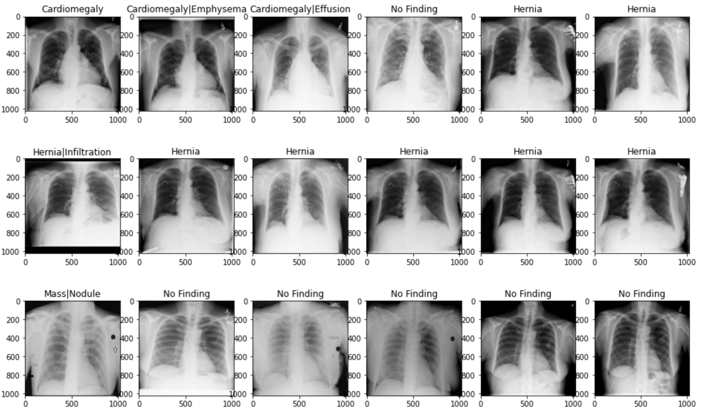
Exploratory Data Analysis
Full Dataset
108,948 frontal-view X-rays of 32,717 unique patients
Features: Patient ID, follow up number, X-ray image, various characteristics of the image, patient demographic information (age, gender), diagnosis label
Notes:
The full dataset under analysis in this study contains 108,948 frontal-view X-rays of 32,717 unique patients [2]. Each observation in the dataset includes a patient ID, a follow up number, an X-ray image, various characteristics of the image, patient demographic information (i.e., age and gender), and a diagnosis label. In this study, individuals' X-ray images will serve as our predictor, while the diagnosis label will serve as our outcome of interest.
Note that due to the massive size of the full dataset, we choose to select only the first 5000 images for use in carrying out our exploratory data analysis and modeling. Although ideally we would conduct our analysis on the entire dataset, this is not feasible due to limited computational power and project time constraints.
Here we explore our predictor, the Xray images. Note that in the original dataset these images are 1024 by 1024 pixels; however, during the model training phase we plan to downsize the images for ease of computation. The grid of plots included above displays 18 sample images with diagnosis labels.

Slide 5
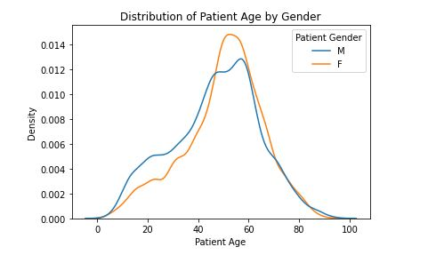
Exploratory Data Analysis (cont.)
Notes:
Here we explore the demographic characteristics of our patients--age and gender. The two plots included above display the distributions of males versus females by age. Note that the density of males in the dataset appears to be larger than the density of females up until about age 45, at which point the dataset appears to be dominated by females. Also note that the highest density of patients (males and females) lies somewhere between 50-60 years old

Slide 6
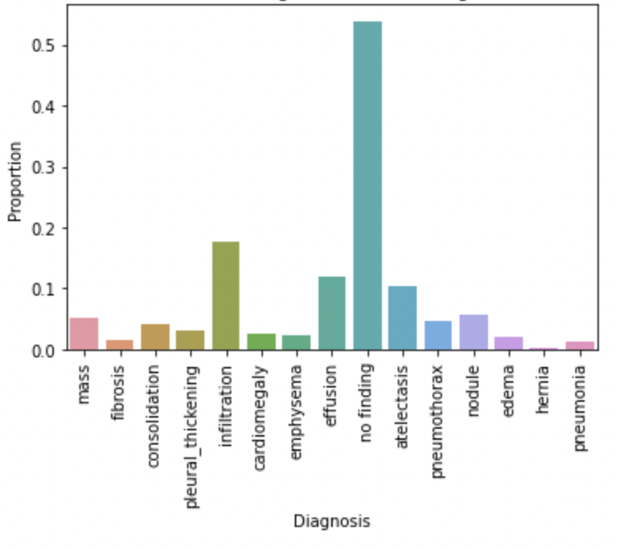
Exploratory Data Analysis (cont.)
Percent of Images by Diagnosis Label
Notes:
Here we explore our outcome variable, the diagnosis label. Note that there are 836 distinct diagnosis labels. However, this arises from the permutation of 15 distinct diagnoses: mass, fibrosis, consolidation, pleural thickening, infiltration, cardiomegaly, emphysema, effusion, no finding, atelectasis, pneumothorax, nodule, edema, hernia, and pneumonia. Thus, we extract each label and generate 15 binary outcomes variables. The proportion of each outcome label included in the dataset is displayed in the plot included above. Note that over half of the images are labeled as no finding. The most prevalent disease appears to be infiltration, as approximately one-fifth of the X-ray images receive this label. This dataset clearly suffers from class imbalance, which we must account for when building our classifier model.

Slide 7
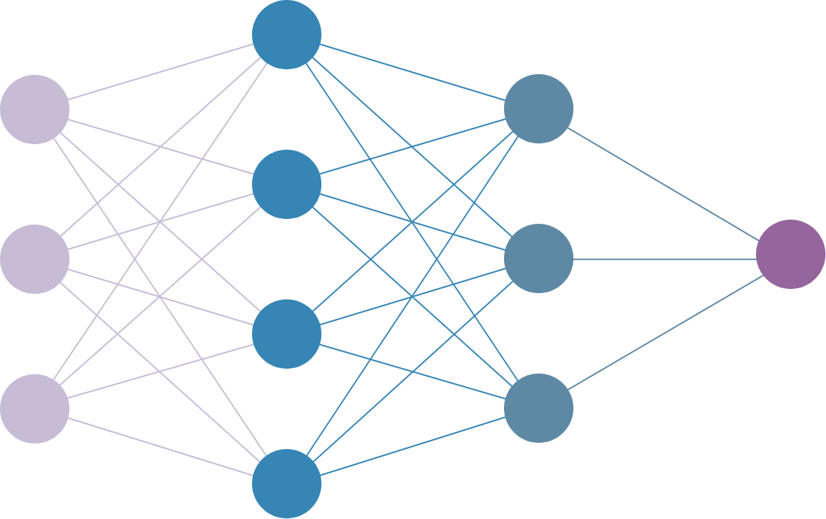
Modeling
Class imbalance
Over-sampling, Under-sampling, Weighted Loss Functions
Data augmentation techniques
Rotation, Translation, Contrast
Transfer learning
DenseNets, EfficientNets
Deep Steganography (AC209B)
Performance metrics—ROC Curve, AUC, F1 Score
Notes:
As we discovered in the previous section, this dataset suffers from major class imbalance. This is an issue because most machine learning models perform best when the number of samples in each class is approximately equal. There are a few different techniques for dealing with unbalanced datasets. One technique is oversampling, which involves duplicating random observations from the minority classes to bring the number of observations within these classes up to par with the majority class. Another technique is undersampling, which involves removing random observations from the majority class to bring the number of observations within this class down to the level of the minority classes. Beyond using resampling techniques, another method to combat class imbalance is the use of a weightedloss function. The idea is to weigh the loss computed for each observation differently based on whether it belongs to the majority or the minority classes. Essentially, the goal is to assign a higher weight to the loss encountered by the observations from the minority classes. In order to account for this phenomenon in the development of our models, we define and make use of a weighted loss function.
Another important aspect of training CNNs is data augmentation, a technqiue used to aritficially create new training data from existing training data. This technique leads to the formation of new and slightly different images, creating amore rich and sufficient training dataset. There are various different methods of data augmentation that can increase the performance of CNN models: adding noise, rotation, translation, flipping, contrast, etc. We use a few of these methods to create variations of the X-ray images prior to training our models
As mentioned in the introduction, the main goal of this project is to demonstrate how to build a chest X-ray pathology classification system using transfer learning on a real-world X-ray dataset. Recall that transfer learning is a machine learning method in which a pre-trained model is re-used as the starting point for a model on a new task. In the following section, we re-use three popular CNN model architectures to create our chest X-ray classification system: DenseNet121, DenseNet169, EfficientNet-B0.
In compliance with the AC209B requirement for this project, we implement the following technique that we did not discuss in class--contrastive learning.** This is a method used to learn the general features of a dataset without labels by enabling a model to learn which data points are similar or different. Contrastive learning typically requires a three-step approach. First, we must perform two data augmentation combinations in order to create two slightly different variations of a training image. Next, we feed these two images to our CNN model to create vector representations of each image. Finally, we attempt to maximize the similarity of the two vector representations by minimizing a contrastive loss function [8].
Although accuracy tends to be the most common performance metric for classifiers, the class imbalance present in our dataset can cause it to be misleading. For example, when dealing with an unbalanced dataset a model that predicts the majority class every time will likely achieve a fairly high accuracy. Additionally, given the context of our data, accuracy may not be preferred metric. Within the medical field it is critically important that when a person has a disease the model correctly predicts the presence of said disease. If not, the consequences can be quite severe, as ill patients can go without receiving the proper treatment as a result.
Given this information, we rely on a few other metrics to report our results, specifically ROC and AUC. A ROC (receiver operating characteristic) curve is a graph that displays the true positive rate versus the false positive rate of a classifier at various thresholds. As mentioned in the previous paragraph, a high true positive rate is desirable within the medical field. AUC (area under the ROC curve) measures the two-dimensional area underneath the entire ROC curve. This provides an aggregate measure of performance across all classification thresholds [9]. In the following section, we outline the results of our modeling in the form of ROC curves and AUC scores for the classification of each disease.

Slide 8
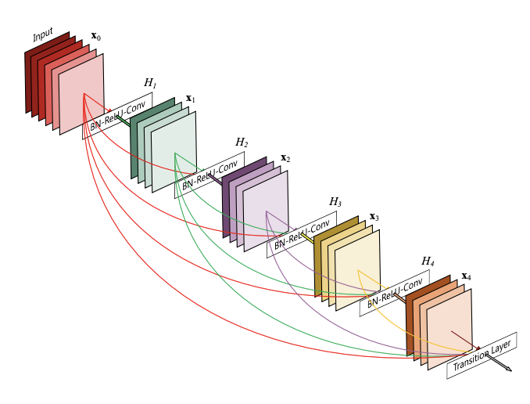
Modeling (cont.)
Model Architecture: DenseNets
Notes:
DenseNet is a type of CNN architecture where each layer is connected to all other layers that are deeper in the network (i.e., the first layer is connected to the 2nd, 3rd, 4th and so on, the second layer is connected to the 3rd, 4th, 5th and so on). This is done to enable maximum information flow between the layers of the network. In order to preserve the feed-forward nature of the network, each layer obtains inputs from all the previous layers and passes on its own feature maps to all the layers which will come after it. Ultimately, the design of DenseNet is intended to improve the declined accuracy caused by the vanishing gradient problem encountered in high-level neural networks. The image included below displays a sample DenseNet architecture [4,5].

Slide 9
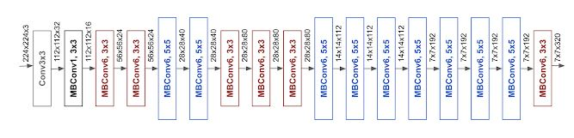
Modeling (cont.)
Model Architecture: EfficientNets
Notes:
EfficientNets are a family of models developed using a simple yet highly effective compound coefficient to scale up CNNs in a more principled manner. These models are known for their ability to achieve high accuracy in an efficient manner, as they tend to utilize less parameters than existing CNN architectures. Given this information, EfficientNets are well suited for this project due to the time constraints and massive size of the dataset. The image included below displays the architecture of EfficientNet-B0 [6,7].

Slide 10
Modeling (cont.)
Model 0: DenseNet121 (Multi-Class Classification)
Model 1: DenseNet121 (Binary Classification)
Model 2: DenseNet169 (Binary Classification)
Model 3: EfficientNet-B0 (Binary Classification)
Model 4:Deep Steganography
Notes:
In this section, we complete the following tasks. First, we split the full dataset into three subsets: training dataset, validation dataset, and test dataset. Note that we perform this split in a manner that ensures each patient only appears once in each of these three datasets. This is a necessary step to prevent data leakage. Next, we implement functions to create data generators for each dataset, enabling for real-time data feeding to our models opposed to loading each entire dataset all at once. Finally, we build several different model architectures and train each model to properly classify each disease. Specifically, we experimented with three different model architectures using pretrained weights: Densenet121, Densenet169, and EfficientNet-B0.

Slide 11
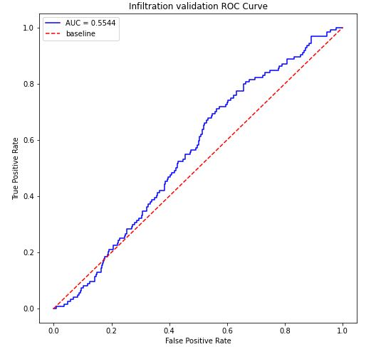
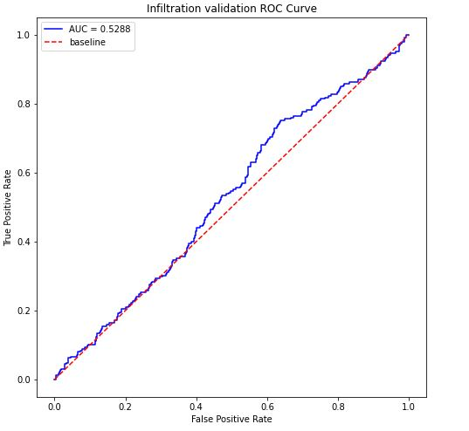
Results
Model 0 (DenseNet121)
Model 1 (DenseNet121)
Model 2 (DenseNet169)
F1 Score (Infiltration): 0.00
F1 Score (Effusion): 0.17
F1 Score (Atelectasis): 0.00
F1 Score (Mass): 0.00
F1 Score (Nodule): 0.00

Slide 12
Results
Model 3 (EfficientNet-B0)

Slide 13
Results
Model 4 (Deep Steganography)

Slide 14
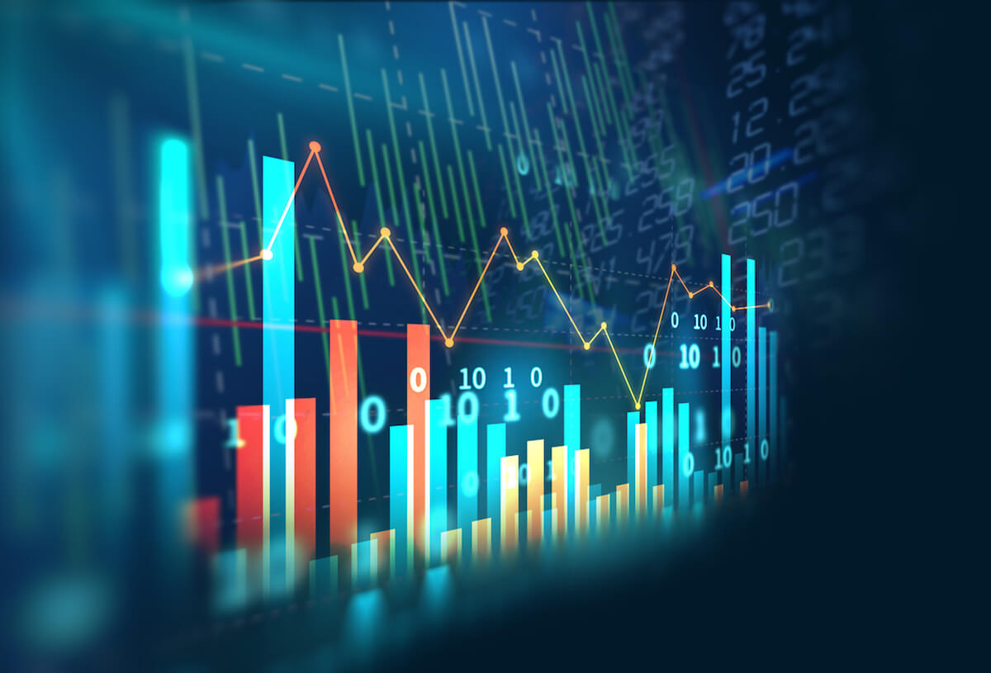
Discussion
Recommended Model: Model 3 (EfficientNet-B0)
Future Work
More images, More training, Use of other CNN architectures
Limitations
Project time constraints, Computation power

Slide 15
References
[1] Igor Kononenko. “Machine Learning for Medical Diagnosis: History, State of the Art and Perspective”. In: Artificial Intelligence in Medicine 23.1 (2001), pp. 89–109. [2] Xiaosong Wang et al. “Chestx-ray8: Hospital-scale Chest X-ray Database and Benchmarks on Weakly-Supervised Classification and Localization of Common Thorax Diseases”. In: Proceedings of the IEEE Conference on Computer Vision and Pattern Recognition. (2017), pp. 2097–2106.
[3] Mikołajczyk, A., & Grochowski, M. "Data Augmentation for Improving Deep Learning in Image Classification Problem." In: 2018 International Interdisciplinary PhD Workshop (IIPhDW). (2018), pp. 117-122. [4] Huang, G., Liu, Z., Van Der Maaten, L., & Weinberger, K. Q. "Densely Connected Convolutional Networks." In: Proceedings of the IEEE Conference on Computer Vision and Pattern Recognition. (2017), pp. 4700-4708. [5] Singhal, Gaurav. "Introduction to DenseNet with TensorFlow." In: Plural Insights. (2020). [6] Tan, M., & Le, Q. "Efficientnet: Rethinking Model Scaling for Convolutional Neural Networks." In: International Conference on Machine Learning. (2019), pp. 6105-6114. [7] Tan, M., & Le, Q. "EfficientNet: Improving Accuracy and Efficiency through AutoML and Model Scaling." In: Google AI Blog. (2019).
[8] Tiu, Ekin. "Understanding Contrastive Learning." In: *Towards Data Science*. (2021). [9] "Classification: ROC Curve and AUC." In: Google AI Blog. (2020). [10] Satya Mallick. “Transfer Learning for Medical Images”. In: LearnOpenCV (2021). 4

Slide 16
Thanks for watching!

