Slide 1

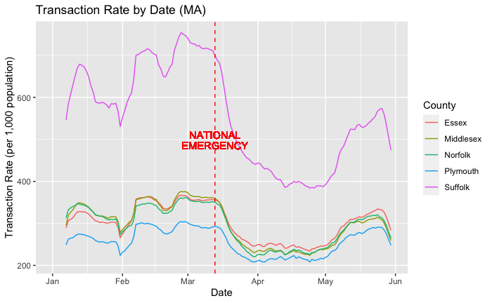
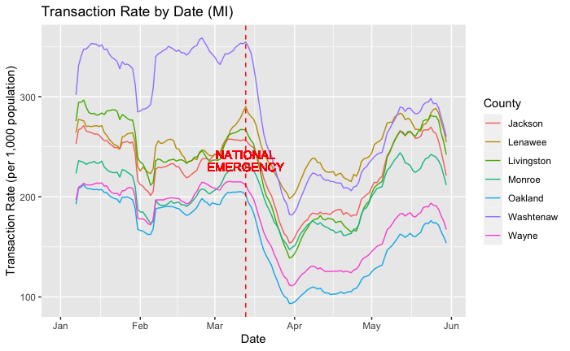
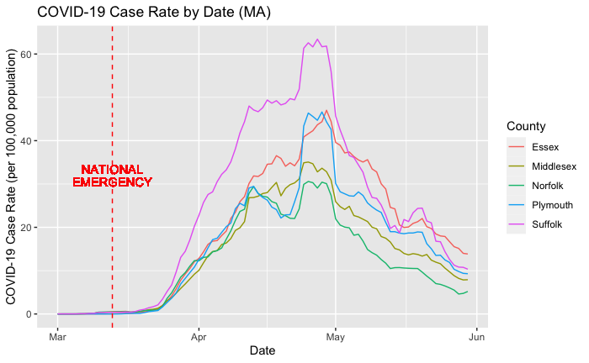
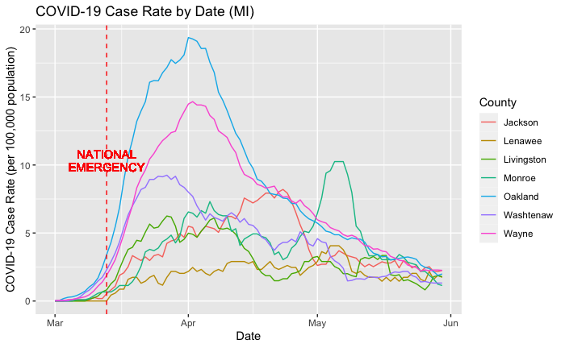


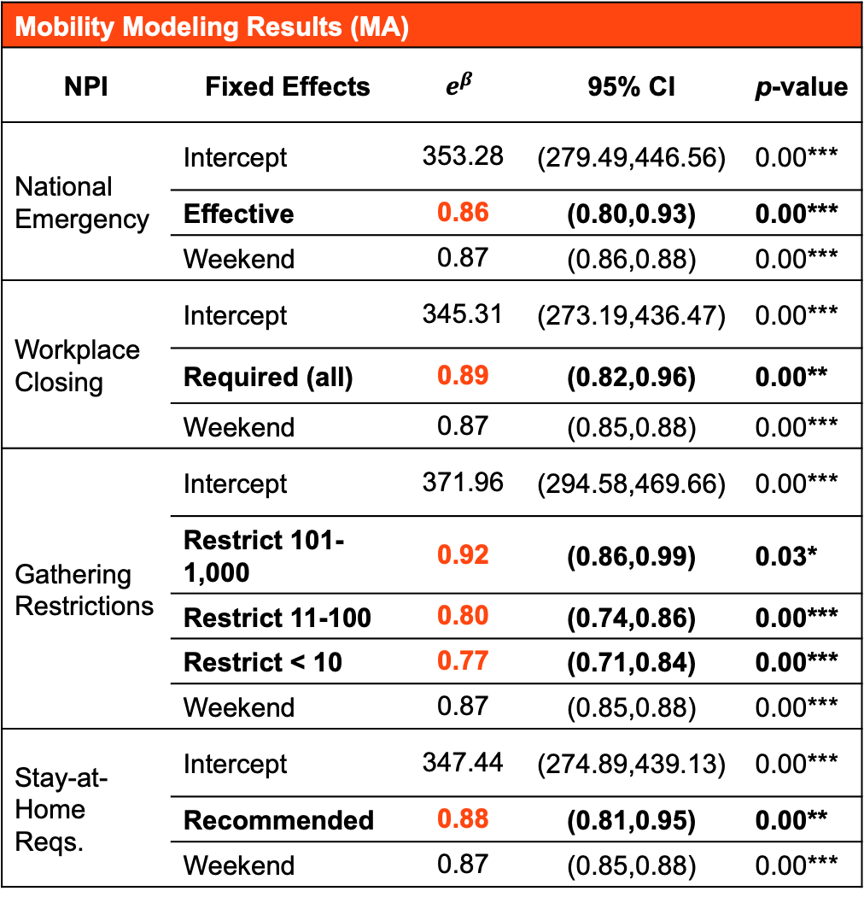
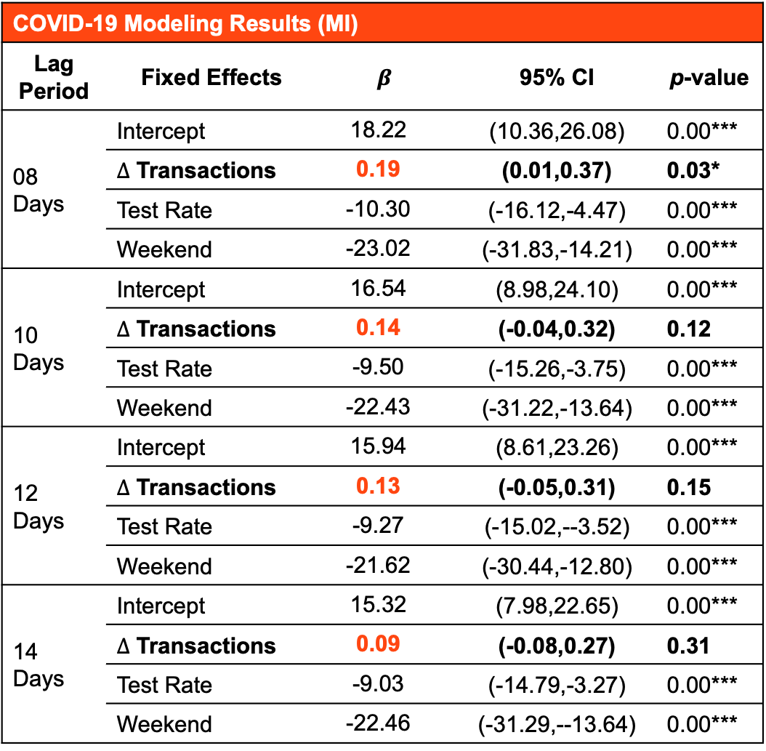
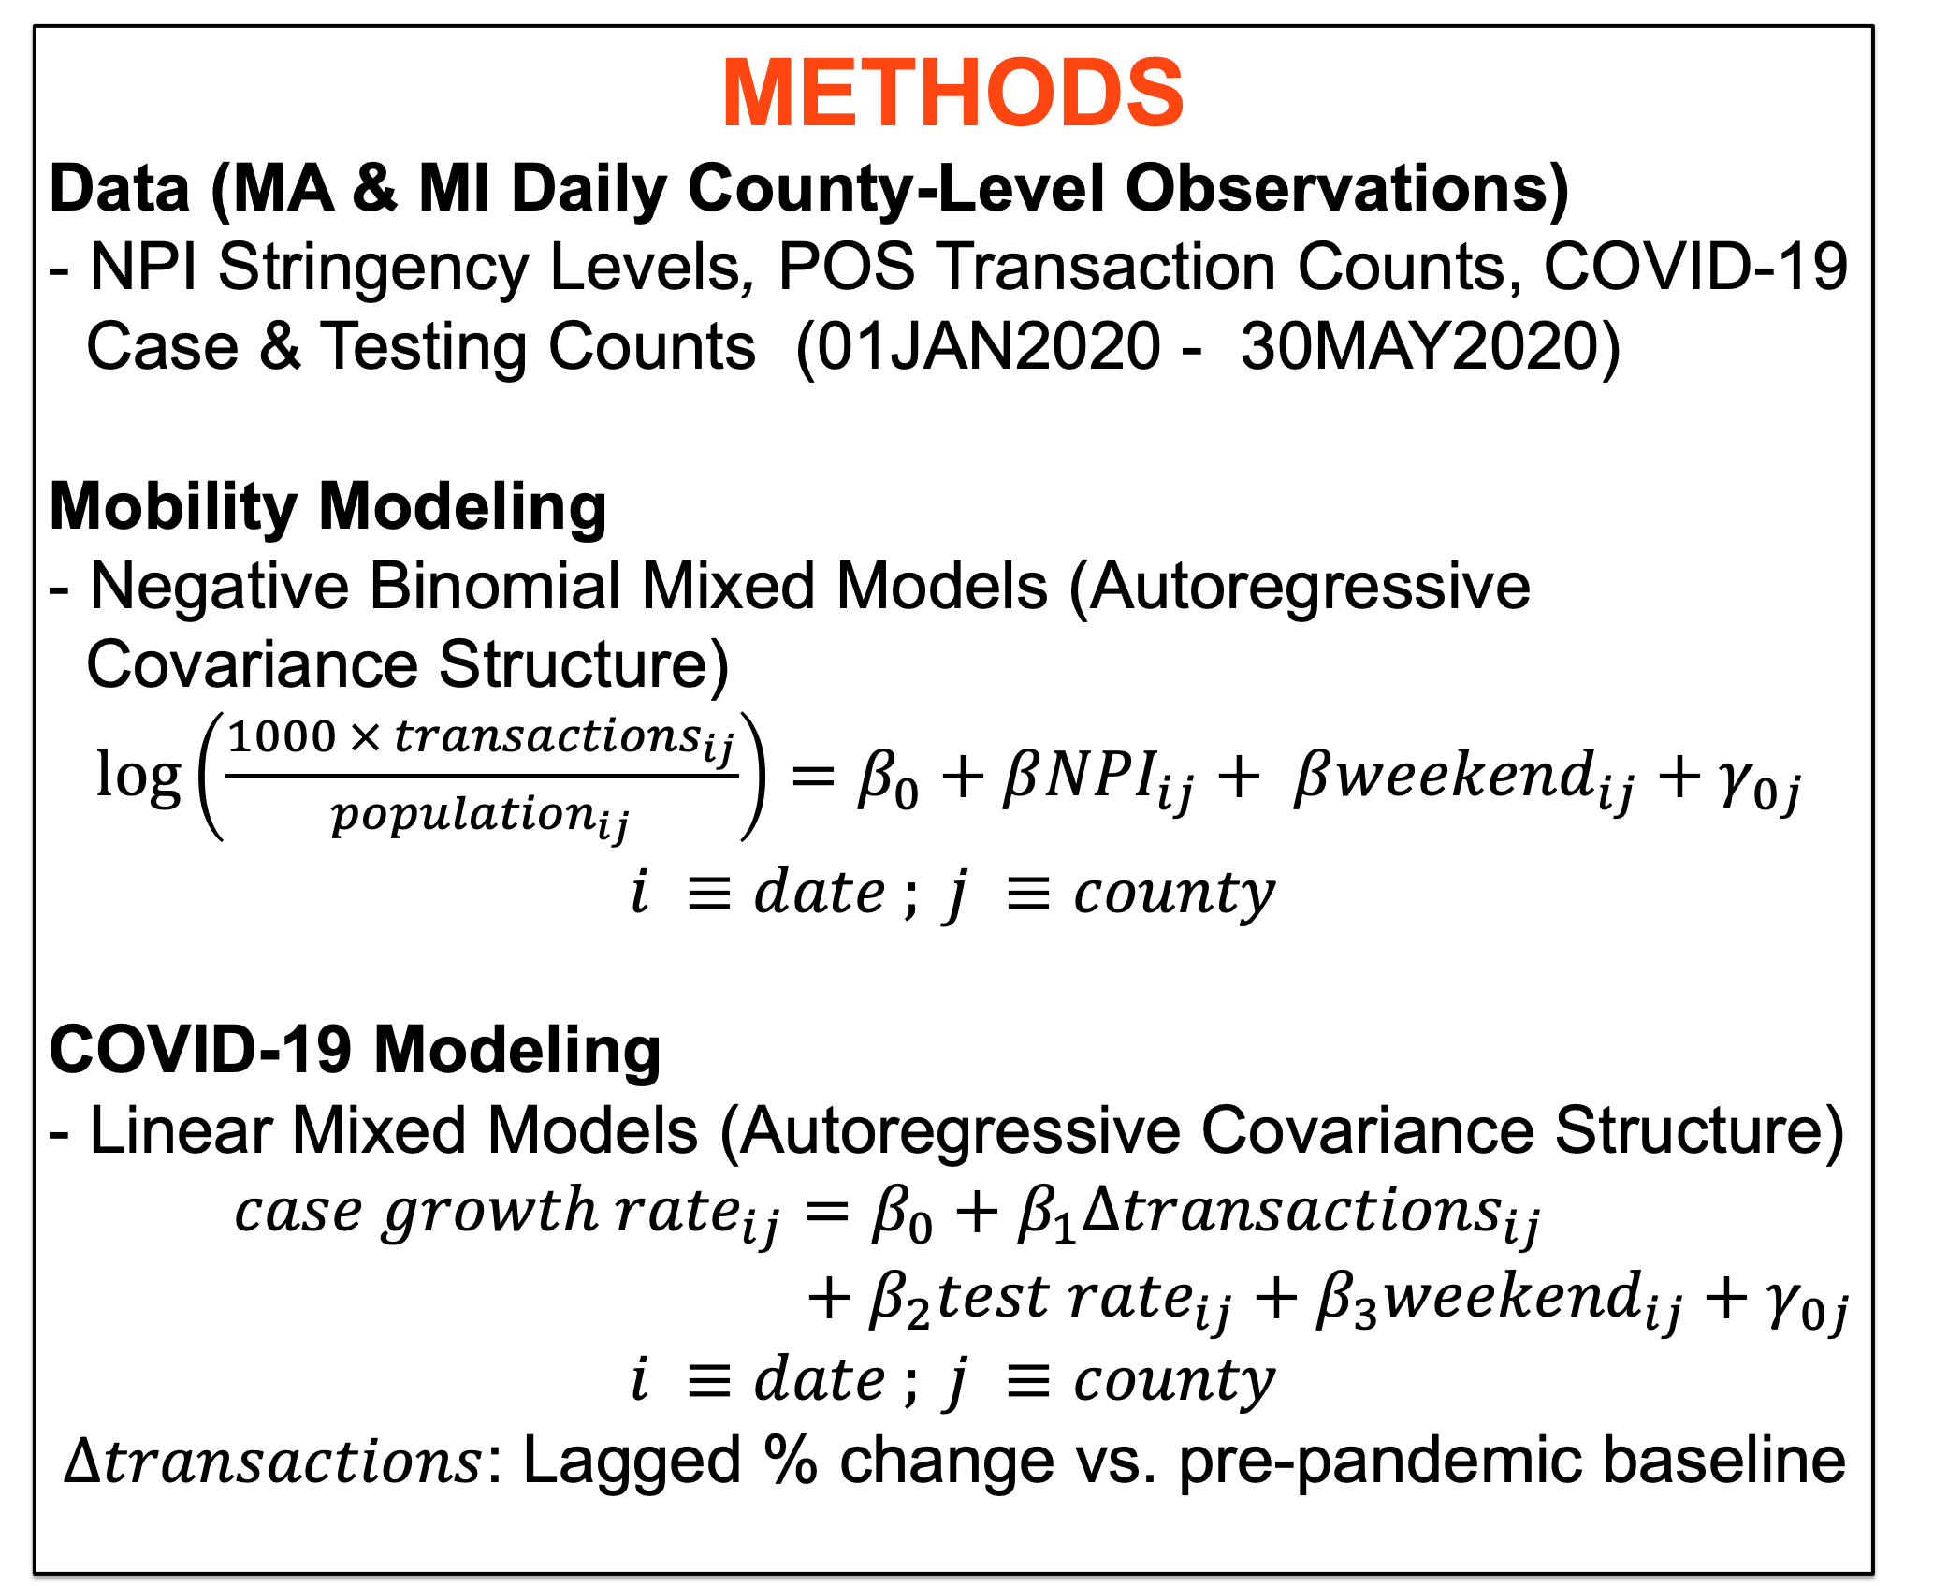
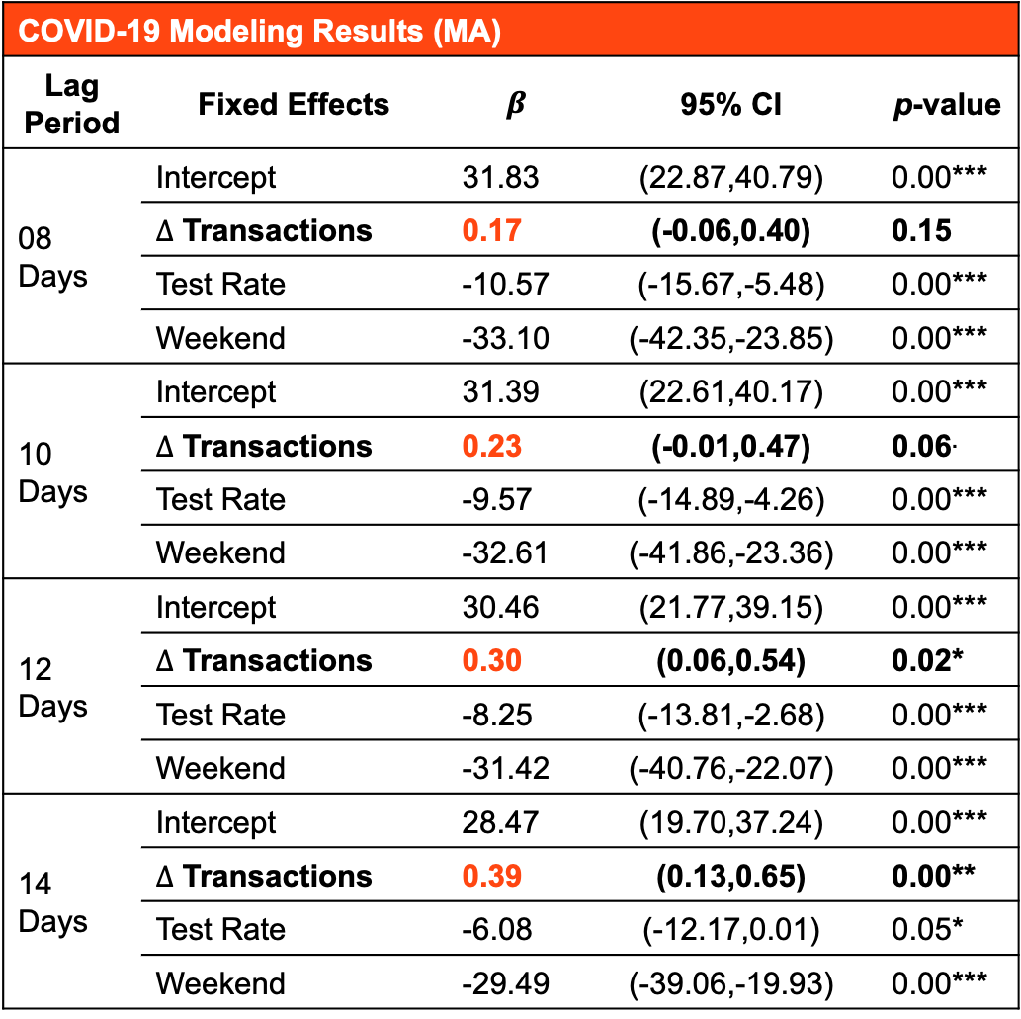


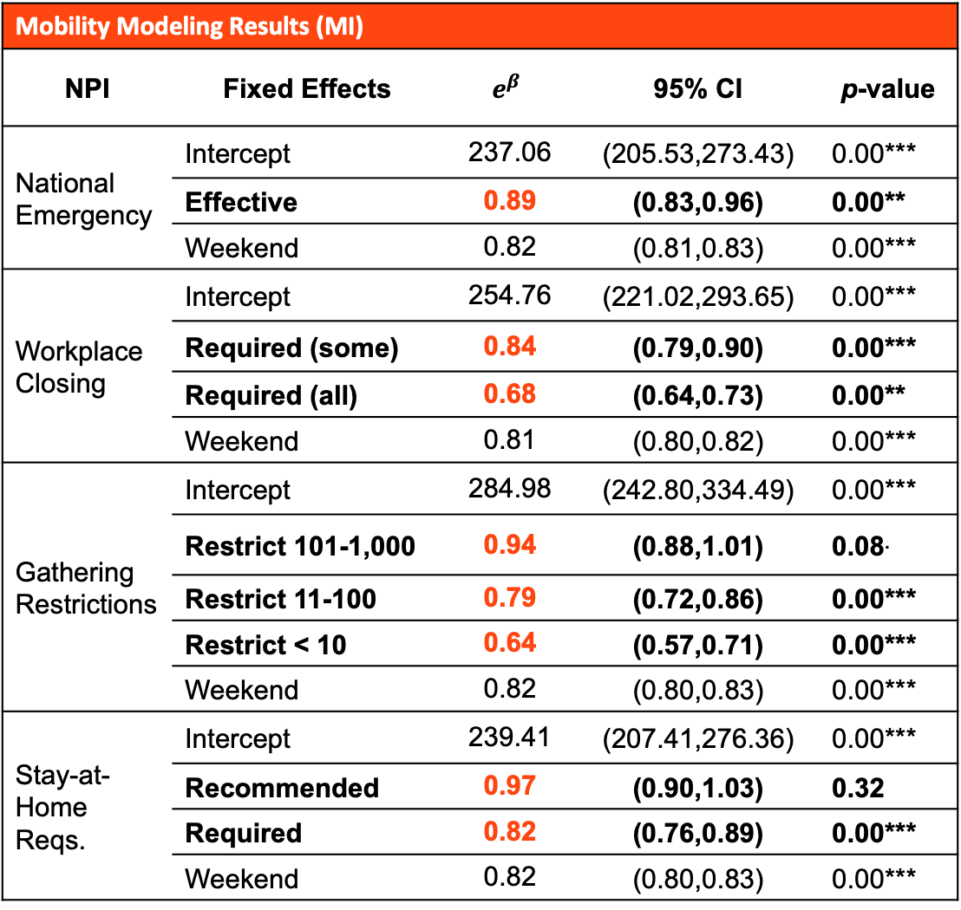
Assessing the Impact of Non-Pharmaceutical Interventions on Consumer Mobility Patterns and COVID-19
Joseph Zuccarelli (Draper Scholar)^{1,2}, Laura Seaman¹, Kevin Rader², Kosuke Imai²
¹The Charles Stark Draper Laboratory, ²Harvard University
ABSTRACT: The COVID-19 pandemic markedly changed consumer mobility patterns. In this project, we investigate these changes as they relate to the initial spread of the disease at the county-level within two states—MA and MI. Specifically, we use mixed effects models to quantify (1) the relationship between government non-pharmaceutical interventions (NPIs) on point-of-sale (POS) transactions, and (2) the relationship between subsequent changes in POS transactions and COVID-19 cases. Our analysis reveals a significant negative association between NPI stringency and POS transaction rates, and a significant positive association between changes in POS transaction rates and COVID-19 case growth rates.
INTRODUCTION
Research Questions
- How did early NPIs affect consumer mobility patterns?
- How did changes in consumer mobility patterns affect the
initial spread of COVID-19?
Literature Review
- Methods: Event Study, Interrupted Time Series
- Data: NPIs, Mobility Measures (Google & SafeGraph),
COVID-19 Cases & Deaths (State & County-Level)
- Results: Early NPIs were effective against COVID-19
MOBILITY MODELING
Results
Discussion
- Each NPI is associated with a significant decrease in POS
transactions ($e^{β}$ NPI fixed effect coefficients < 1)
- As the stringency of NPIs increases, POS transactions decrease
- Results confirm previous findings that early NPIs reduced human
mobility (Mendez-Brito et al., 2021)
- Limitations: Generalizability, confounding, spillover effects
COVID-19 MODELING
Results
Discussion
- Significant positive association between lagged $Δ$ POS transactions
and case growth rates ($β Δ$transactions fixed effect coefficients > 0)
- Optimal lag period undefined (MA ~ 12-14 days, MI ~ 8-10 days)
- Previous studies found stronger associations between human
mobility and case growth rates (Badr et al., 2020; Gatalo et al., 2021)
- Limitations: Generalizability, confounding, limited mobility measure
Mobility Modeling Results (MA) | Mobility Modeling Results (MA)
NPI | Fixed Effects | $$e^{β}$$ | 95% CI | p-value
National Emergency | Intercept | 353.28 | (279.49,446.56) | 0.00***
 | Effective | 0.86 | (0.80,0.93) | 0.00***
 | Weekend | 0.87 | (0.86,0.88) | 0.00***
Workplace Closing | Intercept | 345.31 | (273.19,436.47) | 0.00***
 | Required (all) | 0.89 | (0.82,0.96) | 0.00**
 | Weekend | 0.87 | (0.85,0.88) | 0.00***
Gathering Restrictions | Intercept | 371.96 | (294.58,469.66) | 0.00***
 | Restrict 101-1,000 | 0.92 | (0.86,0.99) | 0.03*
 | Restrict 11-100 | 0.80 | (0.74,0.86) | 0.00***
 | Restrict < 10 | 0.77 | (0.71,0.84) | 0.00***
 | Weekend | 0.87 | (0.85,0.88) | 0.00***
Stay-at-Home Reqs. | Intercept | 347.44 | (274.89,439.13) | 0.00***
 | Recommended | 0.88 | (0.81,0.95) | 0.00**
 | Weekend | 0.87 | (0.85,0.88) | 0.00***
Mobility Modeling Results (MI) | Mobility Modeling Results (MI)
NPI | Fixed Effects | $$e^{β}$$ | 95% CI | p-value
National Emergency | Intercept | 237.06 | (205.53,273.43) | 0.00***
 | Effective | 0.89 | (0.83,0.96) | 0.00**
 | Weekend | 0.82 | (0.81,0.83) | 0.00***
Workplace Closing | Intercept | 254.76 | (221.02,293.65) | 0.00***
 | Required (some) | 0.84 | (0.79,0.90) | 0.00***
 | Required (all) | 0.68 | (0.64,0.73) | 0.00**
 | Weekend | 0.81 | (0.80,0.82) | 0.00***
Gathering Restrictions | Intercept | 284.98 | (242.80,334.49) | 0.00***
 | Restrict 101-1,000 | 0.94 | (0.88,1.01) | 0.08.
 | Restrict 11-100 | 0.79 | (0.72,0.86) | 0.00***
 | Restrict < 10 | 0.64 | (0.57,0.71) | 0.00***
 | Weekend | 0.82 | (0.80,0.83) | 0.00***
Stay-at-Home Reqs. | Intercept | 239.41 | (207.41,276.36) | 0.00***
 | Recommended | 0.97 | (0.90,1.03) | 0.32
 | Required | 0.82 | (0.76,0.89) | 0.00***
 | Weekend | 0.82 | (0.80,0.83) | 0.00***
COVID-19 Modeling Results (MA) | Mobility Modeling Results (MA)
Lag Period | Fixed Effects | $$β$$ | 95% CI | p-value
08 Days | Intercept | 31.83 | (22.87,40.79) | 0.00***
 | $∆$ Transactions | 0.17 | (-0.06,0.40) | 0.15
 | Test Rate | -10.57 | (-15.67,-5.48) | 0.00***
 | Weekend | -33.10 | (-42.35,-23.85) | 0.00***
10 Days | Intercept | 31.39 | (22.61,40.17) | 0.00***
 | $∆$ Transactions | 0.23 | (-0.01,0.47) | 0.06.
 | Test Rate | -9.57 | (-14.89,-4.26) | 0.00***
 | Weekend | -32.61 | (-41.86,-23.36) | 0.00***
12 Days | Intercept | 30.46 | (21.77,39.15) | 0.00***
 | $∆$ Transactions | 0.30 | (0.06,0.54) | 0.02*
 | Test Rate | -8.25 | (-13.81,-2.68) | 0.00***
 | Weekend | -31.42 | (-40.76,-22.07) | 0.00***
14 Days | Intercept | 28.47 | (19.70,37.24) | 0.00***
 | $∆$ Transactions | 0.39 | (0.13,0.65) | 0.00**
 | Test Rate | -6.08 | (-12.17,0.01) | 0.05*
 | Weekend | -29.49 | (-39.06,-19.93) | 0.00***
COVID-19 Modeling Results (MI) | Mobility Modeling Results (MA)
Lag Period | Fixed Effects |  | $$β$$ | 95% CI | p-value
08 Days | Intercept | 18.22 |  | (10.36,26.08) | 0.00***
 | $∆$ Transactions | 0.19 |  | (0.01,0.37) | 0.03*
 | Test Rate | -10.30 |  | (-16.12,-4.47) | 0.00***
 | Weekend | -23.02 |  | (-31.83,-14.21) | 0.00***
10 Days | Intercept | 16.54 |  | (8.98,24.10) | 0.00***
 | $∆$ Transactions | 0.14 |  | (-0.04,0.32) | 0.12
 | Test Rate | -9.50 |  | (-15.26,-3.75) | 0.00***
 | Weekend | -22.43 |  | (-31.22,-13.64) | 0.00***
12 Days | Intercept | 15.94 |  | (8.61,23.26) | 0.00***
 | $∆$ Transactions | 0.13 |  | (-0.05,0.31) | 0.15
 | Test Rate | -9.27 |  | (-15.02,--3.52) | 0.00***
 | Weekend | -21.62 |  | (-30.44,-12.80) | 0.00***
14 Days | Intercept | 15.32 |  | (7.98,22.65) | 0.00***
 | $∆$ Transactions | 0.09 |  | (-0.08,0.27) | 0.31
 | Test Rate | -9.03 |  | (-14.79,-3.27) | 0.00***
 | Weekend | -22.46 |  | (-31.29,--13.64) | 0.00***
METHODS
Data (MA & MI Daily County-Level Observations)
- NPI Stringency Levels, POS Transaction Counts, COVID-19
Case & Testing Counts (01JAN2020 - 30MAY2020)
Mobility Modeling
- Negative Binomial Mixed Models (Autoregressive
Covariance Structure)
$\log\left(\frac{1000 × {transactions}_{ij}}{{population}_{ij}}\right)=β_{0}+β{NPI}_{ij}+ β{weekend}_{ij}+γ_{0j}$
$$i ≡date ; j ≡county$$
COVID-19 Modeling
- Linear Mixed Models (Autoregressive Covariance Structure)
${case growth rate}_{ij}=β_{0}+β_{1}{Δtransactions}_{ij}$
$+ β_{2}{test rate}_{ij}+β_{3}{weekend}_{ij}+γ_{0j}$
$$i ≡date ; j ≡county$$
$Δtransactions$: Lagged % change vs. pre-pandemic baseline
Draper Research Symposium / April 12, 2023 /

