Slide 1

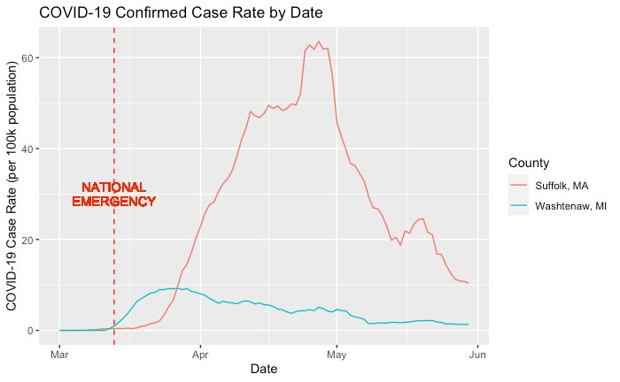
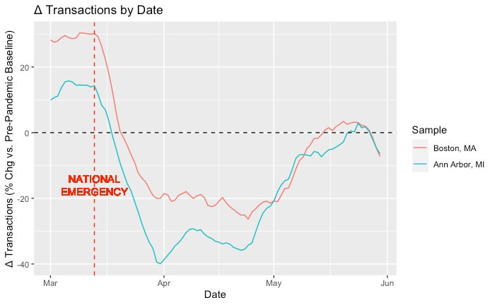
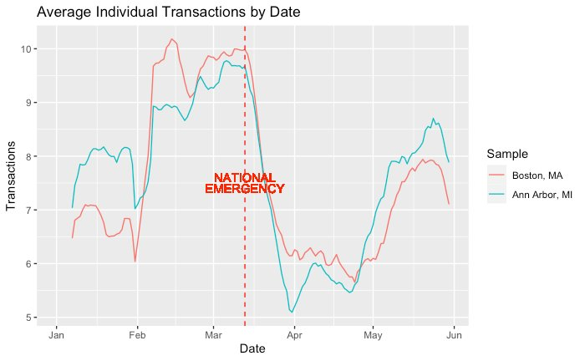
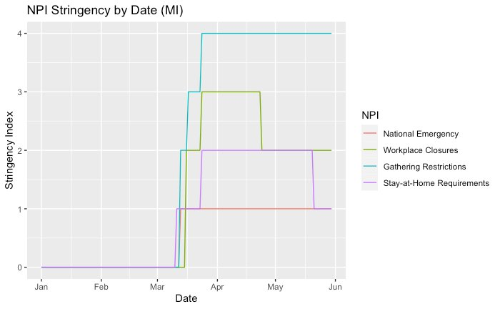


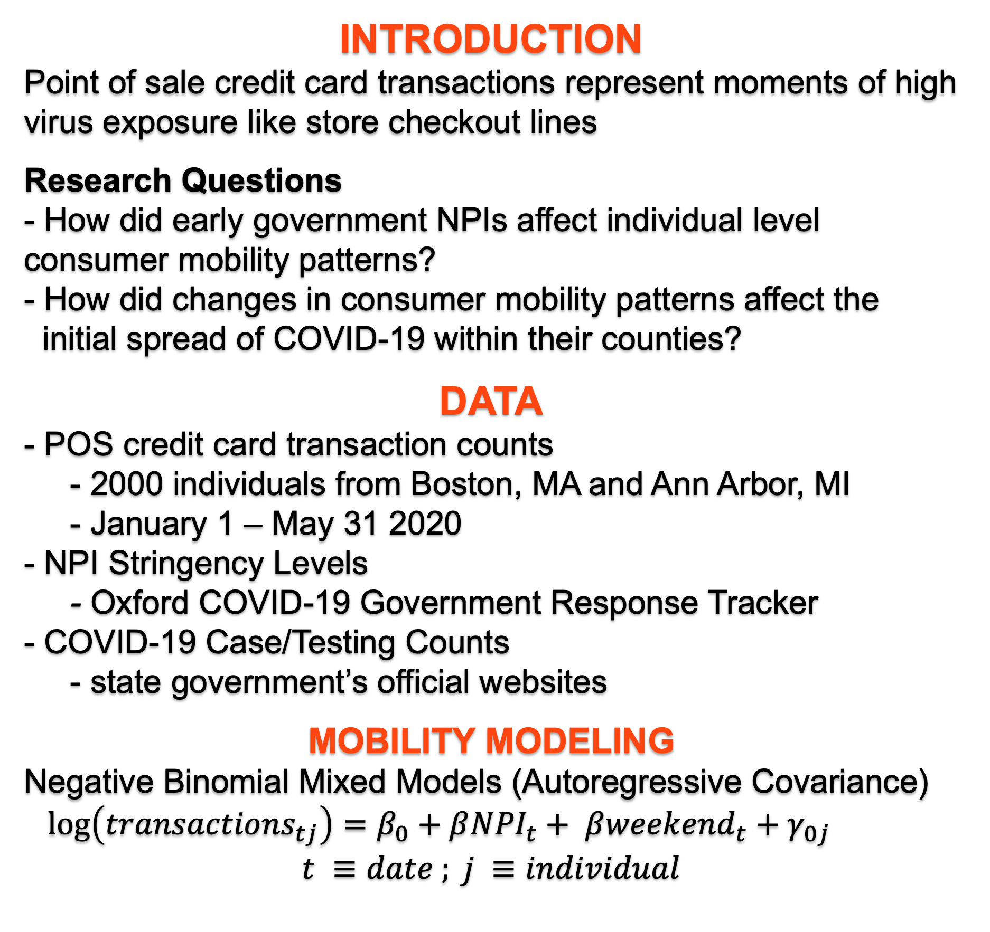
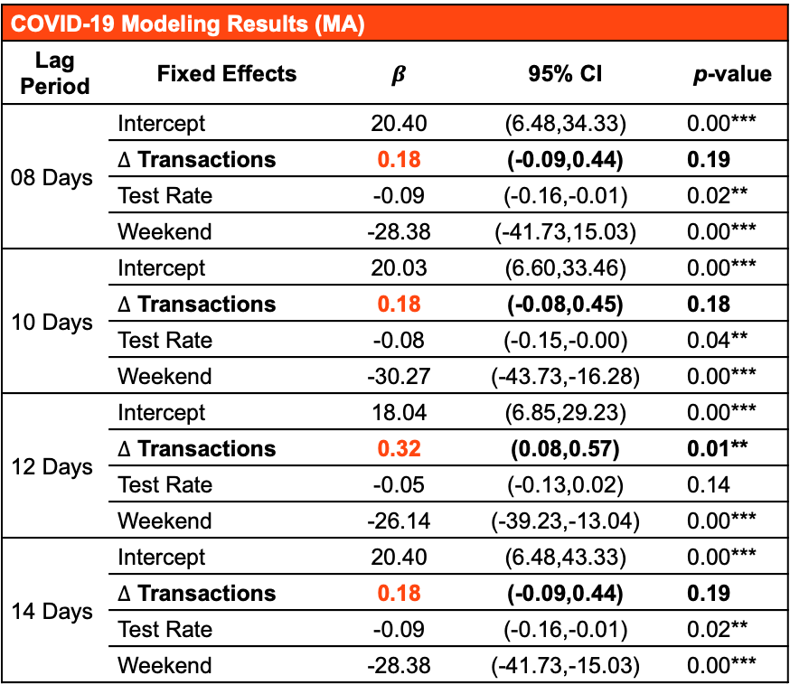
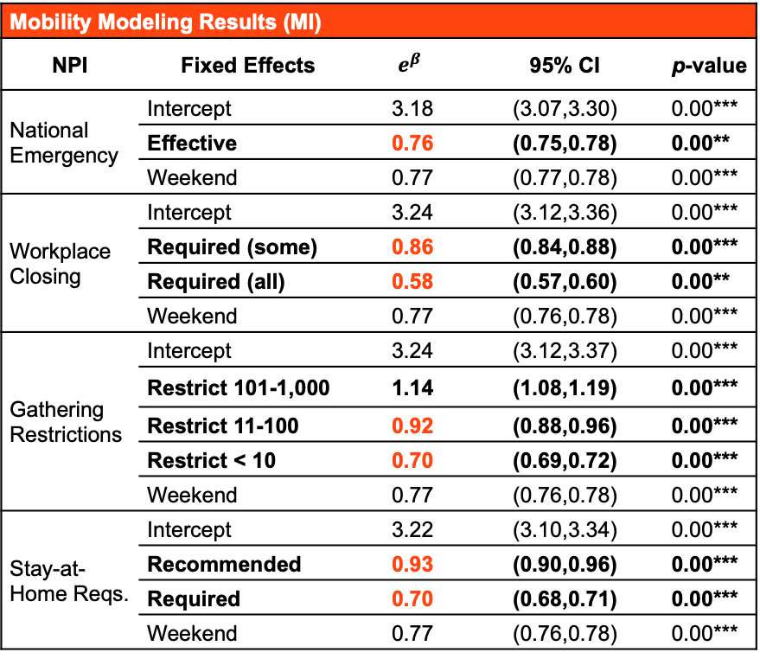

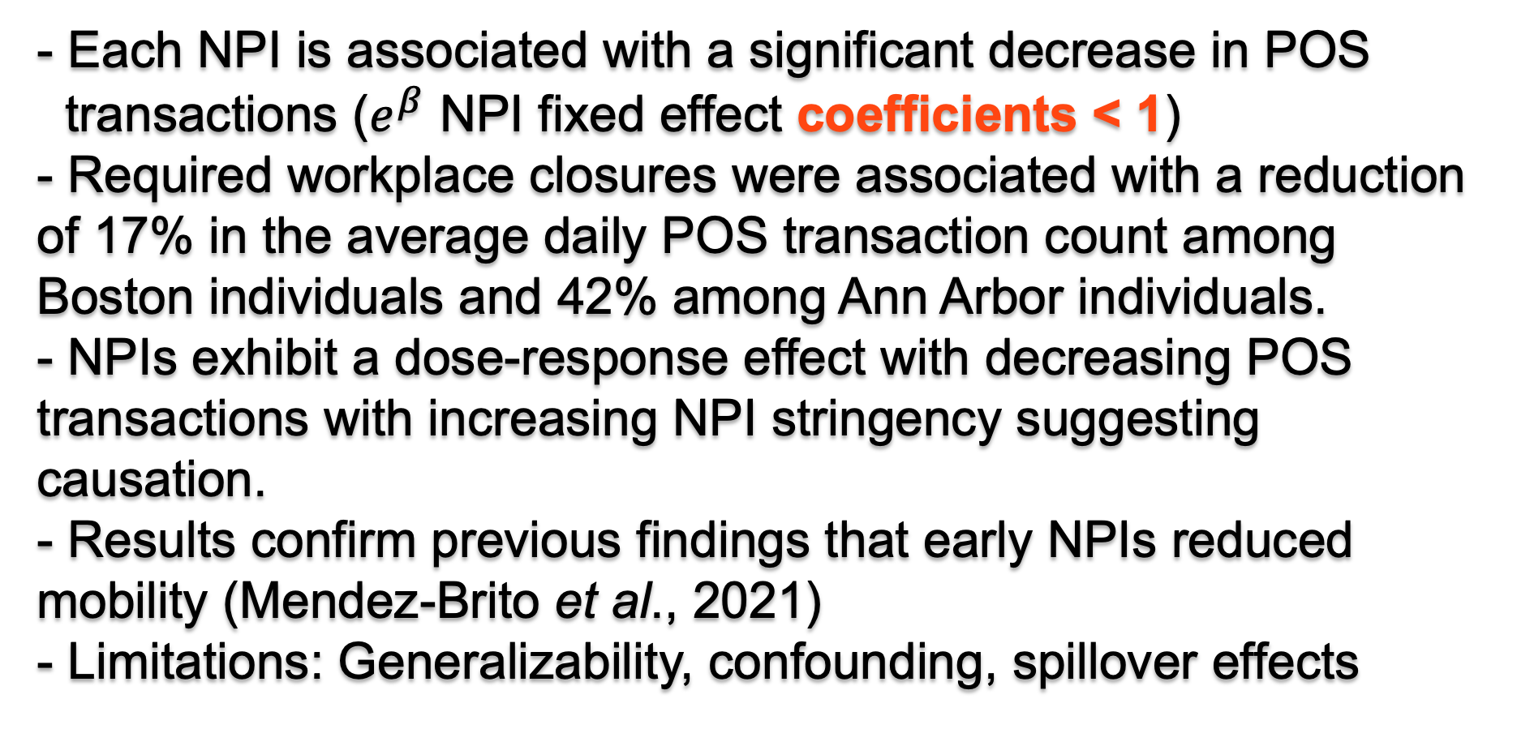
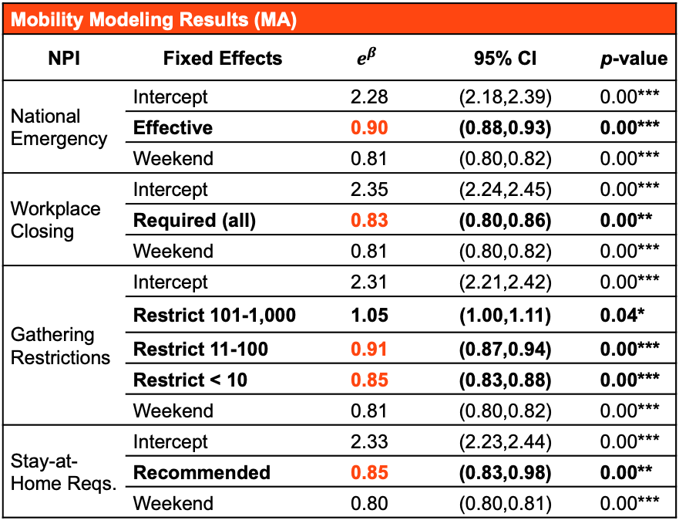
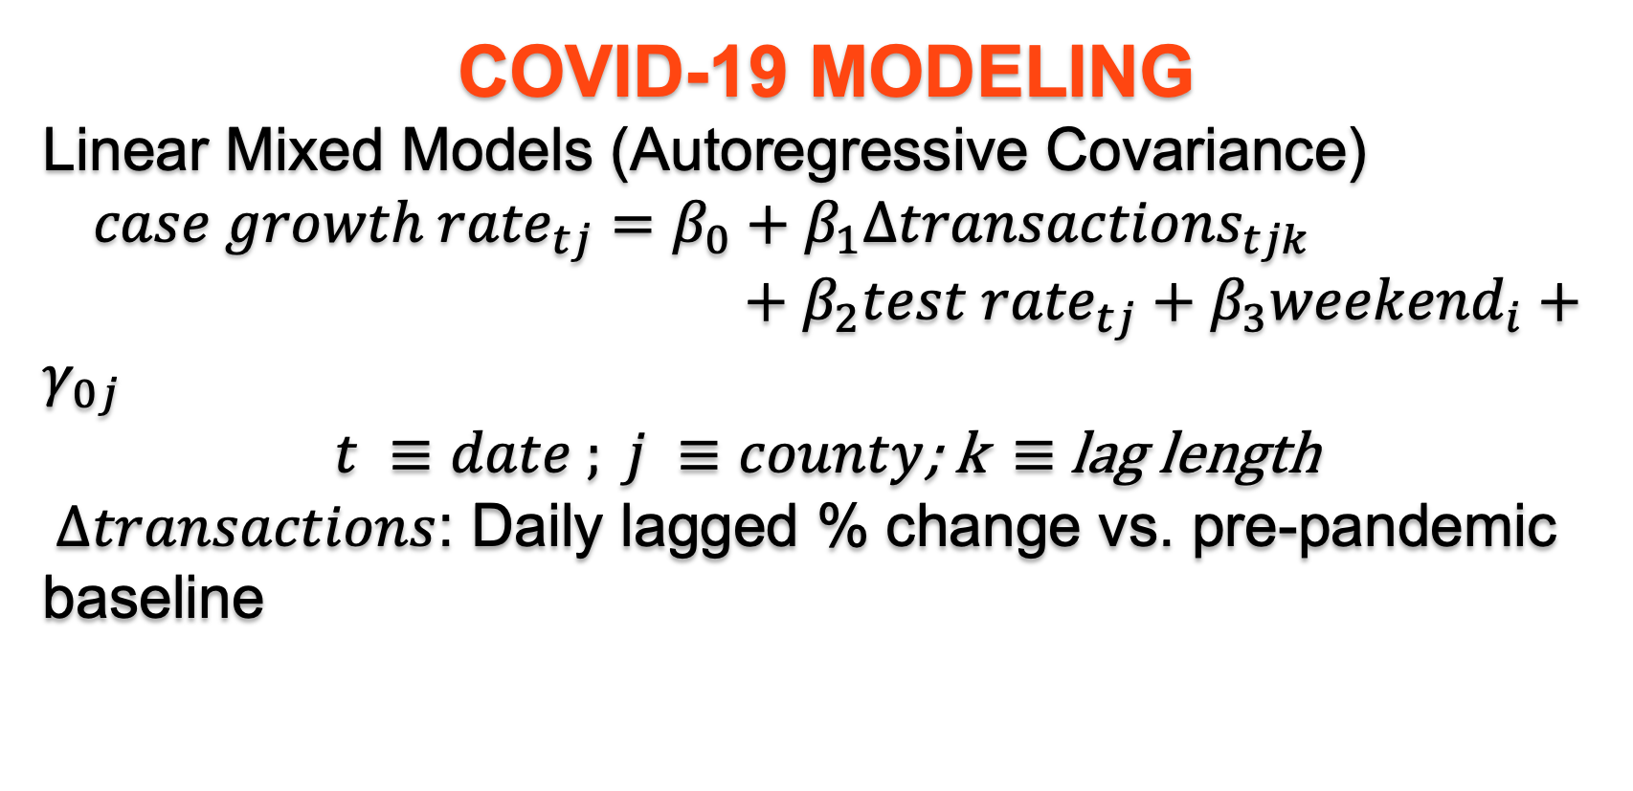
Measuring the Effect of Non-Pharmaceutical Interventions on Consumer Mobility Patterns and COVID-19
Joseph Zuccarelli^{1,2}, Laura Seaman¹, Kevin Rader², Kosuke Imai²
¹Draper Laboratory, ²Harvard University
ABSTRACT: The COVID-19 pandemic markedly changed consumer mobility patterns worldwide. In this study, we investigate these changes as they relate to the initial spread of COVID-19 within two states—Massachusetts and Michigan. Specifically, we use mixed-effects models to quantify the relationship between four non-pharmaceutical interventions (NPIs) and individuals’ point-of-sale (POS) credit card transactions, as well as the relationship between subsequent changes in POS transactions and county-level COVID-19 case growth rates. Our analysis reveals a significant negative association between NPIs and daily POS transactions. We also uncover a significant positive association between 12 day lagged changes in POS transactions compared to county-level COVID-19 case growth rates.
INTRODUCTION
Point of sale credit card transactions represent moments of high virus exposure like store checkout lines
Research Questions
- How did early government NPIs affect individual level consumer mobility patterns?
- How did changes in consumer mobility patterns affect the
initial spread of COVID-19 within their counties?
DATA
- POS credit card transaction counts
- 2000 individuals from Boston, MA and Ann Arbor, MI
- January 1 – May 31 2020
- NPI Stringency Levels
- Oxford COVID-19 Government Response Tracker
- COVID-19 Case/Testing Counts
- state government’s official websites
MOBILITY MODELING
Negative Binomial Mixed Models (Autoregressive Covariance)
$\log\left({transactions}_{tj}\right)=β_{0}+β{NPI}_{t}+ β{weekend}_{t}+γ_{0j}$
$$t ≡date ; j ≡individual$$
COVID-19 MODELING
Linear Mixed Models (Autoregressive Covariance)
${case growth rate}_{tj}=β_{0}+β_{1}{Δtransactions}_{tjk}$
$+ β_{2}{test rate}_{tj}+β_{3}{weekend}_{i}+γ_{0j}$
$t ≡date ; j ≡county$; k$≡$ lag length
$Δtransactions$: Daily lagged % change vs. pre-pandemic baseline
COVID-19 Modeling Results (MA) | Mobility Modeling Results (MA)
Lag Period | Fixed Effects | $$β$$ | 95% CI | p-value
08 Days | Intercept | 20.40 | (6.48,34.33) | 0.00***
 | $∆$ Transactions | 0.18 | (-0.09,0.44) | 0.19
 | Test Rate | -0.09 | (-0.16,-0.01) | 0.02**
 | Weekend | -28.38 | (-41.73,15.03) | 0.00***
10 Days | Intercept | 20.03 | (6.60,33.46) | 0.00***
 | $∆$ Transactions | 0.18 | (-0.08,0.45) | 0.18
 | Test Rate | -0.08 | (-0.15,-0.00) | 0.04**
 | Weekend | -30.27 | (-43.73,-16.28) | 0.00***
12 Days | Intercept | 18.04 | (6.85,29.23) | 0.00***
 | $∆$ Transactions | 0.32 | (0.08,0.57) | 0.01**
 | Test Rate | -0.05 | (-0.13,0.02) | 0.14
 | Weekend | -26.14 | (-39.23,-13.04) | 0.00***
14 Days | Intercept | 20.40 | (6.48,43.33) | 0.00***
 | $∆$ Transactions | 0.18 | (-0.09,0.44) | 0.19
 | Test Rate | -0.09 | (-0.16,-0.01) | 0.02**
 | Weekend | -28.38 | (-41.73,-15.03) | 0.00***
- Significant positive association between 12 day lagged $Δ$ POS transactions and case growth rate ($β Δ$transactions fixed effect coefficients > 0)
- A 10% decrease in the 12-day lagged change in consumer mobility was associated with a 3.2% decrease in COVID-19 case growth rate.
- Previous studies found a stronger association but with similar optimal lag periods (12 days) (Badr et al., 2020; Gatalo et al., 2021)
- Limitations: Generalizability, confounding, limited mobility measure
CONCLUSIONS
- Use of individual level POS transaction data is unique.
- Consumer mobility models detect a statistically significant negative association between POS transactions and all four NPIs of interest.
- The associations were stronger among Ann Arbor residents than Boston residents, potentially reflecting the higher early case rates in Michigan.
- COVID-19 models identify a statistically significant positive association between changes in mobility patterns and COVID-19 case growth rates.
Mobility Modeling Results (MA) | Mobility Modeling Results (MI)
NPI | Fixed Effects | $$e^{β}$$ | 95% CI | p-value
National Emergency | Intercept | 2.28 | (2.18,2.39) | 0.00***
 | Effective | 0.90 | (0.88,0.93) | 0.00***
 | Weekend | 0.81 | (0.80,0.82) | 0.00***
Workplace Closing | Intercept | 2.35 | (2.24,2.45) | 0.00***
 | Required (all) | 0.83 | (0.80,0.86) | 0.00**
 | Weekend | 0.81 | (0.80,0.82) | 0.00***
Gathering Restrictions | Intercept | 2.31 | (2.21,2.42) | 0.00***
 | Restrict 101-1,000 | 1.05 | (1.00,1.11) | 0.04*
 | Restrict 11-100 | 0.91 | (0.87,0.94) | 0.00***
 | Restrict < 10 | 0.85 | (0.83,0.88) | 0.00***
 | Weekend | 0.81 | (0.80,0.82) | 0.00***
Stay-at-Home Reqs. | Intercept | 2.33 | (2.23,2.44) | 0.00***
 | Recommended | 0.85 | (0.83,0.98) | 0.00**
 | Weekend | 0.80 | (0.80,0.81) | 0.00***
Mobility Modeling Results (MI) | Mobility Modeling Results (MI)
NPI | Fixed Effects | $$e^{β}$$ | 95% CI | p-value
National Emergency | Intercept | 3.18 | (3.07,3.30) | 0.00***
 | Effective | 0.76 | (0.75,0.78) | 0.00**
 | Weekend | 0.77 | (0.77,0.78) | 0.00***
Workplace Closing | Intercept | 3.24 | (3.12,3.36) | 0.00***
 | Required (some) | 0.86 | (0.84,0.88) | 0.00***
 | Required (all) | 0.58 | (0.57,0.60) | 0.00**
 | Weekend | 0.77 | (0.76,0.78) | 0.00***
Gathering Restrictions | Intercept | 3.24 | (3.12,3.37) | 0.00***
 | Restrict 101-1,000 | 1.14 | (1.08,1.19) | 0.00***
 | Restrict 11-100 | 0.92 | (0.88,0.96) | 0.00***
 | Restrict < 10 | 0.70 | (0.69,0.72) | 0.00***
 | Weekend | 0.77 | (0.76,0.78) | 0.00***
Stay-at-Home Reqs. | Intercept | 3.22 | (3.10,3.34) | 0.00***
 | Recommended | 0.93 | (0.90,0.96) | 0.00***
 | Required | 0.70 | (0.68,0.71) | 0.00***
 | Weekend | 0.77 | (0.76,0.78) | 0.00***
- Each NPI is associated with a significant decrease in POS
transactions ($e^{β}$ NPI fixed effect coefficients < 1)
- Required workplace closures were associated with a reduction of 17% in the average daily POS transaction count among Boston individuals and 42% among Ann Arbor individuals.
- NPIs exhibit a dose-response effect with decreasing POS transactions with increasing NPI stringency suggesting causation.
- Results confirm previous findings that early NPIs reduced mobility (Mendez-Brito et al., 2021)
- Limitations: Generalizability, confounding, spillover effects
024 Winter Medical & WMD Countermeasure Symposium
Medical & WMD Countermeasure Symposium / February 20, 2024

