Slide 1
Measuring the Effect of Writing Center Visits on Performance
CDT Joseph Zuccarelli
Advisors:
LTC Kevin Cummiskey, LTC Andrew Lee, Dr. Colleen Eils

Slide 2
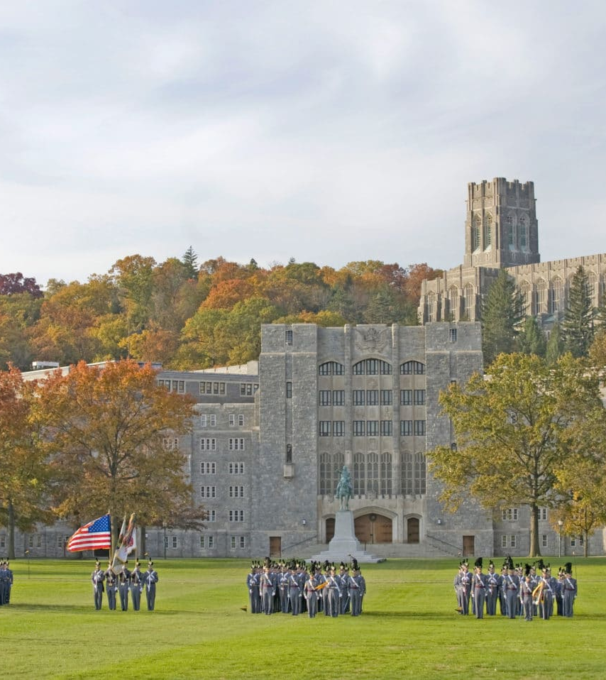
Agenda
Background
Problem Statement
Data
Methodology
Results
Discussion
Conclusion

Slide 3

Background
Mounger Writing Center (MWC)
Mission: Engage clients in productive conversations about their ideas and how to express them more effectively
One-on-one consulting sessions, group workshops, special events

Slide 4
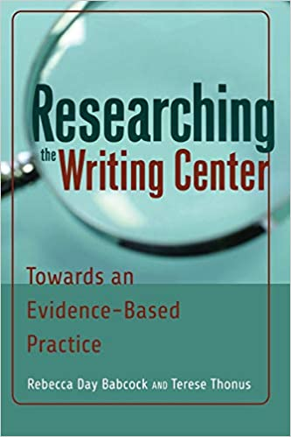
Background
Writing center studies generally lacking advanced quantitative analyses
Cunningham et al (2020) found evidence of a beneficial effect of writing center attendance on signature writing events
Goal: Provide a quantitative assessment of writing center visits on student performance

Slide 5
Problem Statement
Do more writing center visits for an individual result in larger effects on signature writing events?

Slide 6
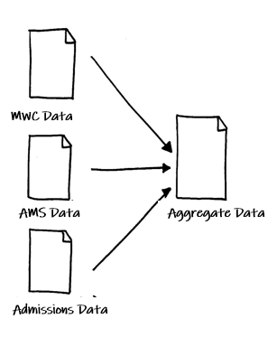
Data
Data Aggregation
Institutional Review Board Approval
MWC Data, AMS Data, Admissions Data
Inclusion Criteria: Core Courses, Grades Above 50%, AY19-2 – AY20-1
2,662 total observations

Slide 7
Methodology
Treatment: MWC Visits (Never, Once, Multiple Times)
Outcome: SWE Grade (0 – 100)
Covariates: Course, Sex, Race, SAT/ACT Scores
7

Slide 8
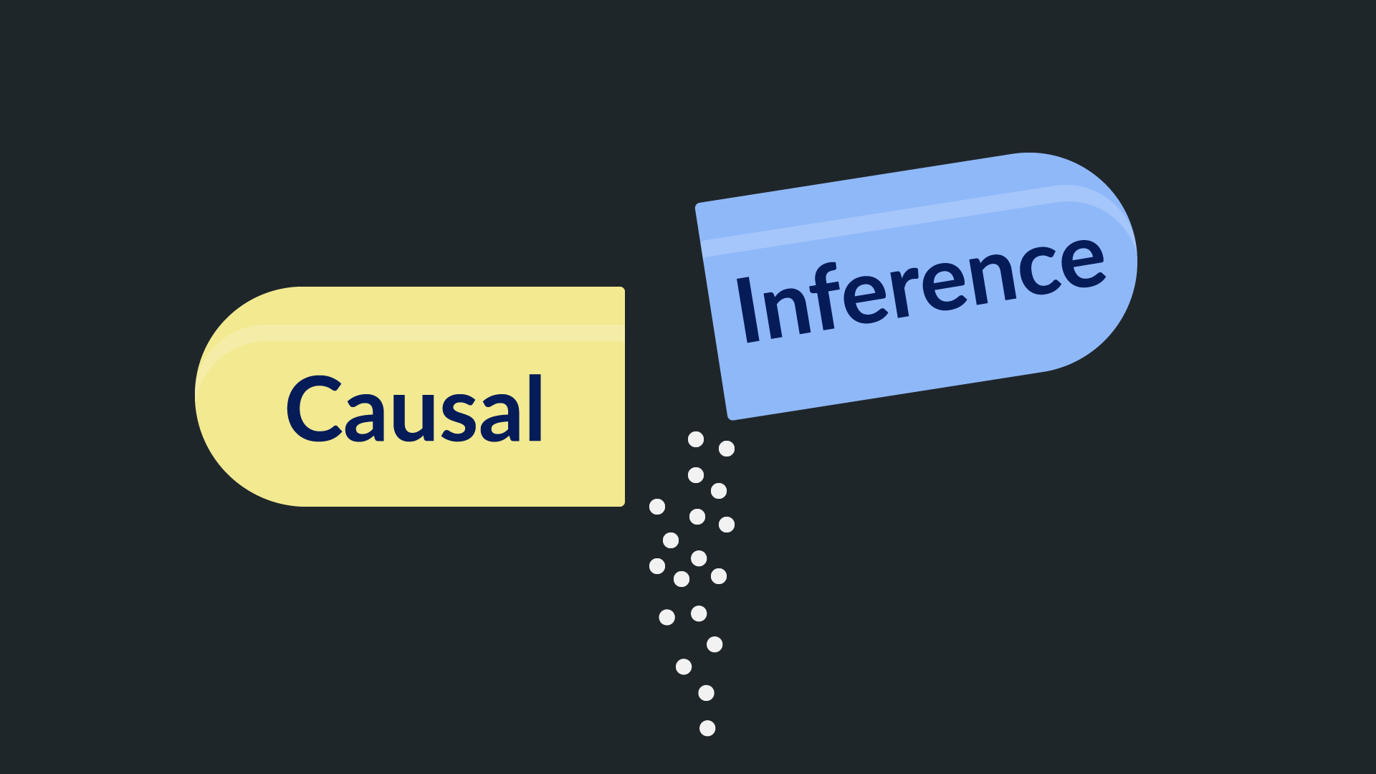
Methodology
Causal Inference
Propensity Score Matching (PSM)
Reduces bias due to confounding
Moves more towards causal estimates
Requires 4 STEPS
8

Slide 9
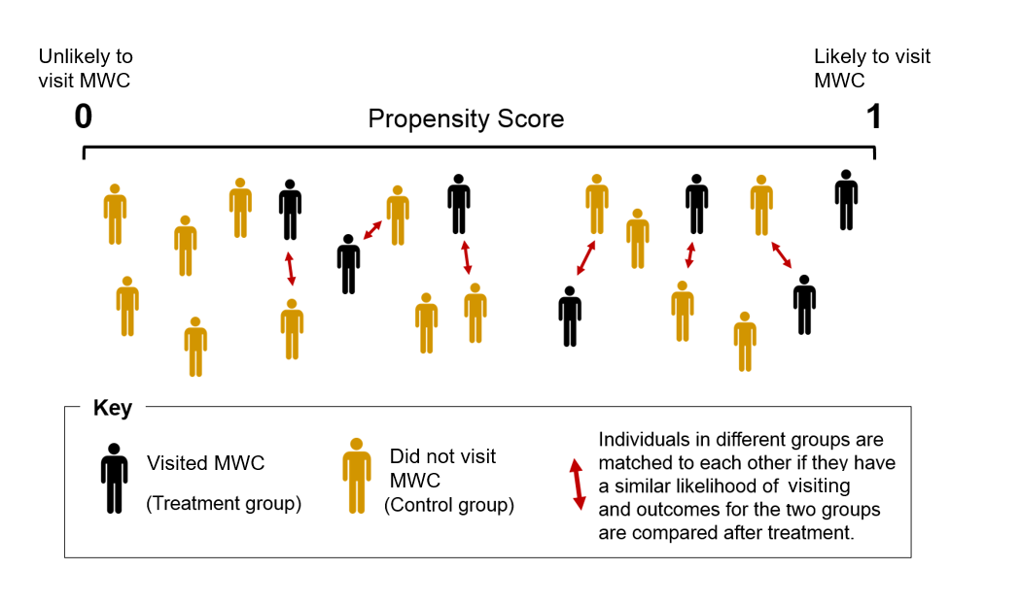
Methodology
STEP 1: Estimate the propensity score
STEP 2: Match
STEP 3: Evaluate the quality of matching
STEP 4: Estimate treatment effects
9

Slide 10
Methodology
Binary v. Multi-Level Treatments
Model 1: Probability of attending once vs. never
Model 2: Probability of attending multiple times vs. never
Model 3: Probability of attending multiple times vs. once
Once
Model 1
Propensity Score
Model 3
Propensity Score
Propensity Score
Never
Model 2
Multiple Visits
10

Slide 11
Results
Table 1. Demographic and Academic Characteristics at Baseline. ˚
Characteristic | All (N = 2662) | Multiple Times (N = 95) | Once (N = 207) | Never (N = 2360) | P Value
Sex—no. (%)
Male | 2056 (77.2) | 66 (69.5) | 136 (65.7) | 1854 (78.6) | 0.000***
Female | 606 (22.8) | 29 (30.5) | 71 (34.3) | 506 (21.4)
Race—no. (%)
Asian | 229 (8.6) | 15 (15.8) | 25 (12.1) | 189 (8.0) | 0.037*
Black | 369 (13.9) | 18 (18.9) | 35 (16.9) | 316 (13.4)
Hispanic | 243 (9.1) | 4 (4.2) | 14 (6.8) | 225(9.5)
Native American | 34 (1.3) | 1 (1.1) | 2 (1.0) | 31 (1.3)
Other | 40 (1.5) | 2 (2.1) | 3 (1.4) | 35 (1.5)
White | 1747 (65.5) | 55 (57.9) | 128 (61.8) | 1564 (66.3)
SAT—score (200 - 800) ^{Ɨ}
Math | 652 ± 71.6 | 661 ± 71.3 | 652 ± 75.2 | 651 ± 71.3 | 0.416
Verbal | 617 ± 78.5 | 612 ± 92.0 | 614 ± 81.6 | 617 ± 77.6 | 0.652
Writing | 602 ± 82.9 | 600 ± 94.1 | 600 ± 86.1 | 603 ± 82.2 | 0.843
ACT—score (1 – 36) ^{Ɨ}
Composition | 28.6 ± 3.77 | 28.5 ± 4.17 | 28.5 ± 3.87 | 28.6 ± 3.75 | 0.928
English | 28.5 ± 4.89 | 27.8 ± 5.19 | 28.5 ± 5.00 | 28.5 ± 4.87 | 0.419
Math | 28.3 ± 3.66 | 28.6 ± 3.83 | 28.3 ± 3.67 | 28.3 ± 3.65 | 0.597
Reading | 29.3 ± 4.86 | 29.1 ± 5.97 | 29.2 ± 4.91 | 29.3 ± 4.81 | 0.933
Writing | 26.0 ± 4.17 | 25.7 ± 4.63 | 26.0 ± 4.22 | 26.0 ± 4.14 | 0.811
SWE Grade—score (0 - 100) | 82.0 ± 8.64 | 83.9 ± 8.64 | 83.0 ± 9.06 | 81.8 ± 8.59 | 0.014*
Significant Predictors of MWC Visits
Sex
Race
11

Slide 12
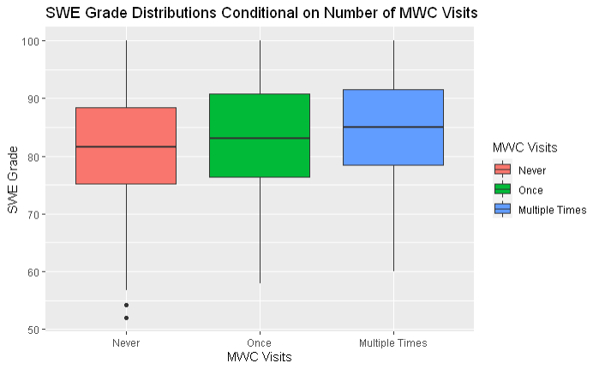
Results
Exploratory Analysis
Never: 81.8 ± 8.59
Once: 83.0 ± 9.06
Multiple Times: 83.9 ± 8.64
12

Slide 13
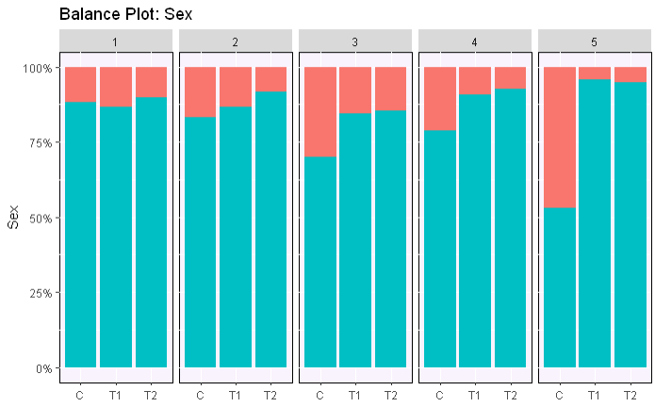
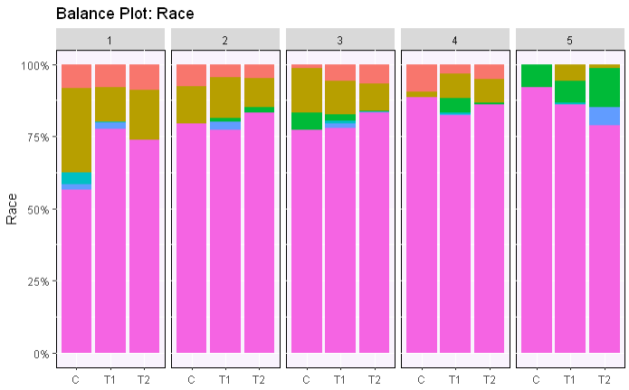
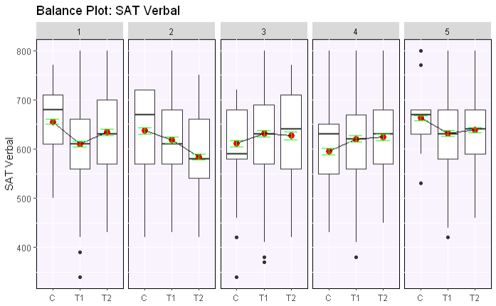
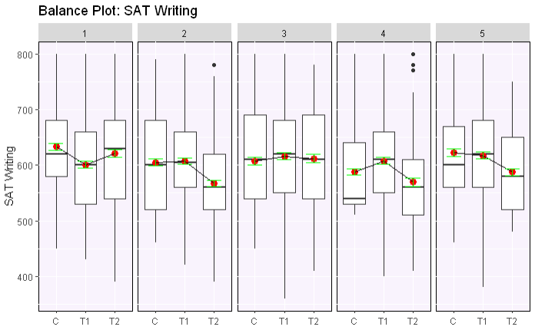
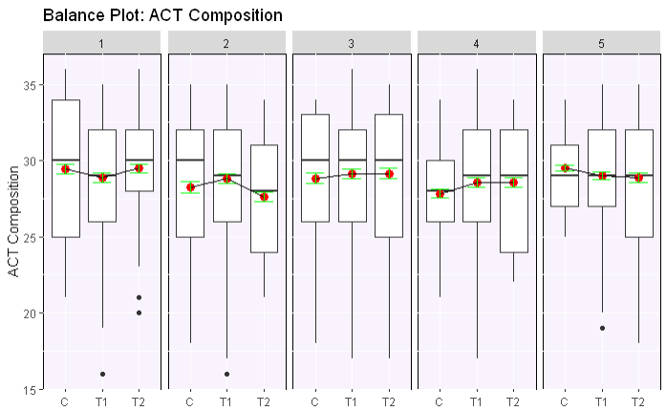
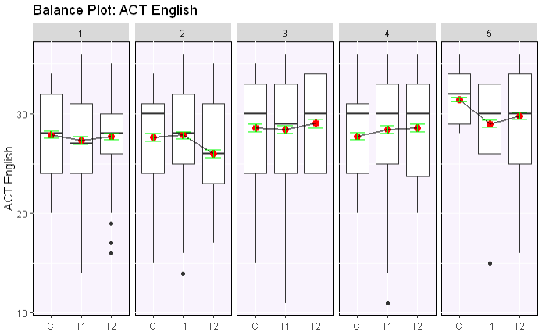
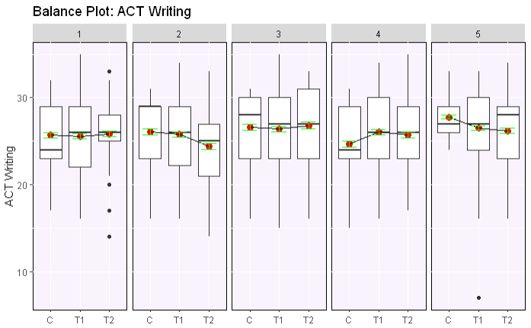
Results
Assessing Balance
Most covariates are effectively distributed across the treatment groups
13

Slide 14
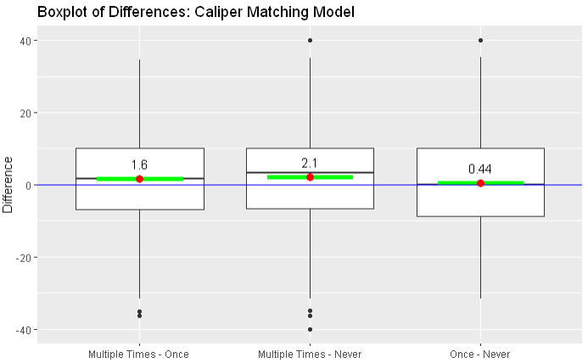
Results
Estimating Treatment Effects
Evidence of a dose-response relationship between MWC Visits and SWE Grade
Table 2. Estimating Treatment Effects.
Treatment | Mean Difference | Confidence Interval | P Value
Multiple Visits – Never | + 2.061 | (1.646, 2.476) | 3.888 x 10^{-22***}
Multiple Visits - Once | + 1.619 | (1.206, 2.031) | 1.894 x 10^{-14***}
Once - Never | + 0.443 | (0.019, 0.875) | 4.486 x 10^{-2*}
14

Slide 15

Discussion
More visits to MWC → Better SWE grade
Novelty of study—scope and statistical analysis
Limitations
Unmeasured Confounding
SWE Grade does not directly align with the MWC’s desired outcome
15

Slide 16
Conclusion
Study introduces quantitative rigor to the field of writing center studies through use of multi-level PSM
More visits to the writing center leads to better performance on SWEs
16

Slide 17
Questions?
17

