Slide 1

DIABETES RISK PREDICTION ANALYSIS
Group two Members.
Kato Joseph Bwanika Reg:2023-B291-11709
Mambo Emmanuel Reg:2022-B291-11357
Ssenkaayi Vihan Reg:2023-B291-11360
Paul
Mark
Bangas

Slide 2
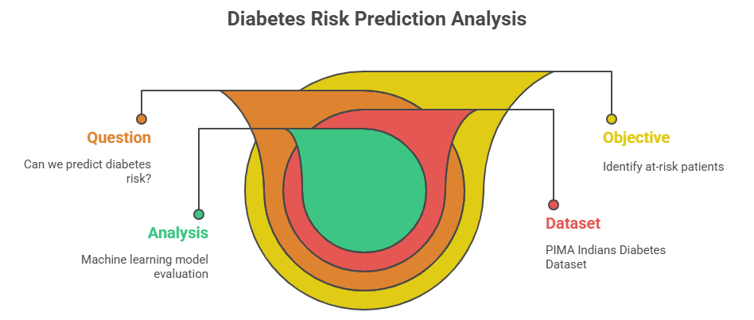
DIABETES RISK PREDICTION ANALYSIS
PIMA Indians Diabetes Dataset
Question: Can we accurately predict diabetes risk using medical features?
Objective: Build and evaluate machine learning models to identify at-risk patients

Slide 3
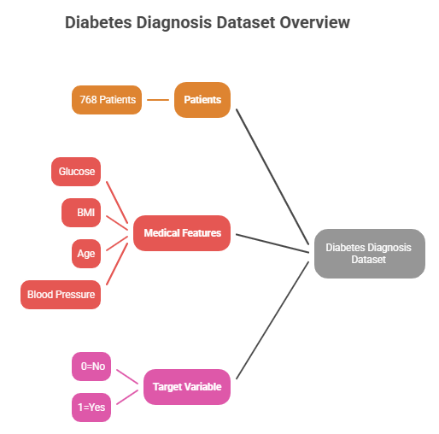
Project Overview
What We're Doing:
Analyze medical data from PIMA Indian population.
Clean and preprocess clinical measurements.
Build predictive models for diabetes risk.
Evaluate model performance for clinical use.
Dataset Details:
768 patients with 8 medical features.
Target: Diabetes diagnosis (0=No, 1=Yes)
Features: Glucose, BMI, Age, Blood Pressure, etc.

Slide 4
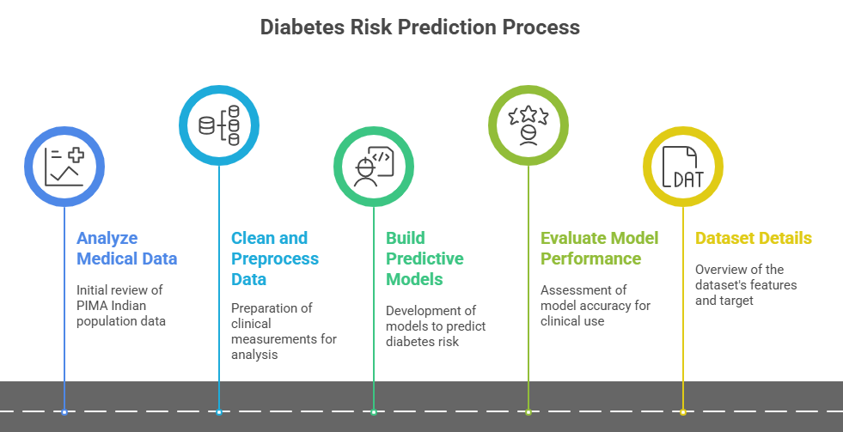
Project Overview

Slide 5
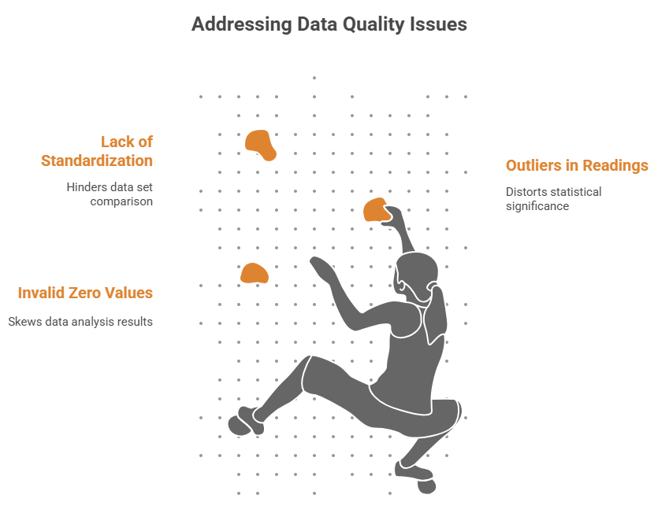
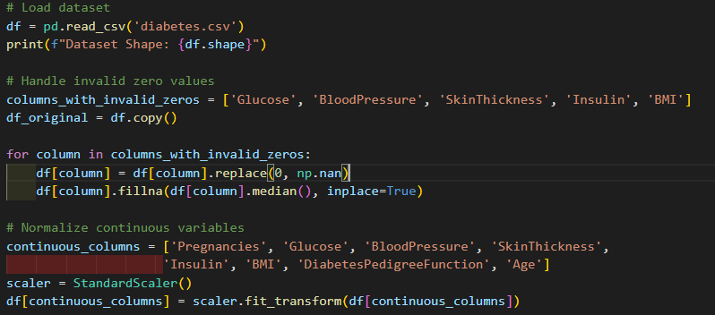
Data Loading & Preprocessing
Data Quality Issues Found:
Invalid zero values in medical measurements
Outliers in clinical readings
Need for standardization
Preprocessing Steps:
Handled invalid zeros, filled missing values, standardized features.

Slide 6
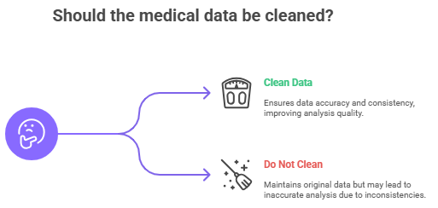
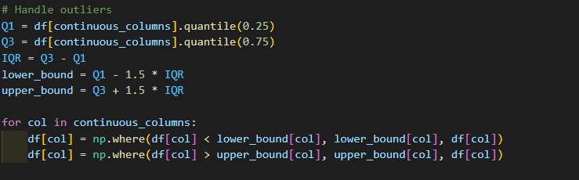
Data Cleaning Results
Before Cleaning:
Multiple zero values in key features
Inconsistent scales
Outliers
After Cleaning:
All values within clinical ranges
Standardized features (mean=0, std=1)
Outliers capped using IQR method

Slide 7

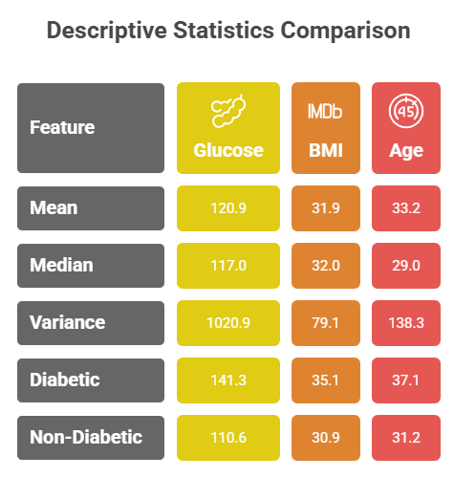
Descriptive Statistics
Key Insights:
Diabetic patients show higher average glucose, BMI, and age.
Sample Data:
Glucose: 120.9 mean
BMI: 31.9 mean
Age: 33.2 mean

Slide 8
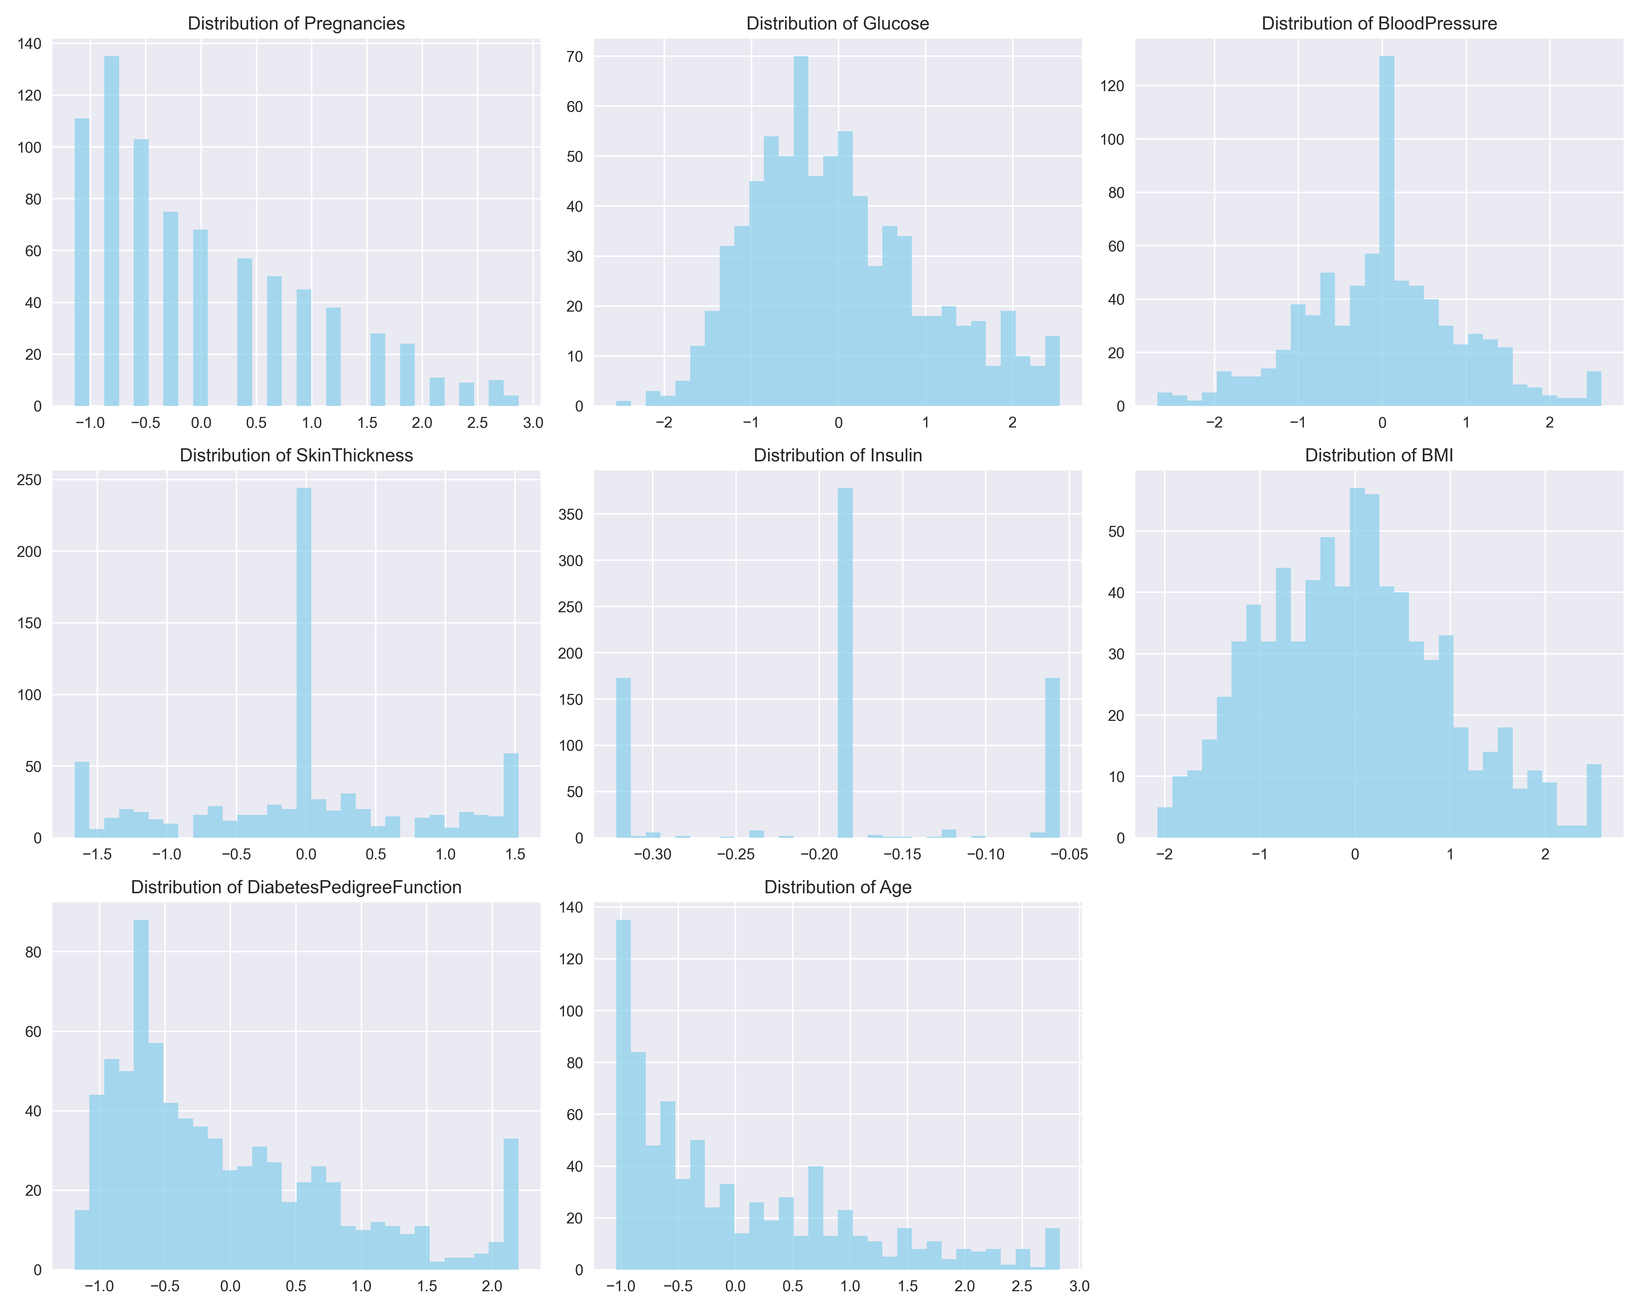
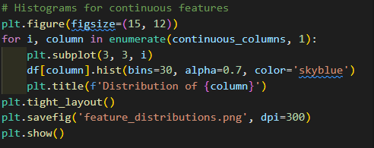
Feature Distributions
Observations:
Most features are approximately normal
Some right-skewed distributions (Insulin, DPF)
Age concentrated in younger adults

Slide 9
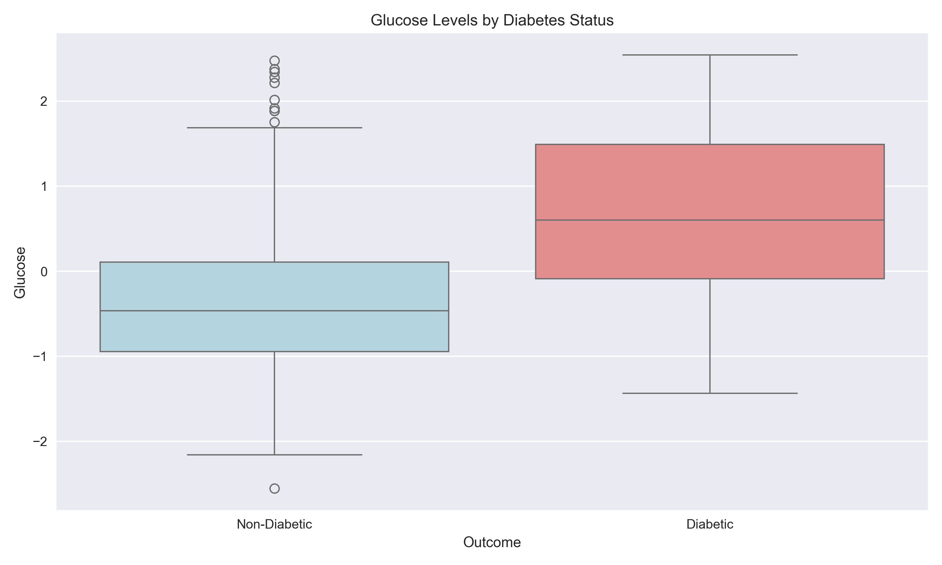
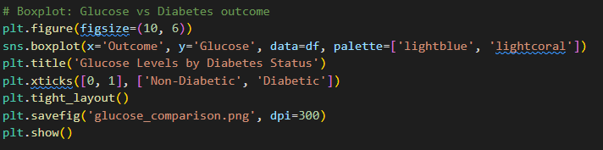
Glucose Comparison
Findings:
Clear separation in glucose levels between groups
Overlap shows glucose alone isn’t enough
Supports clinical knowledge

Slide 10
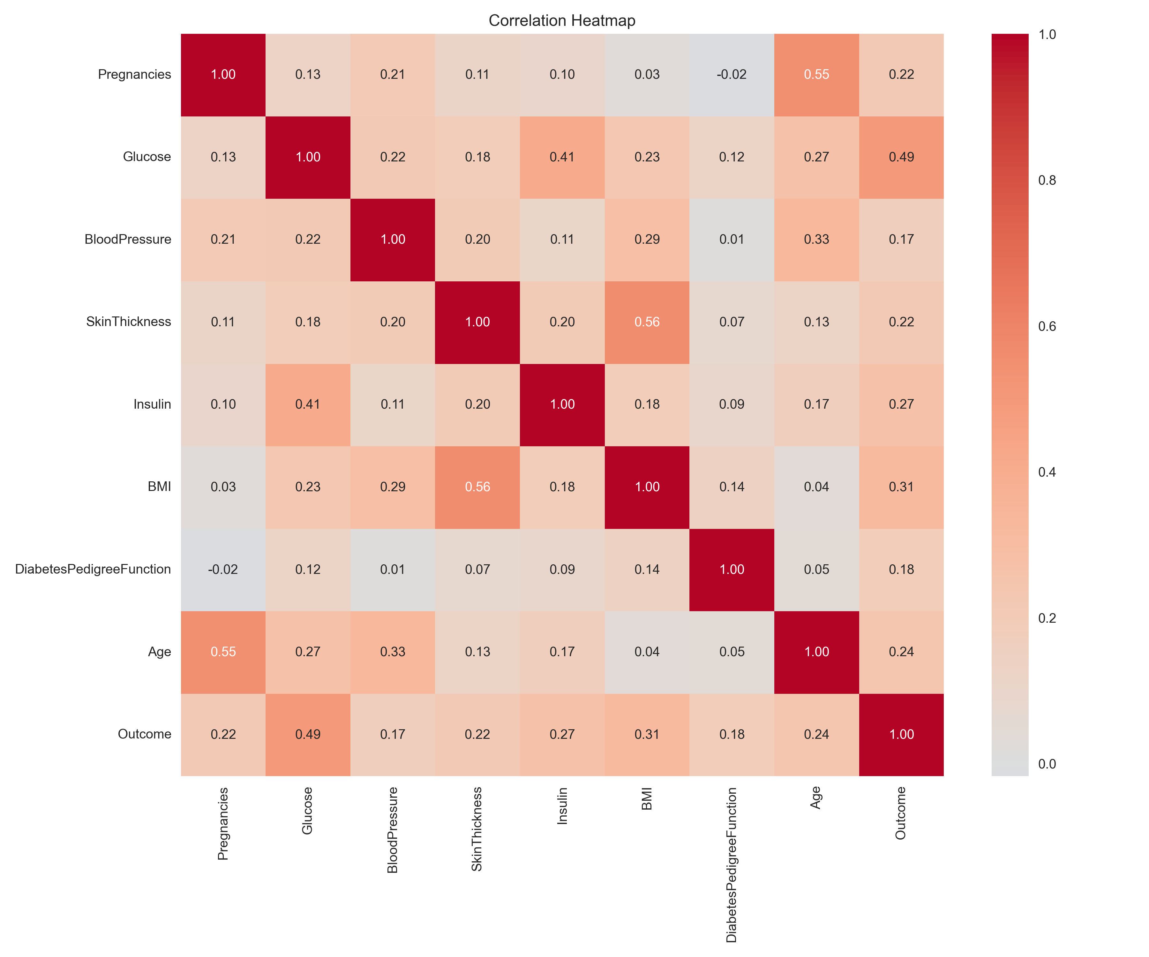
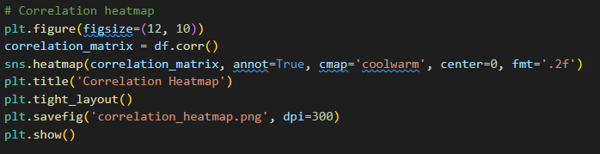
Correlation Analysis
Top Differences:
1. Glucose
2. BMI
3. Age
Strong Correlations:
Age & Pregnancies: r=0.55
Skin Thickness & BMI: r=0.56
Glucose & Outcome: r=0.49

Slide 11
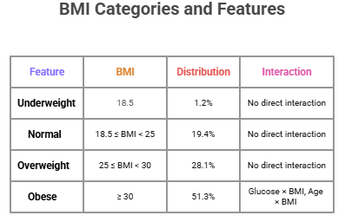
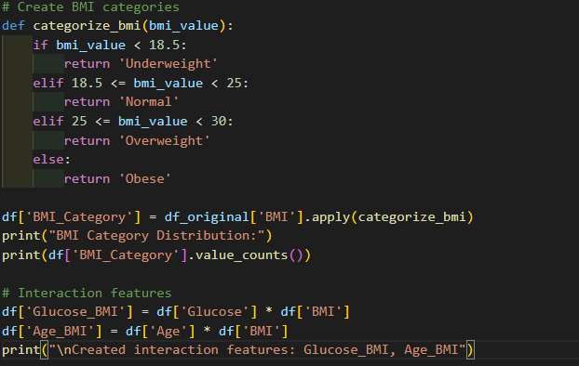
Feature Engineering

Slide 12
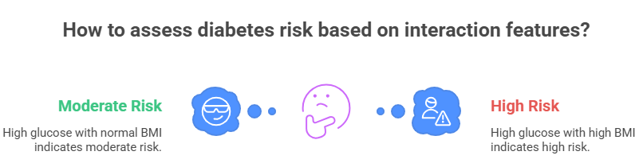
Why Interaction Features Help
Clinical Rationale:
Diabetes risk depends on factor combinations
High glucose with high BMI increases risk
Age modifies weight-related risk

Slide 13
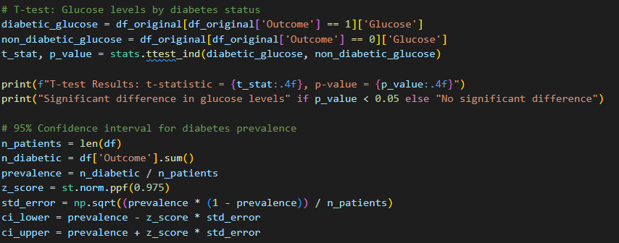
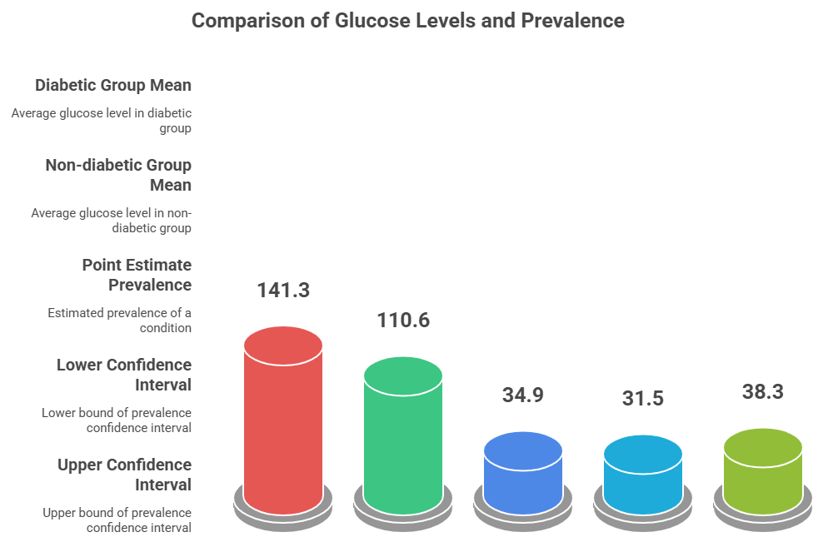
Statistical Inference

Slide 14
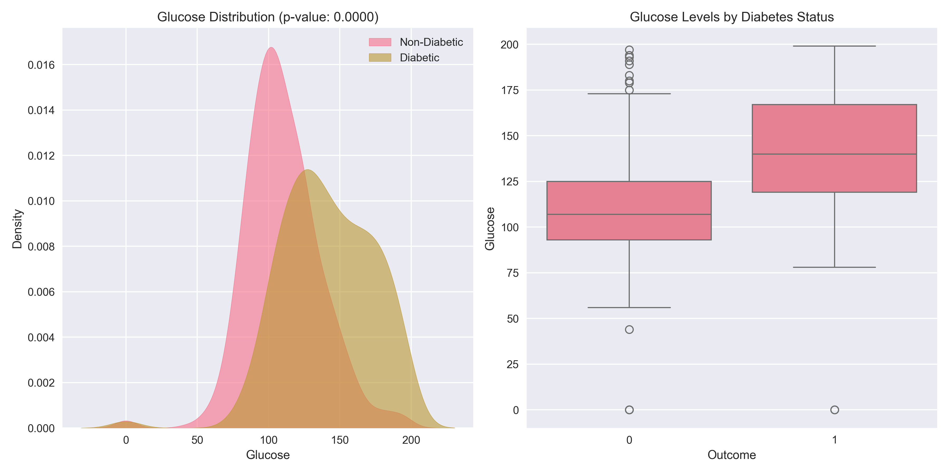
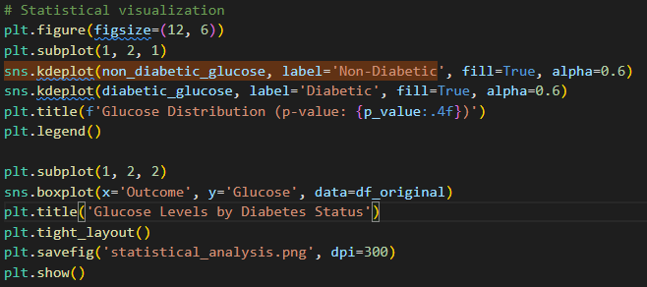
Statistical Visualization
Key Insights:
Clear separation in glucose distributions
Significance confirmed (p < 0.0001)
Supports multivariate modeling

Slide 15
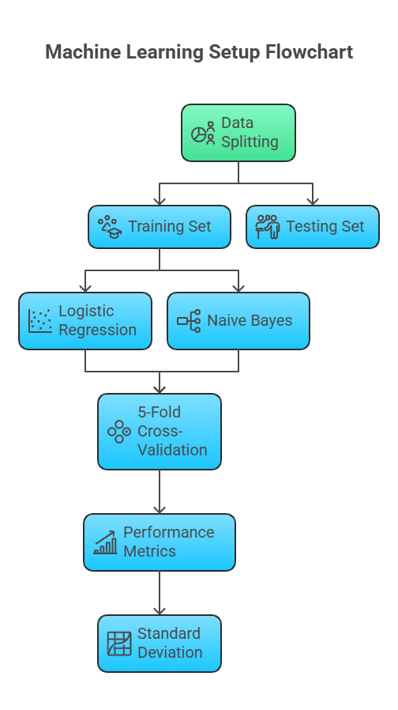
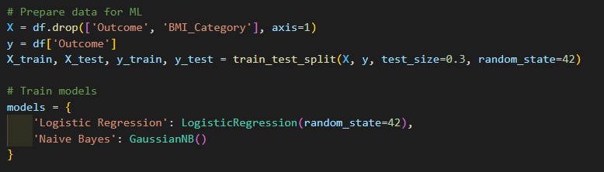
Machine Learning Setup
Data Split:
Train: 70%
Test: 30%
Models:
1. Logistic Regression
2. Naive Bayes
Evaluation:
5-fold CV, multiple metrics

Slide 16
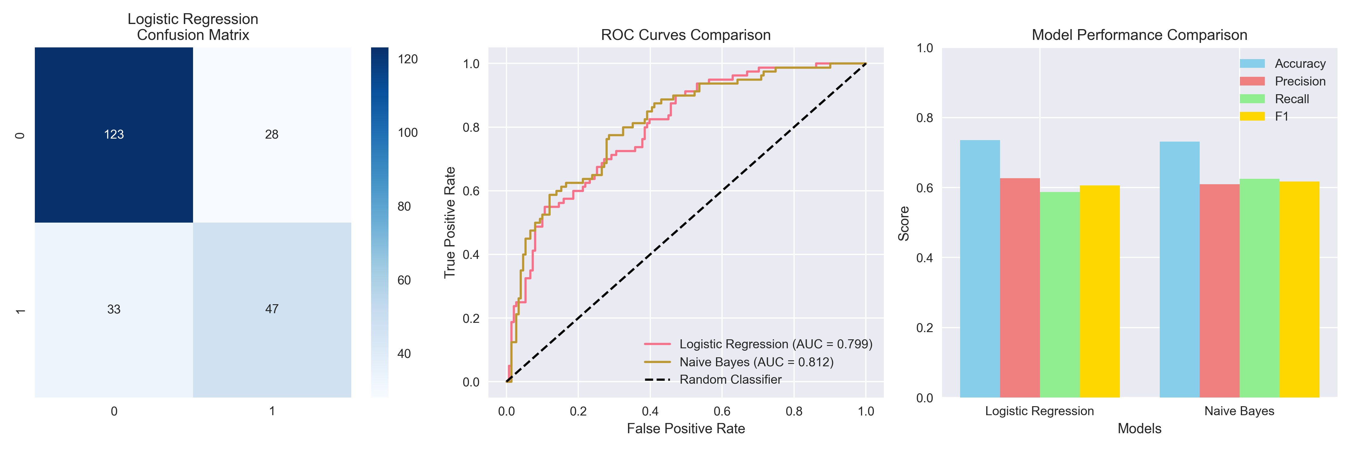
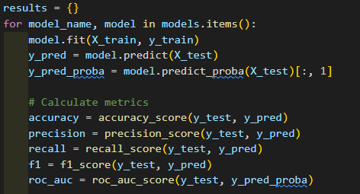
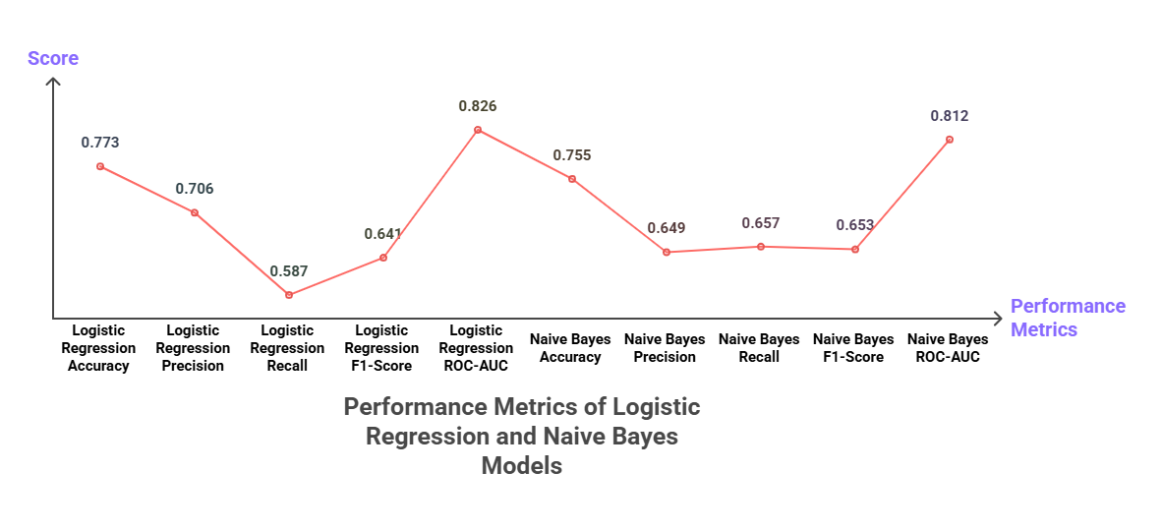
Model Evaluation Results
Performance:
Logistic Regression: Acc 0.77, AUC 0.83
Naive Bayes: Acc 0.75, AUC 0.81

Slide 17
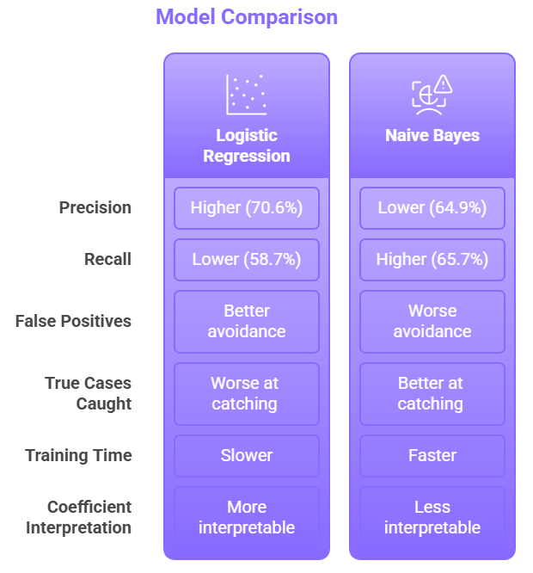
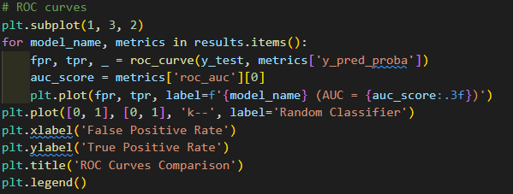
Model Comparison
Logistic Regression:
Higher precision
More interpretable
Naive Bayes:
Higher recall
Faster training
Trade-off:
Recall vs Precision

Slide 18
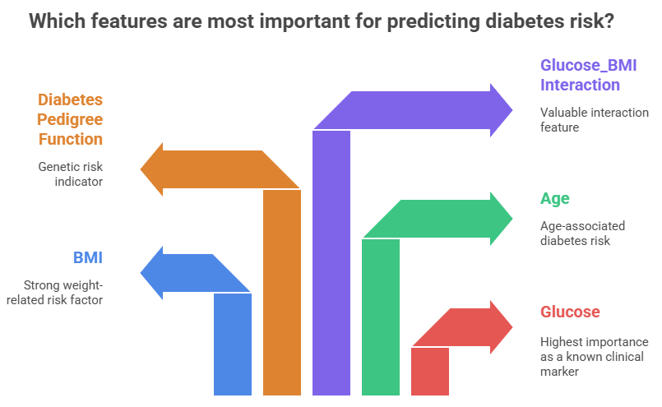

Slide 19
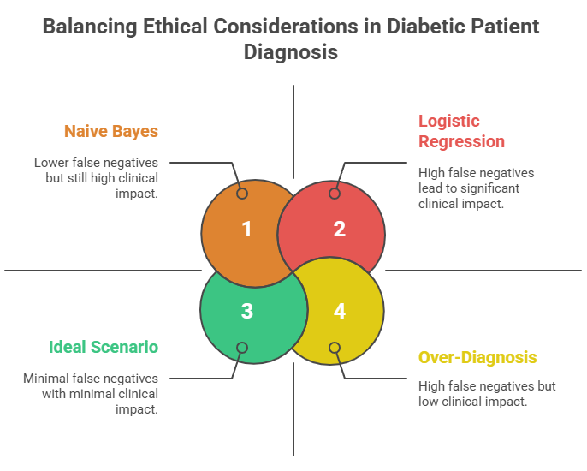

Slide 20
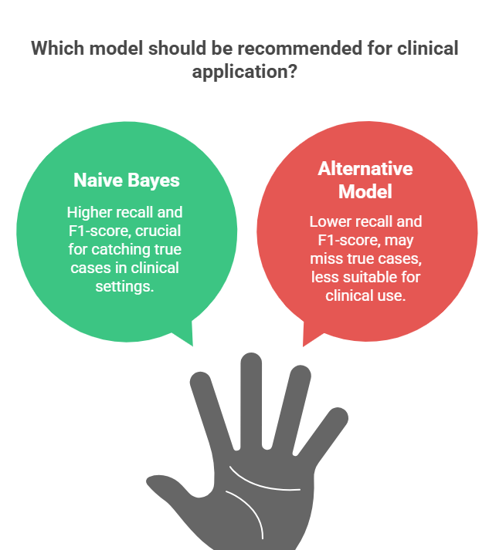
Recommended:
Naive Bayes
Reasons:
Higher recall (65.7%)
Better F1-score (0.653)
Suitable for screening
Clinical Use:
Identify at-risk patients
Not diagnostic alone

Slide 21
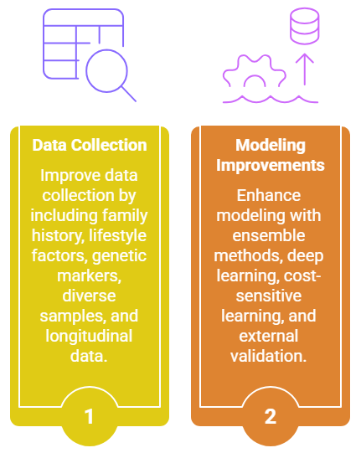
Improvement Suggestions
Data Collection Improvements:
Family history of diabetes
Lifestyle factors (diet, exercise, smoking)
Genetic markers
More diverse population samples
Longitudinal data over time
Modeling Improvements:
Ensemble methods (Random Forest, Gradient Boosting)
Deep learning for complex patterns
Cost-sensitive learning to reduce false negatives
External validation on different populations

Slide 22
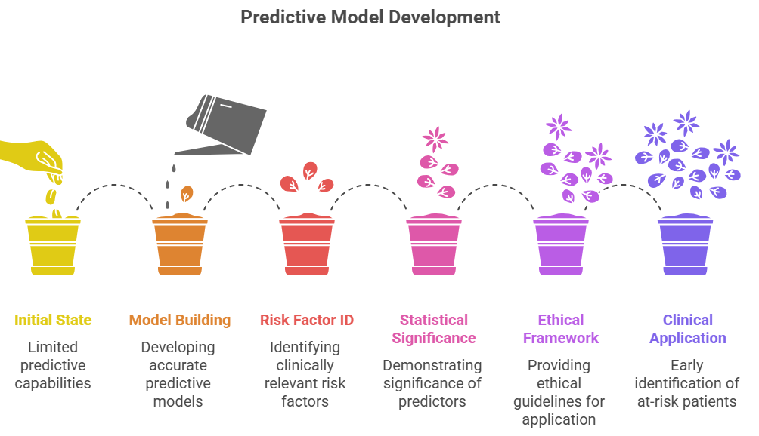
Key Achievements:
Models with 75–77% accuracy, Identified risk factors, and Ethical and clinical context.
Future Work:
Broader validation and Real-time screening tools.

