Slide 1
Project 1 - Data Scientist Job Market (US)
Team R2-D2:
Simon, Davis, Olubmni, Phine

Slide 2
Organziational to dos:
Initial meeting to check how to proceed
Create a repo on GitHub
Create a jupyter notebook
What wrangling steps we want to do on each column - done 3.1 Define the key words we want to extract from description - done 3.2 Find Regexs for it
What insights we want to gather (e.g. company vs locations) - done 4.1 How we want to present it (which plots to use) - done
Regroup on Monday: present individual ideas + decide on game plan
Work on first challenge together
Split next tasks up to work on individual with set time limit
Get back together present individual work and combine
Discuss issues adhoc together

Slide 3
EDA to dos:
Steps
standardize column headers
check null values (how many are there, etc)
can we replace them
can we drop them
standardize column 'positions'
find unique values
harmonize them
standardize column 'company'
check for same description just wirtten differently/ typos
correct them
standardize column 'location'
split up into new columns (State, etc.)
extract words from column 'desrciption'
use boolean columns with True or False

Slide 4
Key words to look for in description
Languages:
Python
C
C ++
R
Perl
Java
Degrees:
Bachelor / BA /BS
Master /MA
Seniotiry Level:
Junior
Senior
Tools:
Tableau/QlikSense, PoerBI, Looker
Skills:
Big Data
structured /un strcutured data
discover pattern
model / modeling
advanced analystics
5+ years of Predictive Analytics
Statistical Modeling
Machine Learning
Programms:
Hadoop, Oracle, SQL
Business Functions:
Sales, Marketing, Supply Chain, Manufacturing
We decided to focus on 3 Key word: languages, degrees and seniority level to not overwhelm the to dos

Slide 5
Column headers & Null Values
standardize column headers → already ok
check null values (how many are there, etc)
# it seems like in all object columns there are 11 NaN values each
# i would assume this is the same 11 rows for all columns
# this might indicate that we could drop those rows as they seem to be empty anyway
# in reviews we have 1638 NaNs, which is 24% of the whole rows in the reviews column
# i would suggest NOT to drop those rows, but to replace the NaNs with 0

Slide 6
Standardize column 'positions'
standardize column 'positions'
# add new column called 'positions_clean'
# take davis list and extract the clean names from positions to 'positions_clean'
# do value count per position
# take top 3 and take this for correlcations standardize column 'company'

Slide 7
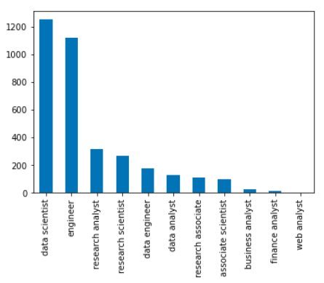
Insights 'positions'
We can see that the most frequent
Job position is “data scientist”.
Followed by “engineer”, which we
Will disregard as its too unspecific.
Top 2 and 3 are approx 4x less repre-
Sented than the top 1 position.
Data Scientist
Research Analyst
Research Scientist

Slide 8
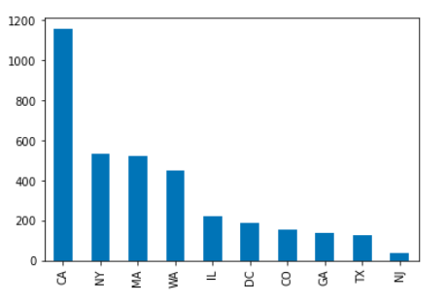
Insights 'location'
standardize column 'location'
split up into new columns ‘state’
We can see that the most job positions
are being posted in CA with nearly
double the amount as the following
Top 2 and 3.
CA
NY
MA

Slide 9
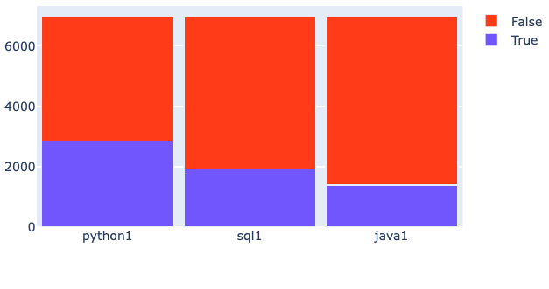
Insights from 'description’ - Languages
We can see that python is the most requested of the 3 programming languages.
Python
SQL
Java

Slide 10
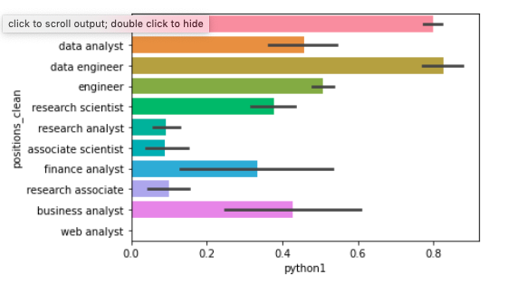
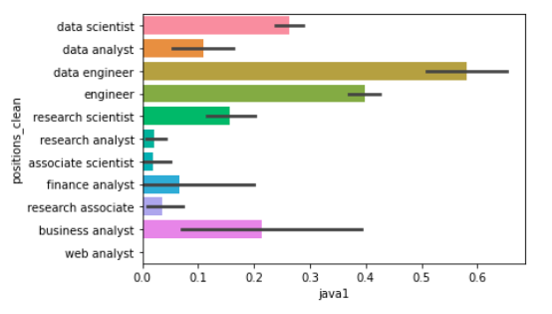
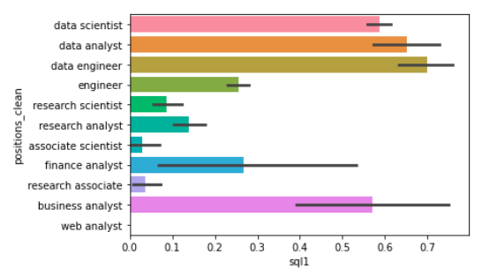
Relation Languages to Positions
We can see the position of a data engineer
requires most of the programming languages.

Slide 11
Python
Python is mostly required by
1. Data engineers
2. Data scientist
3. Engineer (disregard)
3. Data analyst

Slide 12
SQL
SQL is mostly required by
1. Data engineers
2. Data analyst
3. Data scientist

Slide 13
Java
Java is mostly required by
1. Data engineers
2. Engineer (disregard)
2. Data scientist
3. Business analyst

Slide 14
Challenges and how we tackled them
The non-standardised nature of the raw data
The data has a large amount of non-structured information. It is not possible to see at a glance how best to categorise this. A thorough investigation of the full potential of the data would require a lengthy and sophisticated analysis. We decided that given the time restraints it was best to concentrate on just a handful of easily identifiable categories and work with them.
Teamwork in a time pressured environment with new colleagues
The team had not worked together before and we were under pressure to deliver a fist analysis in half a day. Despite this the team worked well together, setting clear time slots for private work and then coming back together to review, as well as successfully working together to solve problems.
Working together on one live document
The team were all writing code on the same data set and with the same starting Jupyter Notebook file. The question was how best to collaborate on this document and pull the work together. We did consider trying to work on one python document at the same time, but abandoned this approach as we were unsure of the technology and through it might cost us time. In the end one team member took responsibility for the main document and other members sent their code snippets to include over slack. This worked, but there was an issue where we were getting different results from the data across the systems.
Displaying the data effectively
The nature of the data required charts based on of categories as well as integers. It was well suited to many types of chart that the team had little experience in working with. This was a harder challenge than we had anticipated and while we produced some basic displays, we did not get the correlations well displayed within the time-limits set.

