Slide 1
Project 1 - Data Scientist Job Market (US)
Team R2-D2:
Simon, Davis, Olubmni, Phine

Slide 2
Organziational to dos:
Initial meeting to check how to proceed
Create a repo on GitHub
Create a jupyter notebook
What wrangling steps we want to do on each column - done 3.1 Define the key words we want to extract from description - done 3.2 Find Regexs for it
What insights we want to gather (e.g. company vs locations) - done 4.1 How we want to present it (which plots to use) - done

Slide 3
EDA to dos:
Steps
standardize column headers
check null values (how many are there, etc)
can we replace them
can we drop them
standardize column 'positions'
find unique values
harmonize them
standardize column 'company'
check for same description just wirtten differently/ typos
correct them
standardize column 'location'
split up into new columns (State, etc.)
extract words from column 'desrciption'
use boolean columns with True or False

Slide 4
Key words to look for in description
Languages:
Python
C
C ++
R
Perl
Java
Degrees:
Bachelor / BA /BS
Master /MA
Seniotiry Level:
Junior
Senior
Tools:
Tableau/QlikSense, PoerBI, Looker
Skills:
Big Data
structured /un strcutured data
discover pattern
model / modeling
advanced analystics
5+ years of Predictive Analytics
Statistical Modeling
Machine Learning
Programms:
Hadoop, Oracle, SQL
Business Functions:
Sales, Marketing, Supply Chain, Manufacturing
We decided to focus on 3 Key word: languages, degrees and seniority level to not overwhelm the to dos

Slide 5
Column headers & Null Values
standardize column headers → already ok
check null values (how many are there, etc)
# it seems like in all object columns there are 11 NaN values each
# i would assume this is the same 11 rows for all columns
# this might indicate that we could drop those rows as they seem to be empty anyway
# in reviews we have 1638 NaNs, which is 24% of the whole rows in the reviews column
# i would suggest NOT to drop those rows, but to replace the NaNs with 0

Slide 6
Standardize column 'positions'
standardize column 'positions'
# add new column called 'positions_clean'
# take davis list and extract the clean names from positions to 'positions_clean'
# do value count per position
# take top 3 and take this for correlcations standardize column 'company'

Slide 7
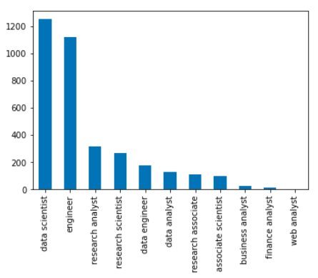
Insights 'positions'
We can see that the most frequent
Job position is “data scientist”.
Followed by “engineer”, which we
Will disregard as its too unspecific.
Top 2 and 3 are approx 4x less repre-
Sented than the top 1 position.
Data Scientist
Research Analyst
Research Scientist

Slide 8
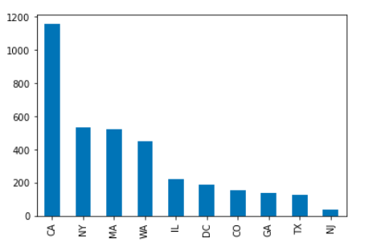
Insights 'location'
standardize column 'location'
split up into new columns ‘state’
We can see that the most job positions
are being posted in CA with nearly
double the amount as the following
Top 2 and 3.
CA
NY
MA

Slide 9
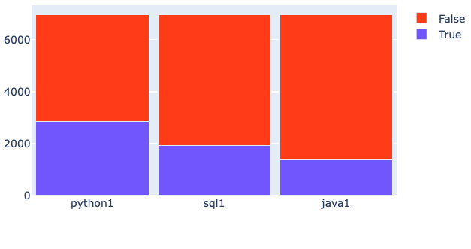
Insights from 'description’ - Languages
We can see that python is the most requested of the 3 programming languages.
Python
SQL
Java

Slide 10
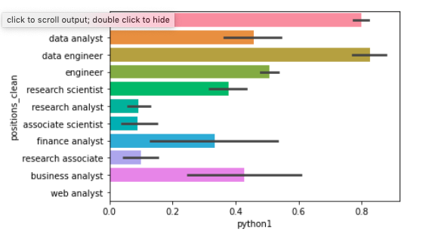
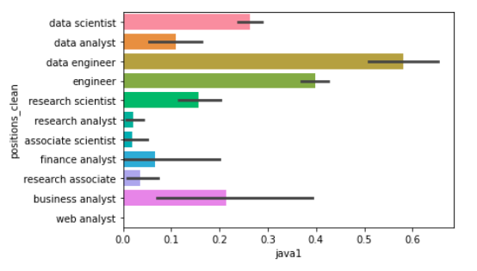
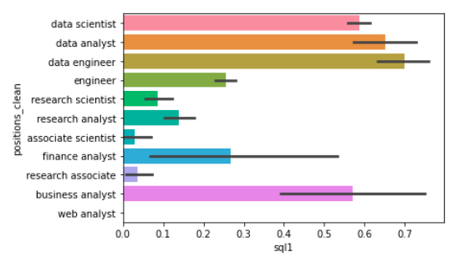
Relation Languages to Positions
We can see the position of a data engineer
requires most of the programming languages.

Slide 11
Python
Python is mostly required by
1. Data engineers
2. Data scientist
3. Engineer (disregard)
3. Data analyst

Slide 12
SQL
SQL is mostly required by
1. Data engineers
2. Data analyst
3. Data scientist

Slide 13
Java
Java is mostly required by
1. Data engineers
2. Engineer (disregard)
2. Data scientist
3. Business analyst

Slide 16
Struggels
Not planning enough time for the plotting
Having different data despite using the same code

