Slide 1

Data Scientist Job Market (US)
Team R2-D2:
Simon, Davis, Olubunmi, Phine

Slide 2
Organizational to dos
What data to use
What cleaning and wrangling steps we want to do on each column
What insights we want to gather
Regroup on Monday: present individual ideas + decide on game plan

Slide 3
EDA to dos
1. Cleaning Data
standardize column headers
check null values (how many are there, etc)
2. Wrangling Data
standardize column 'positions’
standardize column 'company'
standardize column 'location’
extract words from column ‘description’
Languages, seniority level, education
3. Visualization of Insights
Notes:
1. Cleaning Data
2. Wrangling Data
standardize column 'positions’
- Define list of job positions we want to look at
- Extract them into new column & harmonize
standardize column 'company’
- check for same description just written differently/ typos & correct them
standardize column 'location’
- Extract State in new column
extract words from column ‘description’
- Languages, seniority level, education
3. Visualization of Insights
with mathplotlip and seaborn

Slide 4
Key words to look for in description
Languages:
Python
C
C ++
R
Perl
Java
Degrees:
Bachelor / BA /BS
Master /MA
Seniority Level:
Junior
Senior
Tools:
Tableau/QlikSense, PowerBI, Looker
Skills:
Big Data
structured /un structured data
discover pattern
model / modelling
advanced analytics
5+ years of Predictive Analytics
Statistical Modelling
Machine Learning
Programs:
Hadoop, Oracle, SQL
Business Functions:
Sales, Marketing, Supply Chain, Manufacturing
We decided to focus on 3 Key word: languages, degrees and seniority level to not overwhelm the to dos

Slide 5
Column headers & Null Values
standardize column headers → already ok
check null values (how many are there, etc)
# it seems like in all object columns there are 11 NaN values each
# i would assume this is the same 11 rows for all columns
# this might indicate that we could drop those rows as they seem to be empty anyway
# in reviews we have 1638 NaNs, which is 24% of the whole rows in the reviews column
# i would suggest NOT to drop those rows, but to replace the NaNs with 0

Slide 6
Standardize column 'positions'
standardize column 'positions'
# add new column called 'positions_clean'
# take davis list and extract the clean names from positions to 'positions_clean'
# do value count per position
# take top 3 and take this for correlcations standardize column 'company'

Slide 7
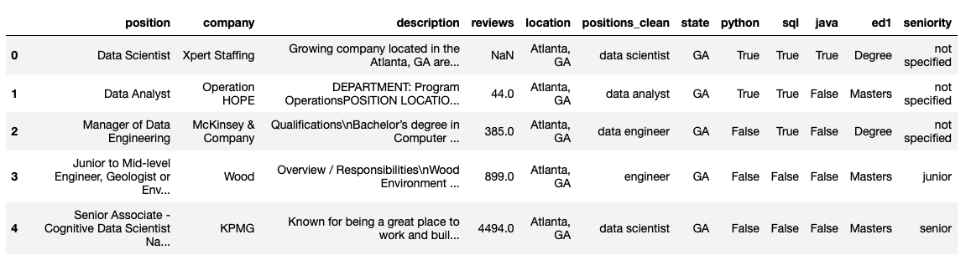
Final table we used for visualization
We dropped the entries which did not in the following list:
positions = ['research scientist', 'data scientist', 'data analyst’, 'data engineer’, 'business analyst’, 'research analyst’, 'web analyst’, 'finance analyst’, 'research associate’, 'associate scientist', 'data analyst', 'engineer']

Slide 8
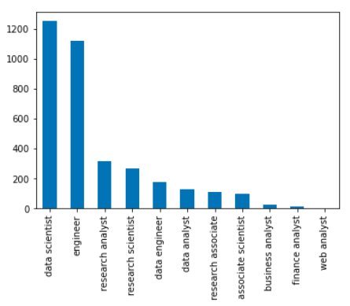
Insights 'positions'
We can see that the most frequent
job position is data scientist.
Followed by engineer, which we
will disregard as its too unspecific.
Top 2 and 3 are approx 4x less repre-
sented than the top 1 position.
Data Scientist
Research Analyst
Research Scientist

Slide 9
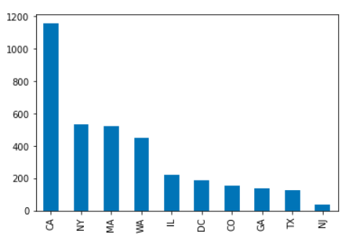
Insights 'location'
We can see that the most job positions
are being posted in CA with nearly
double the amount as the following
Top 2 and 3.
CA
NY
MA

Slide 10
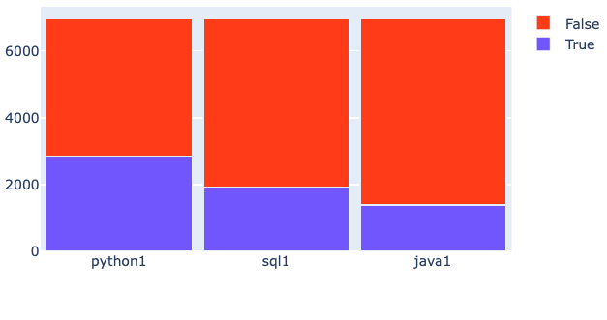
Insights from 'description’ - Languages
We can see that python is the most requested of the 3 programming languages.
Python
SQL
Java

Slide 11
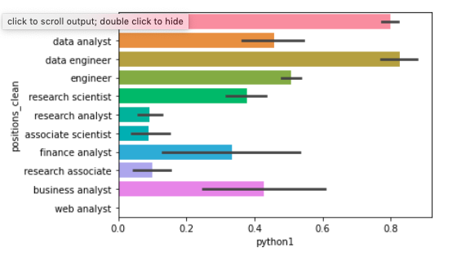
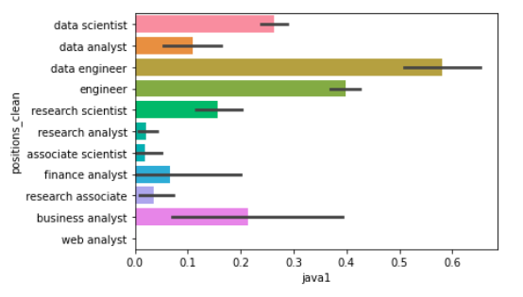
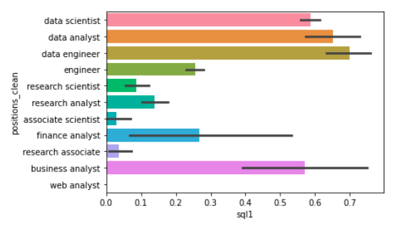
Insights from 'description’ - Languages
We can see the position of a
data engineer requires most of
the programming languages.

Slide 12
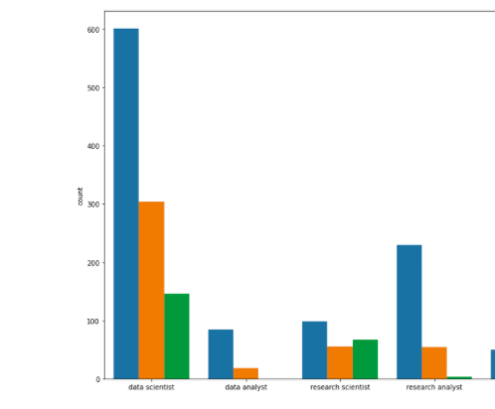
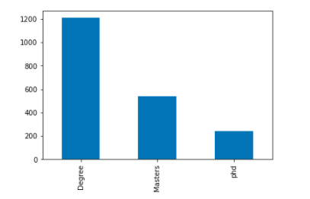
Insights from 'description’ - Education
Nearly all job openings required a degree of some sort. The majority only required a degree, but nearly half specified a masters as a requirement. A much smaller but substantial minority requested PHD level education as required or desirable.

Slide 13
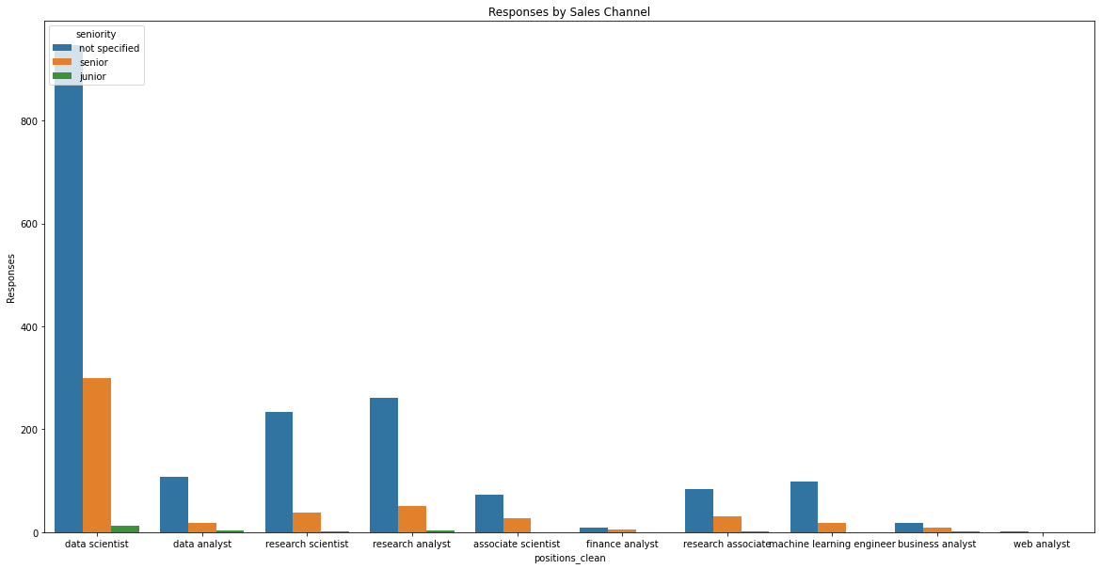
Insights from 'description’ - Seniority
Most of the positions advertised do not indicate specific seniority level. It can be assumed, therefore, that these are mid-level positions. The 2nd most required seniority level is senior. There is very little need for junior level positions.

Slide 14
Python
Python is mostly required by
1. Data engineers
2. Data scientist
3. Engineer (disregard)
3. Data analyst

Slide 15
SQL
SQL is mostly required by
1. Data engineers
2. Data analyst
3. Data scientist

Slide 16
Java
Java is mostly required by
1. Data engineers
2. Engineer (disregard)
2. Data scientist
3. Business analyst

Slide 17
Who gets hired?
Positions: Most requested postions are Data Scientist, Research Analyst, Research Scientist
States: The most positions are to find in CA, NY, MA.
Languages: You most likely need to know Python. SQL and Java are a nice to have as well.
Education: majority only required a degree, but nearly half specified a masters as a requirement. A much smaller but substantial minority requested PHD level education as required or desirable.
Seniority: Most of the positions advertised do not indicate specific seniority level. It can be assumed, therefore, that these are mid-level positions. The 2nd most required seniority level is senior. There is very little need for junior level positions.

Slide 18
Who gets hired?
Positions
Most requested postions are Data Scientist, Research Analyst, Research Scientist
States
The most positions are to find in CA, NY, MA.
Languages
You most likely need to know Python. SQL and Java are a nice to have as well.
Education
Majority only required a bachelor degree
Seniority
mid-level positions

Slide 19
Challenges and how we tackled them
The non-standardised nature of the raw data
Teamwork in a time pressured environment with new colleagues
Working together on one live document
Displaying the data effectively
Notes:
The non-standardised nature of the raw data
The data has a large amount of non-structured information. It is not possible to see at a glance how best to categorise this. A thorough investigation of the full potential of the data would require a lengthy and sophisticated analysis. We decided that given the time restraints it was best to concentrate on just a handful of easily identifiable categories and work with them.
Teamwork in a time pressured environment with new colleagues
The team had not worked together before and we were under pressure to deliver a fist analysis in half a day. Despite this the team worked well together, setting clear time slots for private work and then coming back together to review, as well as successfully working together to solve problems.
Working together on one live document
The team were all writing code on the same data set and with the same starting Jupyter Notebook file. The question was how best to collaborate on this document and pull the work together. We did consider trying to work on one python document at the same time, but abandoned this approach as we were unsure of the technology and through it might cost us time. In the end one team member took responsibility for the main document and other members sent their code snippets to include over slack. This worked, but there was an issue where we were getting different results from the data across the systems.
Displaying the data effectively
The nature of the data required charts based on of categories as well as integers. It was well suited to many types of chart that the team had little experience in working with. This was a harder challenge than we had anticipated and while we produced some basic displays, we did not get the correlations well displayed within the time-limits set.

Slide 20
Feedback/ Questions?

