Slide 1
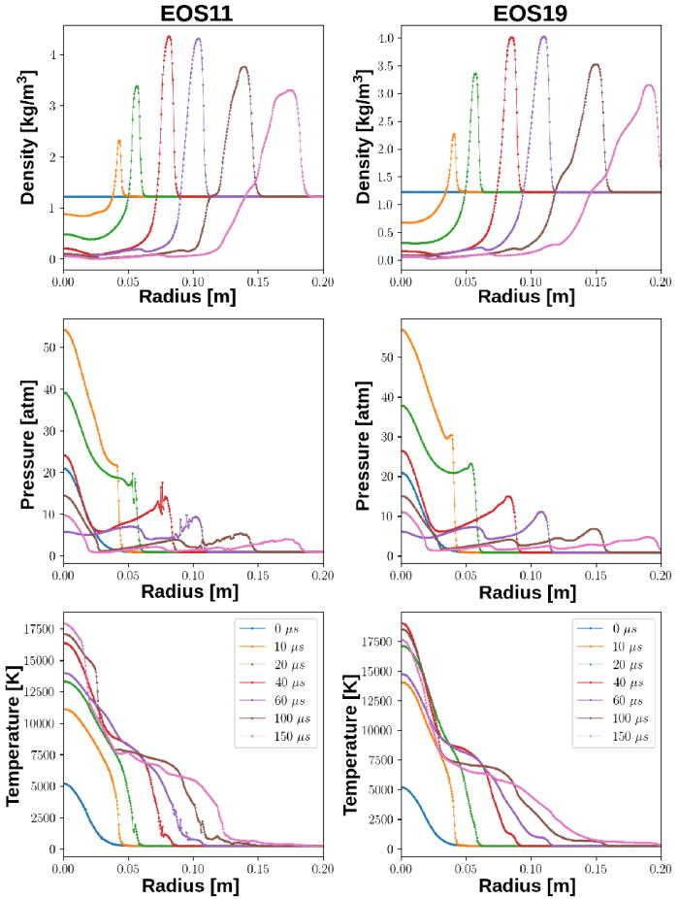
From: An improved equation of state for air plasma simulations
^{Date of Download: 8/15/2025}
Copyright © 2025 . All rights reserved.
Notes:
Figure Legend: Radial profiles (N = 500) for a component V current (see Table I) for EOS11 (left) and the new EOS19 (right) at various times (the legend applies to all variables). In both cases, the results qualitatively agree; however, the oscillations visible at about 2000 K in the EOS11 results do not appear when using EOS19.

