Slide 1

Research on Factors that lead to Employee Attrition.
Presented By: Team Tenet
WAMBUI NJOROGE
MERCY CHERUIYOT - Group Leader
JOSEPH NYINGI

Slide 2
Introduction
People are the lifeblood of an organization. Companies need employees who are fit to do their work.
But there’s a reality that every organization, big or small, has to face: movement within the workforce and teams is inevitable. Employees come, and employees go.
Employee attrition refers to employees’ loss through a natural process, such as retirement, resignation, elimination of a position, personal health, or other similar reasons.

Slide 3
Problem Statement
Employee attrition is a point of concern to the HR department in many organizations due to loss of skilled and learned employees.
From the employee attrition dataset by IBM Data Scientists, an observation was made that most employees that got attritioned were employees with bachelor's degrees and master's degrees ,they fall in the bracket of the learned employees.
Having Monthly Incomes as one of the factors that led to attrition, Team Tenet carried out a research to look into how the masters and bachelors employees were being compensated.
Notes:
The major factor in negative attrition is cost associated in the process of losing and replacing an employee. On a more positive note, if the new employee is more qualified, capable, and productive than his predecessor, the change is positive.

Slide 4
Business Objectives
To determine the monthly income means for attritioned employees with different education levels.
To establish the education level that had the most attritioned employees.
To determine the monthly income earned by gender of attritioned employees.

Slide 5
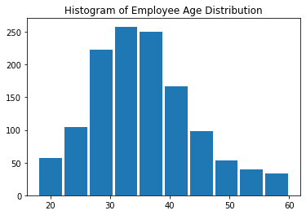
Analysis
Univariate
The age distribution of the employees ranges between 30 and 40 years

Slide 6
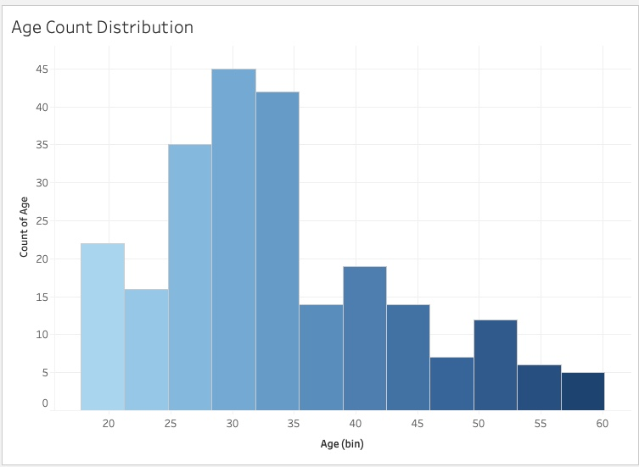
Ages of Attritioned Employees.
The age distribution of most attritioned employees range between 25 and 35 years.

Slide 7
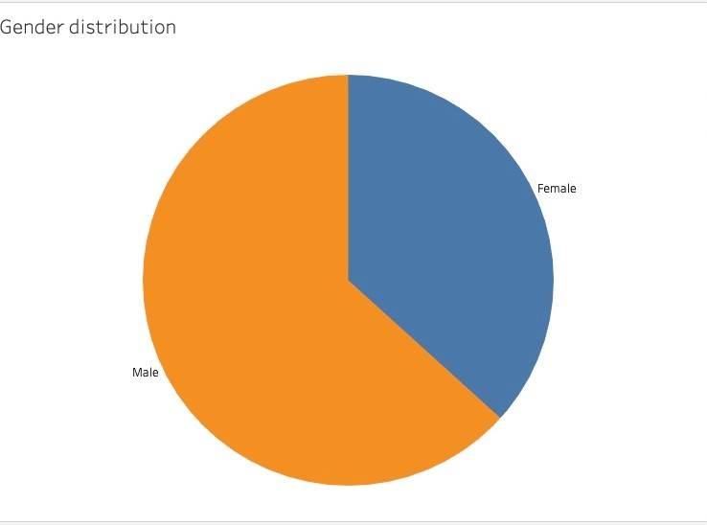
Gender Distribution.
Males constitute to the biggest number of employees.

Slide 8
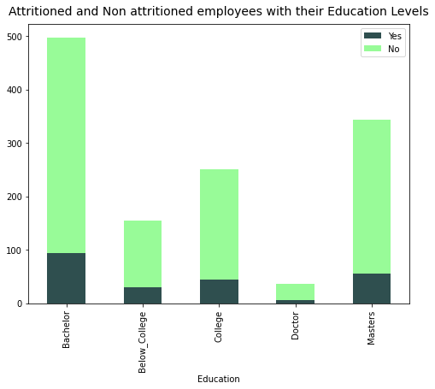
Bivariate Analysis
1. Distribution of employees and their education levels.
Bachelors had the number of employees with doctorate taking the least.

Slide 9
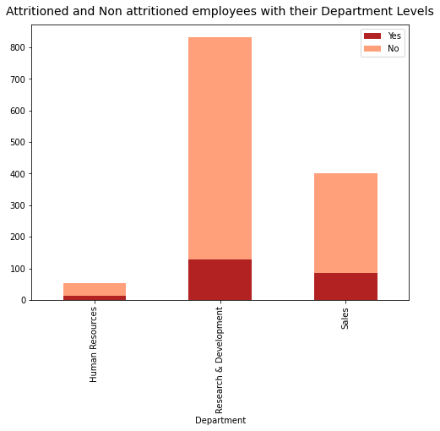
2. Employee Distribution within different Departments.
Research and Development has the most number of employees and equally a big number of those that get attritioned.

Slide 10
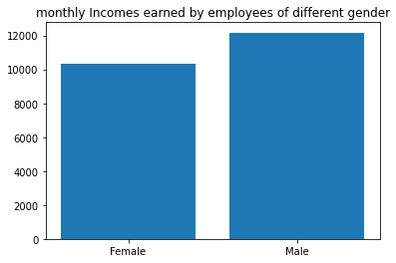
3. Means of Incomes of Employees per Gender.
Male employees earned more than the female employees.

Slide 11
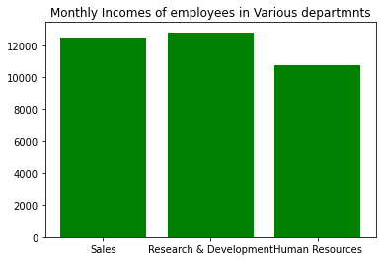
4. Means of Incomes of Employees within different Departments.
The Research and Development Department Employees earned the highest income.

Slide 12
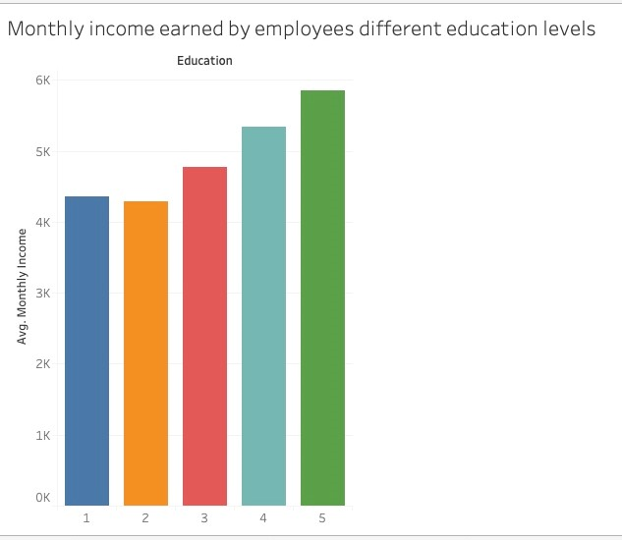
5. Means of Monthly Incomes of Employees with different Education Levels
Highest sum of Income means were observed among employees with a doctors followed by masters.

Slide 13
Hypothesis
Null Hypothesis
H0: There is a difference between monthly incomes made by attritioned employees with a master’s degree and those with a bachelor's degree.
Alternate Hypothesis
H1: There is no difference between monthly incomes made by attritioned employees with a master’s degree and those with a bachelor's degree.

Slide 14
Sampling Approach
The sampling technique we used is a systematic random sampling.
Systematic Random sampling is a sampling technique where samples are chosen at regular intervals of a population.
Why for this study?
Because of its simplicity, and can be viewed as superior because it improves the potential for the sample units to be more evenly spread over the population.

Slide 15
Hypothesis Testing
Used a two-sample z-test and p-value to either accept or reject our null hypothesis to perform hypothesis testing.
Why z-test:
• Data points are independent of each other.
• The sample size is greater than 30.
Samples
Bachelors n = 150, masters n -150
Z_statistics = 51.82
P_value = 1.0

Slide 16
P_value is greater than 0.05 hence we fail to reject the null hypothesis.
This confirms the claim that monthly incomes of attritioned employees with a masters degree were different from those with a bachelor’s degree.

Slide 17
Recommendation.
Companies should ensure that employee compensation and benefits is current for employees at all education levels.
Companies should also ensure there are more opportunities for growth and development.

Slide 18
Thank You for Listening!!!!

