Slide 1


ENERGY EFFICIENCY
ACHARYA INSTITUTE OF GRADUATE STUDIES
1]JOSEPH RAIJU
2]JUSTIN GEOGI CHACKO
3]CHETHAN KUMAR
4]GIRISH Y

Slide 2
Problem Statement
Brief Overview:
Modern buildings consume a significant amount of energy due to inefficient heating and cooling systems. Traditional methods fail to optimize energy usage, leading to excessive costs and environmental impact. This case study explores how AI-based models can predict and optimize energy consumption in buildings.
Key Objectives:-
Identify key factors affecting heating and cooling loads in buildings.
Develop a machine learning model to predict energy usage based on building attributes.
Improve energy efficiency and reduce operational costs.
Demonstrate the role of AI in sustainable energy management.

Slide 3
Dataset Overview(Optional)
Dataset Description:-
The dataset used in this case study is the Energy Efficiency Dataset, available on Kaggle. It contains 768 data points and includes key building features that impact heating and cooling loads.
Source: Kaggle - Energy Efficiency Dataset
Size: 768 records
Key Features:-
Building Attributes: Surface area, wall area, roof area, height, relative compactness
Design Factors: Orientation, glazing area, glazing area distribution
Target Variables: Heating load, Cooling load
This dataset is used to train machine learning models to predict energy consumption based on building characteristics.)

Slide 4
Methodology
Approach:-
Data collection from the Energy Efficiency dataset.
Data preprocessing, including handling missing values and scaling.
Feature selection to identify key factors affecting heating and cooling loads.
Model training using Random Forest Regressor.
Evaluation using Mean Absolute Error (MAE) and Root Mean Squared Error (RMSE)
Algorithms Used:-
Random Forest Regression: Chosen for its ability to handle non-linear relationships and provide accurate predictions.
Standardization (Scaling): Applied to normalize data and improve model efficiency.

Slide 5

Conclusion
Summary:-
The study demonstrated how AI can optimize heating and cooling loads in large buildings.
The Random Forest Regressor model provided accurate predictions, improving energy efficiency.
Results show that AI-driven energy management reduces costs and carbon footprint.
Future Work:-
Integrate real-time occupancy and weather data for better accuracy.
Develop an automated energy management system based on AI predictions.
Expand the study to different building types for broader applicability.

Slide 6
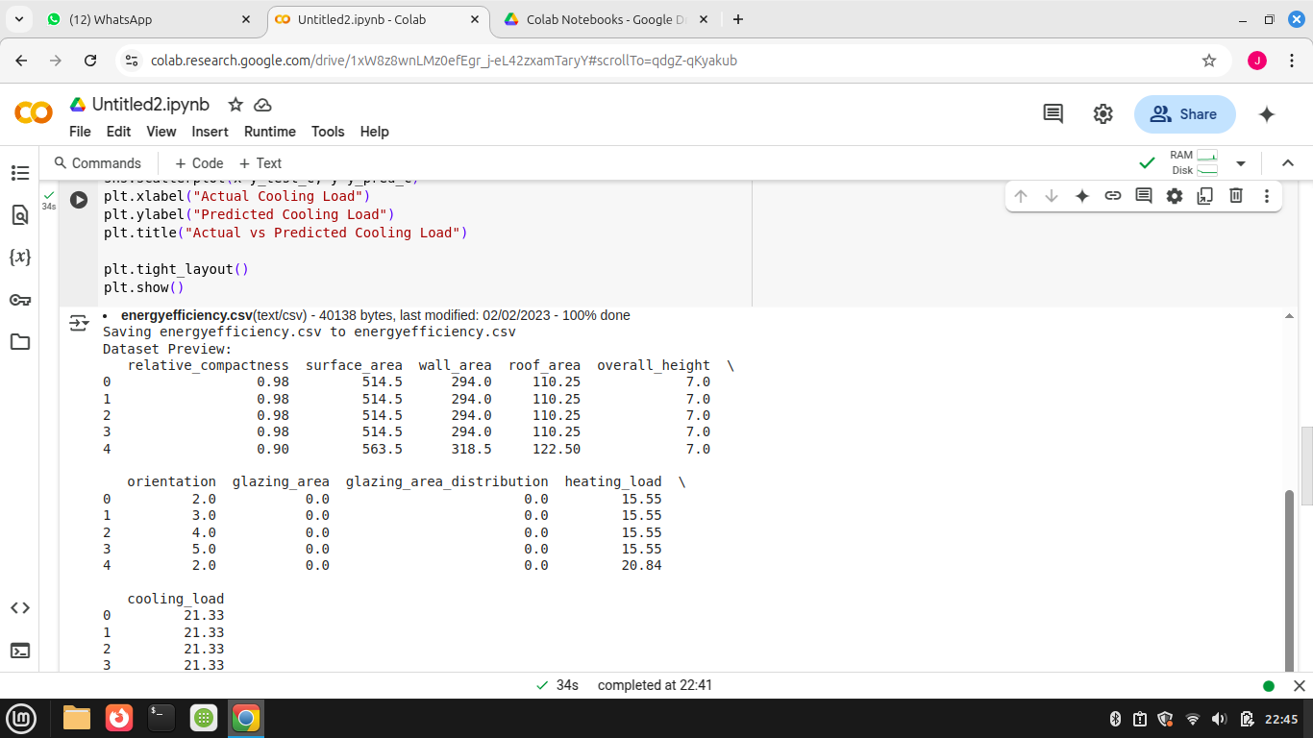
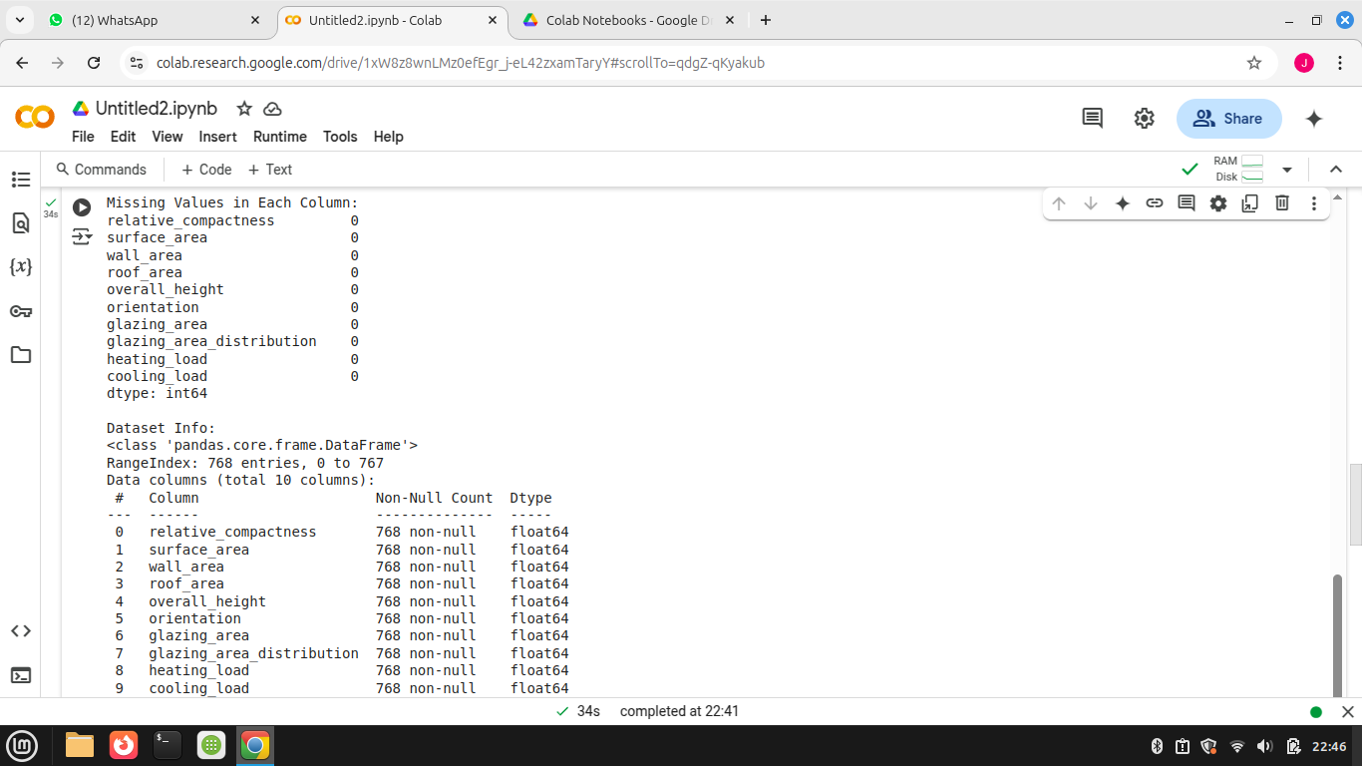

Slide 7
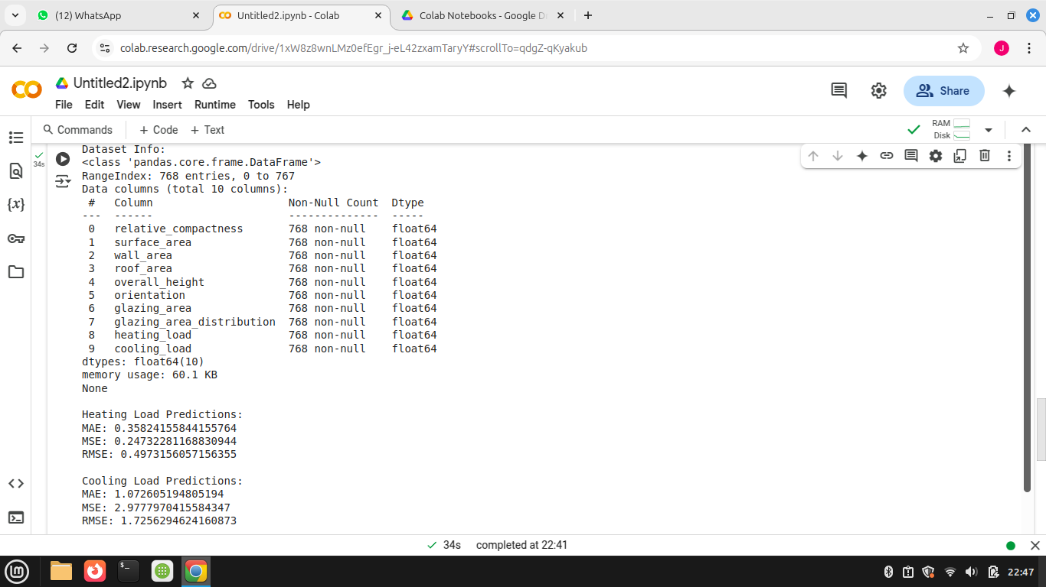
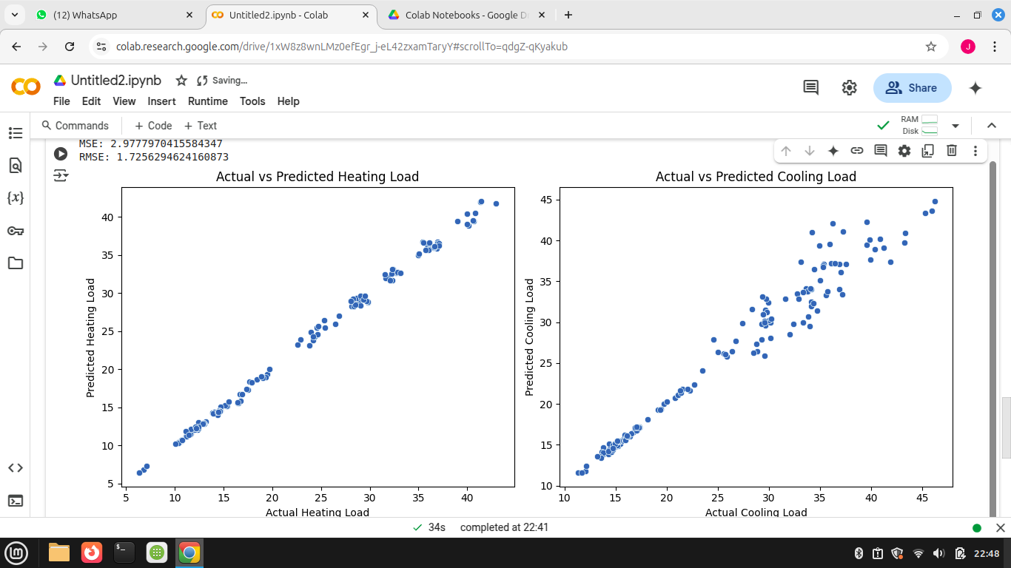

Slide 8
References
Kaggle - Energy Efficiency Dataset: https://www.kaggle.com/datasets/odasiz/energyefficiency-dataset
AI in Energy Management: https://www.sciencedirect.com/topics/engineering/energy-management
Machine Learning Documentation: https://scikit-learn.org/stable/

Slide 9
Thank You
Notes:
Thank You !!

