Slide 1
Diwali Sales Data Analaysics
Joseph Varghese

Slide 2
ABSTRACT
This project focuses on analyzing and visualizing sales data collected during the Diwali season using Python technologies such as pandas, seaborn, and matplotlib. The primary objective is to clean and prepare the dataset for in-depth analysis, ensuring that the data is accurate and relevant. Following the data cleaning process, various visualization techniques will be employed to uncover trends and patterns in the sales data. The insights gained from this project will provide valuable information on consumer behavior and sales performance during Diwali, aiding in strategic decision-making for future marketing campaigns.

Slide 3
INTRODUCTION TO DATA ANALYZING AND VISUALIZATION
Data Analysis:
Involves the systematic process of inspecting, cleaning, transforming, and modeling data.
Tools like pandas are used for data manipulation and analysis, especially for handling structured data such as tables (DataFrames).
NumPy is essential for numerical computations and working with arrays, providing a foundation for more complex data processing.
Exploratory Data Analysis (EDA) is a key step, where patterns, relationships, and trends within the data are identified.

Slide 4
Data Visualization:
Refers to the graphical representation of data using charts, graphs, and maps.
Seaborn and Matplotlib are powerful libraries in Python for creating attractive and informative visualizations.
Visualization helps in communicating insights effectively, making it easier to understand and interpret complex data.
Integration:
Together, data analysis and visualization enable the extraction of meaningful insights from raw data, facilitating data-driven decision-making.
These processes are increasingly important in various fields, helping organizations to leverage data as a key competitive advantage

Slide 5
INTRODUCTION
Dataset: We have a dataset containing Diwali sales information.
Goal: Analyze this dataset to derive insights that can support decision-making.
Tools: Utilize Python libraries such as pandas for data manipulation, seaborn for statistical visualization, and Matplotlib for creating comprehensive visual representations.
Outcome: Identify trends, patterns, and relationships within the data to inform strategic decisions related to Diwali sales.

Slide 6
Problem Statement
The Diwali season is a crucial period for businesses, marked by a significant increase in consumer spending.
Analyzing and understanding the large and complex sales data from this period can be difficult.
Without proper analysis, businesses may miss out on key insights, leading to suboptimal sales strategies, inventory management, and marketing efforts.
This project aims to solve the challenge of extracting actionable insights from Diwali sales data.
We will use data analysis and visualization tools like pandas, seaborn, and Matplotlib to clean, analyze, and visualize the data.
The goal is to uncover trends, patterns, and relationships that will help businesses make informed decisions during the Diwali season

Slide 7
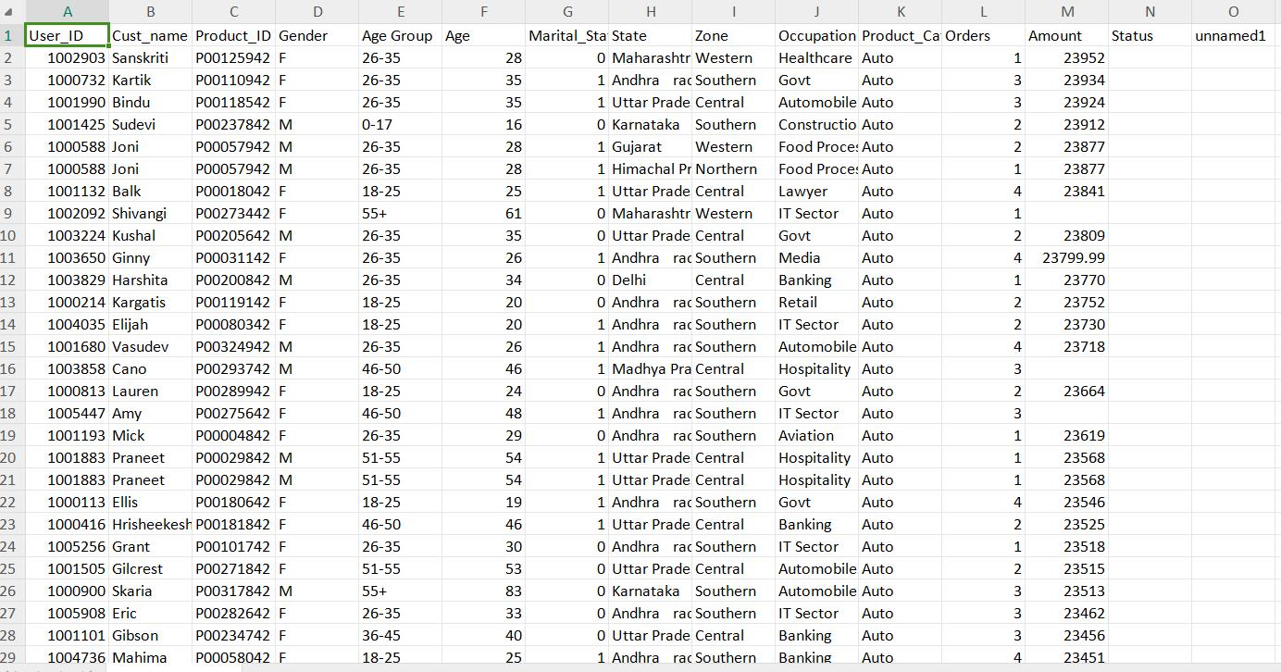
DATASET

Slide 8
METHODOLOGY AND DATA PREPARATION
Data Collection:
Obtain the dataset containing Diwali sales information, which includes various attributes related to sales transactions during the Diwali season.
Data Cleaning:
Handling Missing Values: Identify and address any missing or incomplete data within the dataset to ensure accuracy.
Data Formatting: Convert data into appropriate formats (e.g., dates, numerical values) to facilitate analysis.

Slide 9
Outlier Detection: Identify and handle outliers that may skew the analysis results.
Data Validation: Verify the integrity and consistency of the data, ensuring it aligns with expected patterns.
Descriptive Statistics: Use pandas to generate summary statistics (mean, median, mode, etc.) to understand the basic features of the dataset.
Data Visualization: Utilize seaborn and Matplotlib to create initial visualizations (e.g., histograms, box plots, scatter plots) to identify trends and patterns.

Slide 10
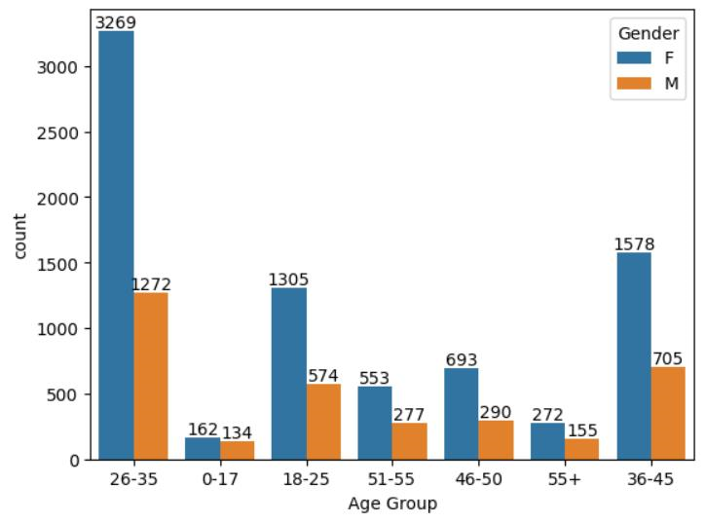
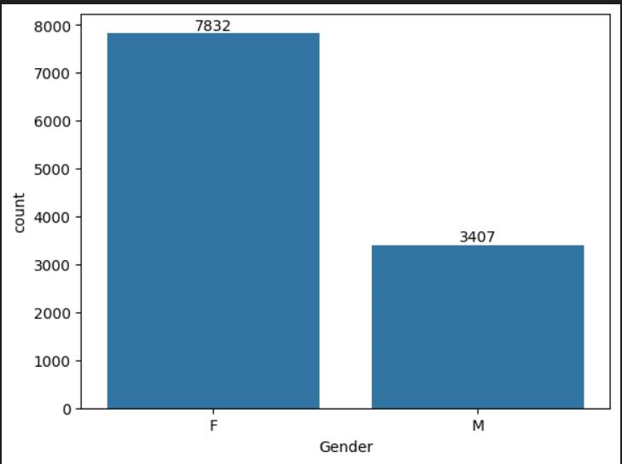
RESULT
The graph shows which age group has the highest count.
The graph shows that the female count is higher than the male count

Slide 11


