Slide 1
Data Science Job Salaries
Joseph Varghese

Slide 2
ABSTRACT
This project analyzes and visualizes salary data to uncover patterns and relationships across job roles and company sizes, utilizing Python and libraries like Pandas, Seaborn, and Matplotlib. Through comprehensive data preprocessing, including handling missing values and standardizing salary figures, and employing various visualization techniques such as histograms, box plots and count plot, the project provides insights into how salaries vary with remote work ratios and company sizes. The findings help in understanding salary distributions and can guide compensation and employment decisions

Slide 3
INTRODUCTION TO DATA ANALYZING AND VISUALIZATION
Data Analysis:
Involves the systematic process of inspecting, cleaning, transforming, and modeling data.
Tools like pandas are used for data manipulation and analysis, especially for handling structured data such as tables (DataFrames).
NumPy is essential for numerical computations and working with arrays, providing a foundation for more complex data processing.
Exploratory Data Analysis (EDA) is a key step, where patterns, relationships, and trends within the data are identified.

Slide 4
Data Visualization:
Refers to the graphical representation of data using charts, graphs, and maps.
Seaborn and Matplotlib are powerful libraries in Python for creating attractive and informative visualizations.
Visualization helps in communicating insights effectively, making it easier to understand and interpret complex data.
Integration:
Together, data analysis and visualization enable the extraction of meaningful insights from raw data, facilitating data-driven decision-making.
These processes are increasingly important in various fields, helping organizations to leverage data as a key competitive advantage

Slide 5
INTRODUCTION
Dataset: We have a dataset containing Data Science Job Salaries.
Goal: Analyze this dataset to derive insights that can support decision-making.
Tools: Utilize Python libraries such as pandas for data manipulation, seaborn for statistical visualization, and Matplotlib for creating comprehensive visual representations.
Outcome: Identify trends, patterns, and relationships within the data to inform strategic decisions related to Data Science Job Salaries.

Slide 6
Problem Statement
Understanding salary dynamics in the modern job market is challenging due to varying factors such as company size, remote work arrangements, and job roles. Employers need to make informed decisions about compensation to attract and retain talent, while employees seek clarity on how different factors affect their salary expectations.
Analyze how salaries differ across small, medium, and large companies.
Investigate the relationship between remote work ratios (no remote, partially remote, fully remote) and salary levels.
Examine how various job titles affect salary distributions.

Slide 7
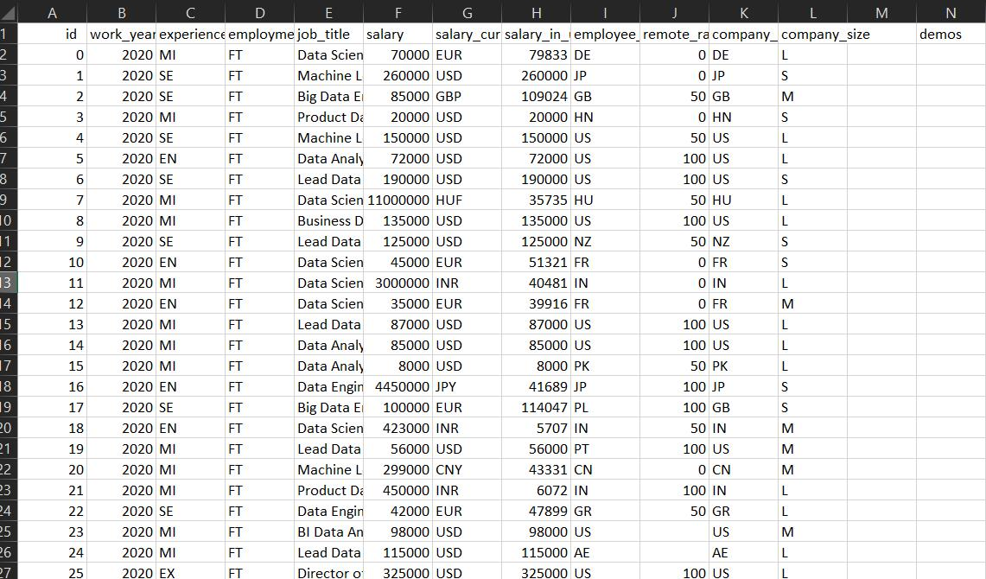
DATASET

Slide 8
METHODOLOGY AND DATA PREPARATION
Data Collection:
Obtain the dataset containing Data Science Job Salaries information, which includes various attributes related to Data Science Job Salaries.
Data Cleaning:
Handling Missing Values: Identify and address any missing or incomplete data within the dataset to ensure accuracy.
Data Formatting: Convert data into appropriate formats (e.g., dates, numerical values) to facilitate analysis.

Slide 9
Outlier Detection: Identify and handle outliers that may skew the analysis results.
Data Validation: Verify the integrity and consistency of the data, ensuring it aligns with expected patterns.
Descriptive Statistics: Use pandas to generate summary statistics (mean, median, mode, etc.) to understand the basic features of the dataset.
Data Visualization: Utilize seaborn and Matplotlib to create initial visualizations (e.g., histograms, box plots, scatter plots) to identify trends and patterns.

Slide 10
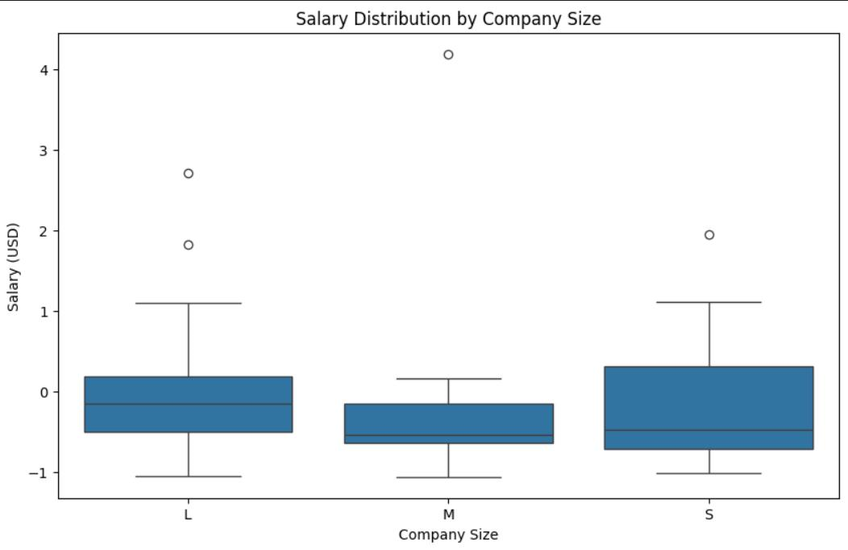
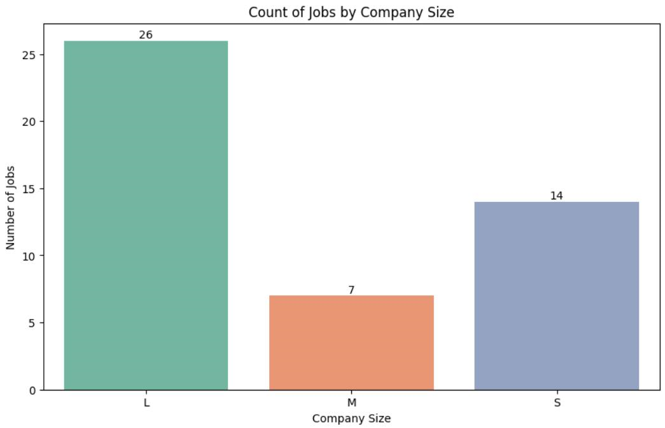
RESULT
Small-scale industries have a broader salary distribution range compared to large and medium-sized industries
Large-scale industries provide a greater number of jobs

Slide 11


