Slide 1

Sommerville Happiness Survey Dataset
Joses Idehen
U3259234

Slide 2
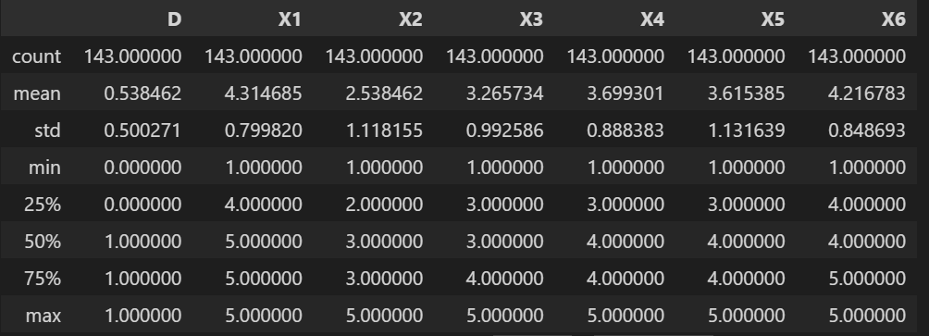
Descriptive Statistics on the dataset used

Slide 3
Attribute Information:
D = decision attribute (D) with values 0 (unhappy) and 1 (happy) X1 = the availability of information about the city services X2 = the cost of housing X3 = the overall quality of public schools X4 = your trust in the local police X5 = the maintenance of streets and sidewalks X6 = the availability of social community events Attributes X1 to X6 have values 1 to 5

Slide 4
QUESTIONS
1. What is the mode rating for each of the six attributes (X1 to X6)?
2. Which attribute (X1 to X6) has the strongest correlation with overall happiness?
3. How does the availability of social events(X6) vary across different levels of happiness (D=0 or D=1)?
4. How does the cost of housing (X2) vary across different levels of happiness (D=0 or D=1)?
5. how does the maintenance of streets and sidewalks affect overall happiness (D=1)?

Slide 5
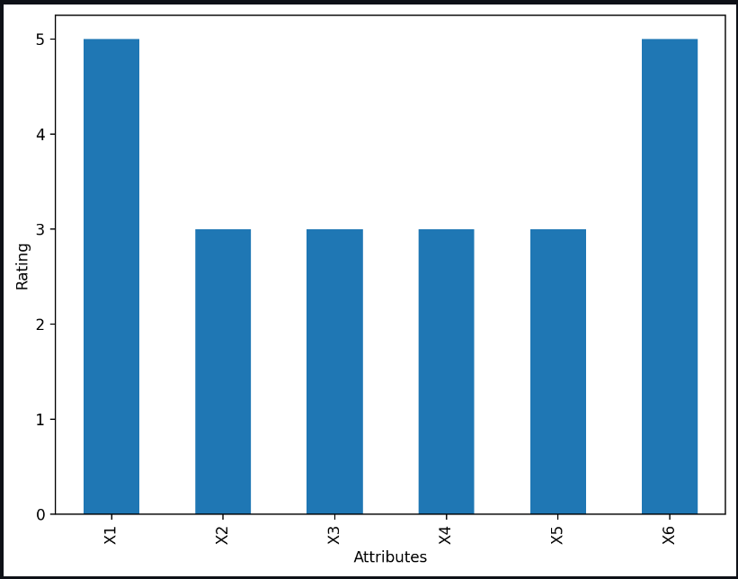
Question 1 What is the mode rating for each of the six attributes (X1 to X6)?
X1=5,X2-X5=3,X6=5

Slide 6
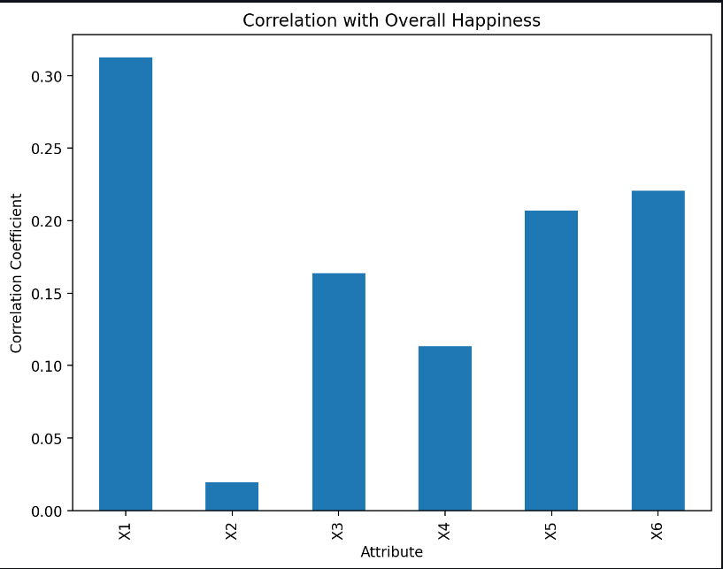
Question 2 Which attribute (X1 to X6) has the strongest correlation with overall happiness?
As shown here X1 is the attribute that Is most closely related to overall happiness

Slide 7
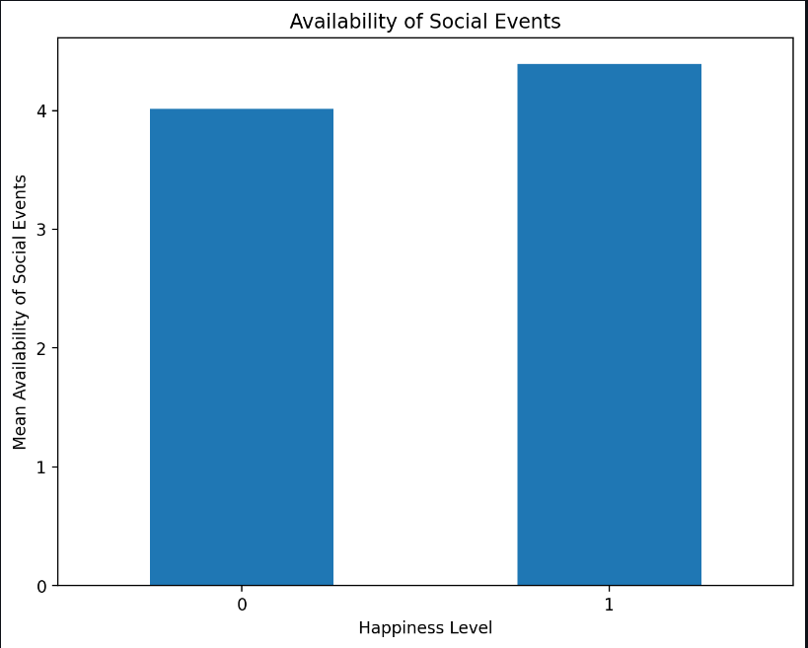
Question 3 How does the availability of social events(X6) vary across different levels of happiness (D=0 or D=1)?
On average people are most likely to be happy if the availability of social events is higher than 4

Slide 8
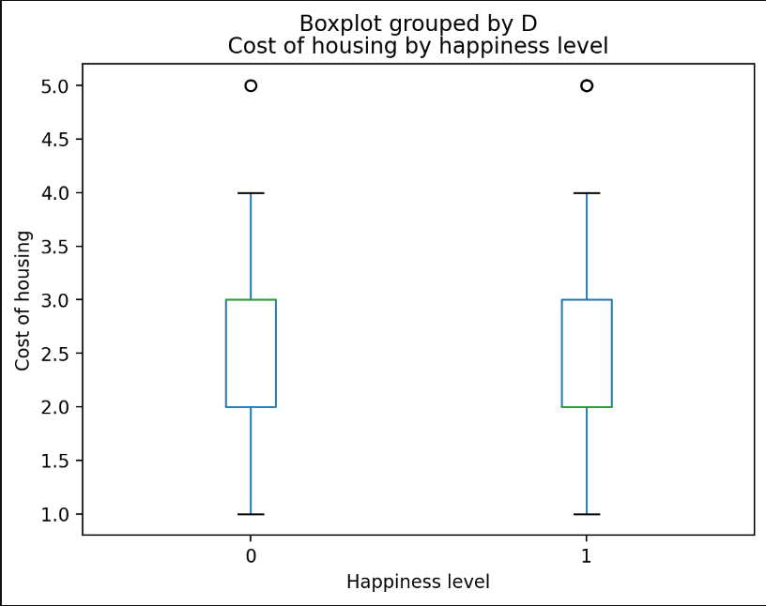
Question 4 How does the cost of housing (X2) vary across different levels of happiness (D=0 or D=1)?
In this figure you can see that the higher the cost of housing is, the more likely people are to be unhappy

Slide 9
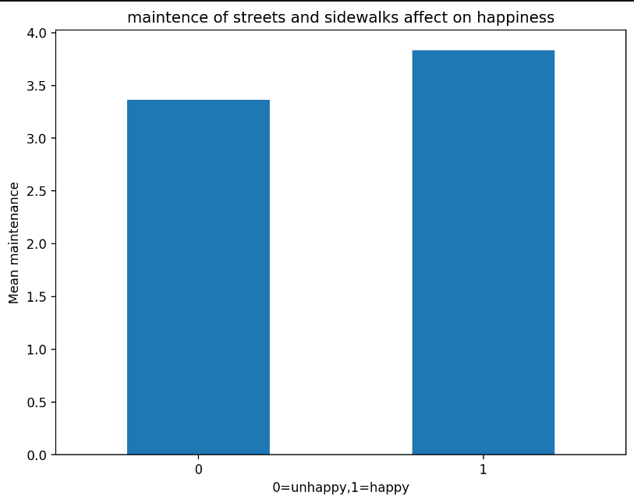
Question 5 how does the maintenance of streets and sidewalks affect overall happiness (D=1)?
As shown in this graph, the higher the frequency of the maintenance of streets and sidewalks, the more likely people are to be happy.

Slide 10
Predictive analytics
Accuracy: 0.5739130434782609
57%
This output how accurate the predicted values are to the real values

