Slide 1

KS1912
Extraction of structured information from dictionary PDFs

Slide 2

Group Introduction
18667471 Roger Leo Bernardo
18993745 Joshua Dib
17593713 Josephine Paculio
19595913 Caleb Smith

Slide 3
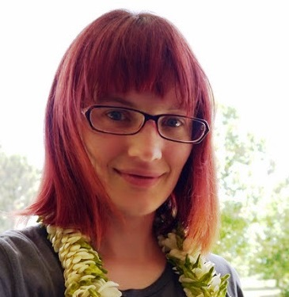
Client Introduction
Dr Rachel Hendery
Associate Professor of Digital Humanities at Western Sydney University
Qualifications:
PhD (ANU,2008)
MA (Johann-Goethe University, Frankfurt am Main, 2003)
BA (Canterbury University, NZ, 2000)
Postdoctoral fellowship and lead CI on ARC Discovery Grant DP110103714 'Change in language, culture and identity in a small isolated speech community: Palmerston Island English' (2011)
Vice Chancellor's Women's Research Fellowship (2016)
Google Research Award (2016)

Slide 4
Project Background
ARC Project
Collection of words from different foreign dictionaries of foreign languages.
Research task is based on finding connection between indigenous communication.
Requires technology format of a digital spreadsheet to make this task realistic and provide the ability to cross reference.
Dictionaries must be manually converted and input into a spreadsheet, a tedious task taking up lots of useful time.

Slide 5
Project Brief
Select a file to extract be used in the extraction and output of the data.
Upon entering the search parameters the appropriate entries will be added to a table.
- Each entry will be split up to their respective headings (Keyword, Part of Speech, Related Text).
Provide an opportunity to filter and edit the results to fine tune the output.
After the user is satisfied with the dataset it will be exported to their local drive as a suitable format such as csv.

Slide 6
Chosen Solution
Web allows for easy access to many packages to enhance development features/difficulty
Accessible on any platform which accommodates for multiple team members and devices
Less moving parts (no server) which is less liability and things to create/maintain
Inviting development environment should it be worked on after project completion

Slide 7

Technology – PDF.js
Open source
JavaScript library developed by Mozilla
Consist of 3 layers:
Core
Display
Viewer
Main use to the project:
Extract:
Text
X-coordinate
Y-coordinate

Slide 8
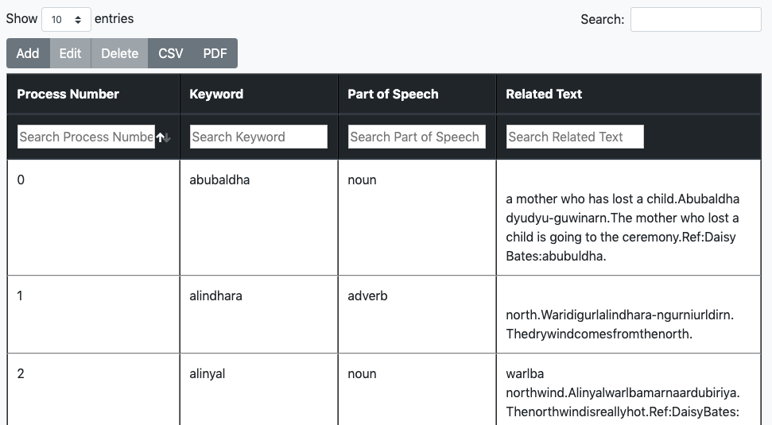
Technology – Datatables
Table plug-in for jQuery Javascript library
Created by SpryMedia
Enhance the accessibility of data in HTML tables.
Functionalities:
Add new data
Delete data
Sort data
Filter data

Slide 9

Technology – Electron
Open-source
Cross platform desktop application builder
Developed by GitHub
Supports:
Javascript
HTML
CSS
Main use:
Converts web application to desktop application

Slide 10
Overall solution
Attach PDF file
Add user input
Extract text
Identify keywords
Fill table
Display results
Identify related text

Slide 11
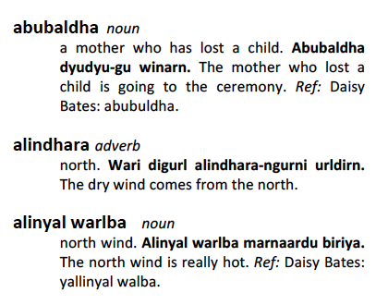
Identifying Keywords
X-coordinates of keyword and related words
Keywords
Related words to the keyword
Related words' x-coordinate
Keyword's x-coordinate
Indentation difference

Slide 12
Challenges
Finding the most generic solution to extract text
Changing scope, previous features and functionality required adjustment to ensure combability with each other

Slide 13
Outstanding Features
Dynamically OCR the file input, currently uses coordinates form the object PDF.js produces and something such as tesseract produces only the string and would require a different text splitting algorithm feature
Tab feature, loads the page within a protected frame and requires IPC (inter process communication) to access JavaScript and pass data, current infrastructure does not have this in mind and the flow of information must be adjusted

Slide 14
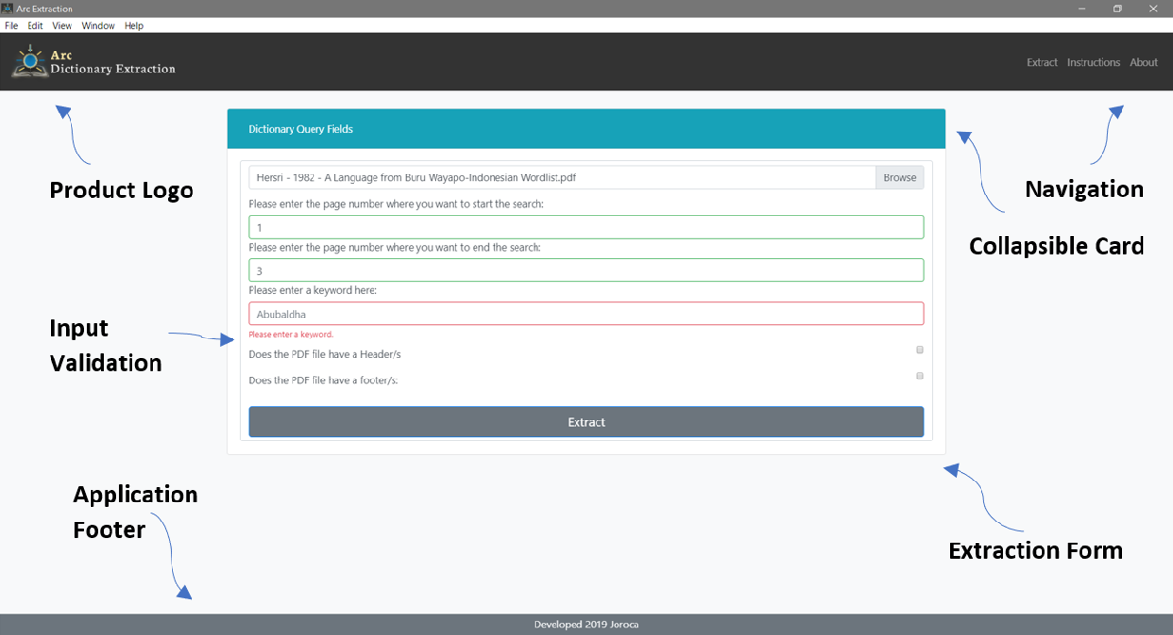
User Interface Design (Form Input)

Slide 15
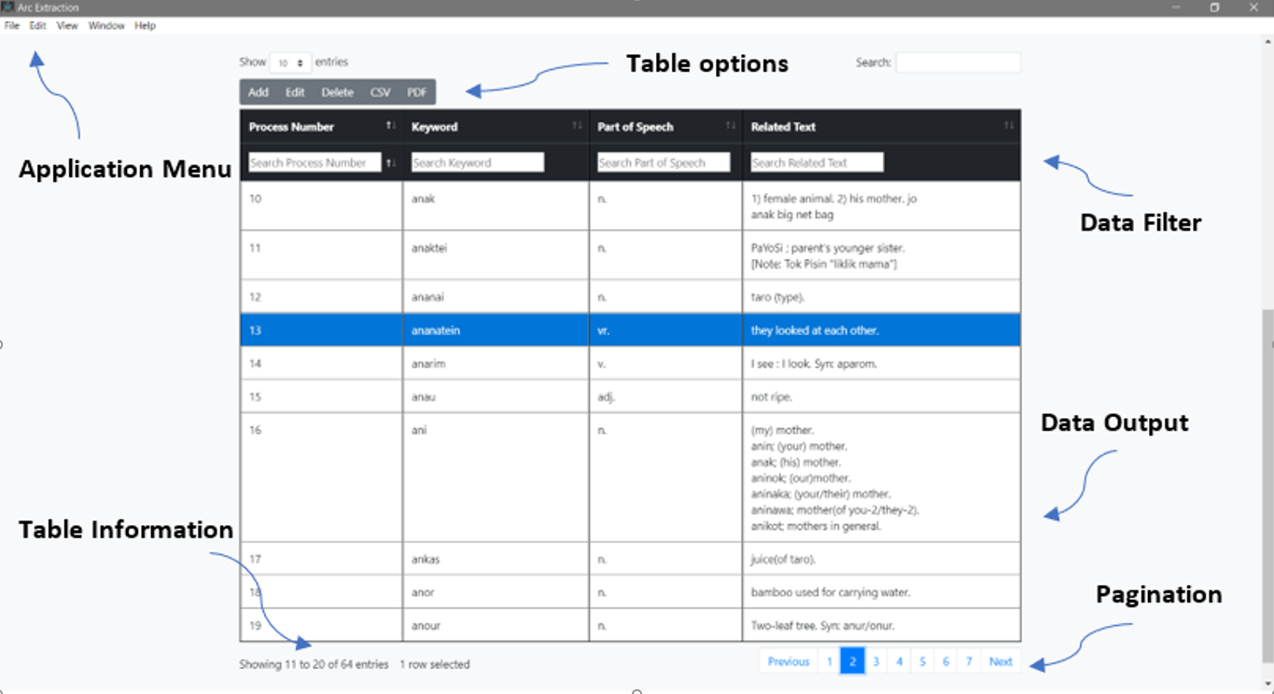
User Interface Design (Form Output)

Slide 16

User Interface Development Method
Developed with the aid of Schneiderman’s eight rules of interface design.
Strive for consistency
Enable the use of shortcuts
Offer informative feedback
Design dialog to yield closure.
Offer simple error handling
Permit easy reversal of actions.
Support Internal locus of control.
Reduce short term memory load.

Slide 17
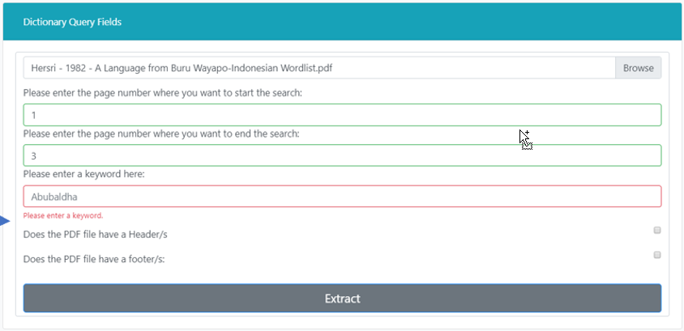
Colour Scheme, logo and Design
Logo has recognizable meaning.
Color scheme was chosen based on client’s project.
Colors do not distract user from system functions.
Navigation is simple and design format is recognizable.
Text has been tested and trialed to scale for user with vision impairments.
Extraction software is featured on the main of the application for fast access.
The form is clear and stands out in the design to navigate user for use.

Slide 18
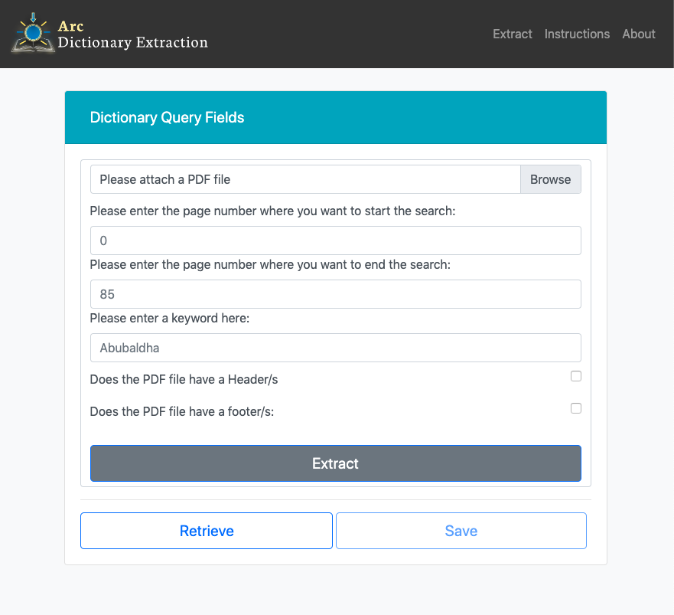
Demonstration

Slide 19
Q&A
We will now take any feedback, comments or questions. ☺

Slide 20
Thank you!!
Thank you all for coming to watch our presentation.
Special thanks to Jonathan Weightman for doing a brilliant job in supervising us throughout this semester.

