Slide 1

Group N
Brandon Loy
Daniel Tarasio
Dalan Shakaj
Dennis Bragilevsky
Hossam EL-Shebiny
Joshua Abraham
Sam Guraya
Zeenia Akram
BAYONET DEVICES PROJECT TBH

Slide 2
Project Overview
Designing a handheld device to capture and match biometric data
For government bodies such as TSA, NATO, & DHS

Slide 3
Hardware Design Plan
Goal: 2 forms of biometric data (Facial Recognition, & Fingerprint Sensor)
Using a wired connection to control our sensors for security, simplicity, and scalability

Slide 4
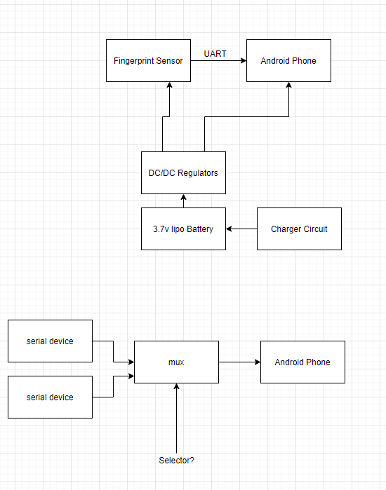
Hardware Diagram

Slide 5
Software Design Plan
Using AWS as our cloud service provider
Currently government biometric data is being transferred to the HART system which is run on AWS GovCloud
Using AES encryption protocols to match US government regulation standards
Following the Electronic Biometric Transmission Specification for compatibility with pre-existing biometric technology

Slide 6
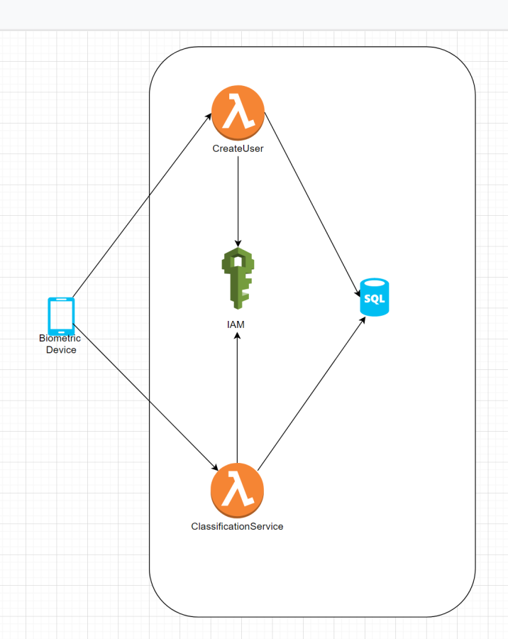
Software Diagram

Slide 7
What Is Going Well
Updated our scope to better fit a new main stakeholder
Determined what was out of scope
Added new requirements to differentiate our product from competitors
Compiled a shortlist of hardware parts

Slide 8
What Is Going Wrong
No communication with stakeholders (previous or current)
Making sure all project deliverables are feasible within the timeframe
We can’t test scalability
High risk because of constrained budget
Need to optimize our critical paths

Slide 9
Next Goals
Design our hardware diagrams
Design our software use cases & diagrams (for onboard device and Android application)
Allocate our budget
Create integration plans (HW – SW)

