Slide 1

Group N
Brandon Loy Electrical Engineering
Daniel Tarasio Electrical Engineering
Dalan Shakaj Electrical Engineering
Dennis Bragilevsky Computer Engineering
Hossam EL-Shebiny Space Engineering
Joshua Abraham Computer Engineering
Sam Guraya Computer Engineering
Zeenia Akram Space Engineering
Advisor
Prof Kassiri
BAYONET DEVICES PROJECT TBH

Slide 2
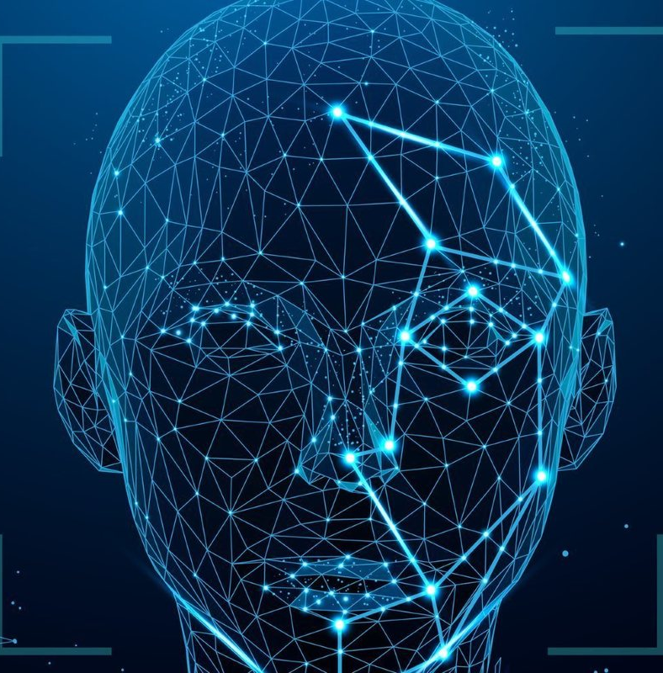

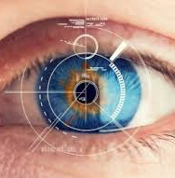
Our Objective
Deliver a tactical mobile, handheld, multi-modal biometric data capture, on-board storage and matching, and transmission device

Slide 3
Key Stakeholders
Capstone Group
TSA
NATO

Slide 4


Key Requirements
Multimodal biometric data capture
Android application
Cloud storage
A 1-1 matching algorithm

Slide 5
Hardware Design Plan
Draw and print a 3d model for the handheld device
Establish serial connection with IOIO board
write software to transfer image file over serial interface

Slide 6
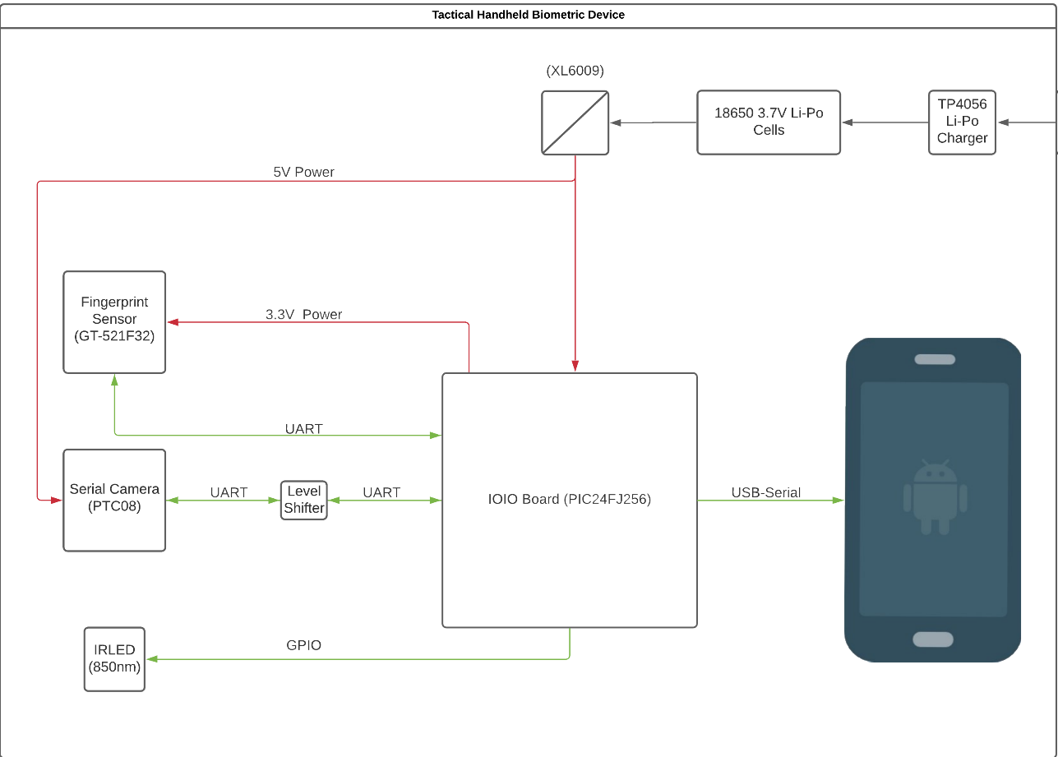
Hardware Diagram

Slide 7
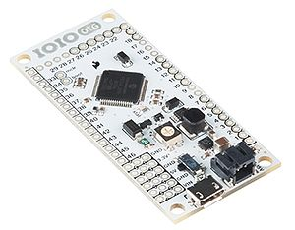
Software Design Plan
Interface android app with IOIO board
Obtain Sensor Data
Clean up data and encrypt in app to send to cloud database
Using AWS as our cloud service provider
DynamoDB for information storage
S3 for file storage
EC2 storage and deployment of ML models
Lambda for serverless endpoints
IOIO microcontroller

Slide 8
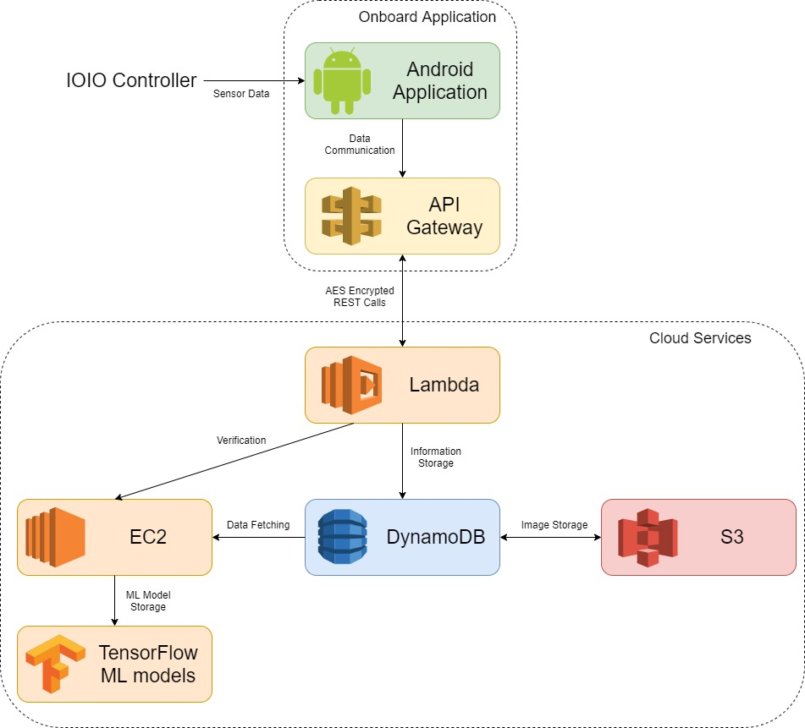
Software Diagram

Slide 9

Development Work
Set up the Android application and can communicate with the IOIO board
Set up some of the cloud infrastructure
Made initial UI on the application for user interaction
Able to communicate with the fingerprint sensor to extract data (not with phone yet)
Developed battery management system

Slide 10
Issues Around Development
Cannot be all serverless as originally thought
Due to size restriction
- ML models are too large
Need to convert sensor code from C++ to Java
Cannot use React-Native
Project that IOIO board was built in is an old library that cannot integrate with current libraries

Slide 11
Issues Around COVID
Cannot meet up to work on hardware portion together
Must purchase multiple IOIO boards and team members can only work individually with them
Limits on Android devices for development
Shipping times for parts are lengthy

Slide 12
Next Goals
Complete entire set up of cloud infrastructure
Write software to transfer image file over serial interface
Continue working on Android App logic to communicate with cloud and microcontroller board

