Slide 1

Group N
Brandon Loy Electrical Engineering
Daniel Tarasio Electrical Engineering
Dalan Shakaj Electrical Engineering
Dennis Bragilevsky Computer Engineering
Hossam EL-Shebiny Space Engineering
Joshua Abraham Computer Engineering
Sam Guraya Computer Engineering
Zeenia Akram Space Engineering
Advisor: Professor Kassiri
BAYONET DEVICES PROJECT TBH

Slide 2
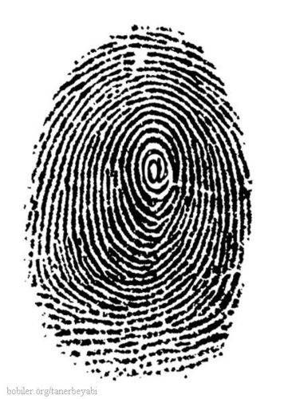
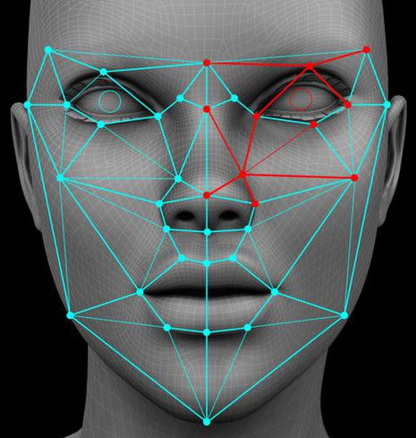

Project Overview
Designing a handheld device to capture and match biometric data
For government bodies such as TSA, NATO, & DHS
Biometrics include fingerprint, facial recognition, and iris scanning

Slide 3
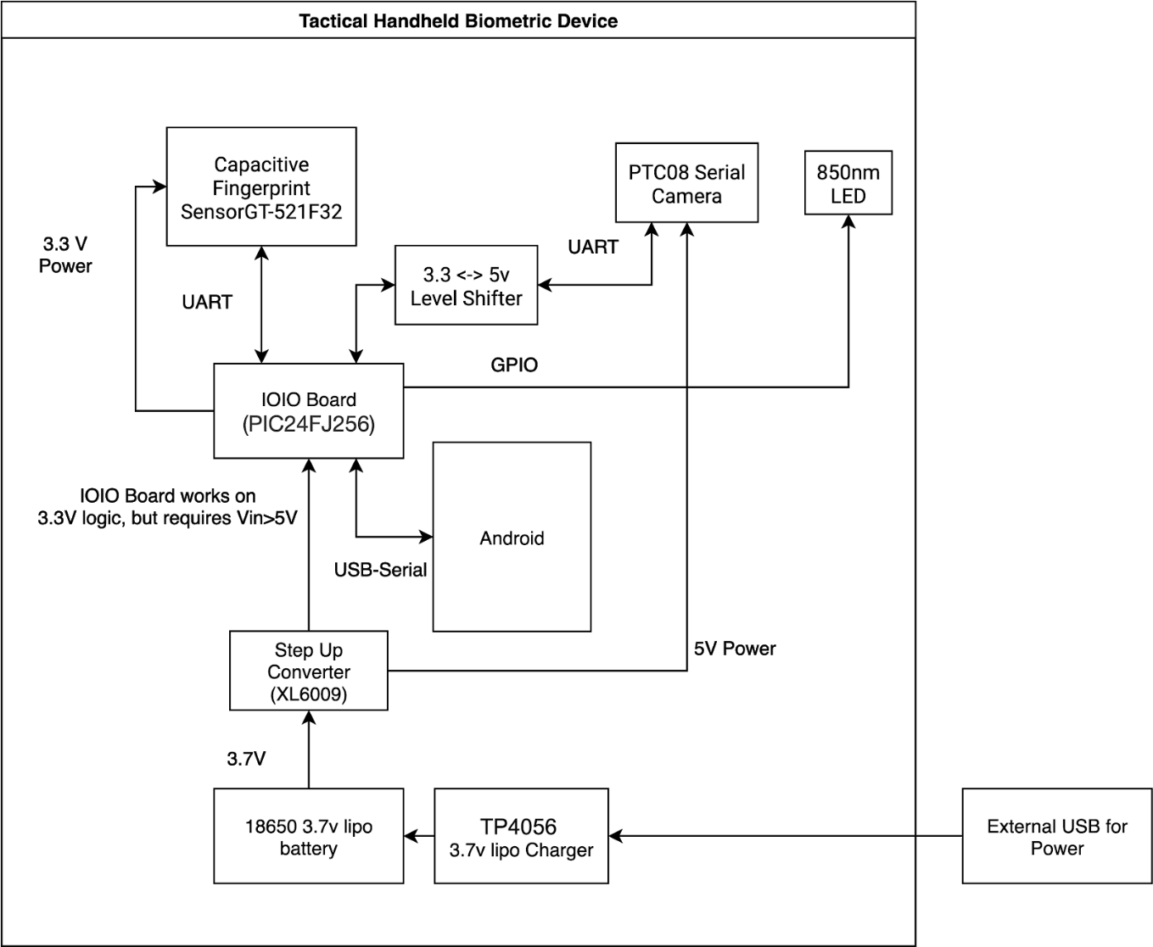
Hardware design

Slide 4
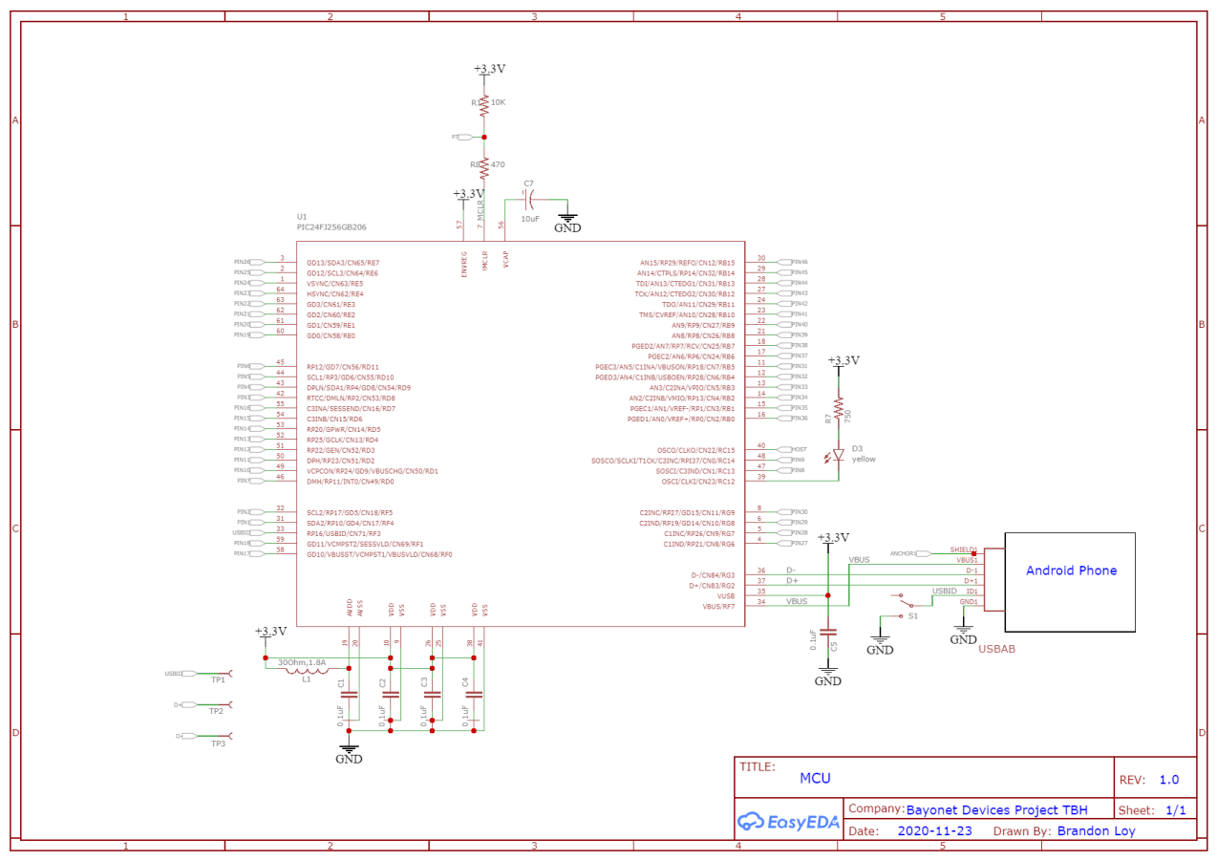
MCU Schematic

Slide 5
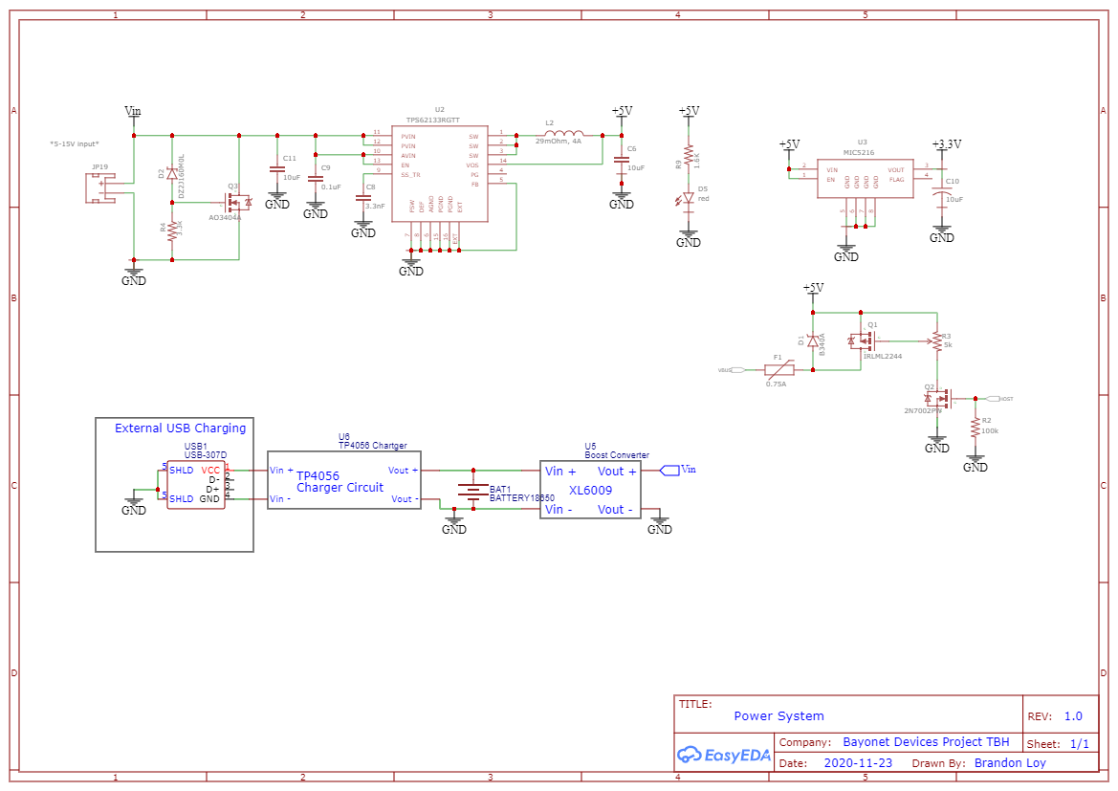
Power system Schematic

Slide 6
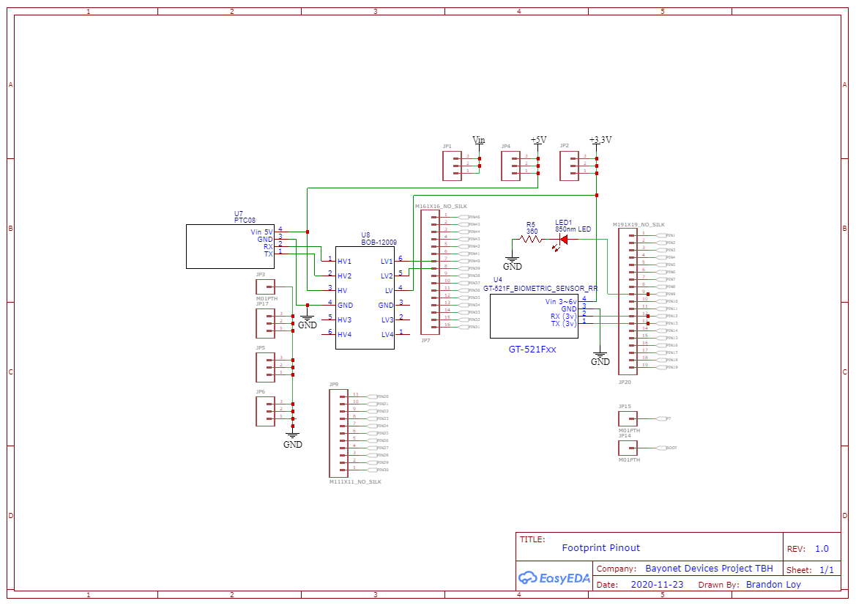
Footprint pinout Schematic

Slide 7
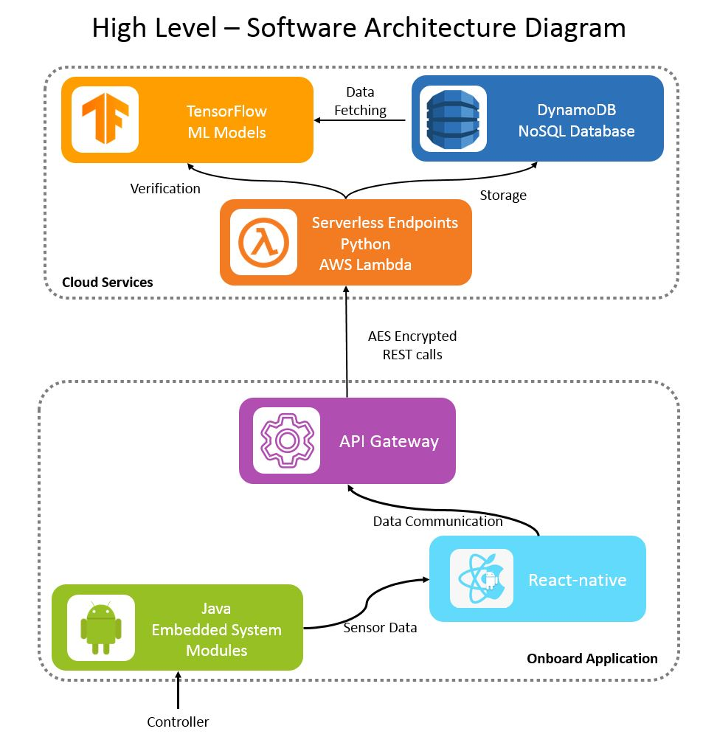
Software design

Slide 8
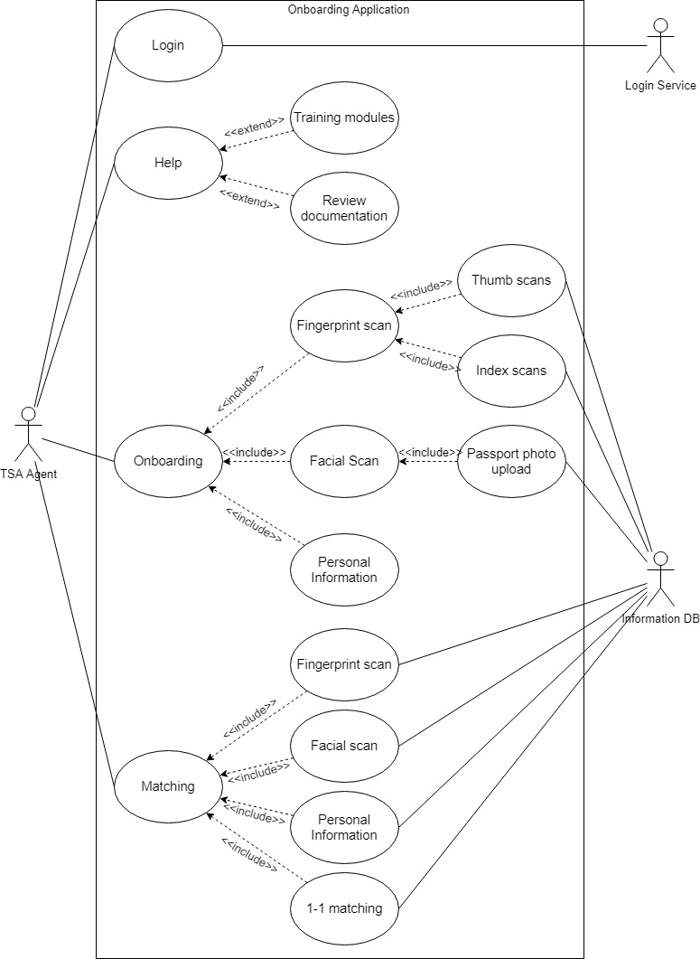
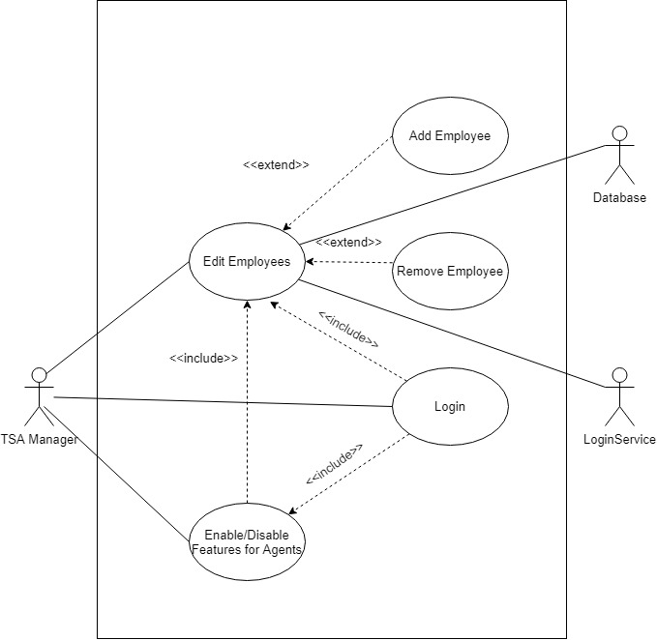
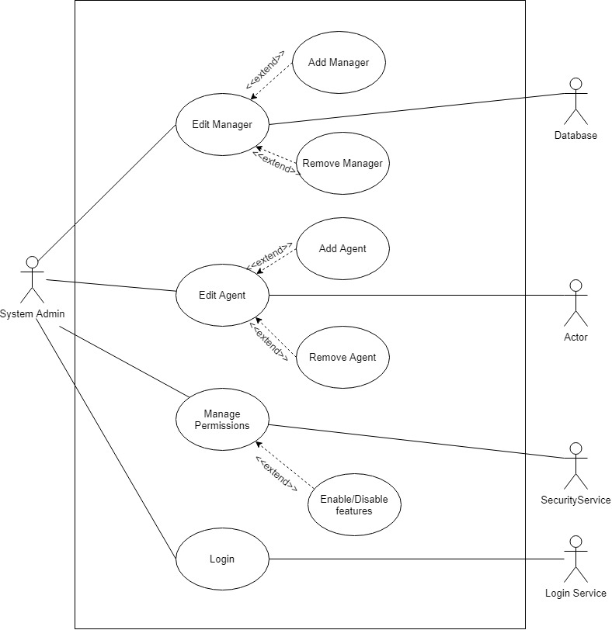
Use cases

Slide 9
What is Going well
Gate 2 document submitted (waiting for results)
Firm understanding of our plan for the project by all members of the group
All members of the SW and HW team know their tasks and who is working on which tasks
Original requirements from Gate 1 were reviewed and updated for feasibility
Software
Use case diagrams
Architecture diagram
Activity diagrams
UML class diagrams
UI/UX specifications
Hardware
Architecture diagram
Schematic
System diagram

Slide 10
What is going wrong
Need to order parts on the HW side
Critical path for development relies on IOIO board and its integration between sensors and Android application (not wrong, but delicate)
We're behind where we want to be in terms of development due to the impact of other courses

Slide 11
Next goals
Software
Begin creating the backbone of the Android application Architecture diagram
Set up endpoints between app and database
Hardware
Order the parts and begin managing connections between sensors
Create communication protocols of each sensor to IOIO board

