Slide 1
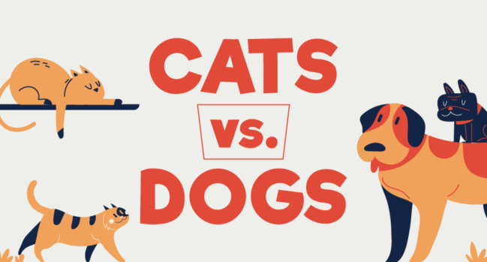
Online Training – Image Classification

Slide 2
System Description
Classify images between dog and cat
System administrators can label images
Re-train model on newly added images for continuous improvement

Slide 3
System Architecture
Main App
Lambda function with API Gateway
Connects to S3 for user image storage
Connects to DynamoDB for image information storage
Uses a running EC2 instance for classification
Monitoring through CloudWatch Logs
Uses Cognito to connect to Manager App
Manager App
Lambda function with API Gateway
Connects to S3 for user image retrieval
Connects to DynamoDB for image information retrieval and storage
Connects to DynamoDB for retrieval and storage of manager settings
Starts an EC2 instance for re-training
EC2 instance saves new model in S3 bucket
Monitoring through CloudWatch Logs
Background Process
Lambda function
Connects to DynamoDB for retrieval of image and manager information
Starts an EC2 instance for re-training
EC2 instance saves new model in S3 bucket
Monitoring through CloudWatch Logs
Timed event managed by EventBridge

