Slide 1
Freedom Narratives as Artifacts of African American Interpretation of Deuteronomy
A Digital Humanities Approach
Stephen Breck Reid
Joshua Been

Slide 2
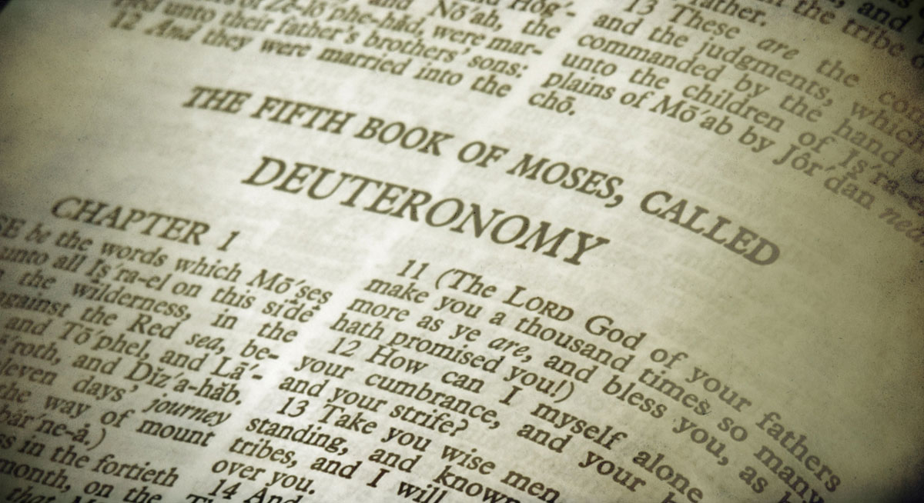
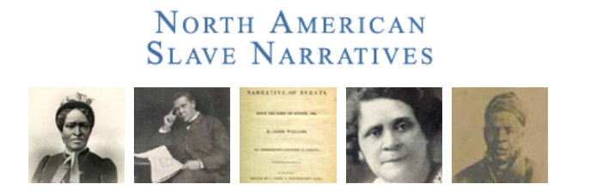
Introduction
University of North Carolina’s Documenting the American South

Slide 3
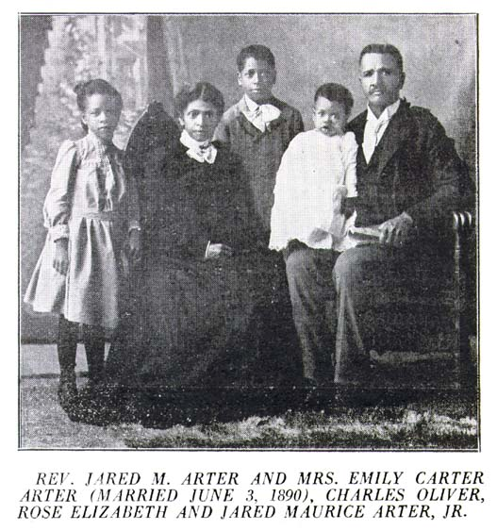
Preliminary Results

Slide 4
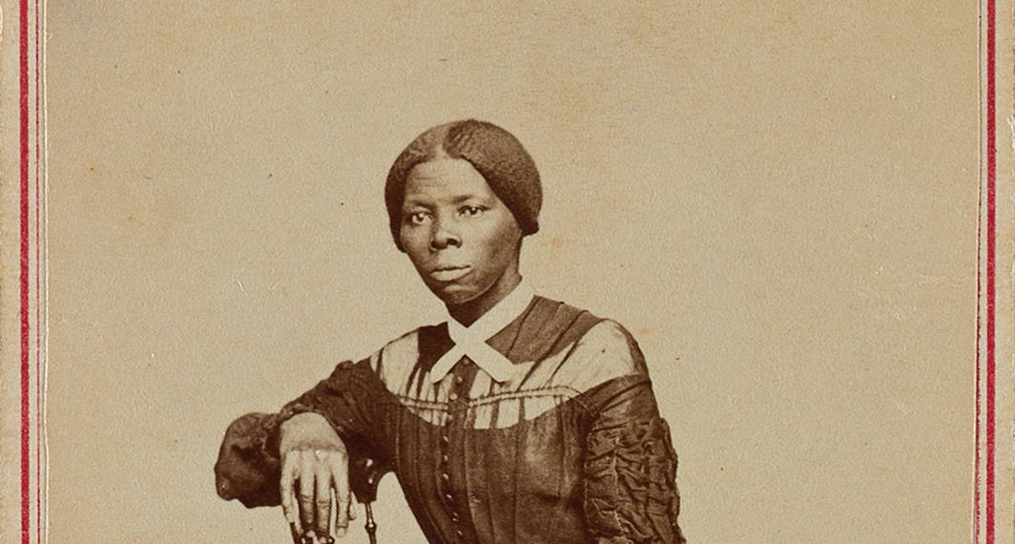
Preliminary Results

Slide 5
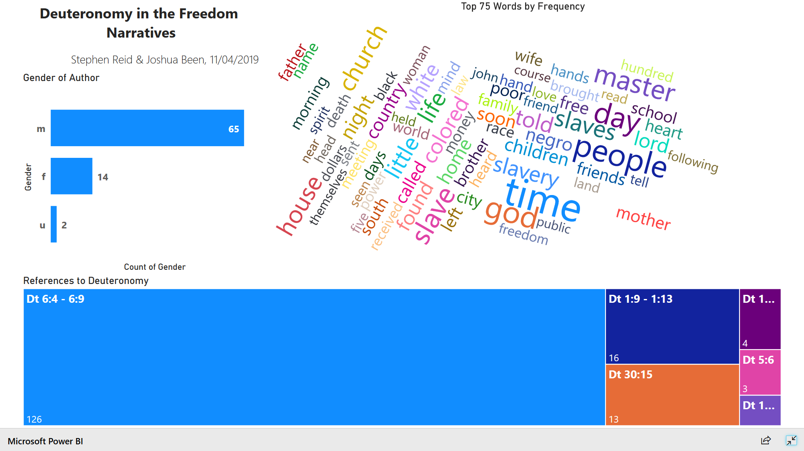
Global Results
http://bit.ly/freedom_narratives

Slide 6
Combination
Distant Reading
Close Reading

Slide 7
Typical Text Data Mining Workflow
Identify Sources for Corpus
Prepare for Reading & Parsing
Enrich Corpus
Preprocess Corpus
Term Frequencies & Keyword Extraction
Analysis
Visualize Corpus
= not needed for this project

Slide 8
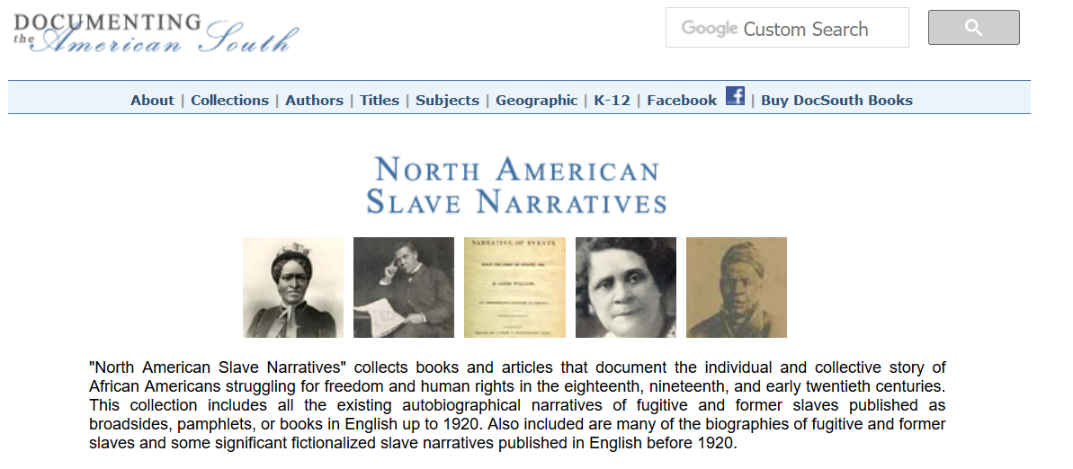
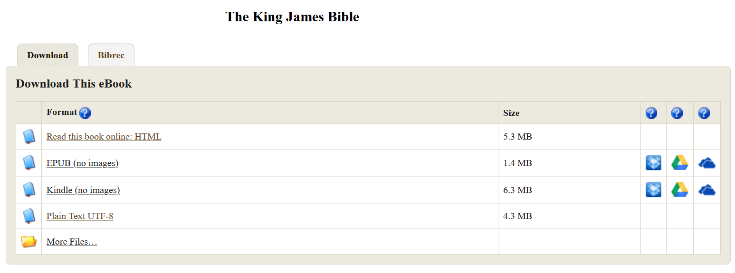
(1) Identify Sources for Corpus & (2) Preparing for Parsing

Slide 9

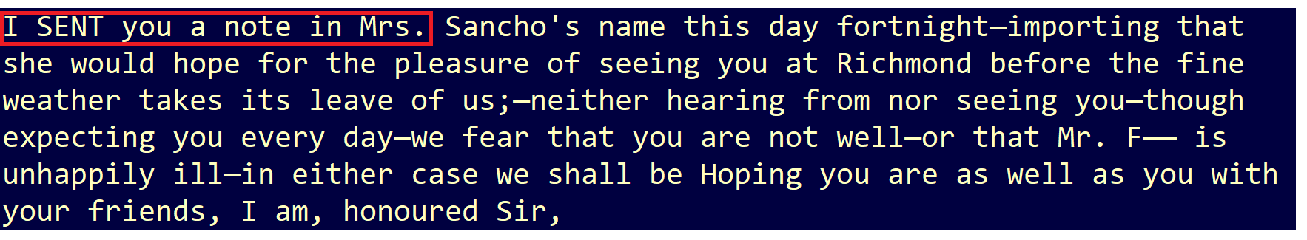
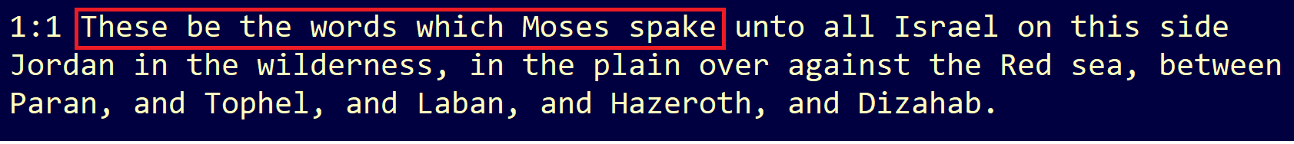
(3) Preprocess Corpus: 7-Word N-Grams

Slide 10
(4) Analysis: Fuzzy Text – Token Set 50%
Ratio
1
best partial when two strings are of noticeably different lengths
Token Sort
3
(1) Tokenize both strings, (2) sort the tokens alphabetically, and then (3) calculate token similarity
Token Set
4
Partial Ratio
2
% Character Moves
(1) tokenize both strings, (2) split the tokens into two groups: intersection and remainder, (3) Calculate token and string similarity
String Similarity
Partial String Similarity

Slide 11
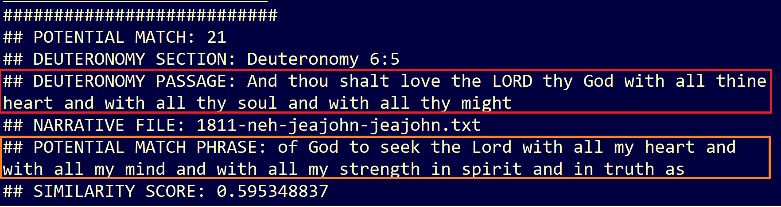
(4) Analysis: Fuzzy Text Matching Output

Slide 12

Close Reading
283 Fuzzy Text Matches >= 0.5
163 Confirmed Manually

Slide 13
Next Steps
Repeat for Psalms
Apply Machine Learning
Create a Reusable Tool

