Slide 1
A.I’s Chance of taking your jobs.
By Joshua Henderson

Slide 2
Dataset Summary
3,000 total records
18 features (mix of numeric + categorical)
Target variable: Risk_Category (Low, Medium, High)
No missing values
Key numeric columns: Average_Salary, Years_Experience, AI_Exposure_Index, Automation_Probability_2030
Key categorical columns: Job_Title, Education_Level

Slide 3
Research Question
How accurately can we predict a job's automation risk category using AI exposure and job-related features?

Slide 4
Python Eda
Dataset head() and info()
Missing values check (all zeros)
Distribution plots for salary, experience, AI exposure
Correlation heatmap
Boxplots of key features vs. Risk_Category
Scatterplots showing relationships between AI_Exposure_Index and Automation_Probability_2030

Slide 5
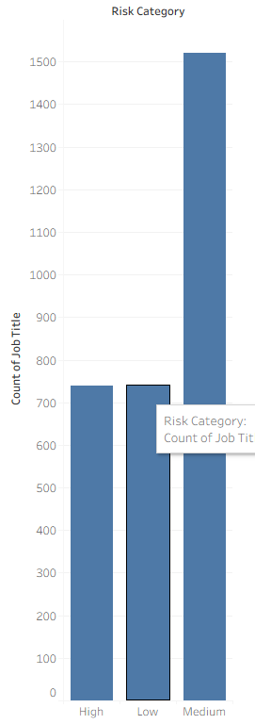
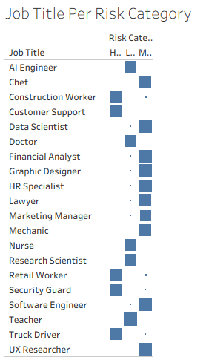
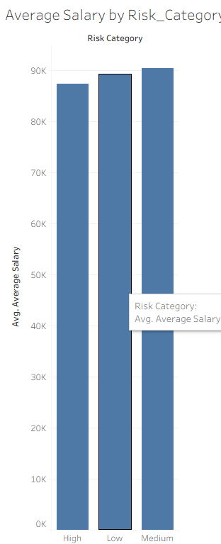
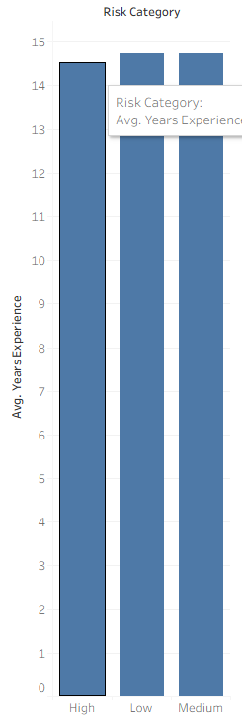
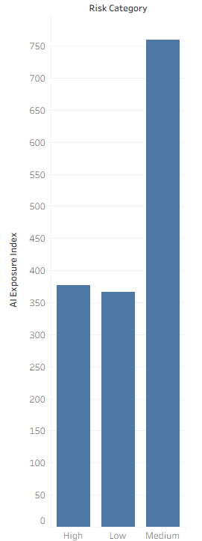
Tableau

Slide 6
Model Training Summary
Model used: Logistic Regression (multiclass)
Train/test split: 75% train, 25% test
Categorical encoding: One-hot
Target encoded with LabelEncoder
Numeric features scaled with StandardScaler
Model trained using max_iter=1000
Evaluated using predictions on test set

Slide 7
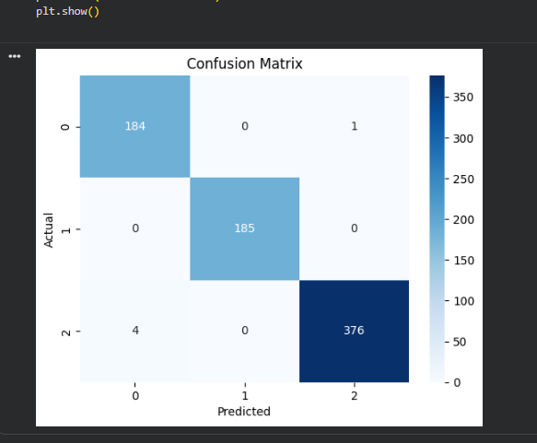
Correlation

Slide 8
Key Insights
AI_Exposure_Index strongly correlates with automation probability
High-risk jobs cluster around high exposure + high automation probability
Salaries are not linear predictors of risk but show some patterning
Medium-risk category overlaps with both high and low groups
Logistic Regression performs reasonably well but could be improved with advanced models

Slide 9
Conclusion
Logistic Regression successfully models automation risk from job features
AI exposure metrics are highly predictive of risk category
The dataset supports meaningful insights but is synthetic
Future work: Random Forest, XGBoost, SHAP values, hyperparameter tuning
Overall, the project demonstrates a complete end-to-end machine learning pipeline

