Slide 1
Hate Speech Detection & Prevention Using Deep Learning
Name: Joshua S
Reg.No: 2019202019
Course: MCA - Regular
Guide: Ms.B.Siva Shankari

Slide 2
Introduction
Hate speech is a subject of worry for online platforms.
Cursing, considering women as objects, comments on physical appearance, inferiority, comparisons, generalization, mocking any events, etc.
Hate speech detection should be an automated task to distinguish hate speech from the provided input.

Slide 3
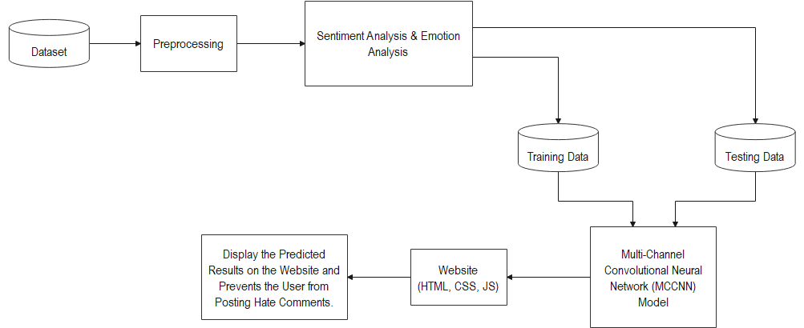
Architecture Diagram

Slide 4
Objective Proposed
To predict the Hate Speech that has been spread online
To build an efficient model with greater accuracy & precision
To create a Deep Learning Model
A Multi-Channel Convolutional Neural Network (MCCNN) model to predict the hate speech in comments

Slide 5

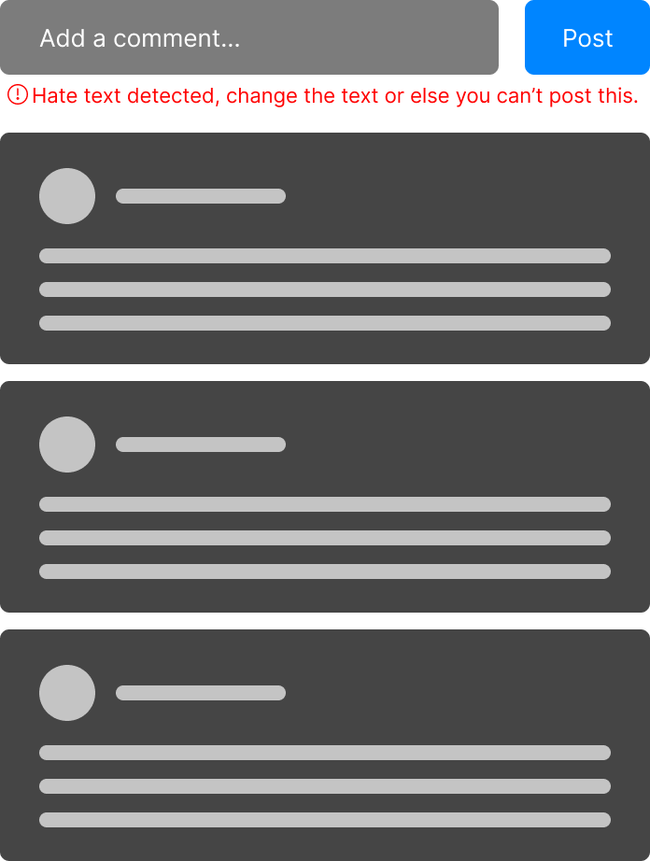
Before
After

Slide 6
Novelty
This project can be implemented in any website which has a comment section to prevent the user from posting abusive comments.
Which can be towards a group of individuals or individuals based on race, religion, sex, colour, disability, illness, etc

Slide 7
Technical Tools & Programming Languages
Tools
Python Libraries
Numpy
Pandas
Keras
Bootstrap
Twitter Hate Speech Dataset
Programming Languages
Python
JavaScript

Slide 8
References
K. A. Qureshi and M. Sabih, "Un-Compromised Credibility: Social Media Based Multi-Class Hate Speech Classification for Text," in IEEE Access, vol. 9, pp. 109465-109477, 2021, doi: 10.1109/ACCESS.2021.3101977.
T. A. Naidu and S. Kumar, "Hate Speech Detection Using Multi-Channel Convolutional Neural Network," 2021 3rd International Conference on Advances in Computing, Communication Control and Networking (ICAC3N), 2021, pp. 908-912, doi: 10.1109/ICAC3N53548.2021.9725696.
A. Kumar, V. Tyagi and S. Das, "Deep Learning for Hate Speech Detection in social media," 2021 IEEE 4th International Conference on Computing, Power and Communication Technologies (GUCON), 2021, pp. 1-4, doi: 10.1109/GUCON50781.2021.9573687.
F. T. Boishakhi, P. C. Shill and M. G. R. Alam, "Multi-modal Hate Speech Detection using Machine Learning," 2021 IEEE International Conference on Big Data (Big Data), 2021, pp. 4496-4499, doi: 10.1109/BigData52589.2021.9671955.

Slide 9
Thank You

