Slide 1
Hate Speech Detection Using Deep Learning
GUIDE: Ms.B.Siva Shankari STUDENT: Joshua S
REG.NO: 2019202019
COURSE: MCA-Regular (3yrs)

Slide 2
MOTIVATION & OBJECTIVE
Motivation:
Hate speech is a subject of worry for online platforms. Cursing, considering women as objects, comments on physical appearance, inferiority, comparisons, generalization, mocking any events, etc.
Hate speech detection should be an automated task to distinguish hate speech from the provided input.
Objective:
Predict the Hate Speech that has been spread online and prevent it.
Build an efficient model with greater accuracy & precision.

Slide 3
INTRODUCTION
Deep learning is a machine learning technique that teaches computers to do what comes naturally to humans: learn by example.
Deep learning is a key technology behind driverless cars, enabling them to recognize a stop sign, or to distinguish a pedestrian from a lamppost.
In deep learning, a computer model learns to perform classification tasks directly from images, text, or sound.
Deep learning is getting lots of attention lately and for good reason. It’s achieving results that were not possible before.

Slide 4
LITERATURE REVIEW
S.No. | Author name & Paper title | Concept in the paper (Algorithm, Advantages, Limitations, Future enhancement) | Paper details
1 | T. A. Naidu and S. Kumar, "Hate Speech Detection Using Multi-Channel Convolutional Neural Network" | Algorithm: Multi-Channel Convolutional Neural Network Advantages: MCCNN achieves more accuracy than CNN | 2021 3rd International Conference on Advances in Computing, Communication Control and Networking (ICAC3N), 2021, pp. 908-912, doi: 10.1109/ICAC3N53548.2021.9725696.
2 | A. Rodriguez, Y. -L. Chen and C. Argueta, "FADOHS: Framework for Detection and Integration of Unstructured Data of Hate Speech on Facebook Using Sentiment and Emotion Analysis" | Algorithm: K-Means Clustering Future Enhancement: To further utilize the framework not only on comments but also their replies. | IEEE Access, vol. 10, pp. 22400-22419, 2022, doi: 10.1109/ACCESS.2022.3151098.
3 | G. H. Panchala, V. V. S Sasank, D. R. Harshitha Adidela, P. Yellamma, K. Ashesh and C. Prasad, "Hate Speech & Offensive Language Detection Using ML &NLP" | Algorithm: Linear SVM, Multi NB Classifier, XG Boost | 2022 4th International Conference on Smart Systems and Inventive Technology (ICSSIT), 2022, pp. 1262-1268, doi: 10.1109/ICSSIT53264.2022.9716417.

Slide 5
DATASET DETAILS
Title: Twitter Hate Speech
Columns: id, tweet
Id – unique id for each row
Tweet – Contains tweet from twitter

Slide 6
IMPLEMENTATION PLATFORM / FRAMEWORK
Tools:
Python
VS code
Jupyter Extension
Tenserflow
Keras
Nltk
Sklearn

Slide 7
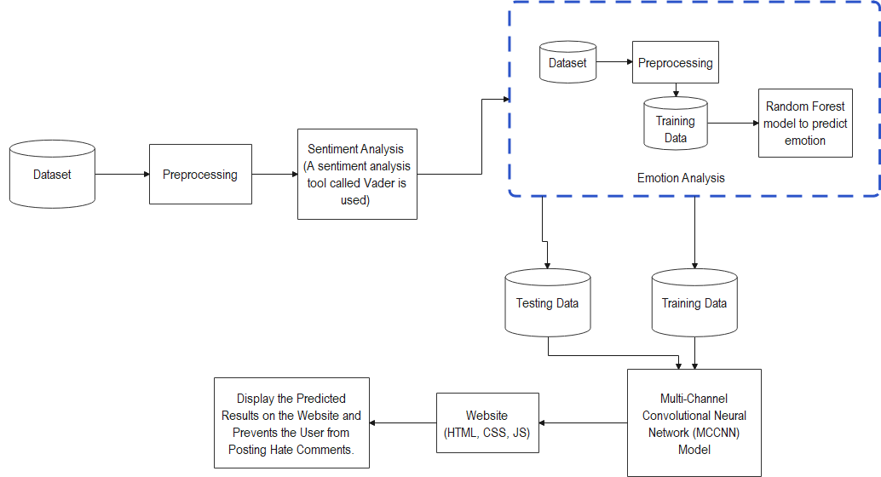
OVERALL ARCHITECTURE (with completed modules highlighted)

Slide 8
LIST OF MODULES
Data acquisition & Pre-processing
Sentiment Analysis
Emotion analysis
Multi-Channel Convolutional Neural Network (MCCNN) model
Front end

Slide 9
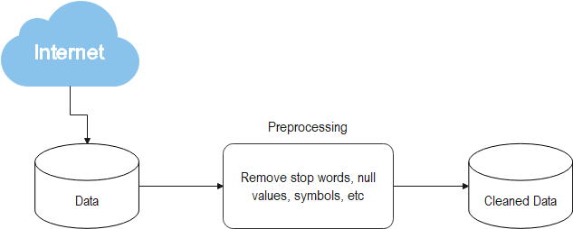
Data acquisition & Pre-processing
Description: Dataset is downloaded from Kaggle and pre-processed to remove junk or noise data
Input-Output:

Slide 10
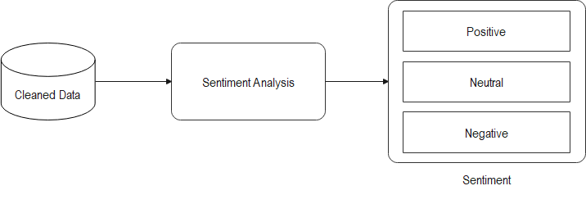
Sentiment Analysis
Description: Sentiment analysis is performed on the data to classify the data as positive or neutral or negative
Input-Output:

Slide 11
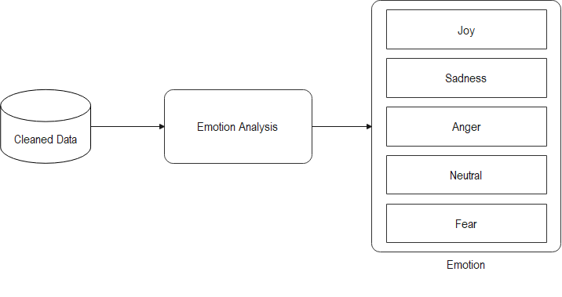
Emotion Analysis
Description: Emotional analysis is performed on the data to classify the data into different emotions (like Joy, Sadness, Fear, etc)
Input-Output:

Slide 12
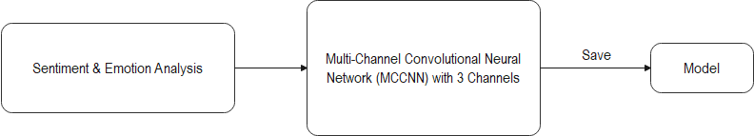
Multi-Channel Convolutional Neural Network (MCCNN) model
Description: MCCNN model is developed to predict the hate speech
Input-Output:

Slide 13

Front end
Description: A website is created with comment section to detect and prevent the hate speech
Input-Output:

Slide 14
EXAMPLE: ALGORITHM STEPS
Emotion Analysis
Step1: Start
Step2: Download dataset
Step3: Import the required modules
Step4: pre-process to remove noise from the data
Step5: Convert the text data into vector by performing TF-IDF vectorizer
Step6: Create a Random Forest Classifier
Step7: Train and Test the model
Step8: Check the Accuracy, Precision and Confusion Matrix
Step9: Save the model to use it for prediction
Step10: Stop

Slide 15
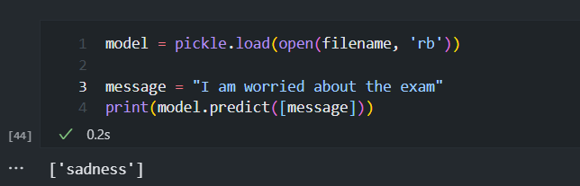
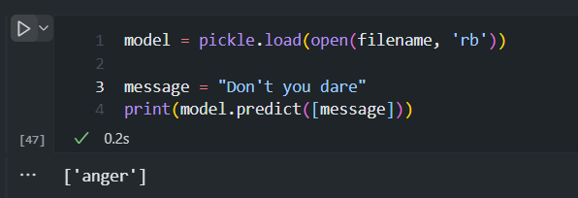
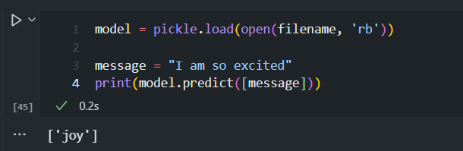
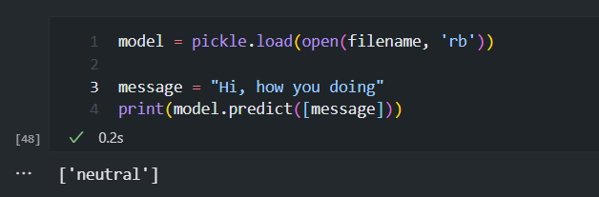
MODULE BASED OUTPUT SCREENSHOTS

Slide 16
REFERENCES
K. A. Qureshi and M. Sabih, "Un-Compromised Credibility: Social Media Based Multi-Class Hate Speech Classification for Text," in IEEE Access, vol. 9, pp. 109465-109477, 2021, doi: 10.1109/ACCESS.2021.3101977.
T. A. Naidu and S. Kumar, "Hate Speech Detection Using Multi-Channel Convolutional Neural Network," 2021 3rd International Conference on Advances in Computing, Communication Control and Networking (ICAC3N), 2021, pp. 908-912, doi: 10.1109/ICAC3N53548.2021.9725696.
A. Kumar, V. Tyagi and S. Das, "Deep Learning for Hate Speech Detection in social media," 2021 IEEE 4th International Conference on Computing, Power and Communication Technologies (GUCON), 2021, pp. 1-4, doi: 10.1109/GUCON50781.2021.9573687.
F. T. Boishakhi, P. C. Shill and M. G. R. Alam, "Multi-modal Hate Speech Detection using Machine Learning," 2021 IEEE International Conference on Big Data (Big Data), 2021, pp. 4496-4499, doi: 10.1109/BigData52589.2021.9671955.
https://towardsdatascience.com/what-is-vectorization-in-machine-learning-6c7be3e4440a
https://towardsdatascience.com/text-processing-is-coming-c13a0e2ee15c

Slide 17
THANK YOU

