Slide 1
HATE SPEECH DETECTION
GUIDE: Ms.B.Siva Shankari STUDENT: Joshua S
REG.NO: 2019202019
COURSE: MCA-Regular (3yrs)

Slide 2
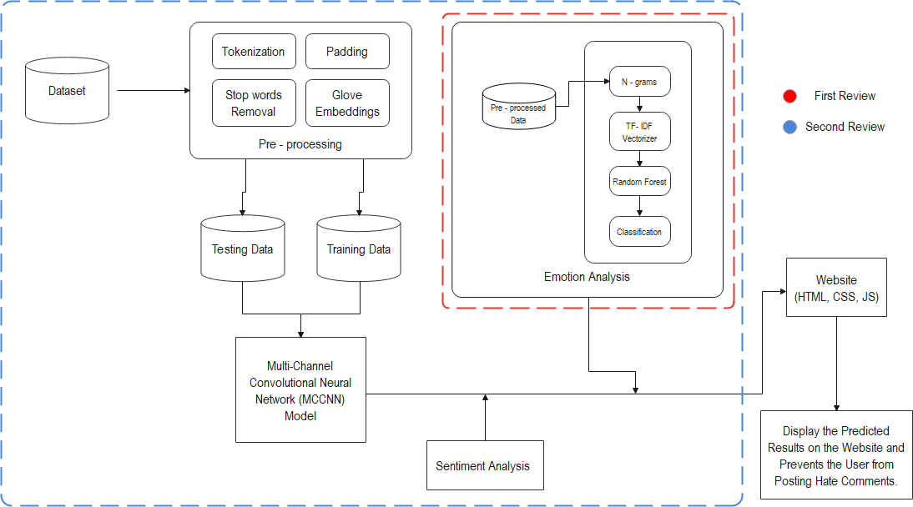
OVERALL ARCHITECTURE

Slide 3
LIST OF MODULES
Data acquisition & Pre-processing
Sentiment Analysis
Emotion analysis
Multi-Channel Convolutional Neural Network (MCCNN) model
Front end

Slide 4
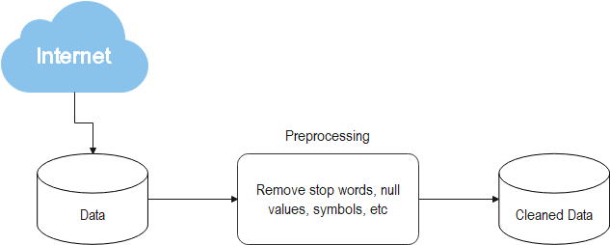
Data acquisition & Pre-processing
Description: Dataset is downloaded from Kaggle and pre-processed to remove junk or noise data
Input-Output:

Slide 5
Data acquisition & Pre-processing Algorithm
Step1: Start
Step2: Import numpy and pandas
Step3: remove stop words, symbols, punctuations, etc
Step4: Convert all text to lower case
Step5: Stop

Slide 6
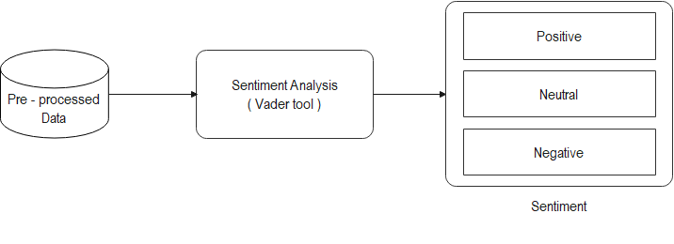
Sentiment Analysis
Description: Sentiment analysis is performed on the data to classify the data as positive or neutral or negative
Input-Output:

Slide 7
Sentiment Analysis
Step1: Start
Step2: Import nltk
Step3: Import Vader from nltk.sentiment
Step4: Use SentimentIntensityAnalyzer from Vader
Step5: Check the polarity score of the text/comment
Step6: Stop

Slide 8
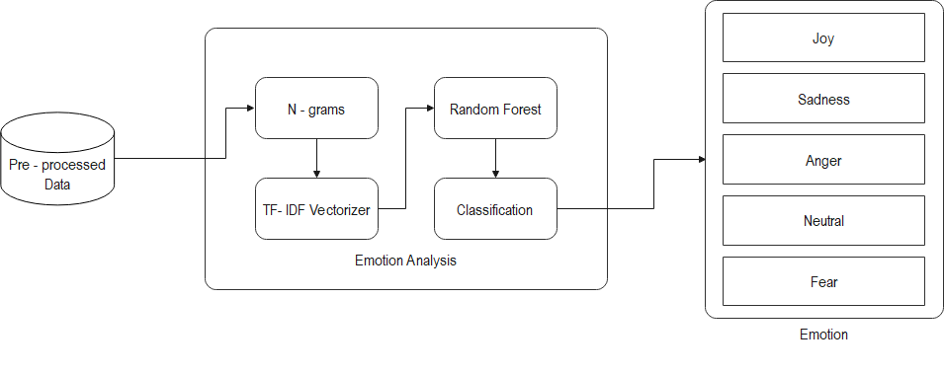
Emotion Analysis
Description: Emotional analysis is performed on the data to classify the data into different emotions (like Joy, Sadness, Fear, etc)
Input-Output:

Slide 9
Emotion Analysis
Step1: Start
Step2: Download dataset
Step3: Import the required modules
Step4: pre-process to remove noise from the data
Step5: Convert the text data into vector by performing TF-IDF vectorizer
Step6: Create a Random Forest Classifier
Step7: Train and Test the model
Step8: Check the Accuracy, Precision and Confusion Matrix
Step9: Save the model to use it for prediction
Step10: Stop

Slide 10
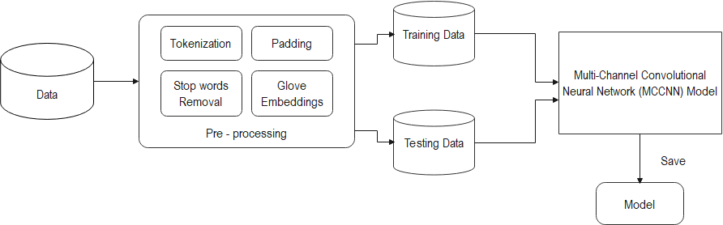
Multi-Channel Convolutional Neural Network (MCCNN) model
Description: MCCNN model is developed to predict the hate speech
Input-Output:

Slide 11
Convolutional Neural Network
Step1: Start
Step2: Import tensorflow and keras
Step3: Add Glove embedding to the tokenized data
Step4: Split the data into train and test
Step5: Create a convolutional base layer with Conv1D with relu activation
Step6: Add Max pooling layer on top
Step7: Add Dense layer with relu activation
Step8: Add Flatten layer
Step9: Add Dense layer with sigmoid with sigmoid activation
Step10: Compile the model with binary cross entropy and adam optimizer
Step11: Stop

Slide 12

Front end
Description: A website is created with comment section to detect and prevent the hate speech
Input-Output:

Slide 13
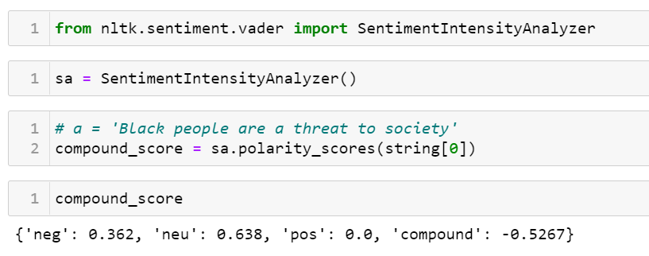
MODULES IMPLEMENTATION

Slide 14
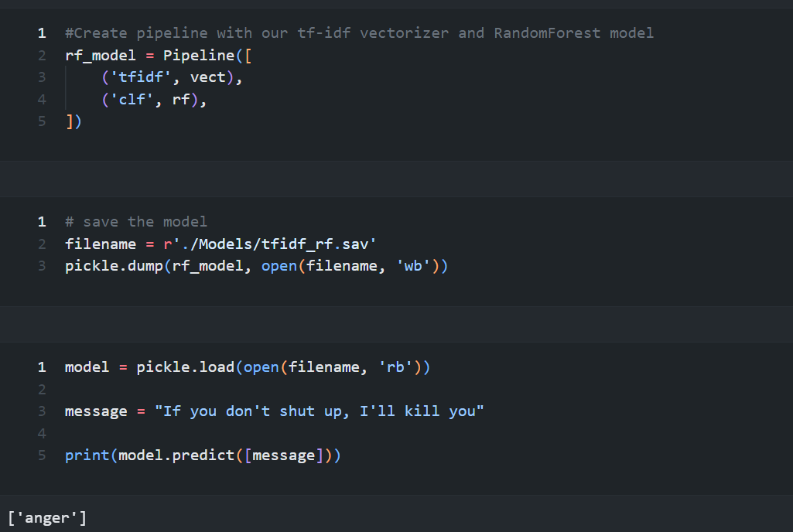

Slide 15
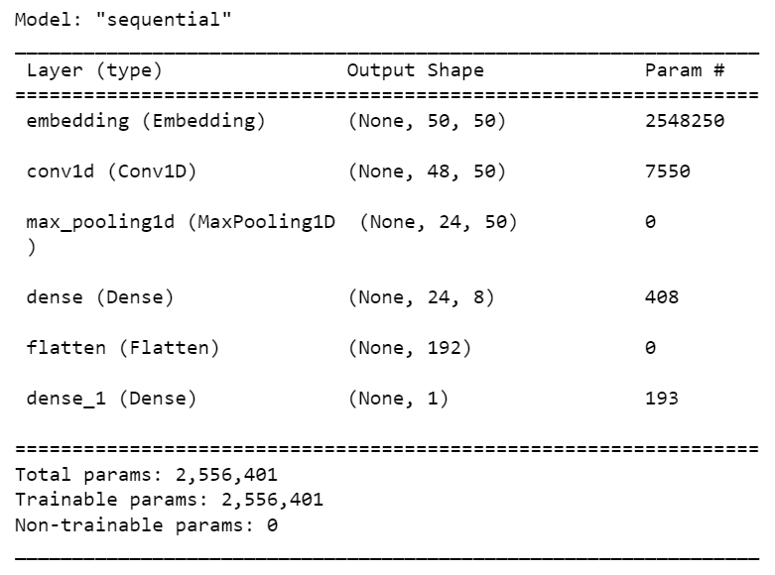

Slide 16
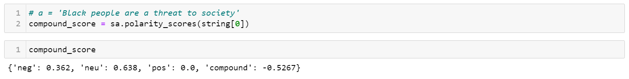
MODULE BASED OUTPUT SCREENSHOTS
Sentiment Analysis output

Slide 17
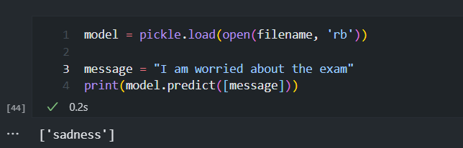
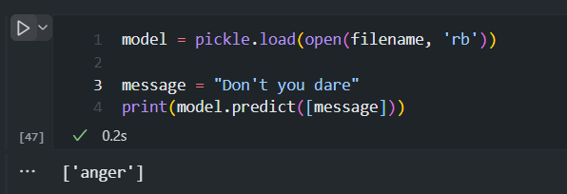
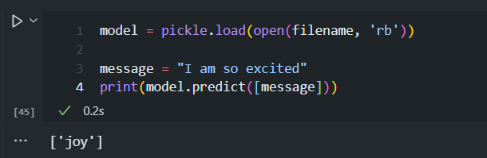
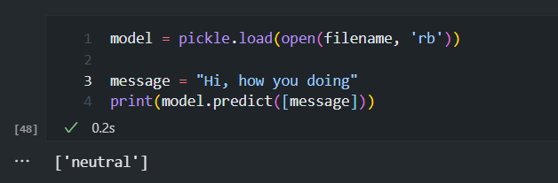
MODULE BASED OUTPUT SCREENSHOTS
Emotion Analysis output

Slide 18
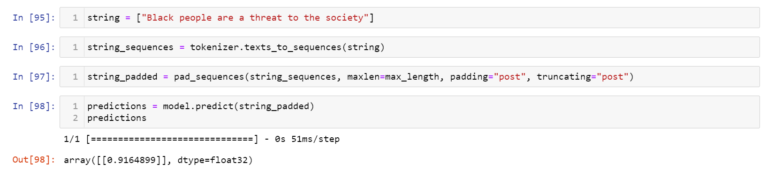
MODULE BASED OUTPUT SCREENSHOTS
Hate Speech Detection Using CNN

Slide 19
THANK YOU

