Slide 1

Make your own games with Roblox

Slide 2
Roblox Studio
https://www.roblox.com/create

Slide 3
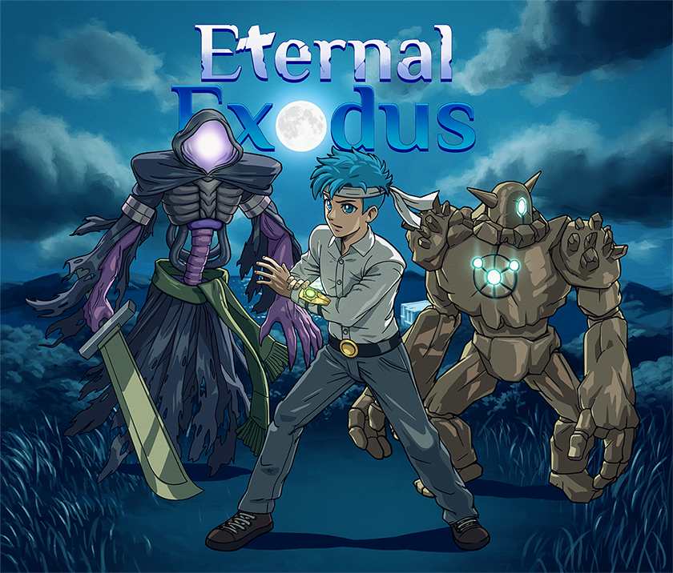
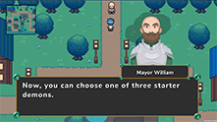
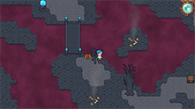
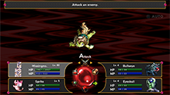
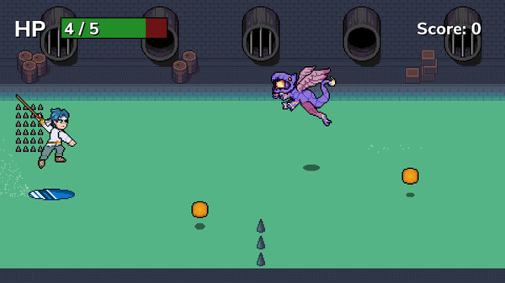
About me
Josh Forde
josh@joshforde.com
Linkedin.com/joshforde
Senior software engineer by day
Game developer by night
Current project: Eternal Exodus, a monster-catching RPG out in 2023 on PC and all consoles. Currently on Kickstarter

Slide 4
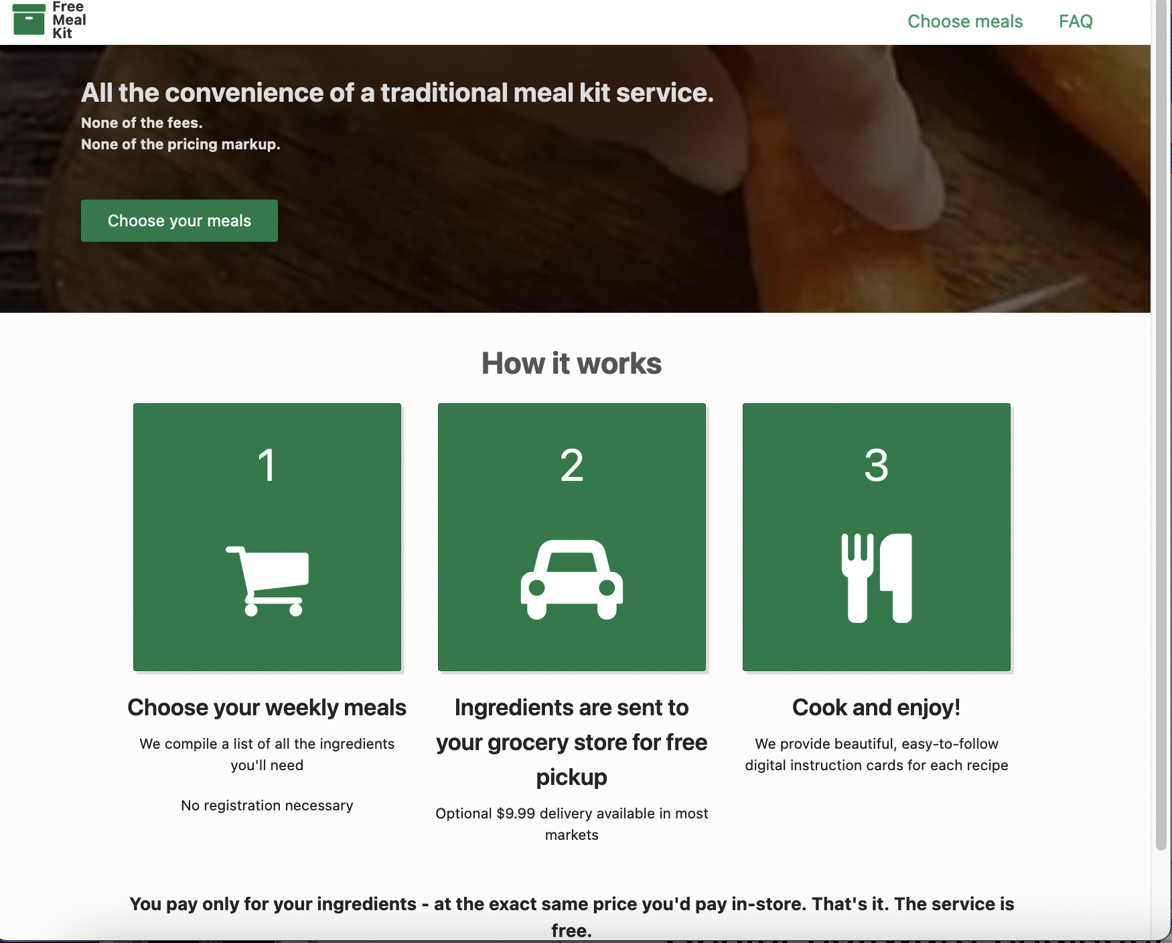
About me
Also publishing some web apps
FreeMealKit.com launching in a couple of weeks
like HelloFresh but free

Slide 5
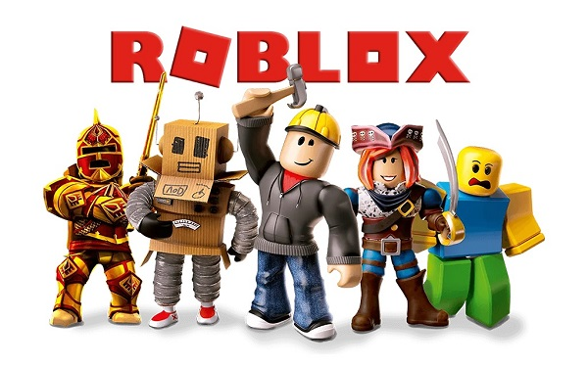
Roblox, the game platform
More than just a game
An entire game engine for making, playing, and distributing small-lobby multiplayer games
Released in 2006, really became popular around a decade ago
Just went public on the stock exchange last year, likely to be popular for years to come

Slide 6
Roblox for developers
You can make a game and sell premium items in it for Robux
These items tend to be similar to microtransactions in mobile games: vanity items (skins), items to give an edge in a game / to speed up progress, spawning new objects to interact with (want a fancy car?), etc.
You can also create objects for other developers to use in their games
Those get sold on the marketplace inside of Roblox Studio
Sold for Robux
Think of things that would have appeal to many developers for a wide variety of games: cars, swords, etc.

Slide 7
Making real money with Roblox
Everything is sold for Robux, but…
You can cash out Robux for real money
There are restrictions: you need to sell 100,000 Robux (around $350) worth of items before you can cash out anything
Some groups of developers make upwards of $1 million/year from Roblox, but this is rare
Still, less famous developers have talked in interviews about paying their way through college with Roblox earnings

Slide 8
Tools for development
Roblox Studio
An editor for everything: creating levels, creating models for objects, writing Lua scripts to power your objects, publishing your game to the world, and selling
When you publish your game in Roblox Studio, it becomes immediately available to play
Rojo
For advanced developers, especially those with other programming experience
A development kit that you can use on top of Roblox Studio
Allows you to write your code in Visual Studio Code, and even allows for use of languages other than Lua, such as TypeScript
Also sets up Git repositories for you

Slide 9
Parts: the foundation of a Roblox game
Almost every object in the game is either a part or a combination of parts
Parts are basic objects: spheres, cubes, cylinders
In your game, you can construct things like this with parts:
Platforms/obstacles for your level
Houses
Swords, guns
You can change what parts do via Lua scripts: how they move, what sound effects they can play, whether the player can pick them up and perform actions with them, etc.

Slide 10
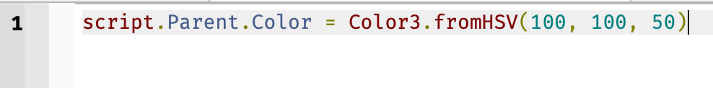
Scripting
Attach a script to a part by hovering over the part’s name and clicking the + button
Scripts can access properties of the object via script.Parent
Example: change the color of a part to orange:

Slide 11
Scripting
Let’s create a moving platform via script
1. Create a part to use as the platform
2. Create a new script for it (hover over its + icon and click Script)
3. Paste the following:
local part = script.Parent
local tweenService = game:GetService("TweenService")
local tweenInfo = TweenInfo.new(3.0, Enum.EasingStyle.Sine, Enum.EasingDirection.Out, -1, true, 0.5)
local tween = tweenService:Create(part, tweenInfo, { Position = part.Position + Vector3.new (0, 20, 0 )})
tween:Play()

Slide 12
Thank you for coming
Slides available at
www.github.com/Josh1billion/roblox
My contact info:
LinkedIn.com/JoshForde
josh@joshforde.com

