Slide 1

Real-time multiplayer game development with Node.js and Socket.io

Slide 2



Slide 3


Slide 4


About me
Josh Forde
Web developer at UW Health by day
  since January 2014
Game developer by night
  founded Fordesoft, LLC in January 2015
  working on PS Vita and PC games. PlayStation 4 soon, probably.

Slide 5
Goals of this talk
Come out able to write a basic game
Approachable to everyone with intermediate JavaScript skills. No Node.js experience or game development experience necessary
Simplicity over everything else; too much to cover otherwise
Skipping some common conventions for that reason

Slide 6
What is Node.js, anyway?
Platform built on JavaScript, running on Google's V8 engine
Not a web framework itself
More like a programming language that extends JavaScript
Comes with a package manager called npm, used frequently when developing Node.js apps

Slide 7
What is Node.js, anyway?
Single-threaded
Asynchronous (woo, callbacks!)

Slide 8
Okay, but what's Socket.io?
One of many packages you can add to your app with npm
Allows easy use of WebSockets
Uses event-based messaging
Client and server can send messages to each other, which consist of a string (the message type) and a JSON object
  Example: client tells server “I want to move to [50, 400]”:
  socket.emit('moveRequest', { x: 50, y: 400 });

Slide 9
Okay, but what's Socket.io?
Consists of a server component (for your Node.js app) and a JavaScript client library
Client libraries also exist for other languages, including C++. You can still write your server with Node.js/socket.io, even if your game isn't an HTML5 game

Slide 10
HTML5 features for game rendering
HTML5 canvas: a way to dynamically generate images without DOM manipulation. In-game, this happens once per frame (generally 30 or 60 times per second)
Allows rendering of images, text and primitives (rectangles, polygons, lines, etc.)
Generally a little slow, so best for simple 2D games

Slide 11
HTML5 features for game rendering
WebGL for 3D games and more performance-intensive games

Slide 12
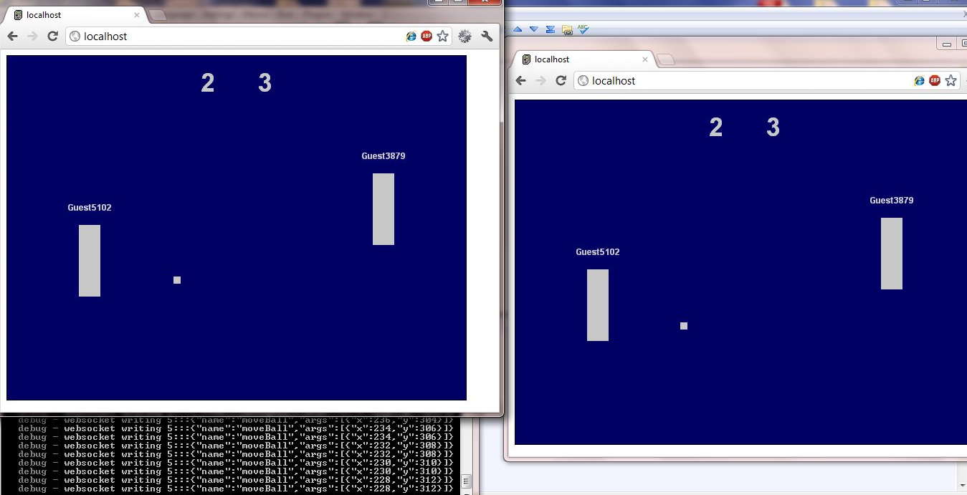
Examples

Slide 13
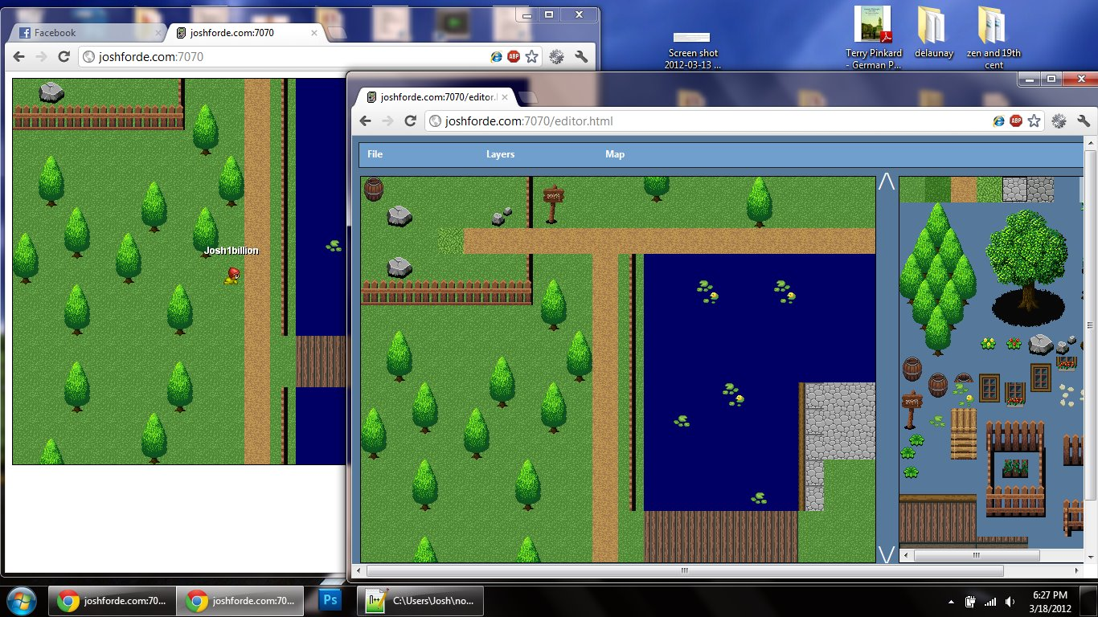
Examples

Slide 14
Demo

Slide 15
Additional considerations: security
The most important rule: never trust the client
This means the server should always have logic to make sure a client's request “makes sense” before acting upon it

Slide 16
Additional considerations: security
Example: if a player wants to move to [x,y], can they get there from their current position? If not, discard the move request

Slide 17
Additional considerations: latency compensation
Currently, if there's any lag between the client and the server, it will be very noticeable to the player
A better approach: update the client's display model immediately, and just have the server correct it if it gets too far off-track

Slide 18
Additional considerations: databases
npm has many packages for dealing with various databases
Document-oriented databases (CouchDB, MongoDB, etc.) are great in Node.js, since you can store and retrieve JSON objects directly
Examples: high scores, players' character information, etc.

Slide 19
Contact info
josh@fordesoft.com
Twitter: @fordesoft

