Slide 1
EDES 301 Project Proposal Remote Controlled, Music Streaming, Self-Balancing Robot
October 5th, 2025
Joshua Aviles

Slide 2
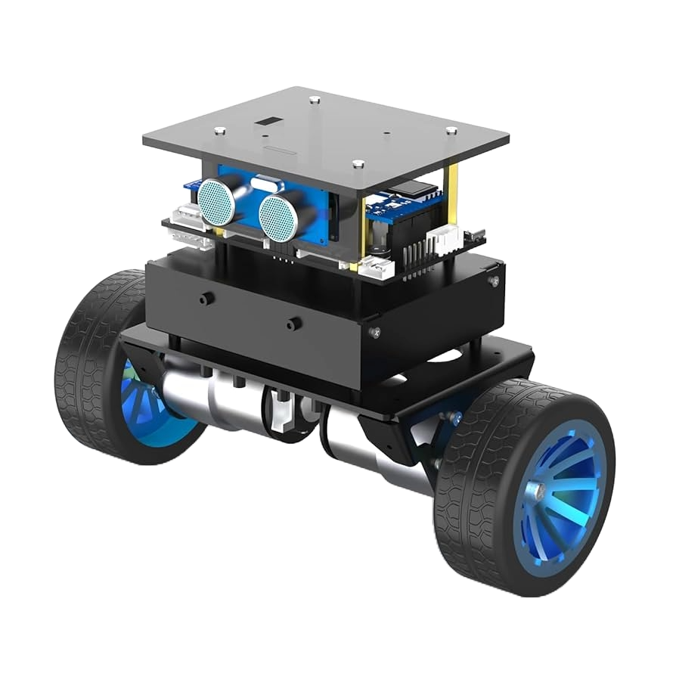
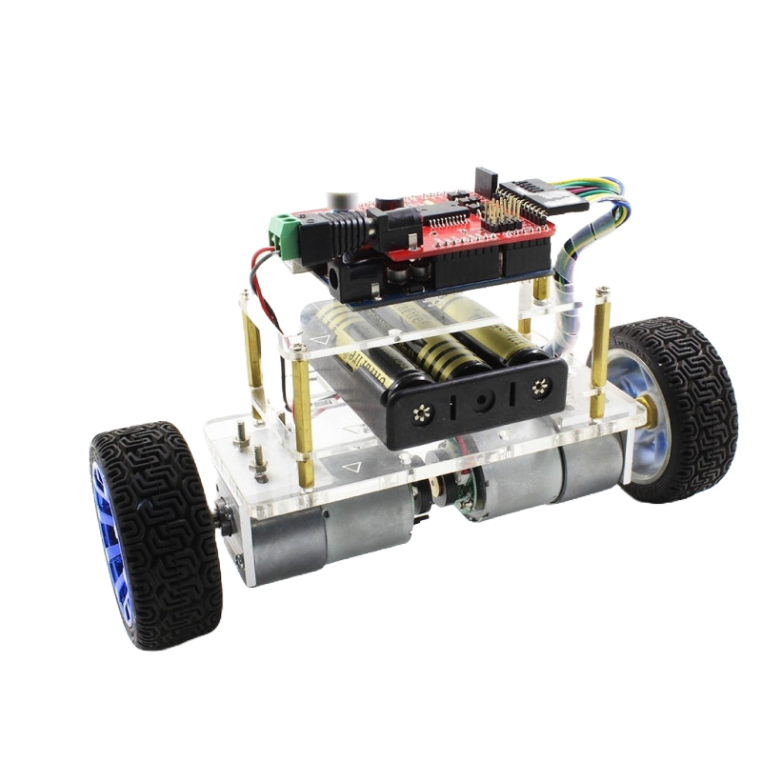
Background Information
Project Proposal
A two wheeled robot that uses two Nema 17 stepper motors and a PID algorithm to self-balance and move around
Wireless controller uses ESP32 and joystick modules to send out commands to robot’s motors and LED display
PocketBeagle uses a USB Bluetooth module in order to wirelessly communicate with controllers ESP32 (PocketBeagle is used instead of another ESP32, like in other projects)
A 16x32 RGB LED display allows for facial expressions and displays songs played on speaker (addition to previous projects)
Robots USB speaker connects to IOS system in order to stream music from an app (addition to previous projects)

Slide 3
System Block Diagram
14.8V LiPo Battery
HiLetgo 12V to 5V Converter
16x32 LED Display
ESP32 WROOM 32
Vmot
13 GPIO Pins
CLK
LA
OE
Voltage
Divider
GPIO
Step
Dir
En
Sleep
A4988 Motor Drivers
A4988 Motor Drivers
Bluetooth USB Adapter
Bluetooth Serial (SPP)
5V LiPo Battery
Powered USB Hub
VRx
Vry
SW
1A
1B
2A
2B
1A
1B
2A
2B
PocketBeagle
Joystick Module
Powered USB Hub
VRx
Vry
SW
P2_11 to SDL
NEMA 17 Stepper Motor
NEMA 17 Stepper Motor
USB Speaker
P2_9 to SCL
Joystick Module
IMU

Slide 4
Power Block Diagram – Robot Components
OVONIC LiPo Battery
14.8V
1300mAh
HiLetgo 12V to 5V Converter
Input: 14.8V
Output: 5V
USB Speaker
Input: 3W = (5V)(600mA)
16x32 LED Display
Input(max):
12.5W = (5V)(2.5A)
A4988 Motor Driver
Motor
Input: 22.2W = (14.8V)(1.5A)
Output: 5.175W = (3.45V)(1.5A)
Logic(From PocketBeagle)
Input: 33mW = (3.3V)(10mA)
A4988 Motor Driver
Motor
Input: 22.2W = (14.8V)(1.5A)
Output: 5.175W = (3.45V)(1.5A)
Logic(From PocketBeagle)
Input: 33mW = (3.3V)(10mA)
PocketBeagle
Input: 2.5W = (5V)(500mA)
Output: 33mW = (3.3V)(10mA)
NEMA 17 Stepper Motor
Input:
5.175W = (3.45V)(1.5A)
NEMA 17 Stepper Motor
Input:
5.175W = (3.45V)(1.5A)
IMU Sensor
Input: 33mW = (3.3V)(10mA)

Slide 5
Power Block Diagram – Controllers Components
5V LiPo Battery
Output:
858mW = (5V)(260mA)
Voltage Divider
Joystick Module
Input: 25mW = (5V)(5mA)
Joystick Module
Input: 25mW = (5V)(5mA)
ESP32 WROOM 32
Input:
825mW = (3.3V)(250mA)

Slide 6
Software Diagram
IMU Sensor
Class: Reads and Filters IMU Data
Class: Runs Balance Control Algorithm(PID)
User Input
Joystick Modules
User Input
Buttons
ESP32 - Controller
Class: Controller Input Reading
and Processing(C++)
Motor Drivers
Class: Motor Speed and
Directions(PWM)
Pocket Beagle
Python and Linux
USB Bluetooth
Class: A2DP Sink
Class: SPP Control Line
Separate Cellular Device
Class: A2DP Source

Slide 7
Components / Budget
Component | EDES301 to Buy? | Cost
NEMA 17 Stepper Motors (2) – Amazon Link | Yes | $19.98
A4988 Motor Drivers (5) – Amazon Link | Yes | $10.19
Joystick Modules (2) – Amazon Link | Yes | $2.66
USB Speaker (1) – Amazon Link | No | $16.98
USB Bluetooth (1) – Amazon Link | No | $9.99
IMU (1) – Amazon Link | Yes | $2.10
OVONIC 4S 14.8V 1300mAh LiPo Battery (1) – Amazon Link | No | $18.99
12V to 5V Converter (1) – Amazon Link | No | $8.89
ESP32 WROOM 32 (1) – Amazon Link | No | $8.99
5V LiPo Battery (1) – Amazon Link | No | $20.99

