Slide 1
CS 143A: Operating Systems
Discussion 7: Midterm review

Slide 2
Q1 Calling Conventions
Use assembly to create a proper call site for the following C function invocation (i.e., invoke this function with the below arguments)
where the foo function looks like this:
ret = foo(1, 2, 3, 4);
int foo (int x, int y, int z, int w)
{
int a = 5,
b = 6;
a += b + x + y + z + w;
return a;
};

Slide 3
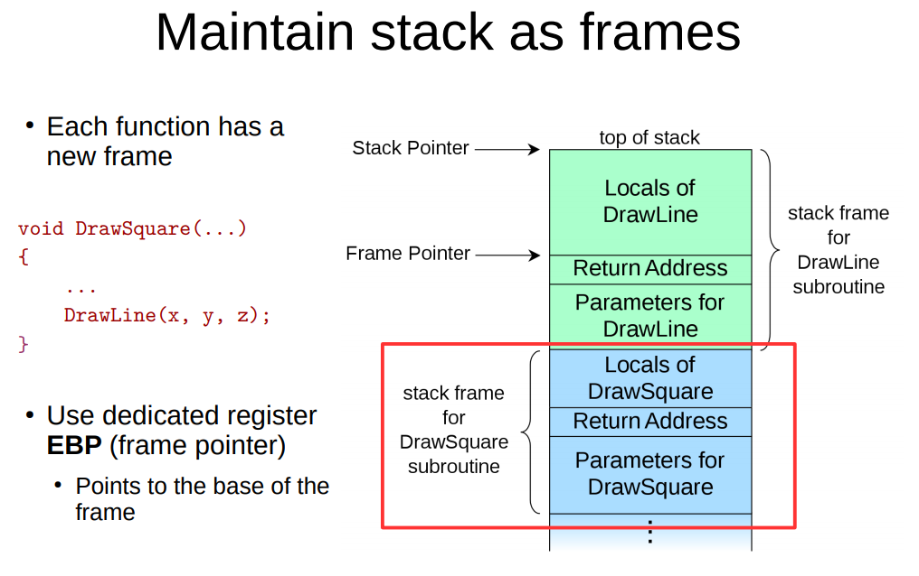
Q1 Calling Conventions

Slide 4
Q1 Calling Conventions
Use assembly to create a proper call site for the following C function invocation (i.e., invoke this function with the below arguments)
ret = foo(1, 2, 3, 4);
push 4
push 3 push 2 push 1 call foo

Slide 5
Q1 Calling Conventions
Use the assembly to save the result returned by the foo function above on the stack, i.e.,
...
call foo
// add you asm code here
;remove arguments from frame
add esp, 16 ;Save result returned by foo push eax

Slide 6
Q1 Calling Conventions
Assume that you program uses x86 32bit machine instructions and maintains the stack frame. Draw the call stack (including the arguments passed to foo) at the instruction that starts computing this arithmetic expression inside foo: b + x + y + z + w
ret = foo(1, 2, 3, 4);
|0x4| [ebp + 20] (4th function argument)
|0x3| [ebp + 16] (3rd function argument)
|0x2| [ebp + 12] (2nd function argument)
|0x1| [ebp + 08] (1st function argument)
|RA| [ebp + 04] (Return Address)
|FP| [ebp] (old ebp value) ← EBP
|0x5| [ebp - 04] (1st local variable)
|0x6| [ebp - 08] (2nd local variable) ← ESP
int foo (int x, int y, int z, int w)
{
int a = 5,
b = 6;
a += b + x + y + z + w;
return a;
};

Slide 7
System call interface
Write a simple xv6 or Linux program that starts grep redirecting its standard input to the /foobar.txt file and connecting its standard output to the pipe that connects to the standard input of wc -l. Your code does not have to be perfect C, but has to use all system calls correctly (please explain the usage with comments), you can use either xv6 or Linux system calls.

Slide 8
System call interface
Write a simple xv6 or Linux program that starts grep redirecting its standard input to the /foobar.txt file and connecting its standard output to the pipe that connects to the standard input of wc -l. Your code does not have to be perfect C, but has to use all system calls correctly (please explain the usage with comments), you can use either xv6 or Linux system calls.
grep xxxx < foobar.txt | wc -l

Slide 9
#include <stdio.h>
#include <sys/types.h>
#include <sys/fcntl.h>
#include <unistd.h>
int main()
{
int p[2], f;
char *argv_grep[3], *argv_wc[3];
argv_grep[0] = "grep"; // grep command
argv_grep[1] = "Q"; // or anything you want to grep
argv_grep[2] = 0; // Null terminator
argv_wc[0] = "wc"; // wc command
argv_wc[1] = "-l"; // -l argument
argv_wc[2] = 0; // Null terminator
pipe(p); // Create a pipe
// Split into 2 processes
if(fork() == 0) { // Child process
f = open("foobar.txt", O_RDONLY);
close(0); // Close STDIN
dup(f); // copy foobar FD to 0
close(f); // Close the duplicate foobar FD
close(1); // Close STDOUT
dup(p[1]); // Connect the pipe's input
close(p[0]); // Close duplicate pipe FD
close(p[1]);
execv("/bin/grep", argv_grep);
} else {
close(0); // Close STDIN
dup(p[0]); // Connect the pipe's output
close(p[0]); // Close duplicate pipe FD
close(p[1]);
execv("/bin/wc", argv_wc);
}
}

Slide 10
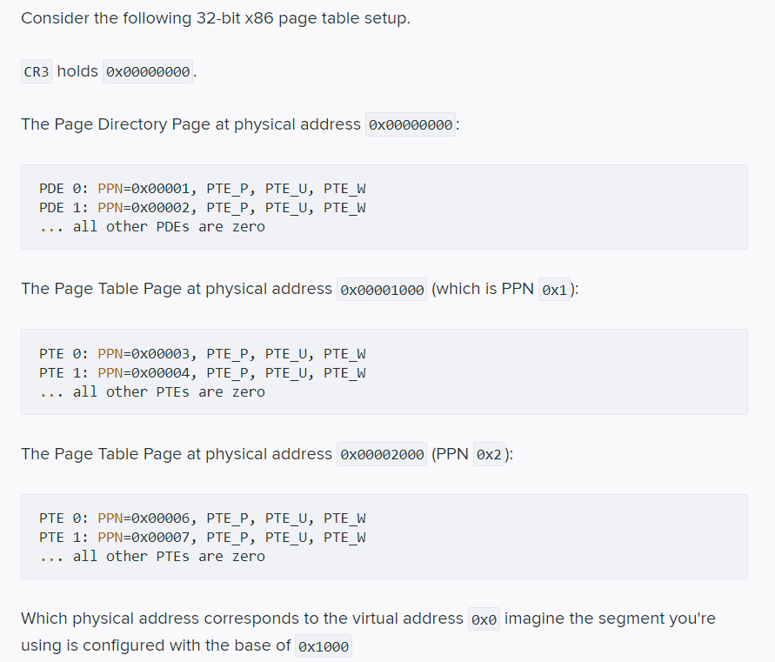
Q3 Segmentation and paging

Slide 11
Q3 Segmentation and paging
VA: 0x0

Slide 12
Q3 Segmentation and paging
VA: 0x0 0b 0000000000 0000000000 000000000000

Slide 13
Q3 Segmentation and paging
VA: 0x0 0b 0000000000 0000000000 000000000000
PTD index
PT index
Offset within page

Slide 14
Q3 Segmentation and paging
VA: 0x0 0b 0000000000 0000000000 000000000000
PTD index
PT index
Offset within page
CR3
0x00000000

Slide 15
Q3 Segmentation and paging
VA: 0x0 0b 0000000000 0000000000 000000000000
PTD index
PT index
Offset within page
0x00001
PPN: 1
CR3
0x00000000

Slide 16
Q3 Segmentation and paging
VA: 0x0 0b 0000000000 0000000000 000000000000
PTD index
PT index
Offset within page
0x00001
0x00001
PPN: 1
PPN: 3
CR3
0x00000000
0x00001000

Slide 17
Q3 Segmentation and paging
VA: 0x0 0b 0000000000 0000000000 000000000000
PTD index
PT index
Offset within page
Physical address before base translation
0x00003000 + 0x000 = 0x00003000

Slide 18
Q3 Segmentation and paging
VA: 0x0 0b 0000000000 0000000000 000000000000
PTD index
PT index
Offset within page
Physical address before base translation
0x00003000 + 0x000 = 0x00003000
Physical address after base translation
0x00003000 + 0x1000 = 0x00004000

Slide 19
Q3.2
Construct a page table that maps three pages at virtual addresses 0x8010 0000, 0x8010 1000, and 0x8010 2000 to physical addresses 0x 0, 0x 10 1000, and 0x 10 2000. To define the page table you can use the format similar to the one in the question above

Slide 20
Q3.2
Construct a page table that maps three pages at virtual addresses 0x8010 0000, 0x8010 1000, and 0x8010 2000 to physical addresses 0x 0, 0x 10 1000, and 0x 10 2000.
0x8010 0000 = 0b 1000000000 0100000000 000000000000 -> 0x0 0x8010 1000 = 0b 1000000000 0100000001 000000000000 -> 0x10 1000 0x8010 2000 = 0b 1000000000 0100000010 000000000000 -> 0x10 2000

Slide 21
Q3.2
0x8010 0000 = 0b 1000000000 0100000000 000000000000 -> 0x0 0x8010 1000 = 0b 1000000000 0100000001 000000000000 -> 0x10 1000 0x8010 2000 = 0b 1000000000 0100000010 000000000000 -> 0x10 2000
CR3: 0x00000000
Page Directory Page at physical address 0x00000000:
The Page Table Page at physical address 0x00001000 (which is PPN 0x1):
Underlined numbers can have different values
Bold numbers are critical
PDE 512 (0x200): PPN=0x00001, PTE_P, PTE_U, PTE_W
... all other PDEs are zero
PTE 256 (0x100): PPN=0x000, PTE_P, PTE_U, PTE_W
PTE 257 (0x101): PPN=0x101, PTE_P, PTE_U, PTE_W
PTE 258 (0x102): PPN=0x102, PTE_P, PTE_U, PTE_W
... all other PTEs are zero

Slide 22
Q4.1: For each variable in the program explain where and how it is allocated
#include <stdio.h>
int y;
static int inc(int a) {
return a + 1;
}
int dec(int b) {
return inc(b) - 1;
}
void main () {
int x;
x = 5;
y = dec(x);
printf("result:%d\n", y);
}

Slide 23
Q4.1: For each variable in the program explain where and how it is allocated
#include <stdio.h>
int y;
static int inc(int a) {
return a + 1;
}
int dec(int b) {
return inc(b) - 1;
}
void main () {
int x;
x = 5;
y = dec(x);
printf("result:%d\n", y);
}
y: Uninitialized global variable placed in .bss section during compilation
a: Local variable in stack, pushed by caller during runtime
b: Local variable in stack, pushed by caller during runtime
x: Local variable in stack, allocated by main() during runtime

Slide 24
Q4.2: Imagine the program was compiled to be loaded at address 0x0. Which symbols in the program need to be relocated if you load this program in memory at address 0x10 0000.
#include <stdio.h>
int y;
static int inc(int a) {
return a + 1;
}
int dec(int b) {
return inc(b) - 1;
}
void main () {
int x;
x = 5;
y = dec(x);
printf("result:%d\n", y);
}

Slide 25
Q4.2: Imagine the program was compiled to be loaded at address 0x0. Which symbols in the program need to be relocated if you load this program in memory at address 0x10 0000.
#include <stdio.h>
int y;
static int inc(int a) {
return a + 1;
}
int dec(int b) {
return inc(b) - 1;
}
void main () {
int x;
x = 5;
y = dec(x);
printf("result:%d\n", y);
}
gcc Q4.c -c -fno-pic -static -fno-builtin -m32 -fno-omit-frame-pointer -o q4_elf
readelf -r q4_elf
Relocation section '.rel.text' at offset 0x23c contains 5 entries:
Offset | Info | Type | Sym.Value | Sym. Name
0000003a | 00000b02 | R_386_PC32 | 0000000b | dec
0000003f | 00000a01 | R_386_32 | 00000004 | y
00000044 | 00000a01 | R_386_32 | 00000004 | y
0000004f | 00000601 | R_386_32 | 00000000 | .rodata
00000054 | 00000d02 | R_386_PC32 | 00000000 | printf
Relocation section '.rel.eh_frame' at offset 0x264 contains 3 entries:
Offset | Info | Type | Sym.Value | Sym. Name
00000020 | 00000202 | R_386_PC32 | 00000000 | .text
00000040 | 00000202 | R_386_PC32 | 00000000 | .text
00000060 | 00000202 | R_386_PC32 | 00000000 | .text

Slide 26
Q4.2: Imagine the program was compiled to be loaded at address 0x0. Which symbols in the program need to be relocated if you load this program in memory at address 0x10 0000.
#include <stdio.h>
int y;
static int inc(int a) {
return a + 1;
}
int dec(int b) {
return inc(b) - 1;
}
void main () {
int x;
x = 5;
y = dec(x);
printf("result:%d\n", y);
}
y, dec, printf, "result:%d\n" (.rodata) (main)

