Slide 1
CS 143A
Principles of Operating Systems

Slide 2
XV6

Slide 3
XV6
QEMU

Slide 4
XV6
QEMU
Virtual Box

Slide 5
XV6
QEMU
Virtual Box
Vagrant

Slide 6
https://goo.gl/UzpgBP
http://www.ics.uci.edu/~aburtsev/143A/hw/xv6-setup.html

Slide 7
ssh into Vagrant
We suggest you create a new folder for your ics143a homeworks, like
andromeda$mkdir ics143a
Change into that directory:
andromeda$cd ics143a
Fetch a version of the vagrant environment that explains to vagrant what kind of virtual machine you're planning to run:
andromeda$ wget http://www.ics.uci.edu/~aburtsev/143A/hw/xv6-vagrant-master.tgz
andromeda$ tar -xzvf xv6-vagrant-master.tgz
Change into the new folder
andromeda$ cd xv6-vagrant-master

Slide 8
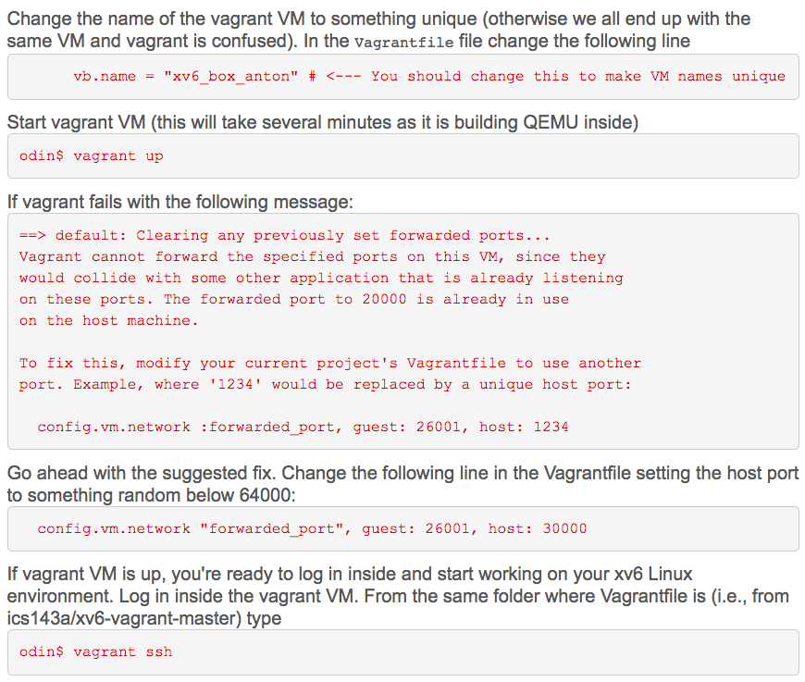

Slide 9
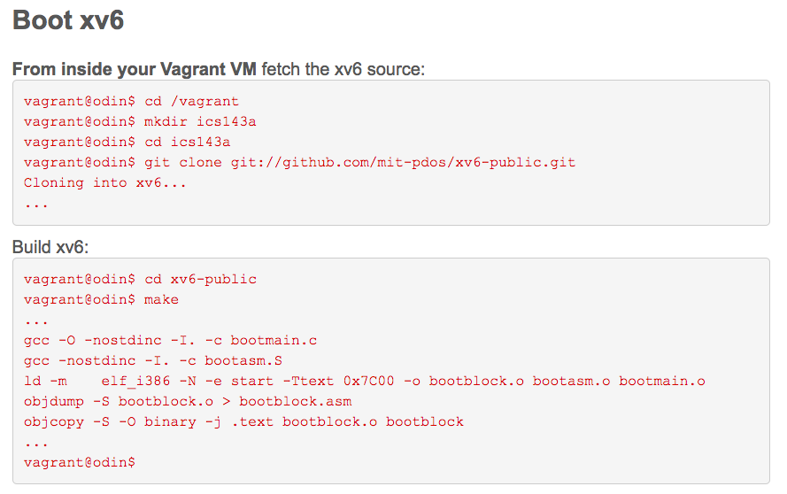

Slide 10
make qemu-nox
make qemu: Build everything and start qemu with the VGA console in a new window and the serial console in your terminal. To exit, either close the VGA window or press Ctrl-c or Ctrl-a x in your terminal.
make qemu-nox Like make qemu, but run with only the serial console. To exit, press Ctrl-a x. This is particularly useful over SSH connections to Athena dialups because the VGA window consumes a lot of bandwidth.

Slide 11
Questions ?

