Slide 1
Memory hierarchy

Slide 2

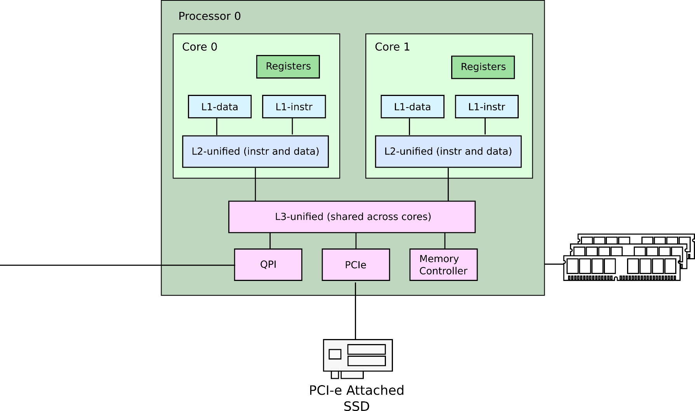
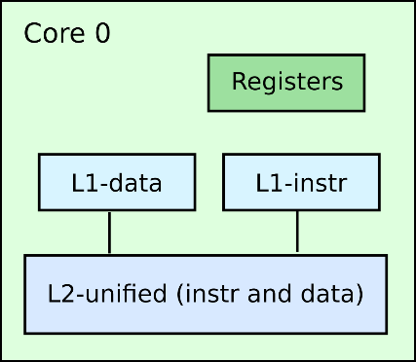
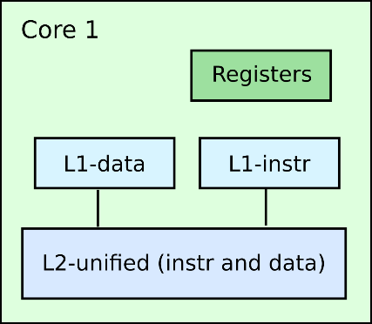
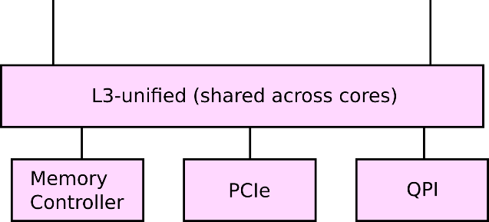
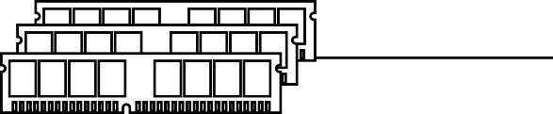
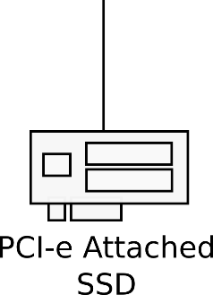
Processors, cores, memory and PCIe

Slide 3

Caches (load)

Slide 4
Cache-coherence (store)

Slide 5
Cache-coherence (load of modified)

Slide 6


Latencies: load from local L1

Slide 7


Latencies: load from local L2

Slide 8


Latencies: load from local L3

Slide 9

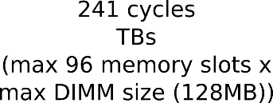
Latencies: load from local memory

Slide 10

Latencies: load from same die core’s L2

Slide 11

Latencies: load from same die core’s L1

Slide 12

Latencies: load from remote L3

Slide 13



Latencies: load from remote memory

Slide 14

Latencies: load from remote L2

Slide 15

Latencies: load from remote L2

Slide 16

Latencies: PCIe round-trip

Slide 17
Device I/O
Essentially just sending data to and from external devices
Modern devices communicate over PCIe
Well there are other popular buses, e.g., USB, SATA (disks), etc.
Conceptually they are similar
Devices can
Read memory
Send interrupts to the CPU

Slide 18

Direct memory access

Slide 19

Interrupts
int 0x…

Slide 20
Device I/O
Write incoming data in memory, e.g.,
Network packets
Disk requests, etc.
Then raise an interrupt to notify the CPU
CPU starts executing interrupt handler
Then reads incoming packets form memory
int 0x…

Slide 21

Device I/O (polling mode)
Alternatively the CPU has to check for incoming data in memory periodically
Or poll
Rationale
Interrupts are expensive

Slide 22
References
Cache Coherence Protocol and Memory Performance of the Intel Haswell-EP Architecture. http://ieeexplore.ieee.org/abstract/document/7349629
Intel SGX Explained https://eprint.iacr.org/2016/086.pdf
DC Express: Shortest Latency Protocol for Reading Phase Change Memory over PCI Express https://www.usenix.org/system/files/conference/fast14/fast14-paper_vucinic.pdf

Slide 23
Thank you!

