Slide 1
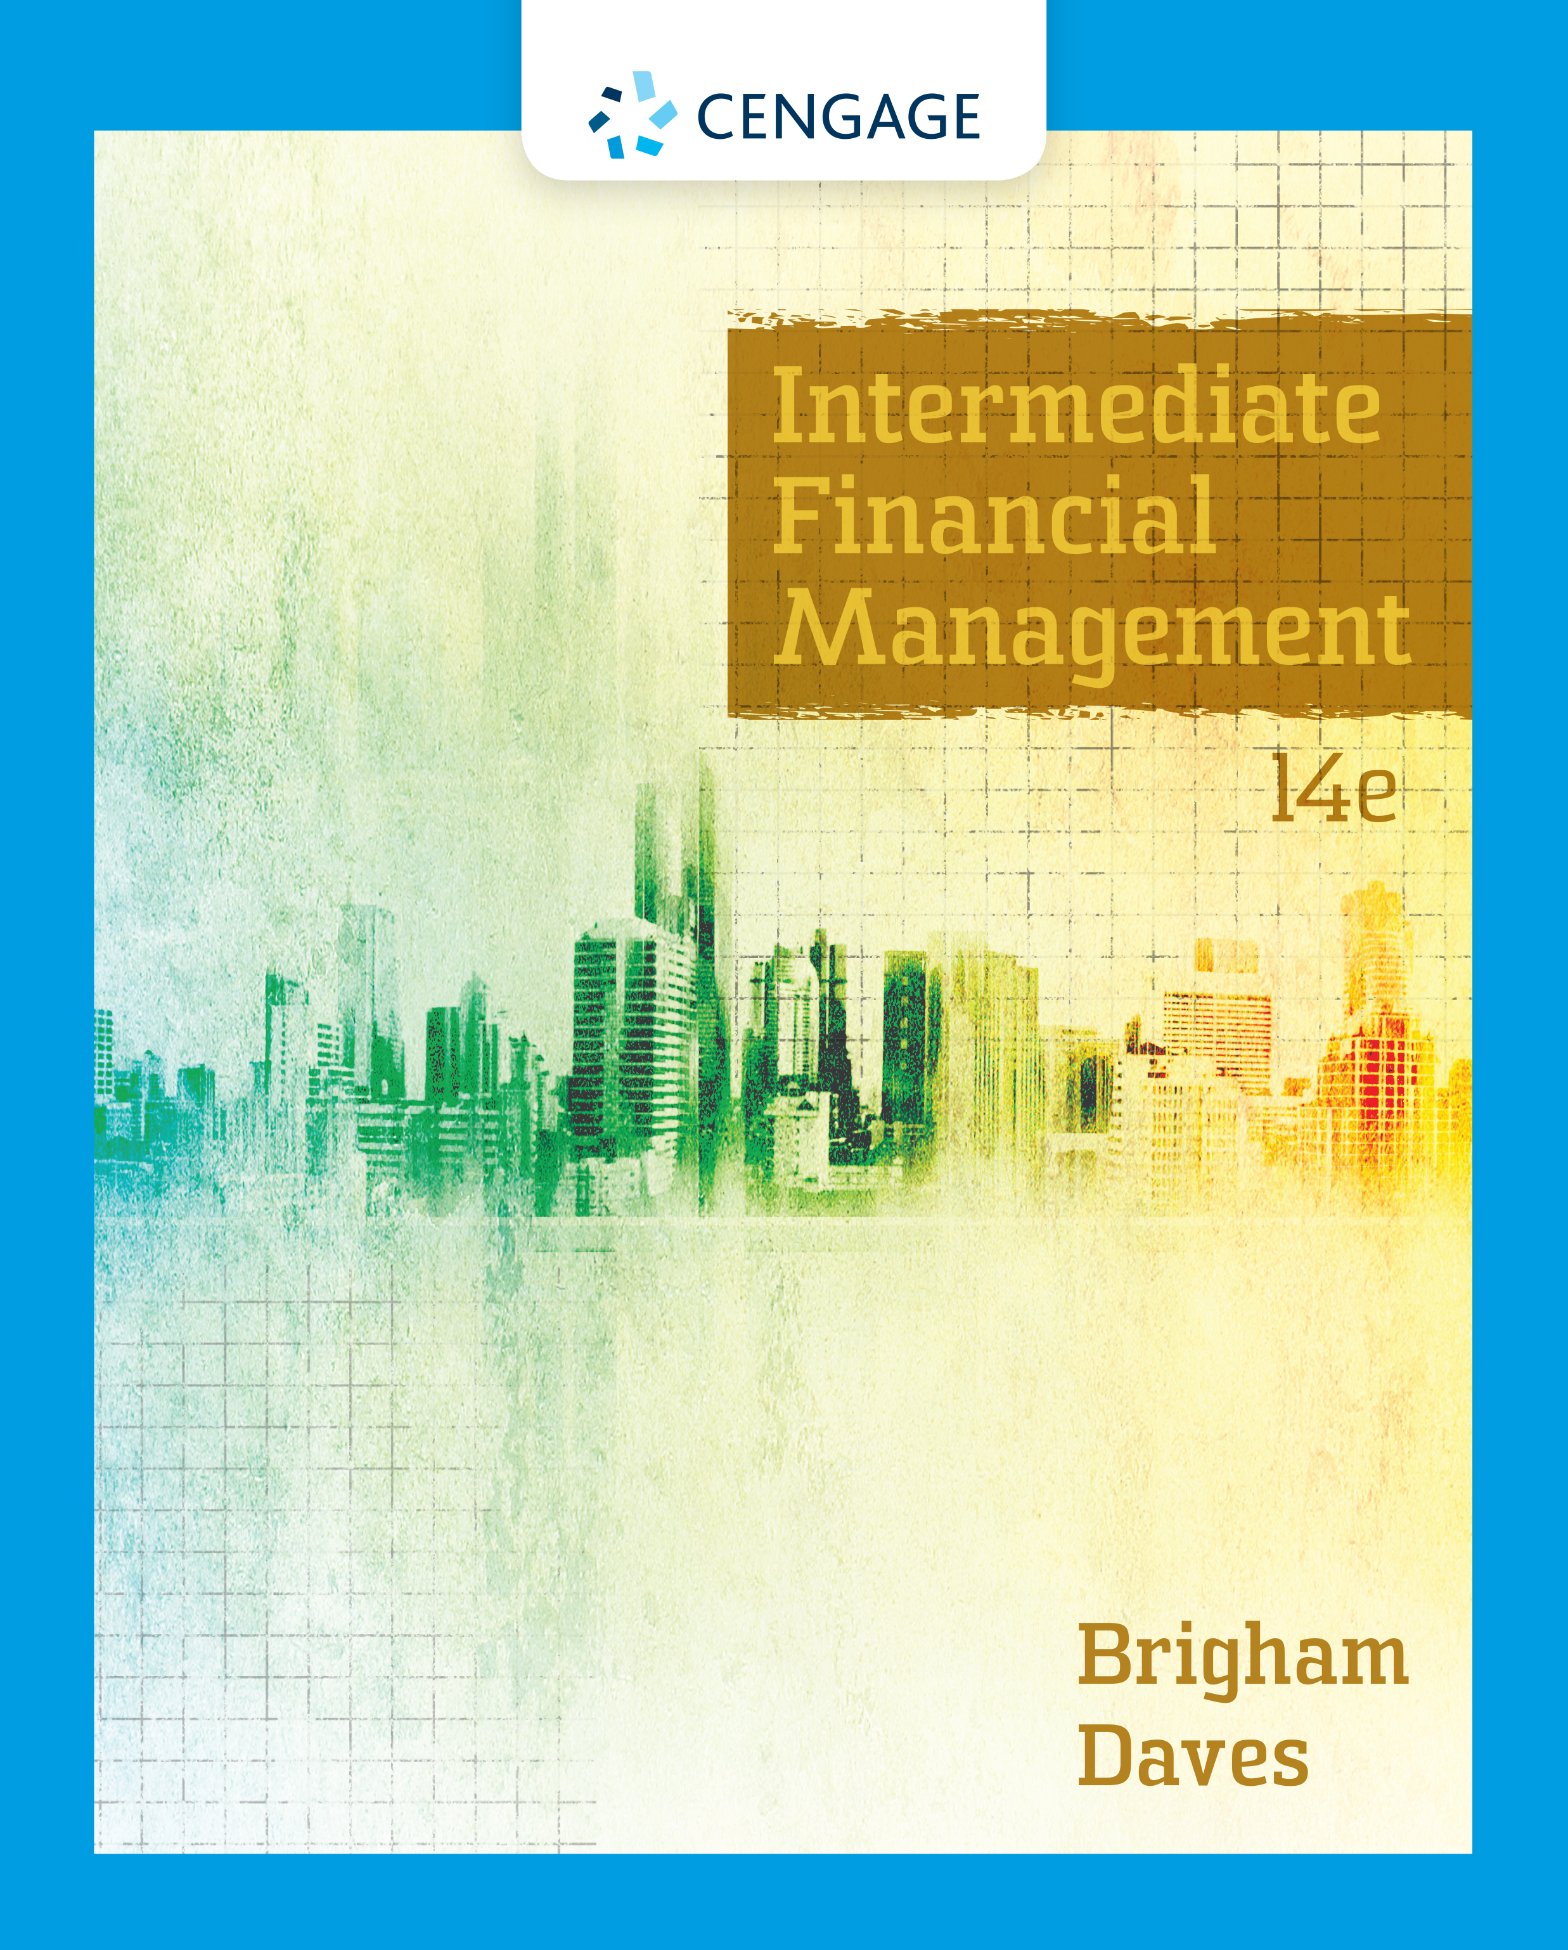
Overview of Financial Management and the Financial Environment
Chapter 1

Slide 2
Chapter topics
Forms of business organization
Objective of the firm: Maximize wealth
Determinants of fundamental value
Financial securities, markets and institutions

Slide 3
Why is corporate finance important to all managers?
Corporate finance provides the skills managers need to:
    Identify and select the corporate strategies and individual projects that add value to their firm.
    Forecast the funding requirements of their company, and devise strategies for acquiring those funds.

Slide 4
Business Organization from Start-up to a Major Corporation
  Sole proprietorship
  Partnership
  Corporation

Slide 5
Starting as a Proprietorship
Advantages:
    Ease of formation
    Subject to few regulations
    No corporate income taxes
Disadvantages:
    Limited life
    Unlimited liability
    Difficult to raise capital to support growth

Slide 6
Starting as or Growing into a Partnership
A partnership has roughly the same advantages and disadvantages as a sole proprietorship.

Slide 7
Becoming a Corporation
A corporation is a legal entity separate from its owners and managers.
File papers of incorporation with state.
    Charter – Corporation name, activities, capital stock, directors
    Bylaws – how directors will be elected, how new stock will be distributed, how bylaws could be changed

Slide 8
Advantages and Disadvantages of a Corporation
Advantages:
    Unlimited life
    Easy transfer of ownership
    Limited liability
    Ease of raising capital
Disadvantages:
    Double taxation
    Cost of set-up and report filing

Slide 9
Becoming a Public Corporation and Growing Afterwards
Initial Public Offering (IPO) of Stock
    Raises cash
    Allows founders and pre-IPO investors to “harvest” some of their wealth
Subsequent issues of debt and equity
Seek approval from SEC (file prospectus)
Apply to be listed on NYSE or NASDAQ

Slide 10
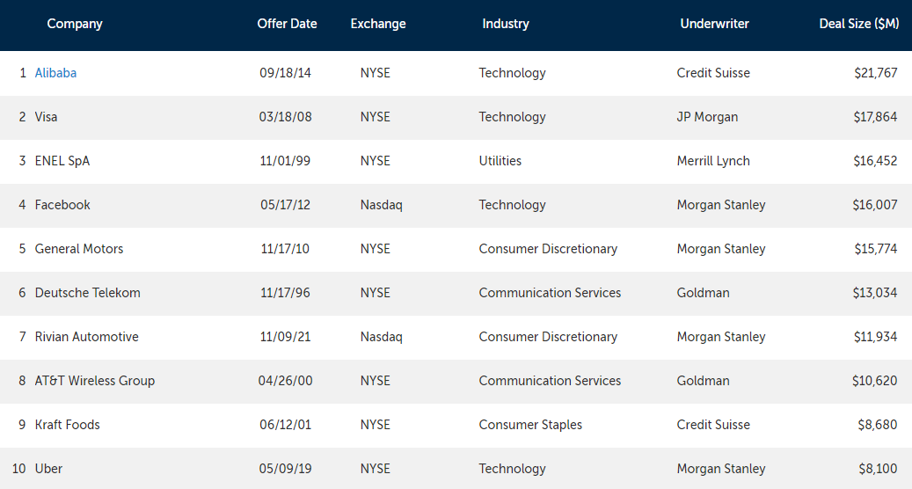
Biggest US IPOs
https://www.renaissancecapital.com/IPO-Center/Stats/Largest-US-IPOs

Slide 11
Agency Problems and Corporate Governance
Agency problem: managers may act in their own interests and not on behalf of owners (stockholders)
Corporate governance is the set of rules that control a company’s behavior towards its directors, managers, employees, shareholders, creditors, customers, competitors, and community.
Corporate governance can help control agency problems.

Slide 12
What should be management’s primary objective?
The primary objective should be shareholder wealth maximization, which translates to maximizing the fundamental stock price.
    Should firms behave ethically? YES!
    Do firms have any responsibilities to society at large? YES! Shareholders are also members of society.

Slide 13
Is maximizing stock price good for society, employees, and customers?
Employment growth is higher in firms that try to maximize stock price. On average, employment goes up in:
    firms that make managers into owners (such as LBO firms)
    firms that were owned by the government but that have been sold to private investors

Slide 14
What three aspects of cash flows affect an investment’s value?
Amount of expected cash flows (bigger is better)
Timing of the cash flow stream (sooner is better)
Risk of the cash flows (less risk is better)

Slide 15
Free Cash Flows (FCF)
Free cash flows are the cash flows that are available (or free) for distribution to all investors (stockholders and creditors).
FCF = sales revenues - operating costs - operating taxes - required investments in operating capital.

Slide 16
What is the weighted average cost of capital (WACC)?
WACC is the average rate of return required by all of the company’s investors.
WACC is affected by:
    Capital structure (the firm’s relative use of debt and equity as sources of financing)
    Interest rates
    Risk of the firm
    Investors’ overall attitude toward risk

Slide 17
What determines a firm’s fundamental, or intrinsic, value?
Intrinsic value is the sum of all the future expected free cash flows when converted into today’s dollars:
See “big picture” diagram on next slide.

Slide 18
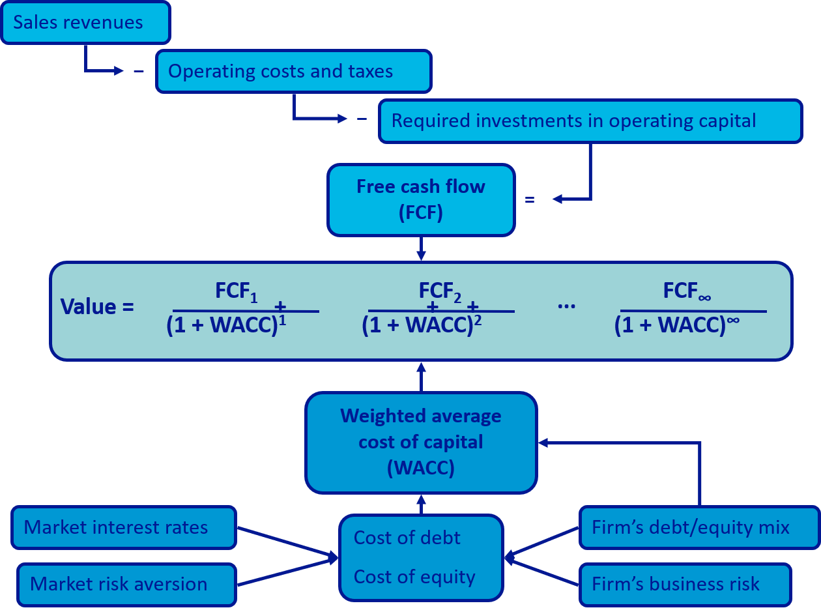
Determinants of Intrinsic Value: The Big Picture

Slide 19
Who are the providers (savers) and users (borrowers) of capital?
Households: Net savers
Non-financial corporations: Net users (borrowers)
Governments: U.S. governments are net borrowers, some foreign governments are net savers
Financial corporations: Slightly net borrowers, but almost breakeven

Slide 20
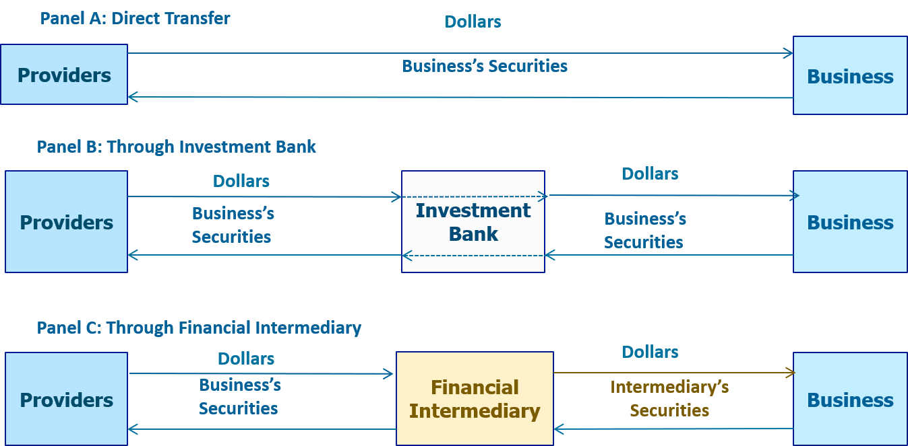
The Capital Allocation Process

Slide 21
Transfer of Capital from Savers to Borrowers
Direct transfer
  Example: A corporation issues commercial paper to an insurance company.
Through an investment banking house
  Example: In an IPO, seasoned equity offering, or debt placement, company sells security to investment banking house, which then sells security to investor.
Through a financial intermediary
  Example: An individual deposits money in bank and gets certificate of deposit, bank makes commercial loan to a company (bank gets note from company).

Slide 22
Cost of Money
What do we call the price, or cost, of debt capital?
    The interest rate
What do we call the price, or cost, of equity capital?
    Cost of equity = Required return = dividend yield + capital gain

Slide 23
What four factors affect the cost of money?
Production opportunities – more production opportunities – higher demand for funds – higher interest rates
Time preferences for consumption – it takes higher interest rates to trade current consumption for future consumption, more savings – higher supply of
Risk – require higher return to take on more risk
Expected inflation – nominal rate = real rate + inflation

Slide 24
What economic conditions affect the cost of money?
Federal Reserve policies – purchasing treasuries from banks increases loanable funds – interest rates go down. However, higher money supply can increase inflation in the long run
Budget deficits/surpluses – if the federal government spends more that collects in taxes – deficit, covered by borrowing – increase money supply
Level of business activity (recession or boom) – boom higher demand for funds, recession – FED will try to stimulate the economy
International trade deficits/surpluses if X<M = trade deficit, financed by debt

Slide 25
Financial Securities
 | Debt | Equity | Derivatives
Money Market | T-Bills CD’s Eurodollars Fed Funds |  | Options Futures Forward contract
Capital Market | T-Bonds Agency bonds Municipals Corporate bonds | Common stock Preferred stock | LEAPS Swaps

Slide 26
What are some financial institutions?
Commercial banks
Investment banks
Savings & Loans, mutual savings banks, and credit unions
Life insurance companies
Mutual funds (active, passive investing)
  Exchanged Traded Funds (ETFs)
Pension funds
Hedge funds and private equity funds

Slide 27
What are some types of markets?
A market is a method of exchanging one asset (usually cash) for another asset.
Physical assets vs. financial assets
Spot versus future markets
Money versus capital markets
Primary versus secondary markets

Slide 28
Primary vs. Secondary Security Sales
Primary
    New issue (IPO or seasoned)
    Key factor: issuer receives the proceeds from the sale.
Secondary
    Existing owner sells to another party.
    Issuing firm doesn’t receive proceeds and is not directly involved.

Slide 29
Securitization in the Home Mortgage Industry
After crisis in 1980s, S&Ls now put their mortgages into “pools” and sell the pools to other organizations, such as Fannie Mae.
After selling a pool, the S&Ls have funds to make new home loans
Risk is shifted to Fannie Mae

Slide 30
Fannie Mae Shifts Risk to Its Investors
Risk hasn’t disappeared, it has been shifted to Fannie Mae.
But Fannie Mae doesn’t keep the mortgages:
  Puts mortgages in pools, sells shares of these pools to investors
  Risk is shifted to investors.
  But investors get a rate of return close to the mortgage rate, which is higher than the rate S&Ls pay their depositor.
  Investors have more risk, but more return
This is called securitization, since new securities have been created based on original securities (mortgages in this example)

Slide 31
Collateralized Debt Obligations (CDOs)
Fannie Mae and others, such as investment banks, can also split mortgage pools into “special” securities
    Some securities might pay investors only the mortgage interest, others might pay only the mortgage principal.
    Some securities might mature quickly, others might mature later.
    Some securities are “senior” and get paid before other securities from the pool get paid.
    Rating agencies give different
Risk of basic mortgage is parceled out to those investors who want that type of risk (and the potential return that goes with it).

Slide 32
The Dark Side of Securitization (1 of 2)
Homeowners wanted better homes than they could afford.
Mortgage brokers encouraged homeowners to take mortgages even thought they would reset to payments that the borrowers might not be able to pay because the brokers got a commission for closing the deal.
Appraisers thought the real estate boom would continue and over-appraised house values, getting paid at the time of the appraisal.
Originating institutions (like Countrywide) quickly sold the mortgages to investment banks and other institutions.

Slide 33
The Dark Side of Securitization (2 of 2)
Investment banks created CDOs and got rating agencies to help design and then rate the new CDOs, with rating agencies making big profits despite conflicts of interest.
Financial engineers used unrealistic inputs to generate high values for the CDOs.
Investment banks sold the CDOs to investors and made big profits.
Investors bought the CDOs but either didn’t understand or care about the risk.
Some investors bought “insurance” via credit default swaps.

Slide 34
The Collapse
When mortgages reset and borrowers defaulted, the values of CDOs plummeted.
Many of the credit default swaps failed to provide insurance because the counterparty failed.
Many originators and securitizers still owned sub-prime securities, which led to many bankruptcies, government takeovers, and fire sales, including:
    New Century, Countrywide, IndyMac, Northern Rock, Fannie Mae, Freddie Mac, Bear Stearns, Lehman Brothers, and Merrill Lynch.
    Books on the Global Financial Crisis - The Big Short by Michael Lewis (2010)

Slide 35
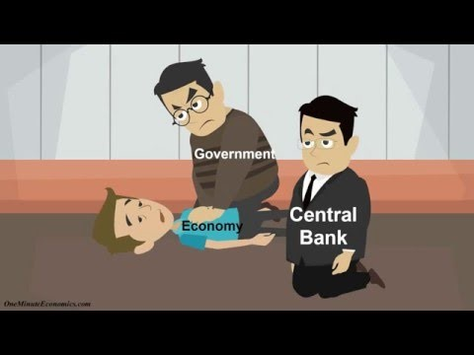
Books on the Global Financial Crisis - The Big Short by Michael Lewis (2010)

