Slide 1

Notes:
1 - Central Minaria
2 - Chauntea
3 - East Side Minaria
4 - Exynn
5 - Flatcoat
6 - Grumbar
7 - Holdfast
8 - Justice Bringers
9 - Kelemvor
10 - Minaria
11 - Myrkul
12 - Talos
13 - Veronna
14 - West Side Minaria
15 - Zehir
16 - Hadaar
17 - Laughing Knives

Slide 2

Notes:
1 - Central Minaria
2 - Chauntea
3 - East Side Minaria
4 - Exynn
5 - Flatcoat
6 - Grumbar
7 - Holdfast
8 - Justice Bringers
9 - Kelemvor
10 - Minaria
11 - Myrkul
12 - Talos
13 - Veronna
14 - West Side Minaria
15 - Zehir
16 - Hadaar
17 - Laughing Knives

Slide 3
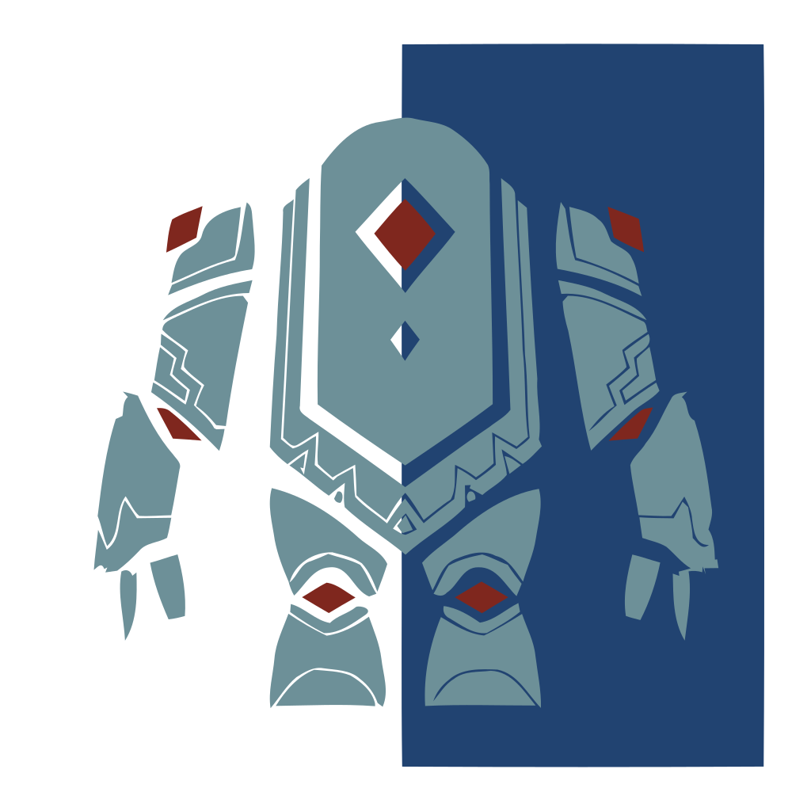
Notes:
1 - Central Minaria
2 - Chauntea
3 - East Side Minaria
4 - Exynn
5 - Flatcoat
6 - Grumbar
7 - Holdfast
8 - Justice Bringers
9 - Kelemvor
10 - Minaria
11 - Myrkul
12 - Talos
13 - Veronna
14 - West Side Minaria
15 - Zehir
16 - Hadaar
17 - Laughing Knives

Slide 4

Notes:
1 - Central Minaria
2 - Chauntea
3 - East Side Minaria
4 - Exynn
5 - Flatcoat
6 - Grumbar
7 - Holdfast
8 - Justice Bringers
9 - Kelemvor
10 - Minaria
11 - Myrkul
12 - Talos
13 - Veronna
14 - West Side Minaria
15 - Zehir
16 - Hadaar
17 - Laughing Knives

Slide 5

Notes:
1 - Central Minaria
2 - Chauntea
3 - East Side Minaria
4 - Exynn
5 - Flatcoat
6 - Grumbar
7 - Holdfast
8 - Justice Bringers
9 - Kelemvor
10 - Minaria
11 - Myrkul
12 - Talos
13 - Veronna
14 - West Side Minaria
15 - Zehir
16 - Hadaar
17 - Laughing Knives

Slide 6

Notes:
1 - Central Minaria
2 - Chauntea
3 - East Side Minaria
4 - Exynn
5 - Flatcoat
6 - Grumbar
7 - Holdfast
8 - Justice Bringers
9 - Kelemvor
10 - Minaria
11 - Myrkul
12 - Talos
13 - Veronna
14 - West Side Minaria
15 - Zehir
16 - Hadaar
17 - Laughing Knives

Slide 7

Notes:
1 - Central Minaria
2 - Chauntea
3 - East Side Minaria
4 - Exynn
5 - Flatcoat
6 - Grumbar
7 - Holdfast
8 - Justice Bringers
9 - Kelemvor
10 - Minaria
11 - Myrkul
12 - Talos
13 - Veronna
14 - West Side Minaria
15 - Zehir
16 - Hadaar
17 - Laughing Knives

Slide 8

Notes:
1 - Central Minaria
2 - Chauntea
3 - East Side Minaria
4 - Exynn
5 - Flatcoat
6 - Grumbar
7 - Holdfast
8 - Justice Bringers
9 - Kelemvor
10 - Minaria
11 - Myrkul
12 - Talos
13 - Veronna
14 - West Side Minaria
15 - Zehir
16 - Hadaar
17 - Laughing Knives

Slide 9

Notes:
1 - Central Minaria
2 - Chauntea
3 - East Side Minaria
4 - Exynn
5 - Flatcoat
6 - Grumbar
7 - Holdfast
8 - Justice Bringers
9 - Kelemvor
10 - Minaria
11 - Myrkul
12 - Talos
13 - Veronna
14 - West Side Minaria
15 - Zehir
16 - Hadaar
17 - Laughing Knives

Slide 10

Notes:
1 - Central Minaria
2 - Chauntea
3 - East Side Minaria
4 - Exynn
5 - Flatcoat
6 - Grumbar
7 - Holdfast
8 - Justice Bringers
9 - Kelemvor
10 - Minaria
11 - Myrkul
12 - Talos
13 - Veronna
14 - West Side Minaria
15 - Zehir
16 - Hadaar
17 - Laughing Knives

Slide 11

Notes:
1 - Central Minaria
2 - Chauntea
3 - East Side Minaria
4 - Exynn
5 - Flatcoat
6 - Grumbar
7 - Holdfast
8 - Justice Bringers
9 - Kelemvor
10 - Minaria
11 - Myrkul
12 - Talos
13 - Veronna
14 - West Side Minaria
15 - Zehir
16 - Hadaar
17 - Laughing Knives

Slide 12

Notes:
1 - Central Minaria
2 - Chauntea
3 - East Side Minaria
4 - Exynn
5 - Flatcoat
6 - Grumbar
7 - Holdfast
8 - Justice Bringers
9 - Kelemvor
10 - Minaria
11 - Myrkul
12 - Talos
13 - Veronna
14 - West Side Minaria
15 - Zehir
16 - Hadaar
17 - Laughing Knives

Slide 13

Notes:
1 - Central Minaria
2 - Chauntea
3 - East Side Minaria
4 - Exynn
5 - Flatcoat
6 - Grumbar
7 - Holdfast
8 - Justice Bringers
9 - Kelemvor
10 - Minaria
11 - Myrkul
12 - Talos
13 - Veronna
14 - West Side Minaria
15 - Zehir
16 - Hadaar
17 - Laughing Knives

Slide 14

Notes:
1 - Central Minaria
2 - Chauntea
3 - East Side Minaria
4 - Exynn
5 - Flatcoat
6 - Grumbar
7 - Holdfast
8 - Justice Bringers
9 - Kelemvor
10 - Minaria
11 - Myrkul
12 - Talos
13 - Veronna
14 - West Side Minaria
15 - Zehir
16 - Hadaar
17 - Laughing Knives

Slide 15

Notes:
1 - Central Minaria
2 - Chauntea
3 - East Side Minaria
4 - Exynn
5 - Flatcoat
6 - Grumbar
7 - Holdfast
8 - Justice Bringers
9 - Kelemvor
10 - Minaria
11 - Myrkul
12 - Talos
13 - Veronna
14 - West Side Minaria
15 - Zehir
16 - Hadaar
17 - Laughing Knives

Slide 16

Notes:
1 - Central Minaria
2 - Chauntea
3 - East Side Minaria
4 - Exynn
5 - Flatcoat
6 - Grumbar
7 - Holdfast
8 - Justice Bringers
9 - Kelemvor
10 - Minaria
11 - Myrkul
12 - Talos
13 - Veronna
14 - West Side Minaria
15 - Zehir
16 - Hadaar
17 - Laughing Knives

Slide 17

Notes:
1 - Central Minaria
2 - Chauntea
3 - East Side Minaria
4 - Exynn
5 - Flatcoat
6 - Grumbar
7 - Holdfast
8 - Justice Bringers
9 - Kelemvor
10 - Minaria
11 - Myrkul
12 - Talos
13 - Veronna
14 - West Side Minaria
15 - Zehir
16 - Hadaar
17 - Laughing Knives

Slide 18

Notes:
1 - Central Minaria
2 - Chauntea
3 - East Side Minaria
4 - Exynn
5 - Flatcoat
6 - Grumbar
7 - Holdfast
8 - Justice Bringers
9 - Kelemvor
10 - Minaria
11 - Myrkul
12 - Talos
13 - Veronna
14 - West Side Minaria
15 - Zehir
16 - Hadaar
17 - Laughing Knives
18 - Peralat Sword
19 - Peralat Armor
20 - Peralat Shield

Slide 19

Notes:
1 - Central Minaria
2 - Chauntea
3 - East Side Minaria
4 - Exynn
5 - Flatcoat
6 - Grumbar
7 - Holdfast
8 - Justice Bringers
9 - Kelemvor
10 - Minaria
11 - Myrkul
12 - Talos
13 - Veronna
14 - West Side Minaria
15 - Zehir
16 - Hadaar
17 - Laughing Knives
18 - Peralat Sword
19 - Peralat Armor
20 - Peralat Shield

Slide 20

Notes:
1 - Central Minaria
2 - Chauntea
3 - East Side Minaria
4 - Exynn
5 - Flatcoat
6 - Grumbar
7 - Holdfast
8 - Justice Bringers
9 - Kelemvor
10 - Minaria
11 - Myrkul
12 - Talos
13 - Veronna
14 - West Side Minaria
15 - Zehir
16 - Hadaar
17 - Laughing Knives
18 - Peralat Sword
19 - Peralat Armor
20 - Peralat Shield

