Slide 1
Mitigating biases in fact-checking models
Joshua Cowan
Supervised by Andreas Vlachos

Slide 2
Background

Slide 3
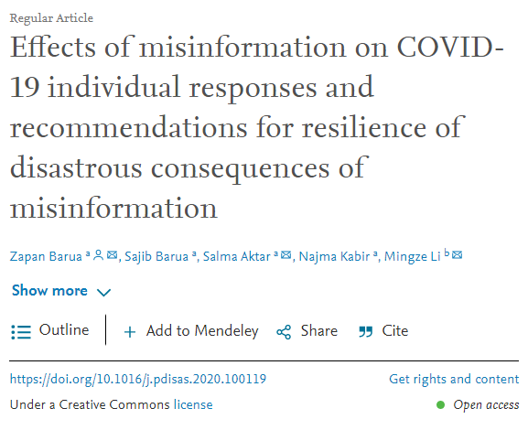
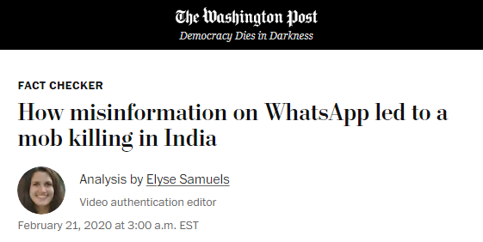
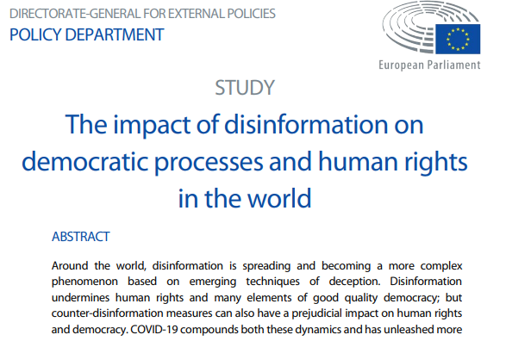
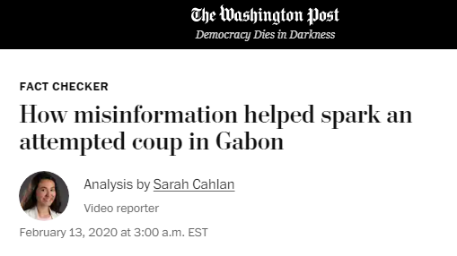
The problem
Misinformation
Dis
Mis
Unknowingly untrue information
Un

Slide 4
A solution?
Fact checking
The assessment of the truthfulness of a claim
(Thorne & Vlachos 2018)
Need it done quickly
Diffuses over time (Karlova & Fisher 2013)
Automated approaches?

Slide 5
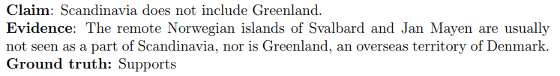
FEVER (Fact extraction and verification)
Shared tasks and dataset.
Dataset: Collection of claims from modified Wikipedia factoids, with the original corresponding evidence.
First shared task: Use claim to both find evidence and derive a classification judgement.
I focused on NLI-style verification only
Notes:
I focused on NLI-style verification only (i.e. evidence is provided). FEVER classifies relations as either Supports (where claim is supported by evidence), refutes, or not enough info when the two are unrelated or the evidence doesn’t say enough to refute or support.

Slide 6
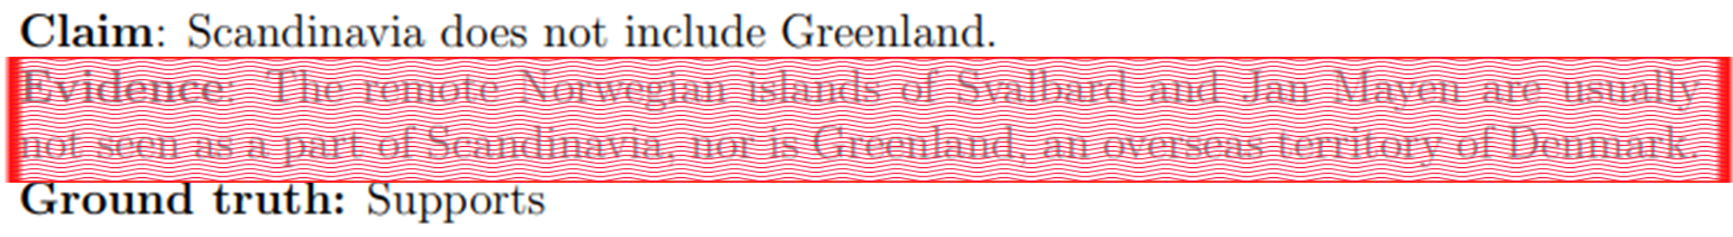
Biases in datasets
Artefacts in the form of superficial patterns whose exploitation facilitates impressive in-domain performance, but poor generalisation.
Hypothesis-only bias
Notes:
Hypothesis only bias is one type, says that high accuracy can be achieved without even considering the evidence, just by inferring patterns from the claim.

Slide 7
Why the need to debias?
Out-of-domain performance is critical here:
Typical human speech is stylistically distinct from Wikipedia claims/evidence.
Must engage with the actual semantics of the claim/hypothesis.
Room for nefarious manipulation through pattern exploitation.
Notes:
…. Problem with this is that the patterns learnt for just the claim don’t transfer out of domain. Typical human speech can differ significantly from concise Wikipedia claims, and by not even looking at the evidence you haven’t engaged with the semantics of the actual pair. The

Slide 8
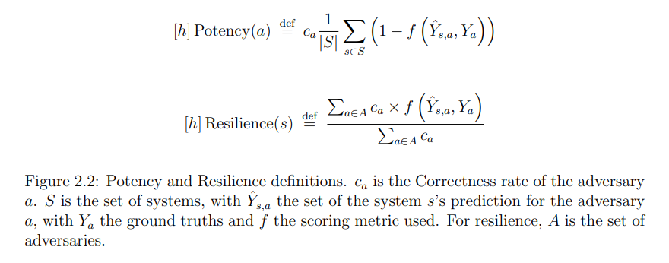
Adversarial datasets: Potency and Resilience
Thorne et al. 2019
Notes:
The prevalence of these biases is proportional to the threat their corresponding adversaries pose, which Thorne et al measure by the effective decrease in score. Potency captures how much an adversary reduces the score over multiple models, and Resilience is the converse. For the ‘score’ you could use different metrics, but I opted for accuracy as its what existing literature uses.

Slide 9
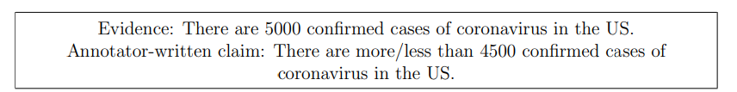
Dataset-targeting debiasing: VitaminC
Schuster et al. 2021
Dataset designed for FEVER models to be trained on.
VitaminC uses contrastive claims to induce contextual sensitivity.
Dataset targeting requires knowledge of biases in each dataset.
Does appear to reduce hypothesis-only bias, but they don’t evaluate on any other types.
Overuse of ‘more than’/’less than’ could induce new biases.
Notes:
Looking at ways to debias, dataset-targeting methods focus on using additional or different datasets to inoculate models against biases.
VitaminC uses contrastive claims – essentially is having for a given evidence (actual dataset uses pairs of evidence from different timeframes), you have two claims where one is refuted and one is supported – the idea being you can’t get them both right by only looking at the claim.

Slide 10
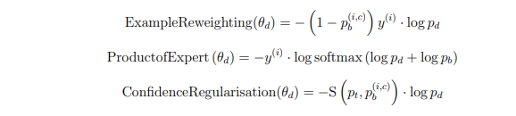
Model-targeting debiasing: Self-debias
Utama et al. 2020b
Can instead detect biased examples automatically.
Use a shallow model to act as a rapid surface learner -> overfit to shallow patterns.
Model then predicts training set – probabilities for each class indicate (over)confidence.
Then downweigh examples the shallow/biased model is confidently correct on.
Notes:
Shallow can do multiple biases at once.
Shallow model uses low number of epochs and examples.
Shallow preds: with these indicating the likelihood the example contains a bias (should that output class be predicted by the main model). Conversely, examples which the shallow model predicts incorrectly with a high score/confidence, are likely to be more challenging examples free of biases.
Example reweighting: Directly downweighs proportional to this confidence
Product of expert – combines softmax outputs of main and shallow models.
Conf-reg uses self-distillation, which basically rescales the predictions of the baseline bert or albert model.
Can tar

Slide 11
Model-targeting debiasing (2)
Utama et al. 2020b
All three methods delivered 2-3pp improvement on fever-symmetric, a hypothesis-only adversary.
Also ran experiments with annealing, an attempt to prevent the shallow model downweighing everything due to dealing with many biases at once.
Had minimal impact on performance vs non-annealed results, however.
Notes:
Shallow can do multiple biases at once.
Shallow model uses low number of epochs and examples.
Shallow preds: with these indicating the likelihood the example contains a bias (should that output class be predicted by the main model). Conversely, examples which the shallow model predicts incorrectly with a high score/confidence, are likely to be more challenging examples free of biases.
Example reweighting: Directly downweighs proportional to this confidence
Product of expert – combines softmax outputs of main and shallow models.
Conf-reg uses self-distillation, which basically rescales the predictions of the baseline bert or albert model.
Can tar

Slide 12
Room for improvement
Little investigation into other biases in FEVER.
Needed for robust fact-checking systems
VitaminC may even introduce its own biases
Do previous results extend to these new biases?
And to different, better-performing, architectures?
Could VitaminC and self-debiases methods be combined?
Do they combine constructively?
Notes:
Good to know if vitc has biases given training on it can produce more robust models.
Combining the two approaches could permit models to debias initially with a-priori knowledge (such as the hypothesis-only bias that VitaminC inoculates against), with self-debiasing approaches ‘catching’ other forms of bias which are not explicitly known.
Dissertation breaks down the two research questions, I’ll leave that to the evaluation section for now to save everyone going through them twice, but a cocmponent of question A is finding these new biases in fever through the design of new adversaries.

Slide 13
Adversaries designed

Slide 14
Negation overlap: Only one of claim/ev is negated
Inspired by Naik (2018).
Implemented with spaCy + inflector
Wordnet, Conceptnet and PPDB for (unsuccessful) antonym/alternative word resolution.
Evidence: In 2014 , she signed her first recording contract with Astralwerks and released her debut EP , titled Room 93 .
Original Claim: Halsey signed her first recording contract in 2014.
Negation-only variant Claim: Halsey did not sign her first recording contract in 2014.
Negation and Antonym variant Claim: Halsey did not sign her second recording contract in 2014.
Notes:
Naik observed similar in NLI.
Adversaries are ones where there is a negation in the evidence but not the claim, but there’s a supports relation; or where the presence of a negation matches, but there’s a refutes relation.
Also have one where the label is preserved by doing essentially a double negative – here replacing first with second isn’t really an ‘antonym’, but it does change the truth conditions such that it acts as a negation.
Neg-only – flip label
Neg-and-ant – preserve label.
Antonym resolution didn’t work very well.

Slide 15
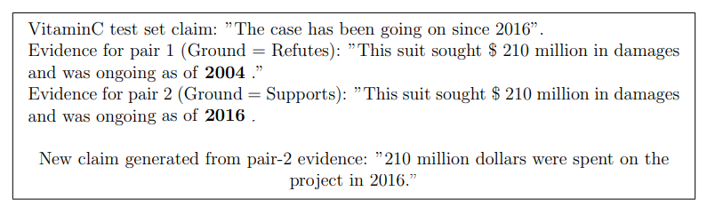
Entity overweighting
VitaminC refutation pairs often due to value of a single entity varying.
Entailment pairs often due to high entity overlap (as seen earlier).
Adversaries are these cases, but a Not Enough Info label.
T5 model takes named entities, generates new claim from them.

Slide 16
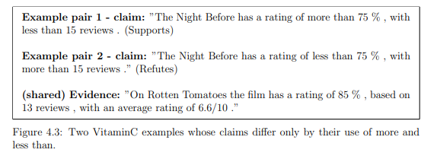
Numerical mismatch
VitaminC heavy with numbers/figures + annotators overused more/less than
Adversaries: Cases where ranges overlap but relation is NEI/Refutes, or where they don’t overlap but relation is supports
Notes:
Nearly all VitaminC examples which contain numbers, runs the risk of training on VitaminC inducing oversensitivity to overlapping number ranges, whilst ignoring the context in between them. Essentially, there is a risk of bias should models see ‘x people have fallen ill’ as evidence and biasedly assuming Supports when seeing a ‘less than x+1 people have died’ claim, despite the non-numeric context enforcing a ground truth of Not Enough Info.

Slide 17
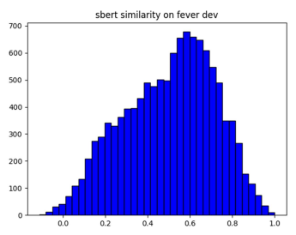
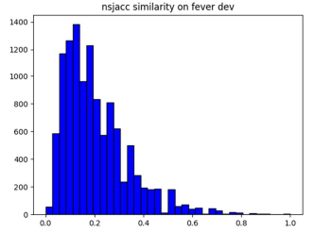
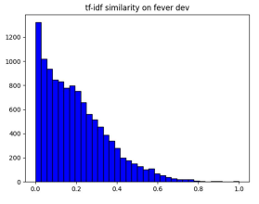
Textual similarity
Inspired by Naik (2018) – word overlap
Biased models may predict ‘Supports’ if high word overlap between claim and hypothesis (or ‘refutes’/’nei’ if low).
Notes:
Compared three different metrics for determining word overlap, opted for sbert as least skewed so allowed for ‘high’ and ‘low’ overlap to be easily determined without dumping half the dataset in the adversary.

Slide 18
Experiments & Results

Slide 19
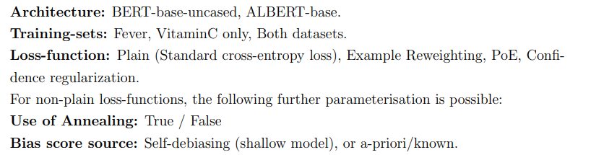
Experiments to be run
Notes:
The remaining research questions essentially lay out the need to train models spanning this state-space of factors explored so far, and then to evaluate their resilience to the newly found biases.
Initially architecture wasn’t part of the plan; was aiming to use ALBERT as a base architecture as performed superlatively but found that the self-debias methods made very little difference on ALBERT-based models.

Slide 20
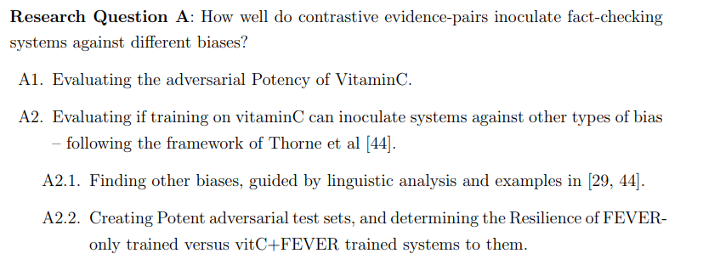
There are other biases in FEVER – performance on newly derived adversarial datasets is below that of their in-domain sources
Training models on contrastive evidence-pairs does enhance performance on non-hypothesis-only biases – higher Resilience in VitaminC+FEVER models than those trained on just one of the two.
VitaminC is not bias-free, but also does not cause many additional examples to be incorrectly predicted, suggesting it introduces no more biases than were already present in FEVER.

Slide 21
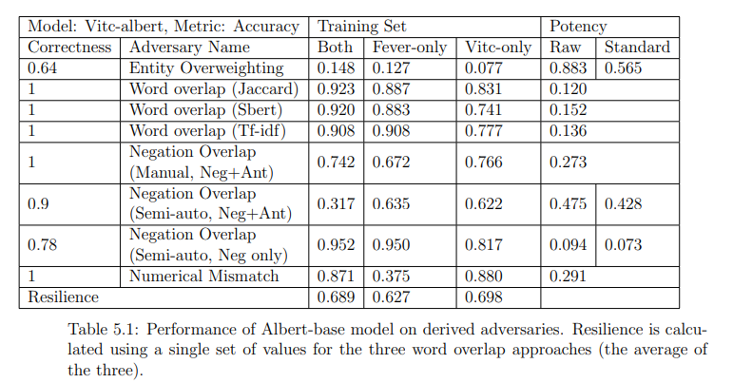
Notes:
Results to back that up; interesting one here was the underperformance on negation+antonym negation overlap of the otherwise supreme both-trained model. This was traced down to the way that antonyms were derived – usually through particularly unique ones chosen to ensure there is no interpretation in which the ground entailment label doesn’t hold. Similarly, the automatically generated ones were oftened form by attaching negating derivational prefixes like ‘dis’. The combination of effects from the subword training for the examples from each dataset may be the cause for this lower performance, but definitely warrants further investigation.

Slide 22
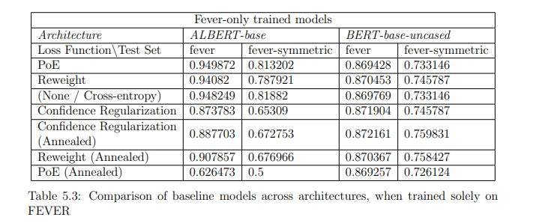
RQB: Architecture comparison
 | BERT | ALBERT
Fever-only | ++ | None
Both | ++ | - - -
Notes:
Results were initially recorded solely for ALBERT-base underpinned models, as to enable comparison with the findings of the VitaminC paper – found the opposite to that of Utama et al’s findings to be true for ALBERT models — namely that, for ALBERT-base models, all forms of debiasing degraded performance on both FEVER and FEVER-symmetric.
Why the disparity when moving from bert to albert isn’t totally clear. Kaneko and Bollegala suggest that ALBERT may be more sensitive to fine-tuning at the risk of losing pre-trained information during debiasing.

Slide 23
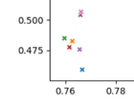
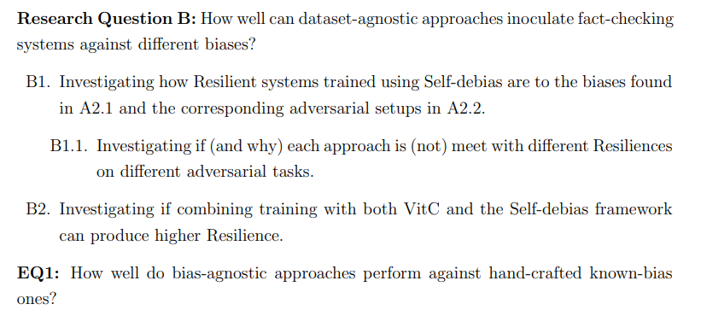
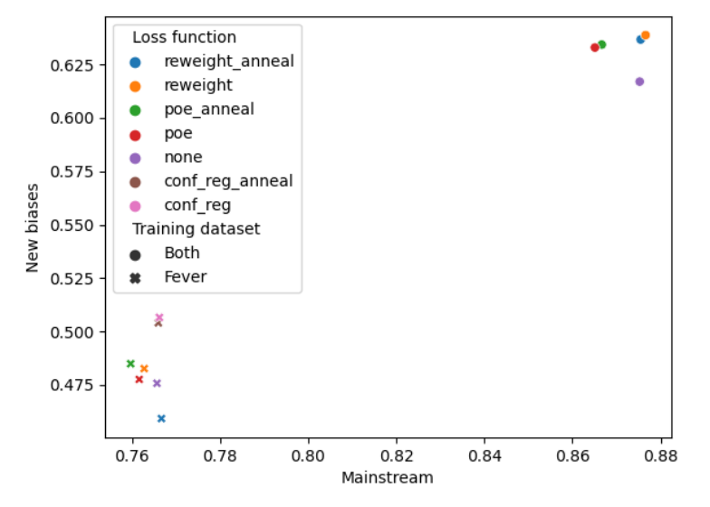
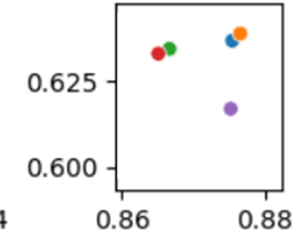
RQB: Offsetting in-domain and adversarial performance
For BERT models:
Adversarial improvement not at cost- of in-domain.

Slide 24
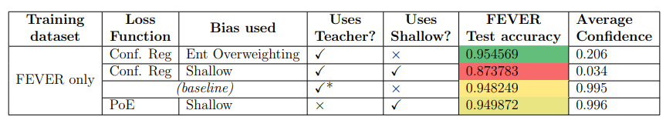
RQB: Comparing loss functions + Annealing
No generally superior loss function
Confidence regularization best performer on FEVER-trained BERT models, and Entity reweighting for those trained on both datasets.
Annealing mostly made no difference
Conf-reg models didn’t converge for ALBERT:
Notes:
Appears that non-convergence (loss does not decrease) comes from loss signal being eliminated – you can see output confidence is very low, and often actually resembles random guessing. This only happens when combining both the baseline teacher model, *and* the shallow model – not the other combinations.
In some cases, where Conf-reg does not converge, performance can still be superior if the shallow model has effectively no impact on the already competitive baseline model – however for fever-only trained ones like are shown here, that baseline model is poor, and the shallow model is also poor, so the combination of the two is even worse.

Slide 25
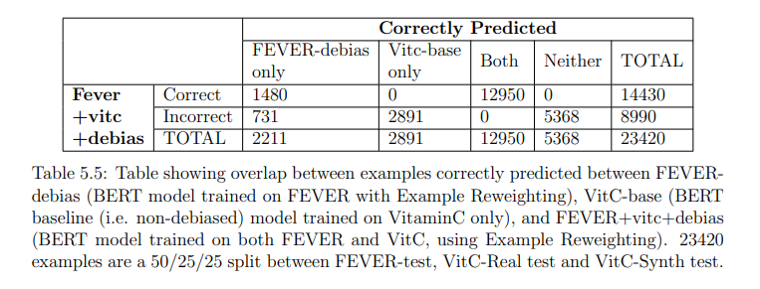
RQB: Combining dataset and model targeting
Training on both FEVER and VitaminC is beneficial both for debiasing and for in-domain performance.
Self-debias does not work with ALBERT-based models, on which VitaminC training delivers a better performing model.
Notes:
Can see from the figure there is an aspect of orthogonality here, but it isn’t being combined particularly well. There may be better ways to combine these dataset and model targeting paradigms

Slide 26
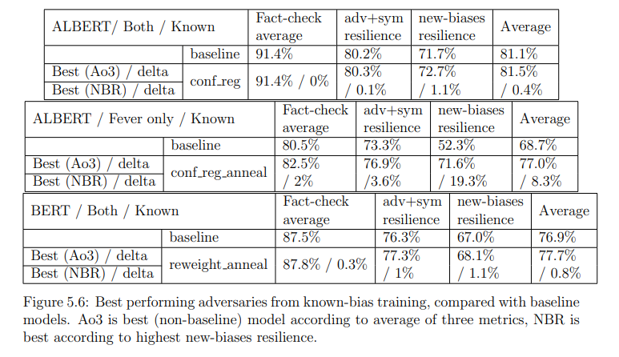
Using known rather than shallow biases yields higher resilience.
Debiasing is also more effective in these cases.

Slide 27
Conclusions

Slide 28
Key technical hurdles
Needed to combine VitaminC with self-debias.
Self-debias was written with Pytorch-Pretrained-Bert which doesn’t support ALBERT models. Needed to migrate to Transformers.
Self-debias was not documented and was missing nearly all code related to FEVER.
VitaminC (obviously) had no concept of bias or teacher files, and so dataloaders and trainers needed extending to pass these through.

Slide 29
Future work
Why do these methods designed for BERT not transfer to ALBERT?
What difference is there in the dynamics of the three loss functions used in self-debias?
Is there a better way to combine dataset-targeting and model-targeting debiasing approaches?
How appropriate is VitaminC to train FEVER-based systems when it exhibits stylistic differences?
Automated antonym generation needs a lot of work.

Slide 30
Questions?

