Slide 1
Massmine for the Masses
Joshua Moore, Logan Hornbuckle, Patricia Tanzer, Morgan McIntyre
Notes:
Patti will present this slide.

Slide 2
Functional Requirements
The following are features MassMine doesn’t implement, but creates a better user experience.
Store user information
Store collected Twitter data
Create and update new users
Allow users to gather Twitter data. The mass of data collected by a query is a ‘study’.
Allow users to perform basic analysis on this Twitter data.
We chose a web application as the best way to complete these goals.

Slide 3
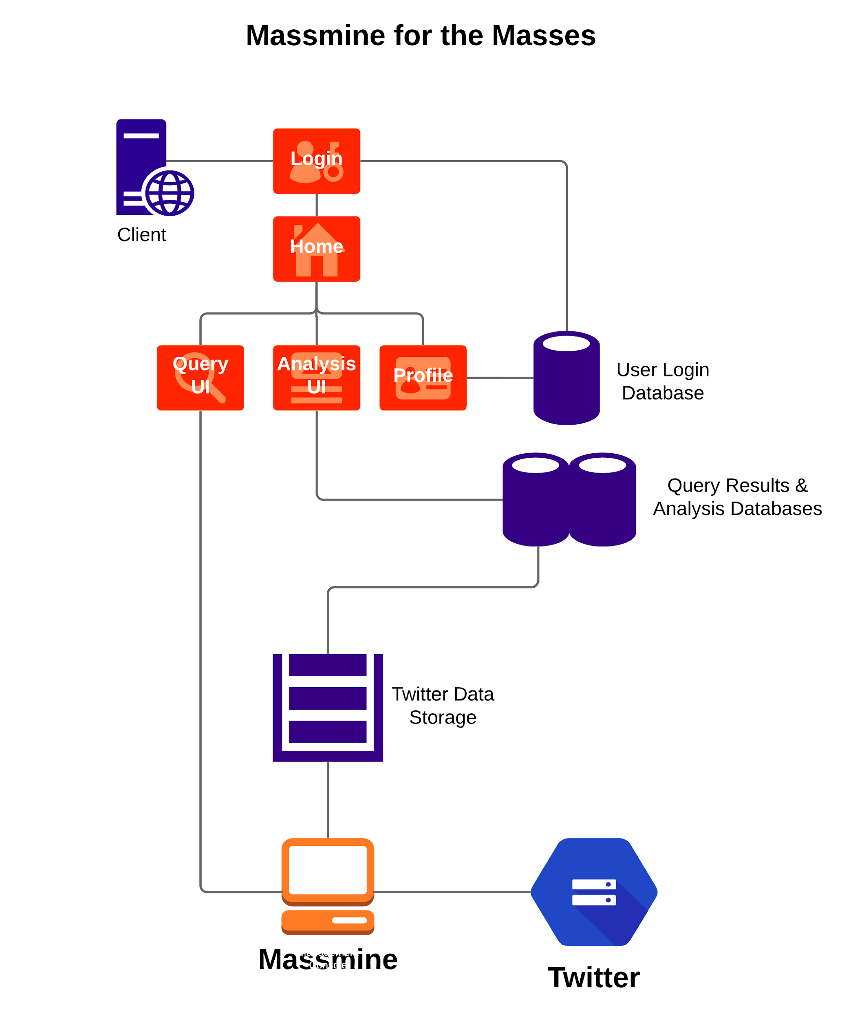
Overview
4 user interfaces:
Login
User profile
Query
Analysis
3 databases:
User information
Analysis formulas
Tweets
Host server
Multiple instances of Massmine
Notes:
Logan will present this slide.

Slide 4
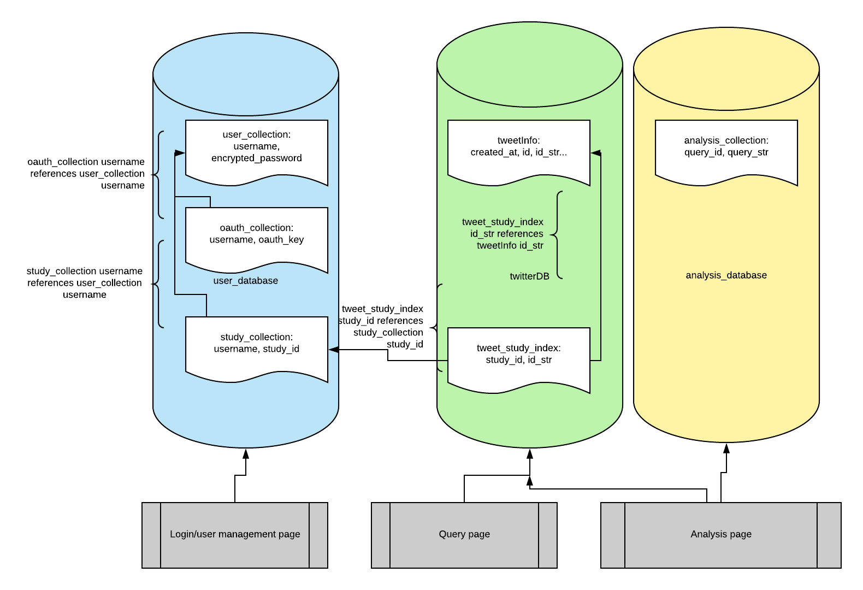
Database usage

Slide 5
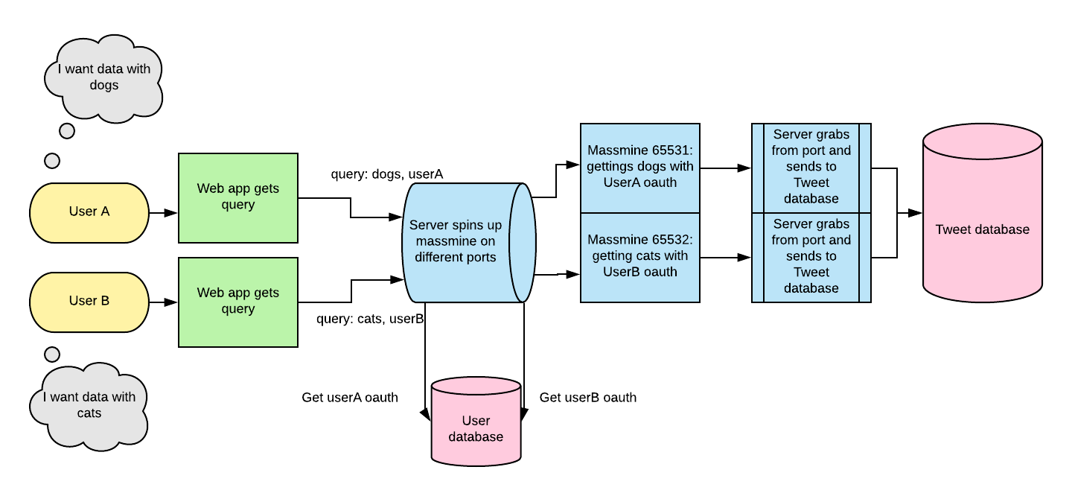
Massmine connection

Slide 6
Security
MassMine for the masses will implement the following security measures…
At-rest encryption of user authorization keys, usernames, and Twitter data
Passwords will be salted and hashed
The site will be be accessed via an https page
Built-in security features within the Django framework used to prevent
Cross site scripting
Cross site request forgery
Additional measures to prevent:
Injection attacks (input validation)
Notes:
Patti will present this slide.

Slide 7
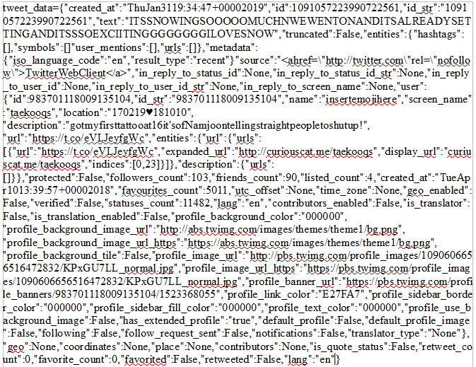
Challenges: The Tweet Object
Contains around 50 fields:
Notes:
This is a major obstacle for database management

Slide 8
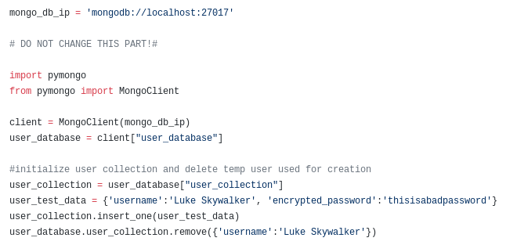
Creating a database in MongoDB
Our database creation all follows this format:

Slide 9
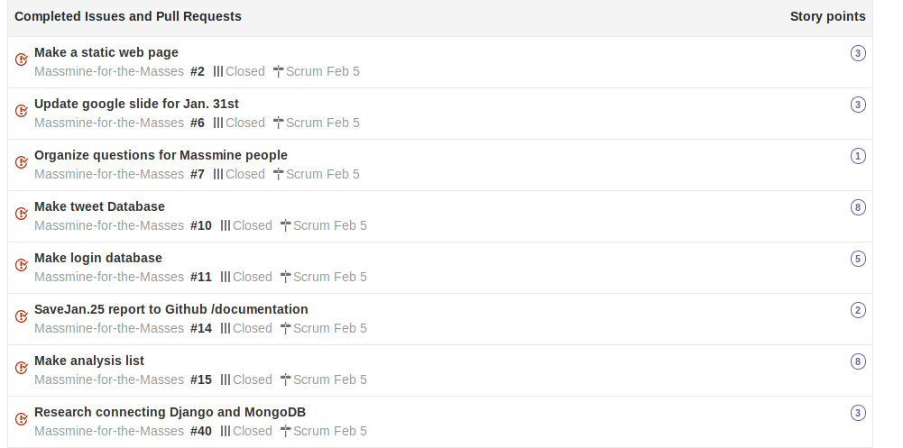
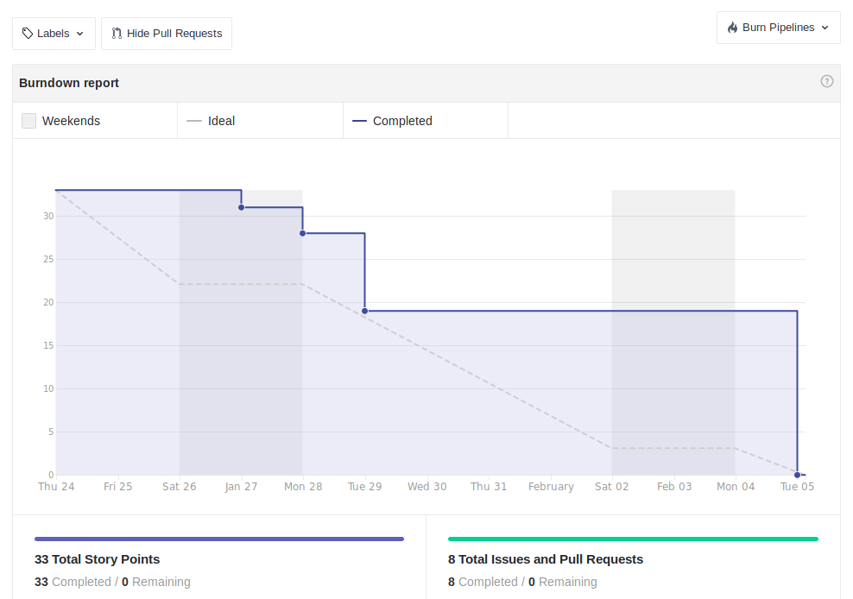
Scrum Update: Feb 5
Sprint past week: On target!

Slide 10
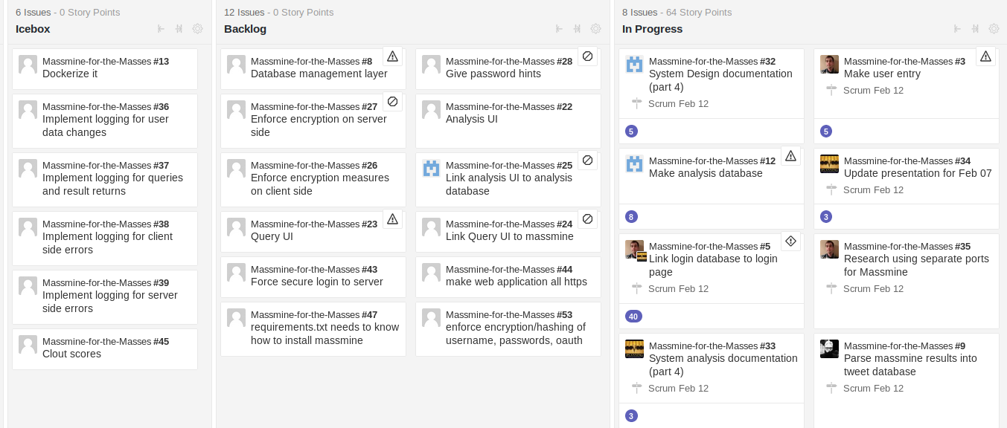
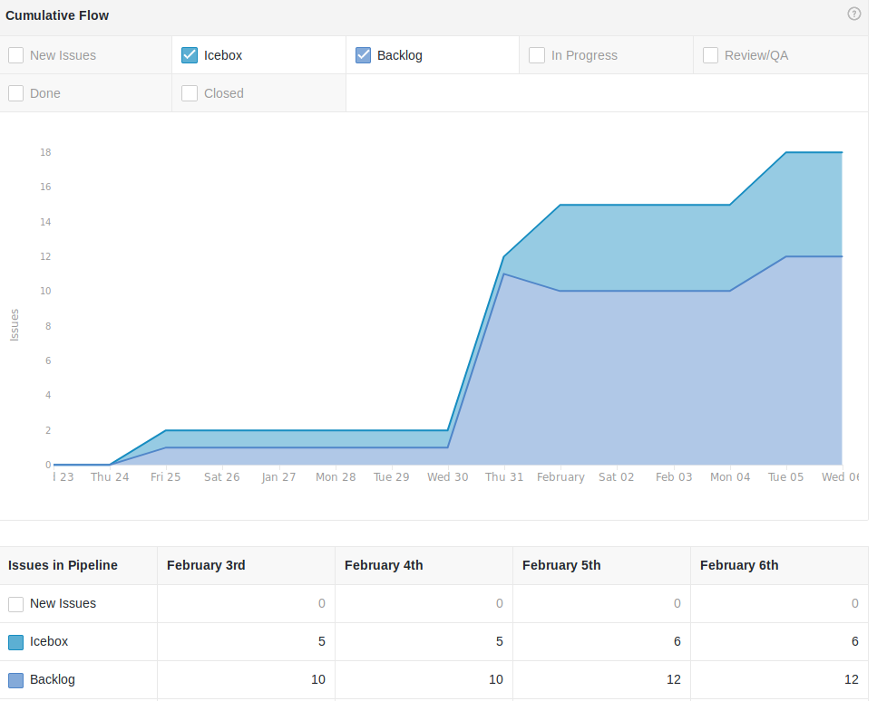
Backlog: Feb. 05
We have a lot to do...

Slide 11
Here’s what we’ve done...
Patti: database template and login database
Josh: login page and work on massmine socket
Logan: tweet database and code review
Morgan: analysis database and code review

Slide 12
Tools used
Github: https://github.com/JoshCMoore/Massmine-for-the-Masses
Massmine: https://www.massmine.org/
MongoDB: https://www.mongodb.com/
Django: https://www.djangoproject.com/
Notes:
Logan will present this slide.

