Slide 1
Massmine for the Masses
Joshua Moore, Logan Hornbuckle, Patricia Tanzer, Morgan McIntyre

Slide 2
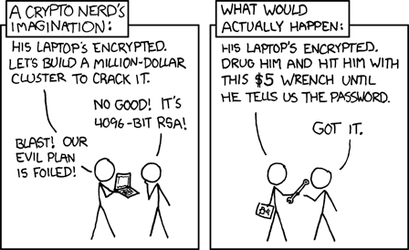
Assorted updates
Sensitive data encrypted! Script can now validate each user with massmine

Slide 3
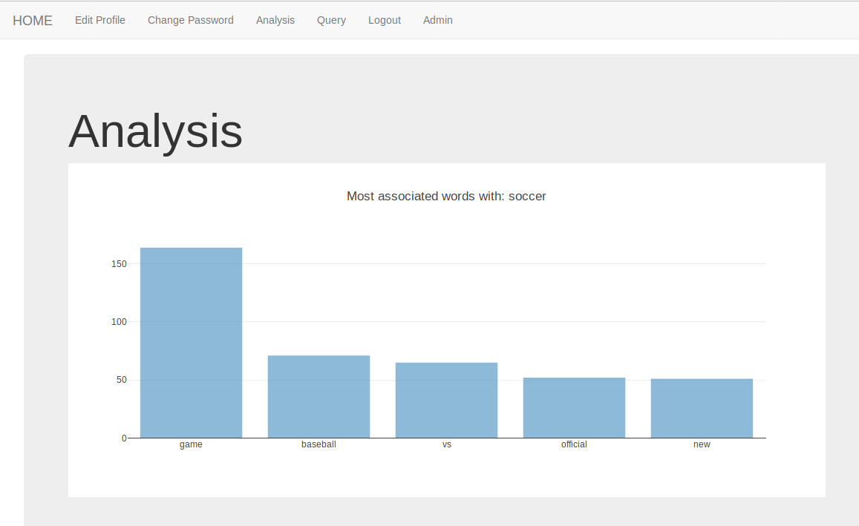
Text mining! Plotly! Killing your darlings!
To be done:
Same analysis but hashtags?
By date
Do histograms increase usability?
Sentiment analysis

Slide 4
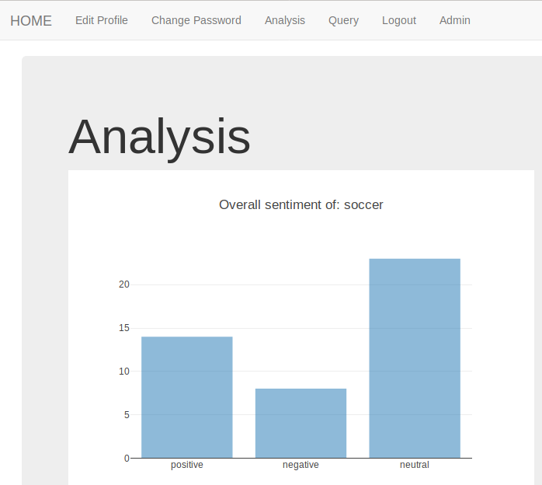
New Graph
To nix:
Active Authors
Popular Authors
Mentioned accounts
Language
Source Device
Country

Slide 5

Query Page Progress Update:
Now successfully storing Tweets to database!
In Progress:
Validating User Oauth Key
Creating new study with each query
TO DO:
Make these tasks Asynchronous using Shared Tasks implemented by Celery

Slide 6
Massmine Integration Update
No longer using a CSV
Piped directly into python to be saved into a study
View Past Studies
Successfully pulls all of a user’s studies from the database
Next step is a pretty drop down menu

Slide 7
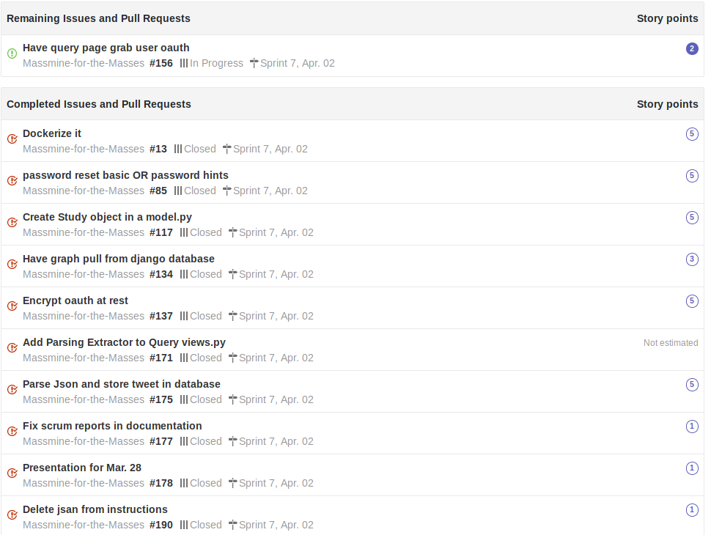
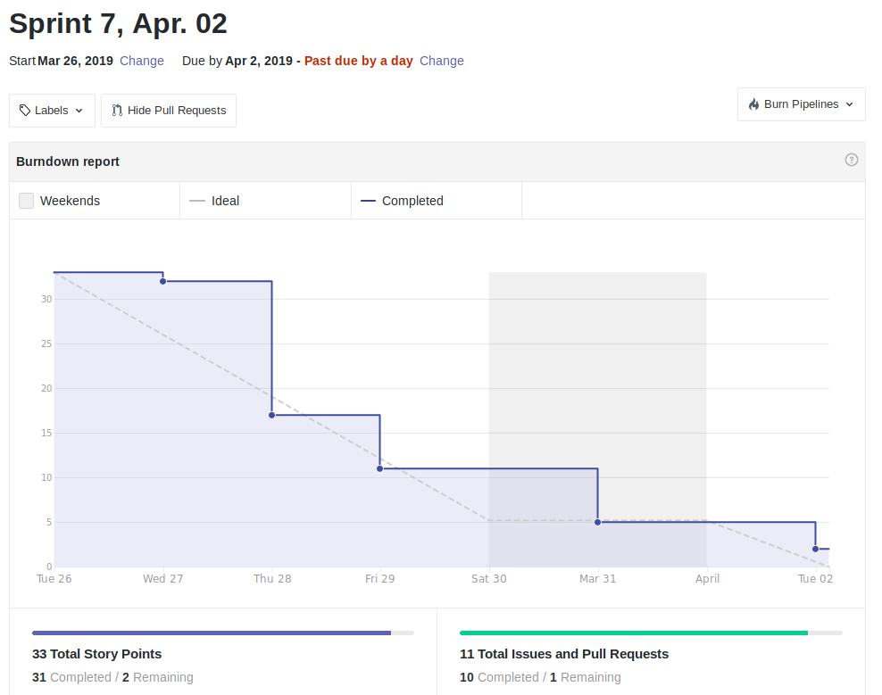
Scrum Update: April 2
Almost there. Integration of query page and its dependencies remains open.
Notes:
Patti

Slide 8
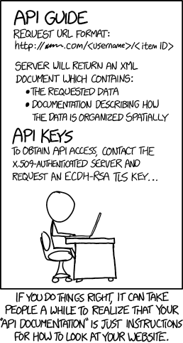
Goals for April 9
Priorities:
Query page interact with study model
Massmine command asynchronous
Massmine query validates user credentials
Analysis graphs for sentiment analysis and date
Coming up:
Test docker image
Complete documentation
Make videos

