Slide 1
Massmine for the Masses
Joshua Moore, Logan Hornbuckle, Patricia Tanzer, Morgan McIntyre
Notes:
Patti will present this slide.

Slide 2
What is MassMine?
MassMine is a command line tool designed for researchers to simplify the collection and use of data from online sources such as social media networks.
www.massmine.org
Notes:
Josh will present this slide.

Slide 3
What is MassMine for the Masses?
A web application that…
Facilitates using the MassMine tool for researchers
Provides an analysis feature without user having to interact with command line
Saves prior studies and analyses
Allows studies of big data
Notes:
Mention how MassMine is not user friendly for non-tech savvy researchers.
Josh will present this slide.

Slide 4
Domain, Intended Users, and Area
MassMine for the masses will be used by…
Researchers interested in gathering data from Twitter
Universities that want to host and implement their own version of the application
The areas involved in this project are…
Big data/data analysis - This project will involve large sets of metadata that must be parsed through and organized efficiently.
Database management - There will be several databases used and maintained within the scope of this project.
Web application/web application security
Notes:
Mention that we wanted to implement this project in a way that other universities could host this application with ease.
Morgan will present this slide

Slide 5
Functional Requirements
Store user information
Store collected Twitter data
Create and update new users
Allow users to gather Twitter data. The mass of data collected by a query is a ‘study’.
Allow users to perform basic analysis on this Twitter data.
We chose a web application as the best way to complete these goals.

Slide 6
Security
MassMine for the masses will implement the following security measures…
At-rest encryption of user authorization keys, usernames, and Twitter data
Passwords will be salted and hashed
The site will be be accessed via an https page
Built-in security features within the Django framework used to prevent
Cross site scripting
Cross site request forgery
Additional measures to prevent:
Injection attacks (input validation)
Notes:
Patti will present this slide.

Slide 7
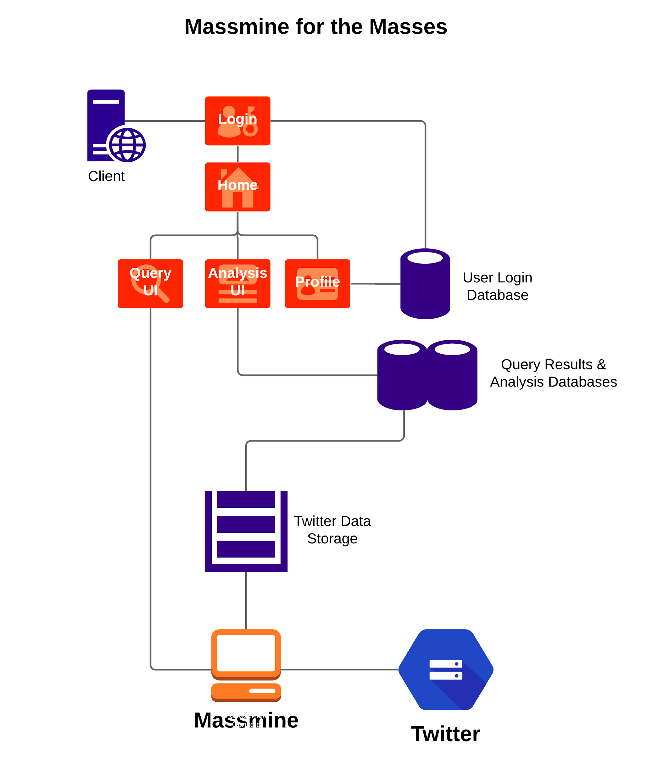
Overview
4 user interfaces:
Login
User profile
Query
Analysis
3 databases:
User information
Analysis formulas
Tweets
Host server
Multiple instances of Massmine
Notes:
Logan will present this slide.

Slide 8
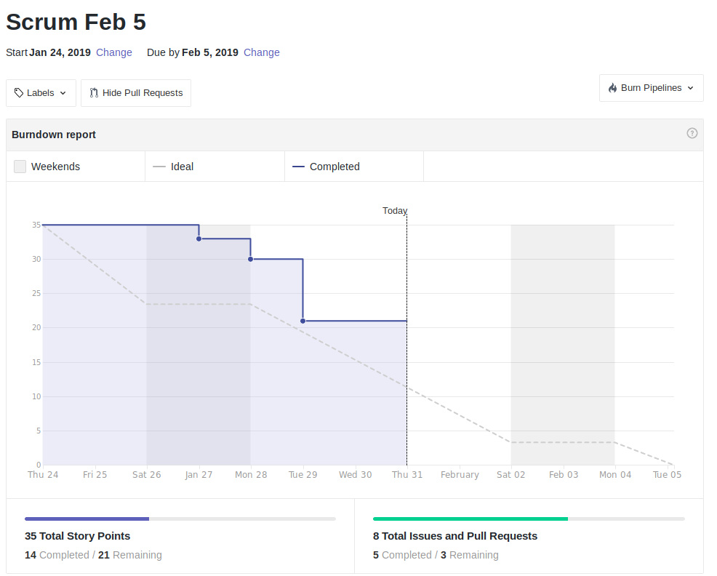
Scrum Update
So far so good!

Slide 9
Tools used
Github: https://github.com/JoshCMoore/Massmine-for-the-Masses
Massmine: https://www.massmine.org/
MongoDB: https://www.mongodb.com/
Django: https://www.djangoproject.com/
Notes:
Logan will present this slide.

