Slide 1
Massmine for the Masses
Joshua Moore, Logan Hornbuckle, Patricia Tanzer, Morgan McIntyre

Slide 2
Subsystems of Massmine for the masses
Database Management
Analysis
Web GUI
MassMine Integration
Notes:
Morgan

Slide 3
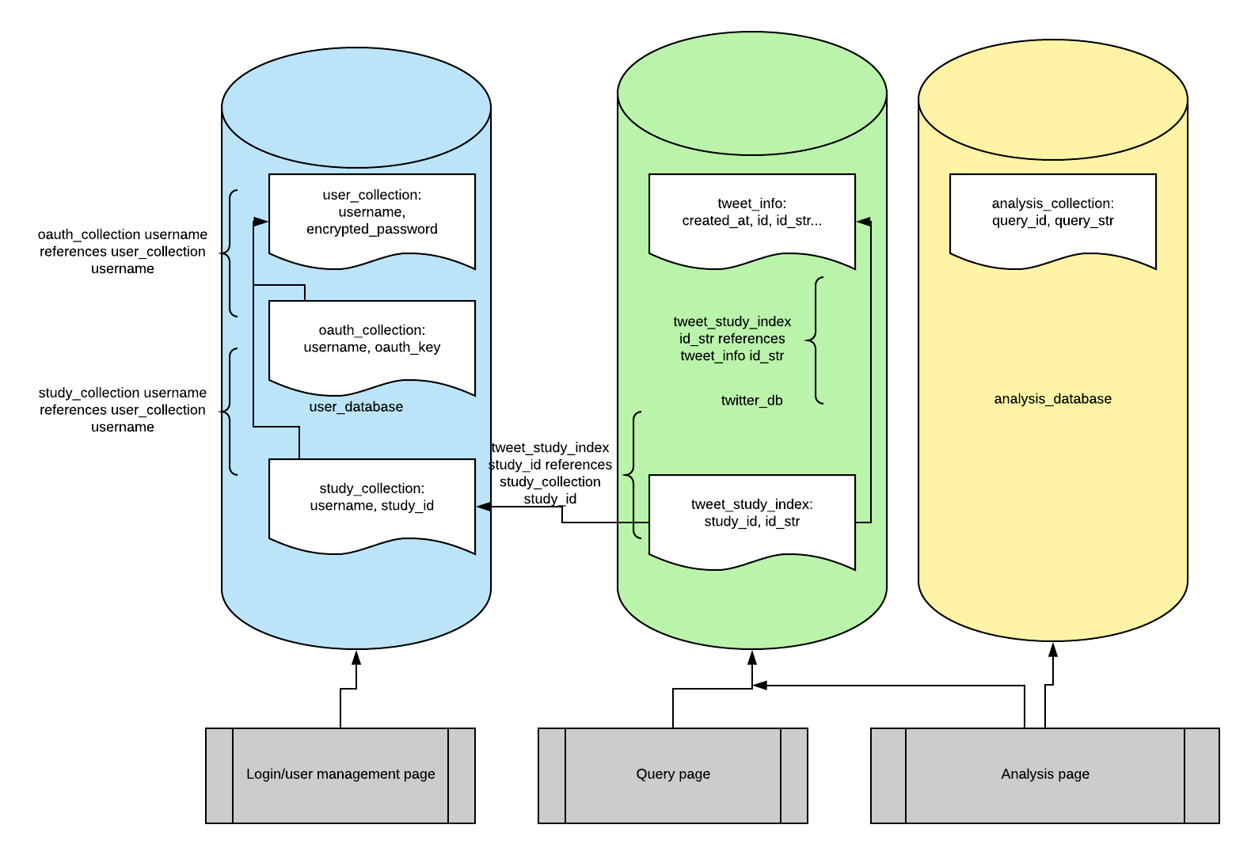
Database Management Design
Controls:
User must be authenticated to access database
Data inserted from Web GUI must pass input validation
Input/Output:
In: User information, tweets from Massmine, authentication response
Out: Tweets from massmine as part of analysis
Notes:
Patti? Going over 4.1 essentially.

Slide 4
Database Management Analysis
Up to 100 TB requested for storage
Allow 100 socket connections to insert into tweet database
Allow 25 users to access user database
Store ‘documents’ in JSON format
Notes:
Patti

Slide 5
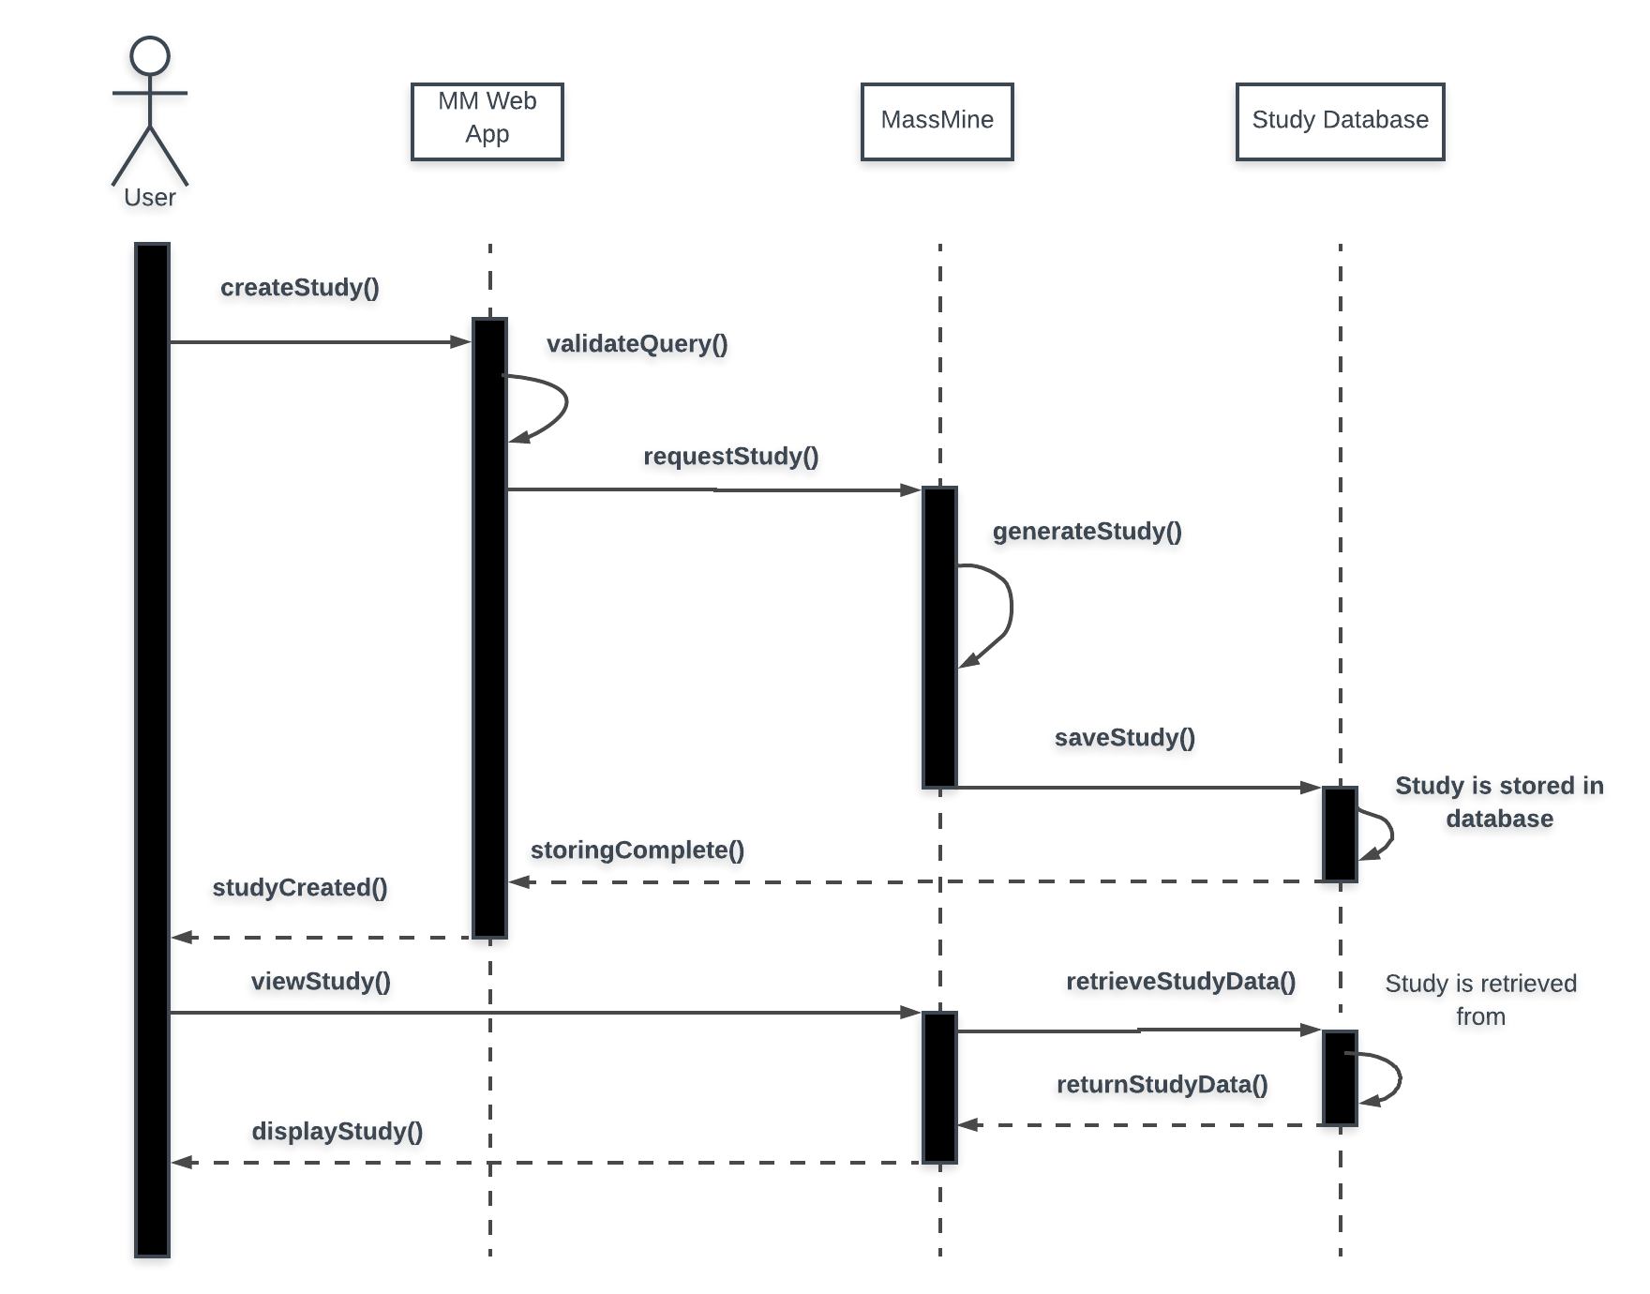
Study creation (DBMT)
Notes:
MORGAN
Talk about controls and I/O

Slide 6
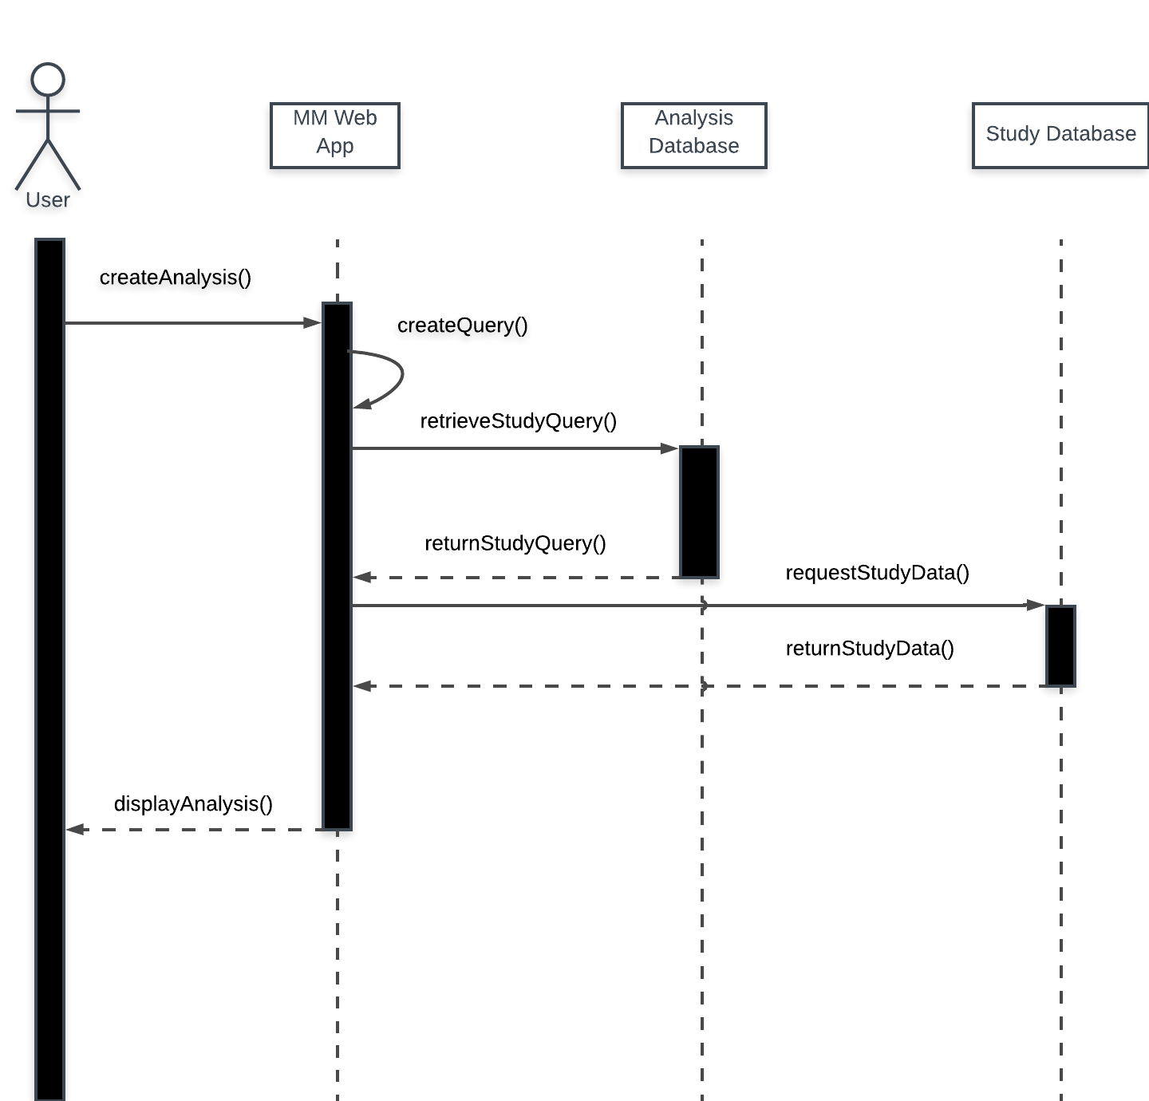
Analysis Design
Controls:
User can’t write their analysis criteria outright
Tweets from other users’ studies may not be retrieved from database
Input/Output:
In: Analysis requirements from user
Out: Prompt user for query, and the analysis results
Notes:
MORGAN
What analyses? Try to list all from memory.

Slide 7
Analysis of Analysis Subsystem
Analysis type functions as filter on set of data
Multiple filters applied
Graphics update continuously until analysis complete
Notes:
MORGAN

Slide 8
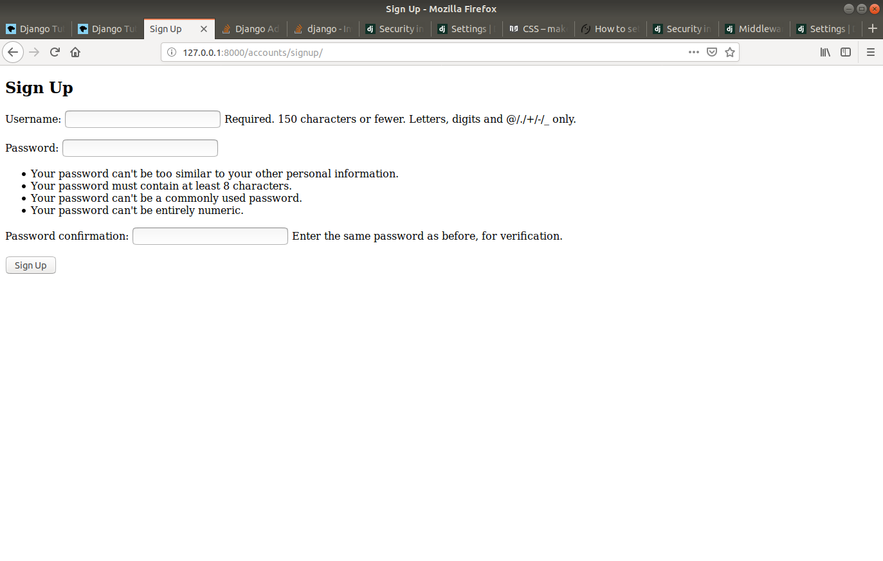
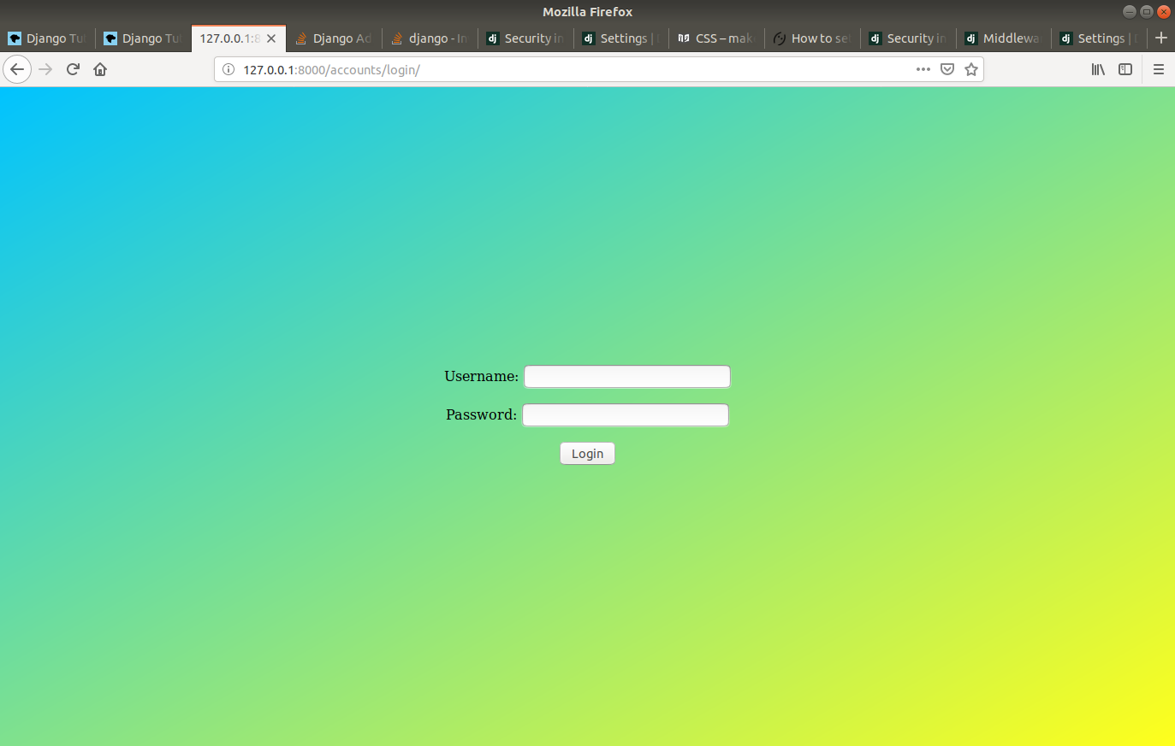
Web GUI mockup login

Slide 9
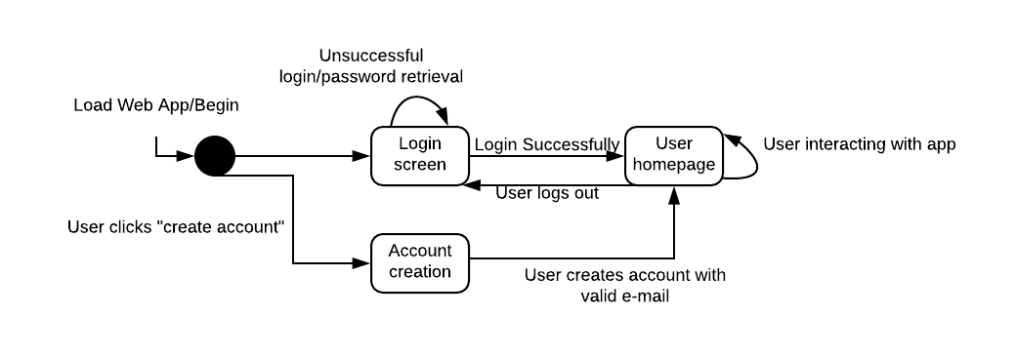
Web GUI Design
Additional pages are the user management page, the query page, and the analysis page.
Notes:
JOSH
Talk about controls in place.

Slide 10
Web GUI Analysis
Web Server: Apache 2.4.38
Login page allows connection, internal pages require authentication
Server must support at least 25 simultaneous user sessions
Notes:
JOSH

Slide 11
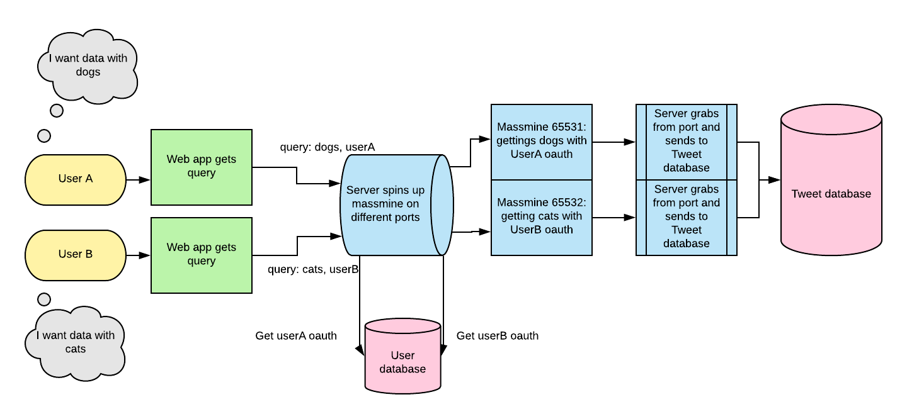
MassMine Integration Design
Notes:
JOSH: need to explain how we’re designing our MassMine integration.

Slide 12
MassMine Integration Analysis
Server initiates instance of Massmine for each uncompleted user query
Instance closed when server finished
Server constantly monitors massmine ports for output
Notes:
LOGAN

Slide 13
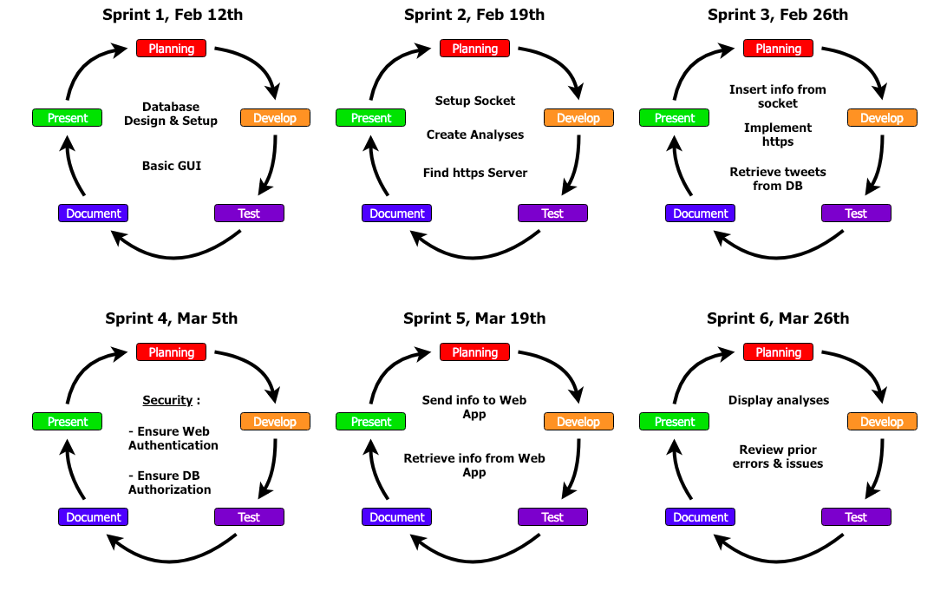
Process Model
This leaves us space for an extra sprint to fix whatever comes up
Notes:
Logan

Slide 14
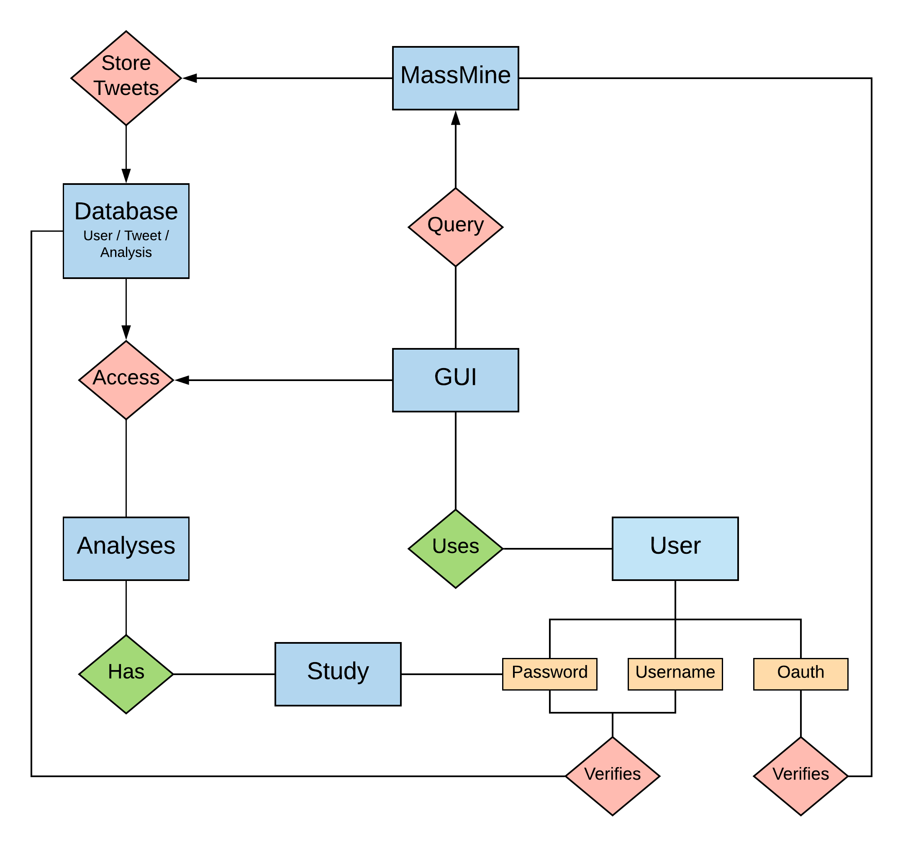
ER model
Notes:
Logan

Slide 15
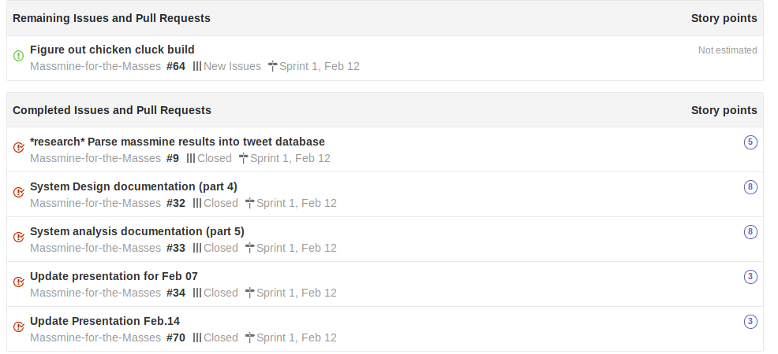
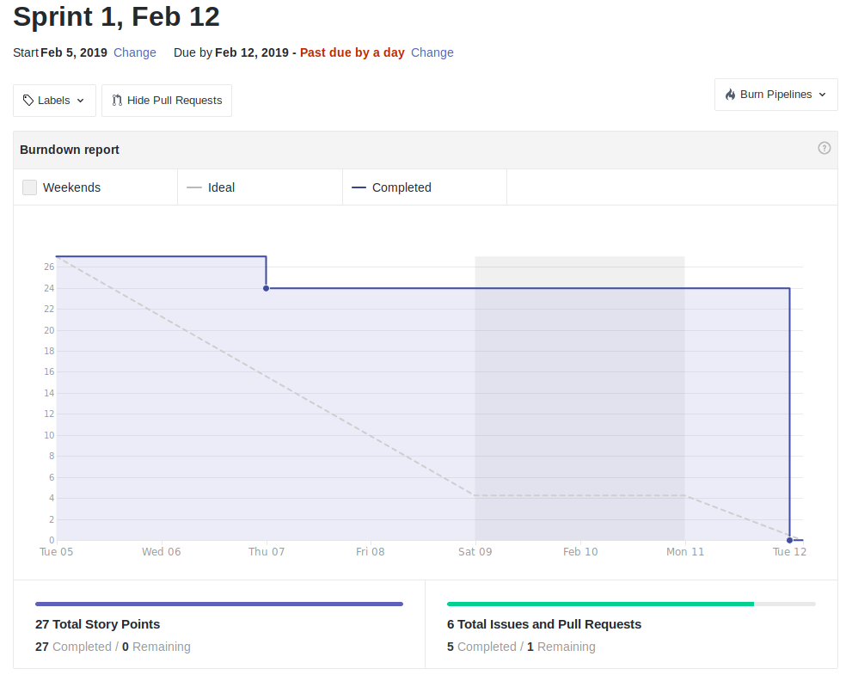
Scrum Update: Feb 12
Bit of last minute catch-up, but still moving ahead
Notes:
Patti

Slide 16
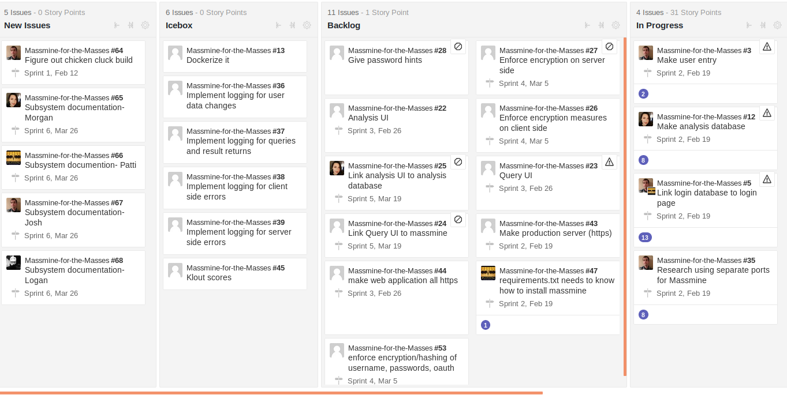
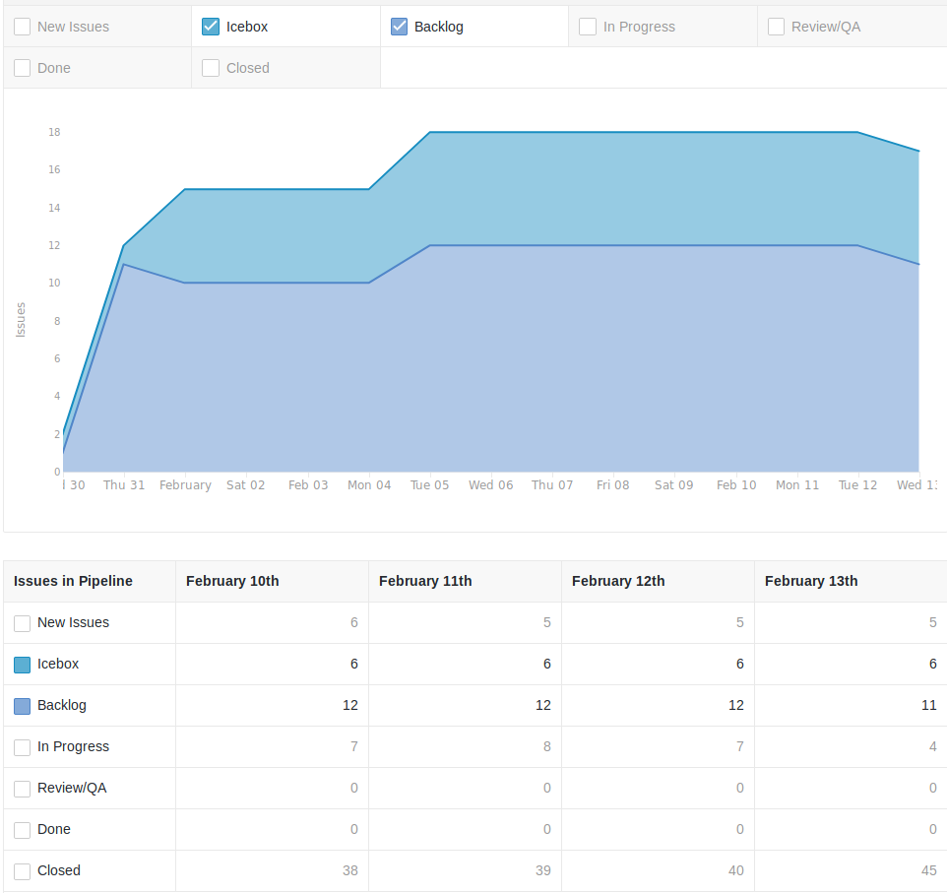
Backlog: Feb. 12
We actually completed things!
Notes:
Patti

