Slide 1
Massmine for the Masses
Joshua Moore, Logan Hornbuckle, Patricia Tanzer, Morgan McIntyre
Notes:
Josh

Slide 2
Subsystems of Massmine for the masses
Database Management
Analysis
Web GUI
MassMine Integration
Notes:
Morgan

Slide 3
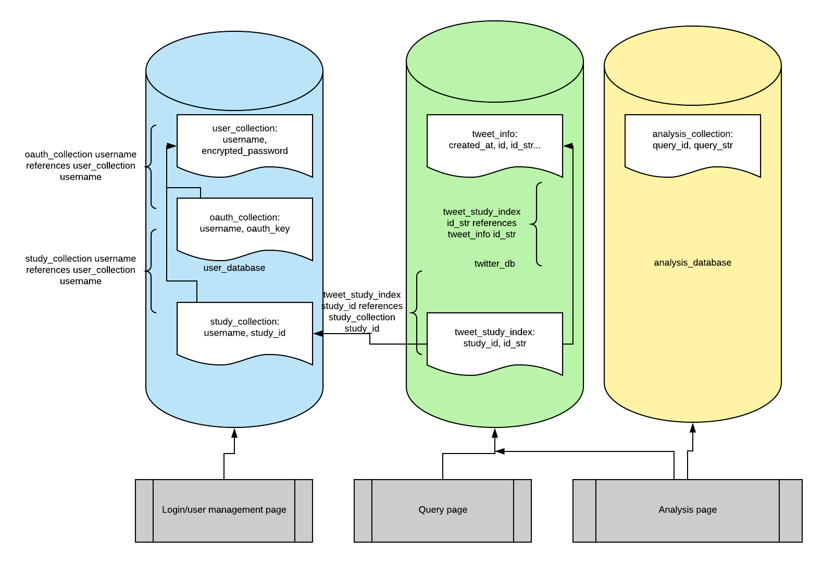
Database Management Design
Controls:
User must be authenticated to access database
Data inserted from Web GUI must pass input validation
Input/Output:
In: User information, tweets from Massmine, authentication response
Out: Tweets from massmine as part of analysis
Notes:
Patti? Going over 4.1 essentially.

Slide 4
Database Management Analysis
Up to 100 TB requested for storage
Allow 100 socket connections to insert into tweet database
Allow 25 users to access user database
Store ‘documents’ in JSON format
Notes:
Patti

Slide 5
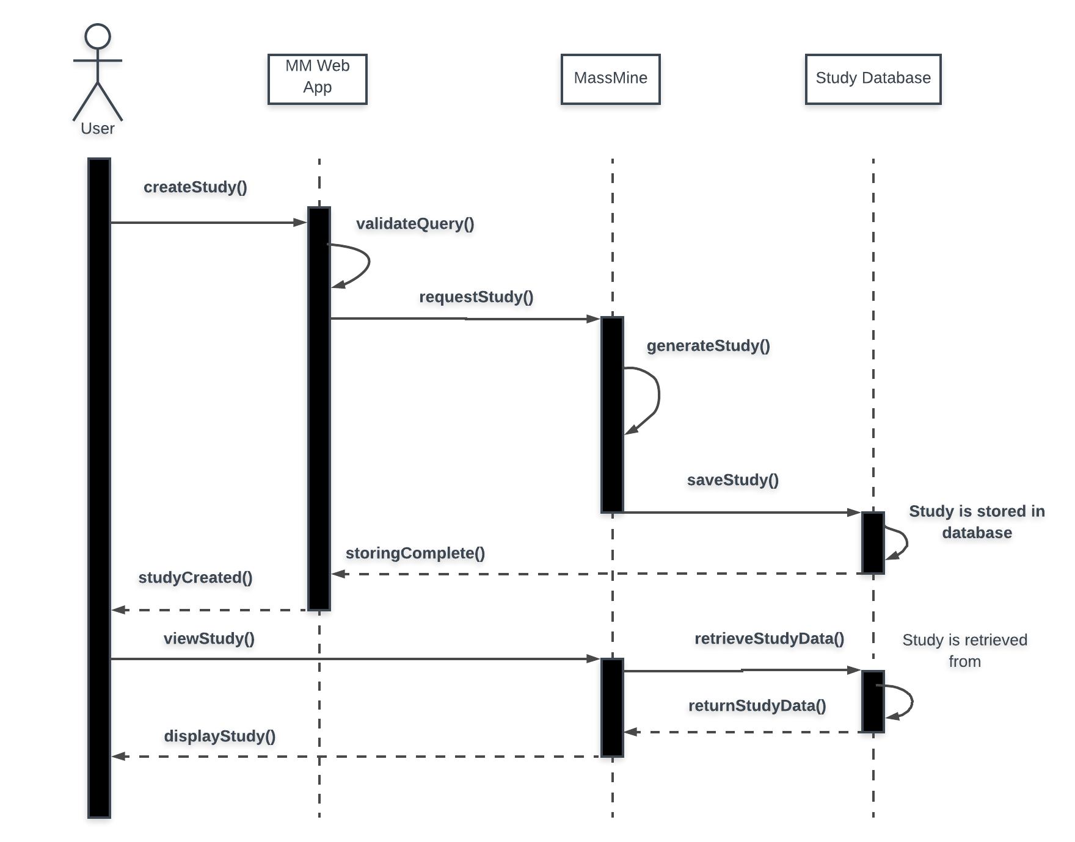
Study creation (DBMT)
Notes:
Talk about controls and I/O

Slide 6
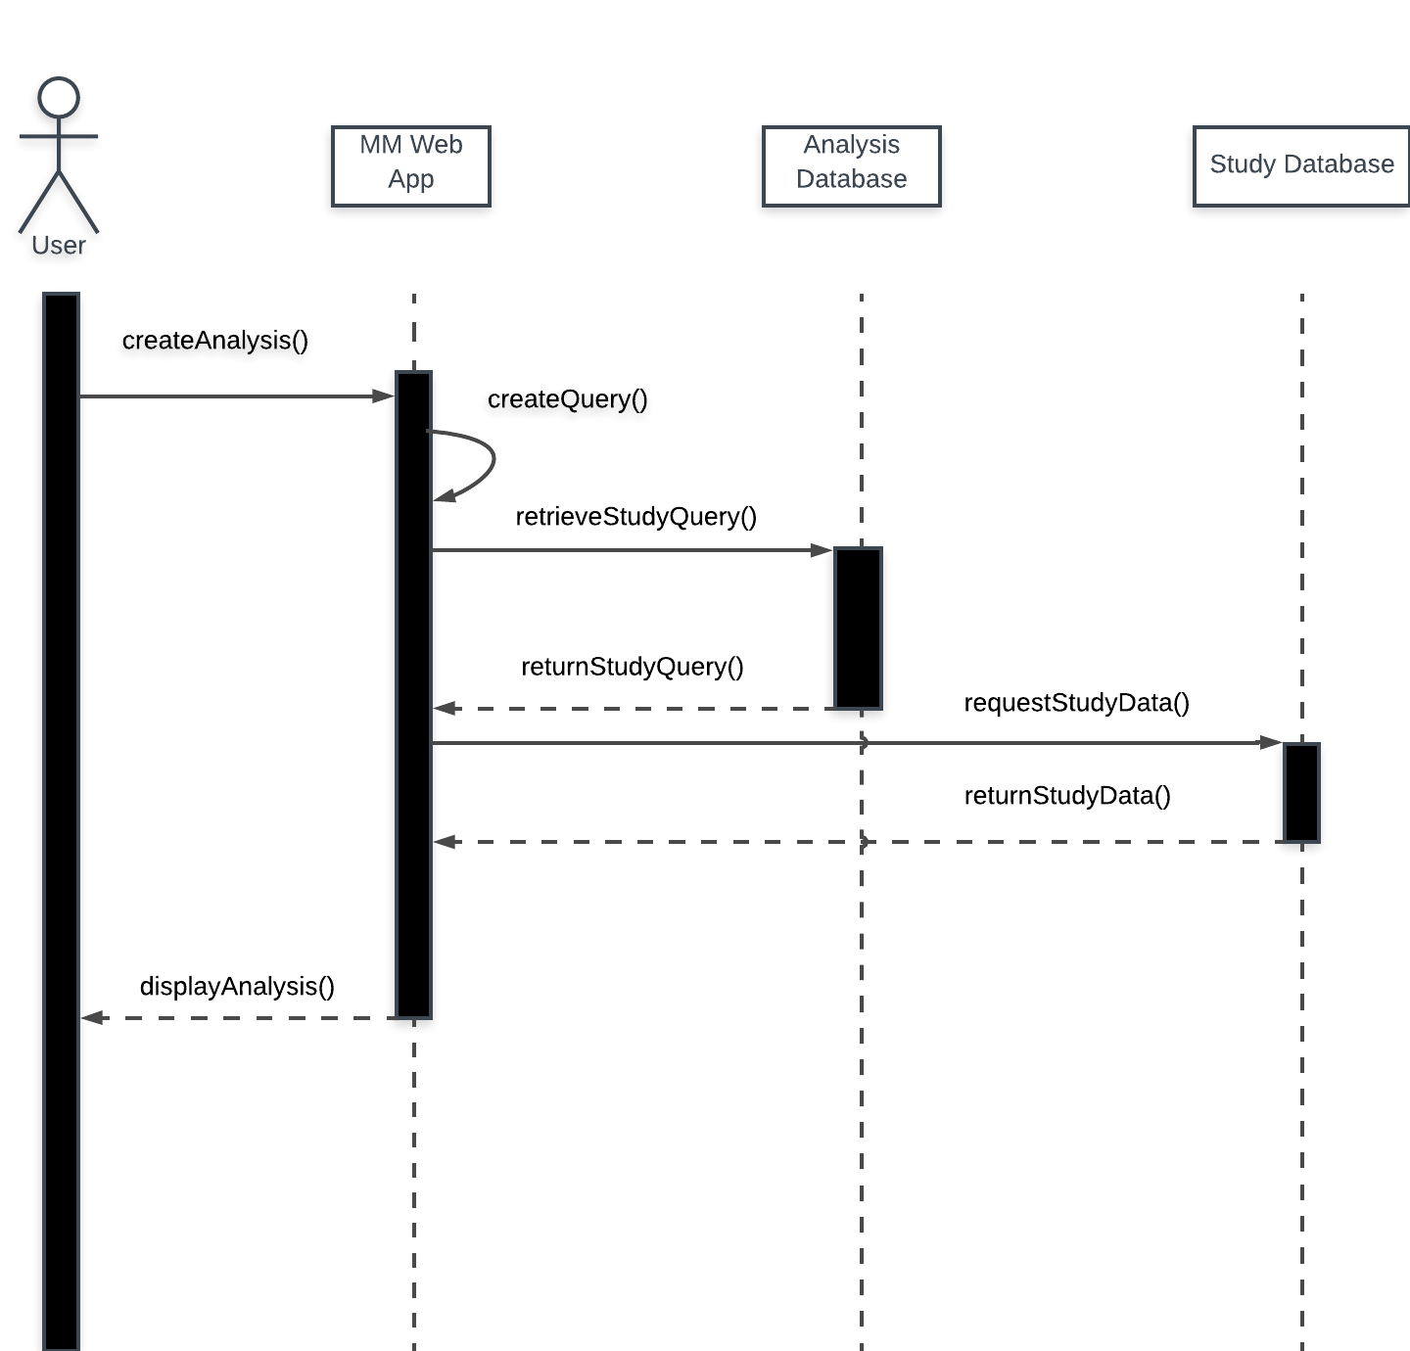
Analysis Design
Controls:
User can’t write their analysis criteria outright
Tweets from other users’ studies may not be retrieved from database
Input/Output:
In: Analysis requirements from user
Out: Prompt user for query, and the analysis results
Notes:
What analyses? Try to list all from memory.

Slide 7
Analysis of Analysis Subsystem
Analysis type functions as filter on set of data
Multiple filters applied
Graphics update continuously until analysis complete

Slide 8
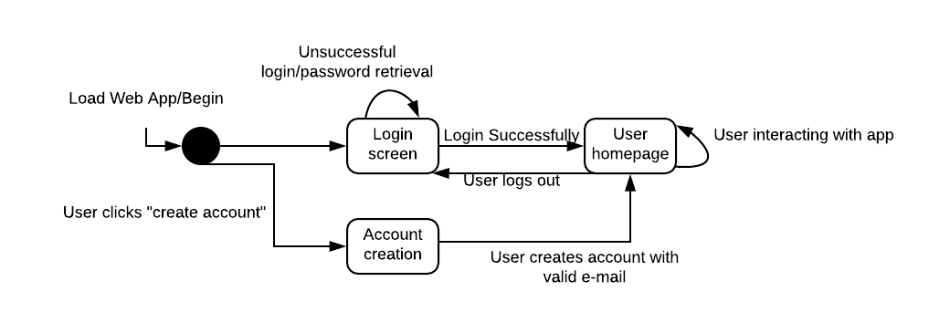
Web GUI Design
Additional pages are the user management page, the query page, and the analysis page.
Notes:
Talk about controls in place.

Slide 9
Web GUI Analysis
Web Server: Apache 2.4.38
Login page allows connection, internal pages require authentication
Server must support at 25 user session

Slide 10
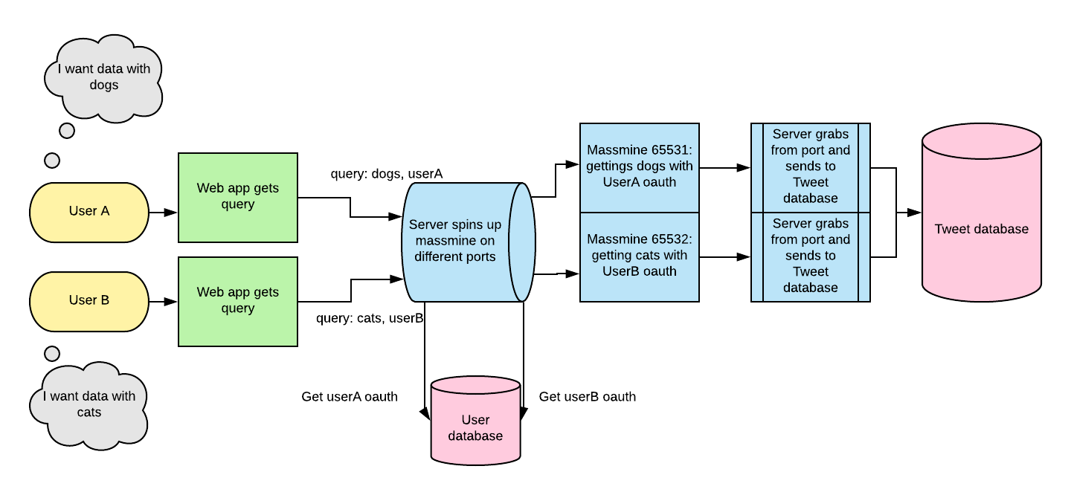
MassMine Integration Design
Notes:
Josh needs to explain how we’re designing our MassMine integration.

Slide 11
MassMine Integration Analysis
Server initiates instance of Massmine for each uncompleted user query
Instance closed when server finished
Server constantly monitors massmine ports for output

Slide 12
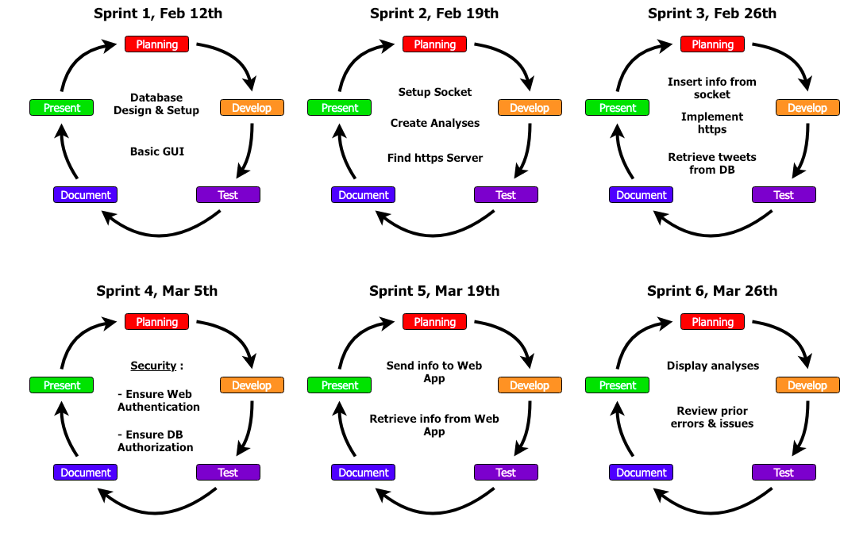
Process Model
This leaves us space for an extra sprint to fix whatever comes up

Slide 13
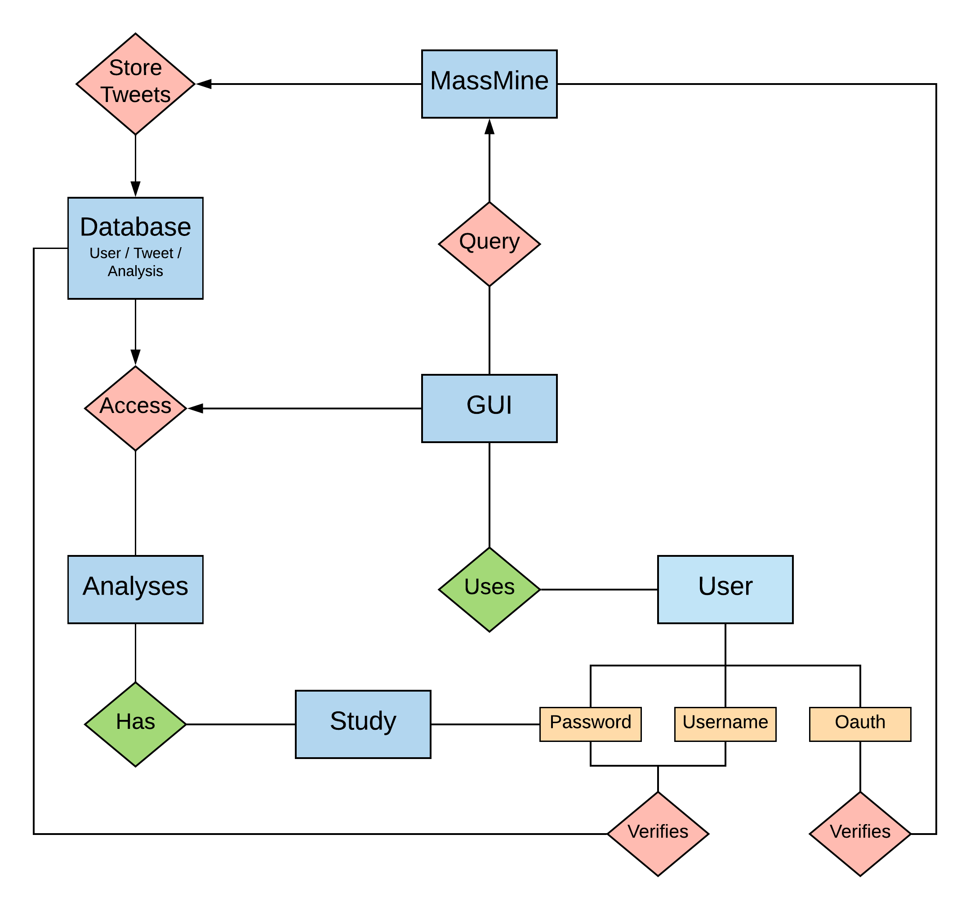
ER model

Slide 14
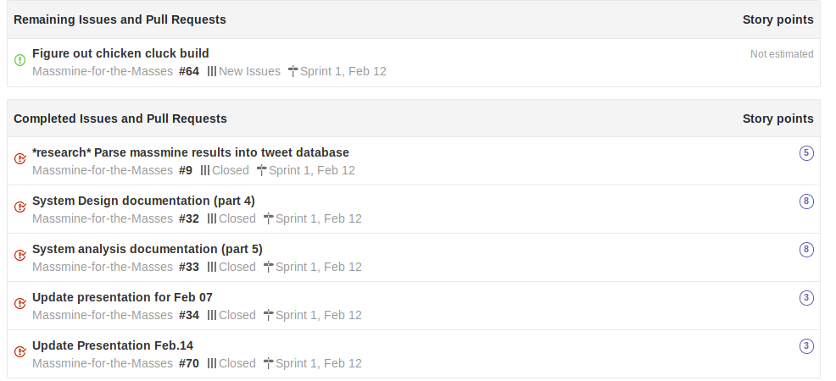
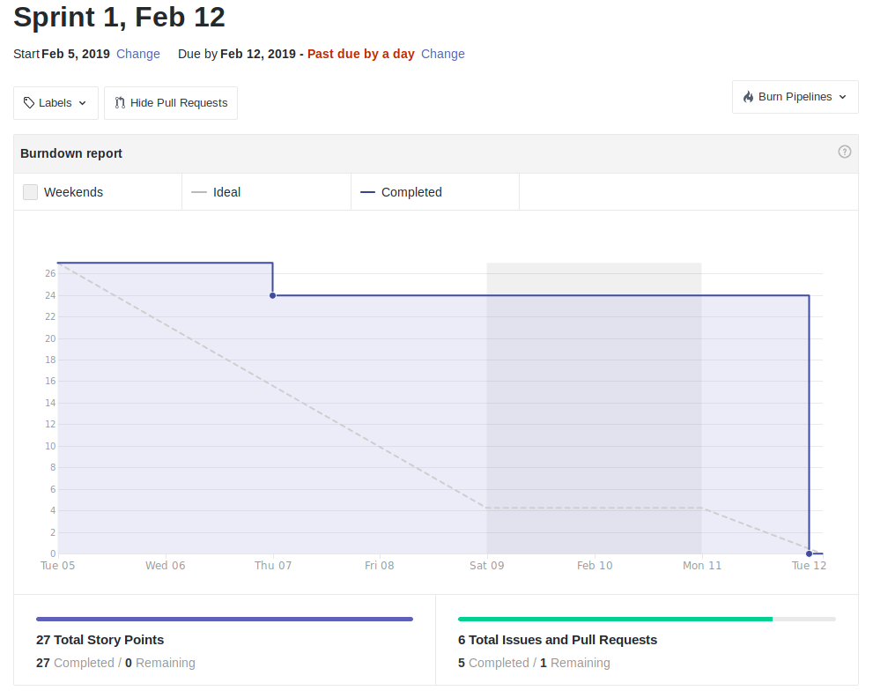
Scrum Update: Feb 12
Bit of last minute catch-up, but still moving ahead
Notes:
Patti

Slide 15
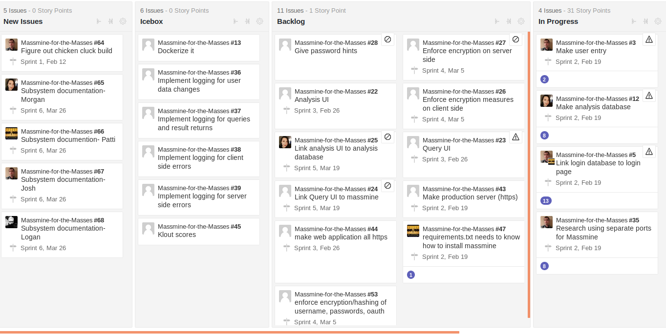
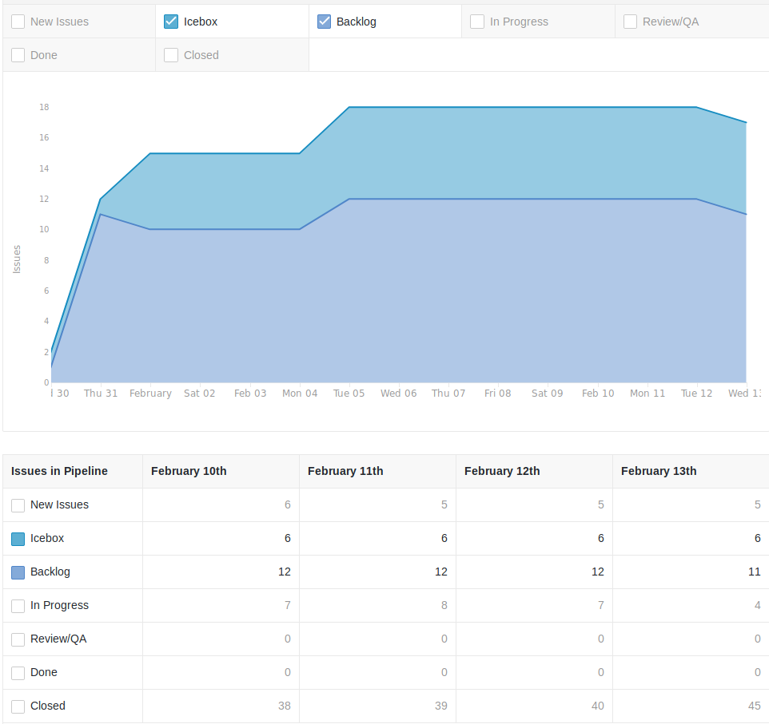
Backlog: Feb. 12
We actually completed things!
Notes:
Patti

